Slide 1
Kangaroo Options
An options credit-spread grid on 25 instruments, and a model that may only take risk away.
START
EQUITY
P&L
OPEN SPREADS
FILLS
100,000
87,817
-12,183
50
648
Live sheet, republished every five minutes: hanky27.github.io/KangarooOptions
Alpaca AI Trading Agents Hackathon · paper account PA3S85G7JUS0 · every figure read back through the Alpaca CLI · as of 2026-09-03 08:05 ET

Slide 2
THE STRATEGY
No entry signal. The only judgement is how much.
Open. Sell one credit spread — put on the long side, call on the short side. Short strike nearest spot, wing at the first width that exists as a real strike.
Add. The underlying moves 1.2 % against the cluster → sell another, further out. Every further step needs 0.10 %. Each leg is 1.1× the last.
Close. On the AGGREGATE mark of the whole cluster, never a single leg. A losing first leg is carried by the credit of the ones behind it.
Stop adding. At 5 % adverse from the anchor. Nothing is closed — a grid that stops adding survives, a grid forced to reduce realises its loss.
The edge is not prediction. It is that a mean-reverting underlying only has to come back part of the way.

Slide 3
THE AI LOGIC
The decision the code structurally cannot make
Blind. KangarooCore sees its own legs and nothing else. Every one of the 25 grids is right on its own terms.
The real risk. Not one bad instrument — MANY deep at once, each correctly following its rule, together consuming the margin any one of them needed to recover.
So. On every rebuy that matters, the model gets the WHOLE account: equity, cash, options buying power, maintenance margin, and all open clusters sorted by adverse move.
One question. May this cluster add the size it asked for, less, or none?
Asked only from leg 4, or below 40 % headroom. Routine rebuys never reach it — the token bill is proportional to the decisions that carry weight.

Slide 4
THE RISK GATE · IN CODE, NOT IN THE PROMPT
It can only take risk away
if qty > requested or qty < 0:
self.clamped += 1 # a broken contract,
source = 'clamped' # not a judgement
qty = max(0, min(qty, requested))
Answers 50 to a request of 2? It gets 2, and the violation is counted.
Answers prose, nothing, a negative? The request passes through untouched.
No key, timeout, refusal? Logged, counted, and the grid proceeds with the size it asked for — failing OPEN.
There is no path through risk_gate.py by which a model opens a position, enlarges one, picks a strike or moves a stop. The worst a hallucinating or compromised model can do is stop the grid from adding — which a constant already does.

Slide 5
LIVE, 2026-09-01
Its first decision on the competition account
GOOGL_long: RISK GATE [model] 2 -> 1 (10124 ms):
Multiple clusters (AMZN, TSLA, GLD, SLV) already breached
5% adverse simultaneously; reduce to conserve shared margin.
It halved the size. And justified it by naming four OTHER instruments. No single cluster's state machine can see AMZN, TSLA, GLD and SLV at once. A threshold cannot either.
49 DECISIONS SINCE, ALL FROM THE AGENT LOG
UNCHANGED
REDUCED
REFUSED TO 0
CONTRACTS ASKED
ALLOWED
5
31
13
108
38
Twice it failed and passed the request through untouched, loudly: 3 -> 3, no JSON object in answer and 1 -> 1, read timed out. Failing closed would make an outage a silent strategy change.

Slide 6
ALPACA IMPLEMENTATION
One binary, structured JSON, auditable from a log
CLI only. the alpaca binary, pinned to v0.0.13. Not an SDK, not raw HTTP. Positions, clock, quotes, chains, orders, fills, portfolio history, account activities.
Multi-leg limit orders. order_class mleg with a NEGATIVE limit price — that is how a credit is expressed. Both legs fill or neither does.
Batched. Quotes for every instrument in one request per 100 symbols — the ceiling the endpoint enforces. Poll cost is near-constant in the instrument count.
The broker is the authority. client_order_id carries instrument, cluster, leg and kind, so a close that filled while the agent was stopped is recovered on the next start.
OS-level single-instance lock. A PID file survives a power cut. A kernel lock does not.

Slide 7
THE MEASUREMENT REGIME
It has to add up, or nothing is published
equity - start = realized + unrealized - fees + transfers
87,817.09 - 100,000 = -70.00 -12,079.20 - 33.71 - 0.00
residual +0.0000 USD
Realized rebuilt fill by fill at average cost — not taken from a field.
Fees summed from the account's own FEE bookings (628 of them), never from a rate.
The curve assembled from days that each had to agree with the broker's own close. Days that did not are published as refused, with the numbers.
A published equity curve was once 100,000 above this account and showed a drawdown of -102,137.75 that never happened. That is why every level is now checked against a second reading before it is drawn.

Slide 8
DEVLOG
Seventeen defects, each with its measurement
f9b7bc0 client_order_id must be unique 6 instruments, every poll
ad109a5 wing selection diverged from the sim TLT halted at 20/20
5cac761 a rebuy stepped onto its own wing 422 position intent mismatch
2477d66 three phantom clusters close filled 33-55 s before a stop
8717fff fees modelled, not read 15.12 booked vs 7.75 assumed
8717fff the curve was not this account -102,137.75 drawdown, 18 h public
8a84e63 the batch had no size 102 legs > limit 100, 93 min down
32977da a guard that fired only at the cap 500 rows returned, 831 exist
Every fix carries a regression test built from the account data behind it. 107 tests.
The worst was not a wrong number — it was 93 minutes of a trading agent silently not trading. Nine more arrived on the last day; next slide.

Slide 9
THE LAST MORNING
Nine more, and each was invisible where you would look
an anchor-to-anchor cut deleted activities() 39 insertions, 54 deletions
a live path read C:/Users/.../env.txt 4 of 25 instruments halted
assignment deadlocked its own instrument halt -> never reaches the gate
one shared snapshot, two directions both would have bought 100 AMZN
the BROKER closed legs with its own ids 3 fills at 19:45:07Z, not ours
an assignment's premium counted twice identity 927.00 out, to the cent
today's bars asked for before the open start cannot be after end: 400
a CDN edge served a two-day-old snapshot curl 07:09, the page 09-01
the publish task ran in C:\Windows\System32 WinError 5 every five minutes
None was found by reading code. Each was found by asking the account a question and comparing the answer to what the code assumed.
And one of my own explanations was wrong. The fix I proposed for the premium made the gap worse, 373 to 567 — so the experiment refuted me, and the log says so.

Slide 10
WHAT THE MEASURING FOUND
The backtest never paid the bid/ask
SPY put grid, 2024-02..2026-08, one parameter changed:
cost per spread per execution realized drawdown
0 <- every published run +2,850.00 -2,994
17.00 median-based -433.00 -3,716
34.95 MEASURED on the live book -6,172.65 -7,024
34.95 USD is half the bid/ask per spread, measured across 188 open legs. 69.89 round trip. Median quote width 4.9 % of mid.
The whole published profit was smaller than the cost that was never charged. cost_usd now has no default anywhere — every tool refuses to start without it.
And two fixes I proposed were refuted by their own tests. Both are in the log, with the tables that killed them.

Slide 11
WHAT IS HONEST ABOUT THIS
The parts that are not finished
Untuned. The grid parameters come from the author's cTrader Forex bot. They are not tuned for options, or for a one-week window.
An unmeasured tail. Alpaca option data begins 2024-02 and holds no sustained bear market. The tail is bounded by construction — every position is a spread — but unmeasured.
A martingale, deliberately. It adds into a losing position. That is the strategy, not a defect, and the drawdown on this page is what it looks like.
The AI sizes only. Underlying choice and DTE/strike policy are still rules, not judgements.
EQUITY
P&L
OPEN SPREADS
RESIDUAL
87,817
-12,183 (-12.18 %)
50
+0.0000

Slide 12
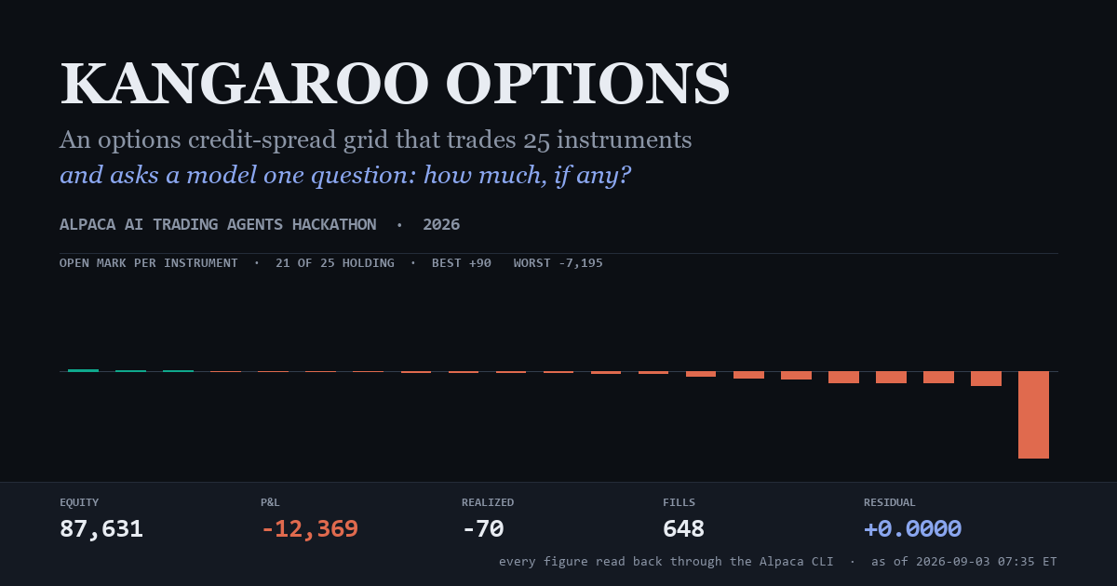
Watch it trade
hanky27.github.io/KangarooOptions · github.com/Hanky27/KangarooOptions · PA3S85G7JUS0

