Slide 1

Canada Drug Products Overview
A dashboard aims to provide insights of the drug market in Canada.

Slide 2
Why Drug Market?
Passion – majored in Pharmacology
Complexity – various angels for data analysis
Simplicity – easy data collection from Health Canada
Importance – it matters

Slide 3


Data Collection
Four datasets from
One dataset scraped from
Drug Product Database (DBD)
ATC/DDD Index 2024
Active Ingredient, Drug Product, Schedule, Product Status
Descriptions of ATC to second level are scraped

Slide 4
Data Cleaning
Data Collection
Terminology Definition
Data Quality Check
Regrouping
Merge

Slide 5
Drug Status – 7 * 56459
Four columns kept:
drug_code: key variable
status: the status name
11 unique drug status, regrouped to 4 status
Cancelled Post Market, Cancelled Pre Market, Under Review, Currently Marketed
history_date: the historical date associated with a drug’s status
original_market_date: the original market date of a product

Slide 6
Drug Product – 9 * 56459
Six columns kept:
drug_code: key variable
brand_name: brand name for the drug product
class_name: the therapeutic class of a drug product
Four classes: Human, Veterinary, Disinfectant, Radiopharmaceutical
ai_group_no: active ingredients group number
number_of_ais: number of active ingredients
company_name: the company name

Slide 7
Drug Schedule– 2 * 57225
Two columns kept:
drug_code: key variable, contains duplicates, investigated and dropped
schedule_name: drug schedule according to the Food and Drug Regulations and the Controlled Drugs and Substances Act (CDSA)
15 schedules regrouped into 2 big groups and 4 subgroups:
Prescription: Controlled, Prescription, Biologic
OTC: Over-The-Counter (OTC)

Slide 8
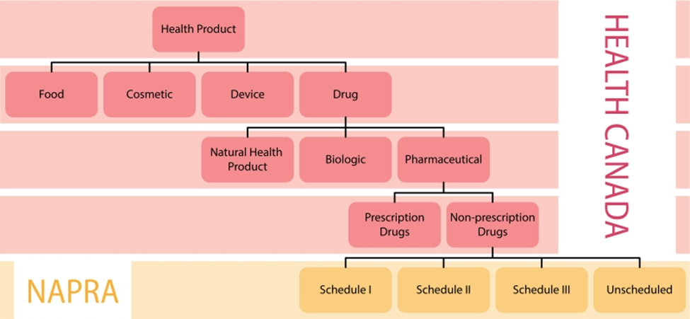

Why Grouping?
National Drug Schedule from NAPRA

Slide 9
Therapeutic Class – 5 * 46331
Two columns kept + Two columns created
drug_code: key variable
tc_atc_number: the anatomical therapeutic chemical code
atc_1st: first level of atc (first letter)
atc_2nd: second level of atc (first 3 letters)

Slide 10
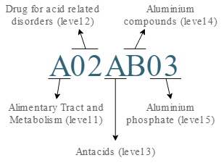
What is atc number
It is a number that indicates the mechanism of a drug.
BUT
It is more complicated than that:
Some drugs can have effect on multiple systems
One atc number is assigned
Drugs with more than one active ingredients
One atc number is assigned or no act number
Homeopathic products does not have atc - Dropped

Slide 11


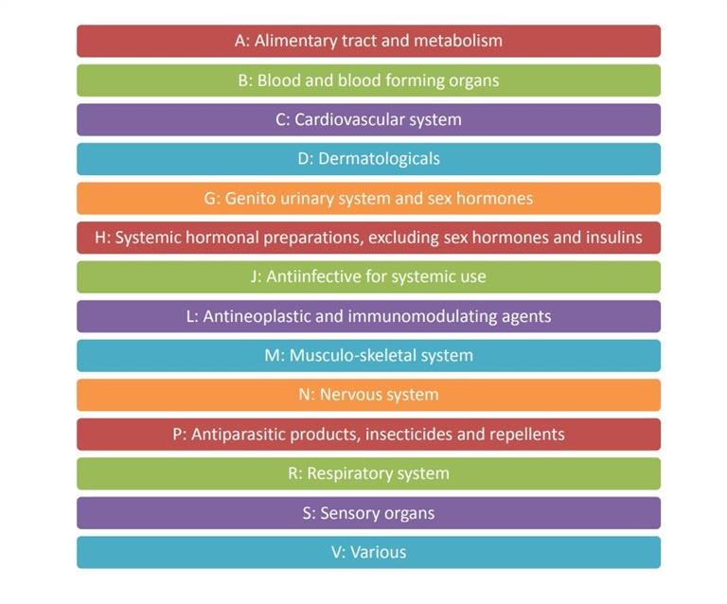



atc to first level

Slide 12
atc description scraped - to second level
Two columns:
atc code: key variable
Description: description of atc code – to first and second level

Slide 13
Final dataset – 14 * 43373
Merged by drug_code
Kept only drugs that belongs to Human class
Dropped homeopathic products

Slide 14
Dashboard
Four Dashboards in total
Cover page
Dashboard 1: Time series lineplot
Dashboard 2: Drug distribution by atc first level
Dashboard 3: Drug distribution by atc second level

Slide 15
Dashboard 1
Number of Drugs Grouped by the Year of original_market_date

Slide 16
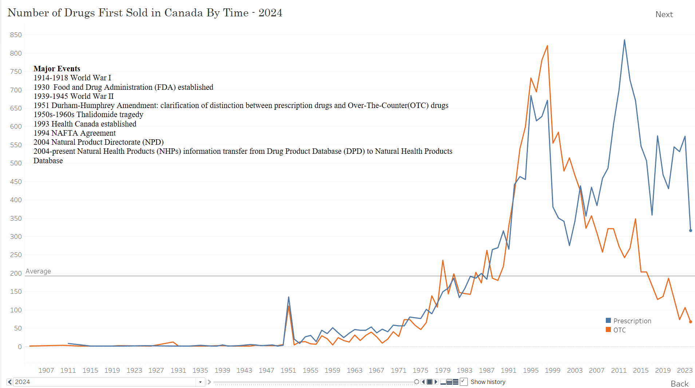
To Dashboard 2
Average number of drugs
Select Year (1904-2024)
Can be played
To Cover Page

Slide 17
Dashboard 2
Drug distribution by schedule (prescription vs OTC)
Drug distribution by atc first level
Drug distribution by drug status (Currently Marketed, Cancelled Post Market, Under Review)
Top 3 companies in tooltip

Slide 18
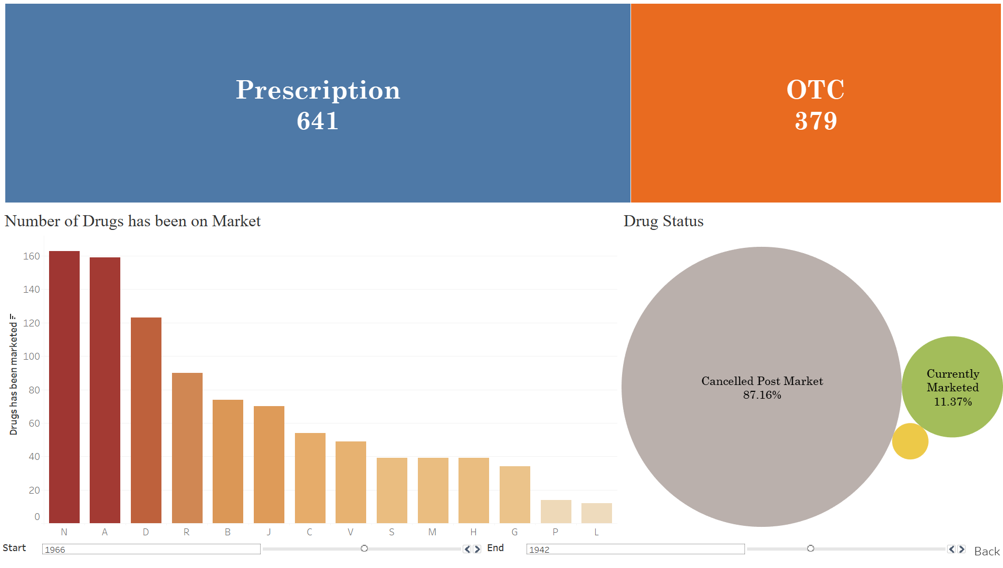
Hover to show tooltip:
1. Click to filter based on status
Hover to show tooltip:
Top three companies in this category
Filter based on schedule
Hover to show tooltip:
Top three companies in this category
Drill down to Dashboard 2 -> atc code second level
Click on bar to filter based on atc
Select Year
(1904-2024)
To Dashboard 1
Select Year (1904-2024)

Slide 19

Notes
Time Filter – Start, End
If End < Start, then End = Start
(To show number of drugs on market in the definitive period)
2014
2021
Drug C, Cancelled
1973
1997
2018
Current
Drug E, Cancelled
Drug D, Marketed
Defined Period
1999
2017
1989
2005
Drug A, Cancelled
1982
Current
Drug B, Marketed

Slide 20
Dashboard 3
Drug distribution by schedule (prescription vs OTC)
Drug distribution by atc second level
Top 8 companies in bar chart, stacked by drug status

Slide 21
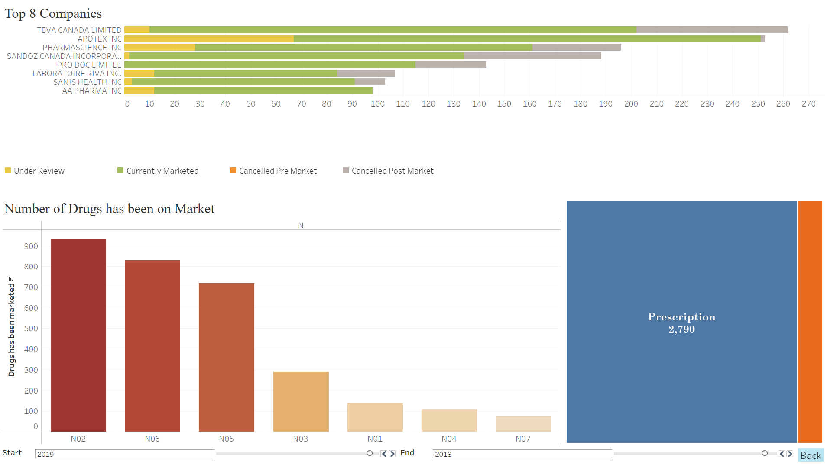
Click on bar to filter based on atc

Slide 22
Key Insights
Dashboard 1:
1951 peak: Clear split between presctiption vs OTC – completed documentation
Peak in 1998: Decreased processing time by Health Canada
Since 2004, more Prescription than OTC: Establishment of Natural Health Product Regulations

Slide 23
Citation
Health Canada. (n.d.). *Drug product database API documentation*. Retrieved August 29, 2024, from https://health-products.canada.ca/api/documentation/dpd-documentation-en.html#a2
Norwegian Institute of Public Health. (n.d.). *ATC/DDD Index*. Retrieved August 29, 2024, from https://atcddd.fhi.no/atc_ddd_index/
Health Canada. (n.d.). *Drug product database terminology*. Retrieved August 29, 2024, from https://www.canada.ca/en/health-canada/services/drugs-health-products/drug-products/drug-product-database/terminology.html
Health Canada. (n.d.). *Drug product database terminology*. Retrieved August 29, 2024, from https://www.canada.ca/en/health-canada/services/drugs-health-products/drug-products/drug-product-database/terminology.html
Health Canada. (n.d.). *Regulation of non-prescription and natural health products*. Retrieved August 29, 2024, from https://www.canada.ca/en/health-canada/services/drugs-health-products/natural-non-prescription/regulation.html
National Association of Pharmacy Regulatory Authorities. (n.d.). *Drug scheduling in Canada*. Retrieved August 29, 2024, from https://www.napra.ca/national-drug-schedules/drug-scheduling-in-canada/
Canadian Health History. (n.d.). *Drug timeline in Canada*. Retrieved August 29, 2024, from https://drugtimeline.ca/

