Slide 1
Movie Revenue Prediction
CSE 351 Project #1
Author: Hailey Zheng
ID: 116843193

Slide 2
Identify the Real World Issue
Every year, billions of dollars are invested into the film industry. Some movies become massive hits, while others suffer devastating box office failures.
Some believe that a bigger budget leads to greater returns.
Avatar (2009) cost $237 million to produce and became the highest-grossing film of all time.
Yet not all high investments guarantee success.
John Carter (2012) had a $250 million budget but lost over $200 million at the box office.
Some argue that star power is the key, while others insist that release timing makes all the difference.
So who is right?
Can we use previous data to
predict a future movie’s revenue?
Machine Learning!

Slide 3
How Can Machine Learning help?
Instead of guessing, we can let the data speak for itself.
Machine Learning allows us to:
Analyze patterns from thousands of past movies
Identify which features actually drive revenue
Build models that can predict a movie’s box office performance

Slide 4
Project Overview
This project uses the TMDB 5000 Movies Dataset to build machine learning models that predict a movie's worldwide box office revenue.
Through data cleaning, JSON parsing, and feature engineering, we identify the key factors that drive financial success in the film industry.
Our Approach:
Dataset: TMDB 5000 Movies Dataset
- tmdb_5000_movies.csv (1572 movies, 20 features)
- tmdb_5000_credits.csv (1572 movies, 4 features)
Features: budget, popularity, cast, crew, genres, release date, keywords, and more
Models: Linear Regression, Random Forest, XGBoost
Evaluation: RMSE, RSE, R²

Slide 5
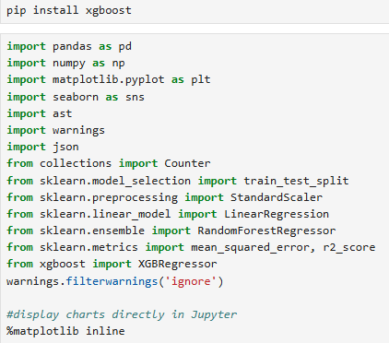
Section 0 – Environment Setup
Libraries Used:
pandas — data loading, cleaning, and manipulation
numpy — numerical computation
matplotlib & seaborn — data visualization
ast / json — parsing JSON-formatted columns
collections — genre trend analysis
scikit-learn — train/test split, StandardScaler, Linear Regression, Random Forest, and evaluation metrics
xgboost — XGBoost regression model

Slide 6
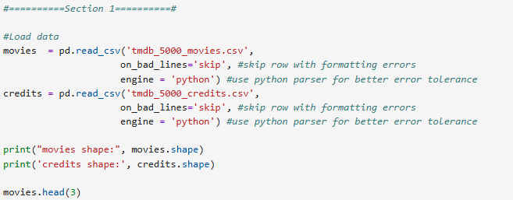
Section 1 – Data Loading
Loaded two datasets using pandas
Used python engine to handle formatting errors
on_bad_lines='skip': skip rows with formatting errors
engine='python': better error tolerance than default C engine

Slide 7
Section 2 – Data Cleaning
Initial Inspection:
Checked missing values and data types for both datasets
Steps Taken:
Converted release_date from string to datetime - Removed rows where revenue = 0 (indicates missing data)
Removed rows where budget = 0 (indicates missing data)
Dropped homepage column (846 missing values, no predictive value)
Dropped tagline column (85 missing values, text-based sentiment analysis is beyond the scope of this project)
Removed outliers in revenue using IQR method
Result:
1572 → 1306 movies remaining after cleaning
Data Dictionary – Key Decisions
Drop Columns
Convert data types
Parsing JSON Columns

Slide 8
Section 3 – JSON Parsing & Credits Merging
Columns Parsed:
genres → genre_list
keywords → keyword_list
production_companies → production_company_list
production_countries → production_country_list
spoken_languages → spoken_language_list
Credits Merging:
Merged credits dataset into movies using movie ID as key
cast → extracted top 3 actor names → cast_list
crew → extracted director name → director

Slide 9
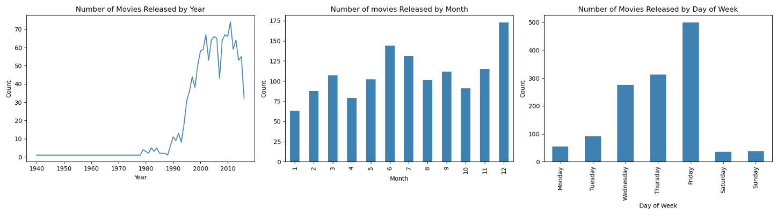
Section 4 – EDA: Release Patterns
Movies Released by Year / Month / Day of Week
Movies increased significantly from 1990 onwards
June, July and December have the highest release counts
→ Summer season and Christmas holiday season
Friday is by far the most popular release day
→ Studios target Friday to capture the full weekend box office

Slide 10
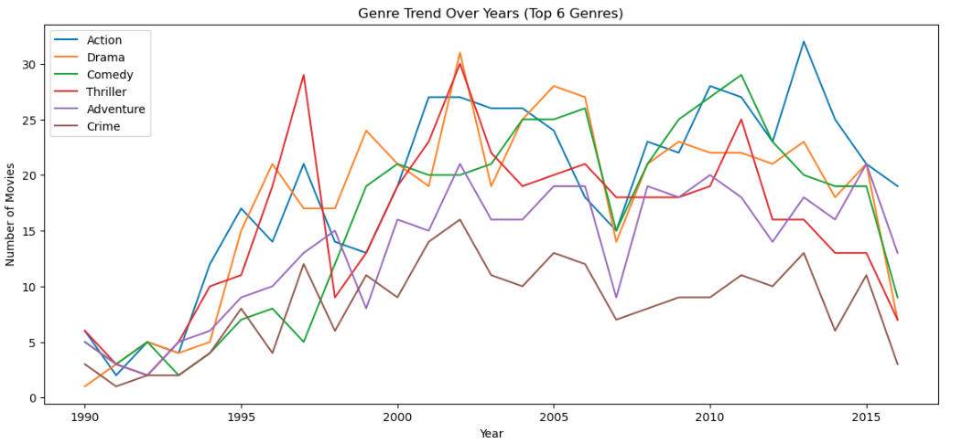
Section 4 – EDA: Genre Trends
Genre Trend Over Years (Top 6 Genres, 1990-2016)
All genres increased from 1990 to ~2013, then slightly declined toward 2016
Action has been the most popular genre since 2000, peaking around 2015
Drama remained consistently popular throughout, suggesting stable audience demand
Thriller peaked around 1997 and 2003 then declined
Crime remained the least produced genre throughout, staying consistently at the bottom

Slide 11
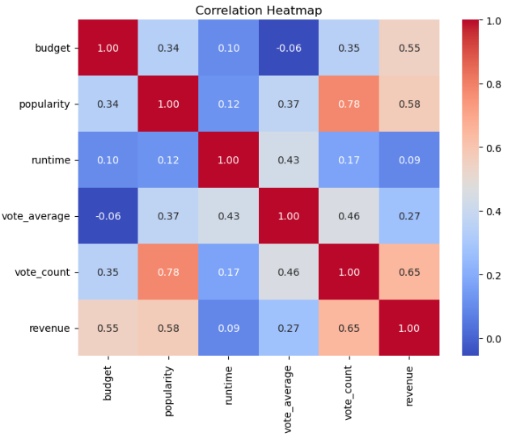
Section 4 – EDA3: Correlation & Revenue Distribution
Strongest predictors:
- vote_count: 0.65
- popularity: 0.58
- budget: 0.55
Weakest predictors:
- vote_average: 0.27
- runtime: 0.09

Slide 12
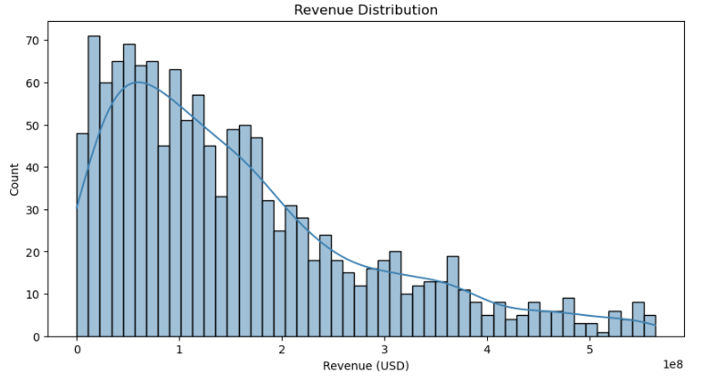
Section 4 – EDA3: Correlation & Revenue Distribution
Revenue Distribution:
Distribution is right-skewed
Most movies earn relatively low revenue
A small number of blockbusters earn extremely high revenue

Slide 13
Section 5 – Feature Extraction
Extracted from JSON columns:
num_genres — number of genres per movie
num_companies — number of production companies per movie
num_countries — number of production countries per movie
num_languages — number of spoken languages per movie
num_keywords — number of keywords per movie
Extracted from release_date:
release_year
release_month
Final Feature Set (12 features): budget, popularity, runtime, vote_average, vote_count, num_genres, num_companies, num_countries, num_languages, num_keywords, release_year, release_month
Target Variable: revenue
Final dataset: 1306 movies, 13 columns

Slide 14
Section 6 – Train/Test/Cross-Validation Split
Split the dataset into three parts: training, validation, and test set
Training set is used to train the models
Validation set is used to tune and verify model performance
Test set is held out until final evaluation to prevent data leakage
Features were normalized using StandardScaler (Z-score normalization)
Total Dataset
1306 movies(100%)
Train + Validation
1044 movies(80%)
Test
262 movies(20%)
Training
835 movies(64%)
Validation
209 movies(16%)

Slide 15
Section 7 – Modeling
Model 1: Linear Regression
Assumes a linear relationship between features and revenue
Simple and interpretable, used as a baseline model
Model 2: Random Forest
An ensemble of decision trees
Reduces overfitting by averaging predictions from multiple trees
Handles non-linear relationships well
Model 3: XGBoost
Gradient boosting algorithm
Builds trees sequentially, each correcting errors of the previous one
Generally achieves best performance on tabular data

Slide 16
Section 8 – Evaluation Metrics
RMSE – the lower the better
RSE – the lower the better
R² - the higher the better
 | Validation Set |  |  | Test Set
 | RMSE | RSE | R² | RMSE | RSE | R²
Linear Regression | $86,474,524 | 0.7363 | 0.4579 | $81,976,417 | 0.6839 | 0.5322
Random Forest | $72,044,587 | 0.6134 | 0.6237 | $80,009,477 | 0.6675 | 0.5544
XGBoost | $70,820,810 | 0.6030 | 0.6364 | $80,357,526 | 0.6704 | 0.5505

Slide 17
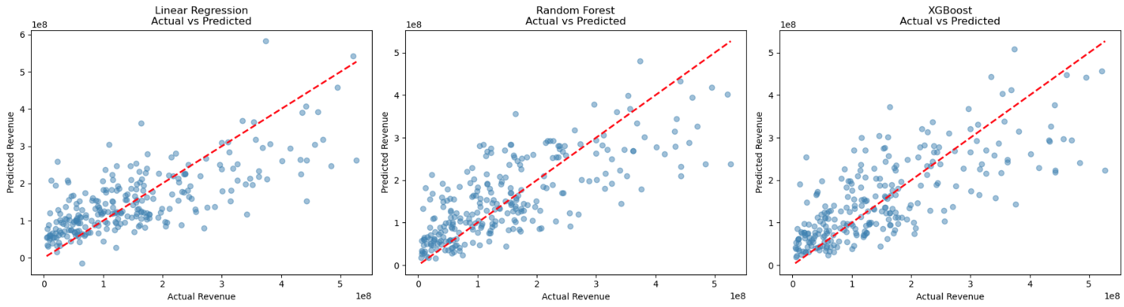
Section 9 – Model Comparison Visualization
All 3 models show similar patterns:
Good predictions for mid-range revenue movies
Larger errors for extremely high-revenue blockbusters
Notes:
- Scatter plot comparing actual vs predicted revenue for all 3 models - Red dashed line = perfect prediction - Points close to the red line = accurate predictions

Slide 18
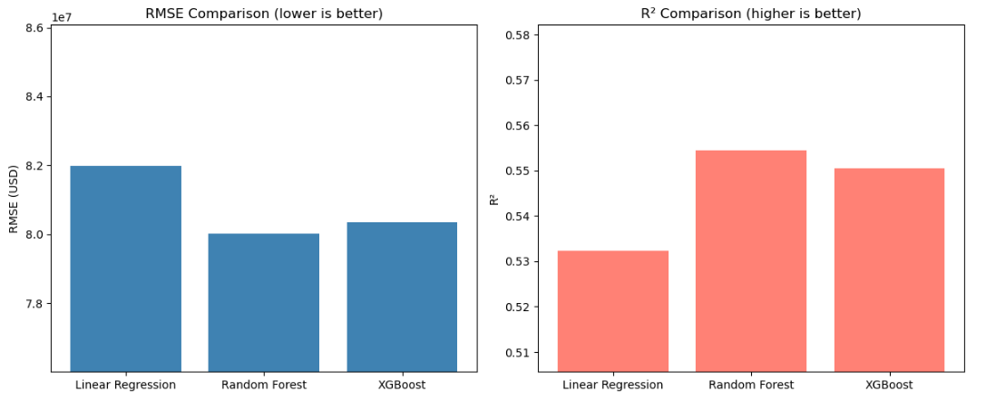
Section 9 – Model Comparison Visualization
Random Forest achieves the lowest RMSE and highest R² on test set
Three models perform similarly, suggesting the limiting factor is the features available instead of the choice of model

Slide 19
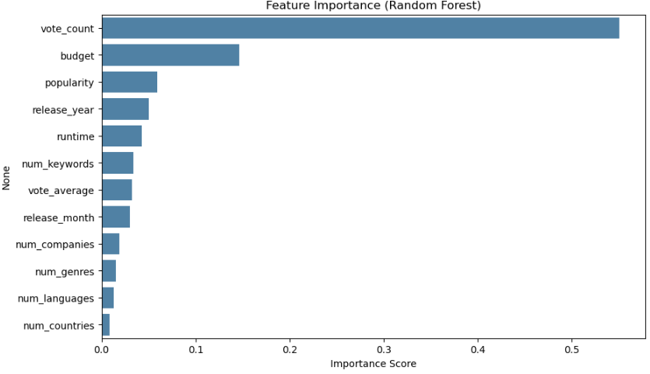
Section 9 – Model Comparison Visualization
Audience engagement (vote_count, popularity) matters more than production scale (budget, num_companies)
release_year is a surprisingly strong predictor (4th place) → Overall box office has grown significantly over the decades
release_month contributes less — specific month matters less than the year
num_countries, num_languages, num_genres contribute the least
Notes:
Top 3 strongest predictors: - vote_count (0.55) — audience engagement is the strongest signal - budget (0.14) — higher production cost tends to mean higher revenue - popularity (0.06) — TMDB public interest score Weakest predictors: - release_month, num_companies, num_genres - num_languages, num_countries

Slide 20
Conclusion
Best Model: Random Forest
RMSE: $80.0M | RSE: 0.6675 | R²: 0.5544
Explains 55% of worldwide box office revenue variation
Key Findings
vote_count, budget, and popularity are the strongest predictors
release_year matters — box office revenue has grown over the decades
release_month contributes very little to prediction
All three models perform similarly, suggesting the limiting factor is feature availability, not model choice

Slide 21
Conclusion
Limitation
Models struggle to predict extremely high-revenue blockbusters
Missing features: marketing budget, star power, critic reviews
Dataset size (1306 movies) is relatively small
Future Work
Incorporate more features (social media buzz, critic scores)
Try neural network models for better non-linear capture
Expand dataset with more recent movies

Slide 22
—William Goldman
Thank You!
“Nobody knows anything in Hollywood.”
Author: Hailey Zheng
ID: 116843193

