Slide 1
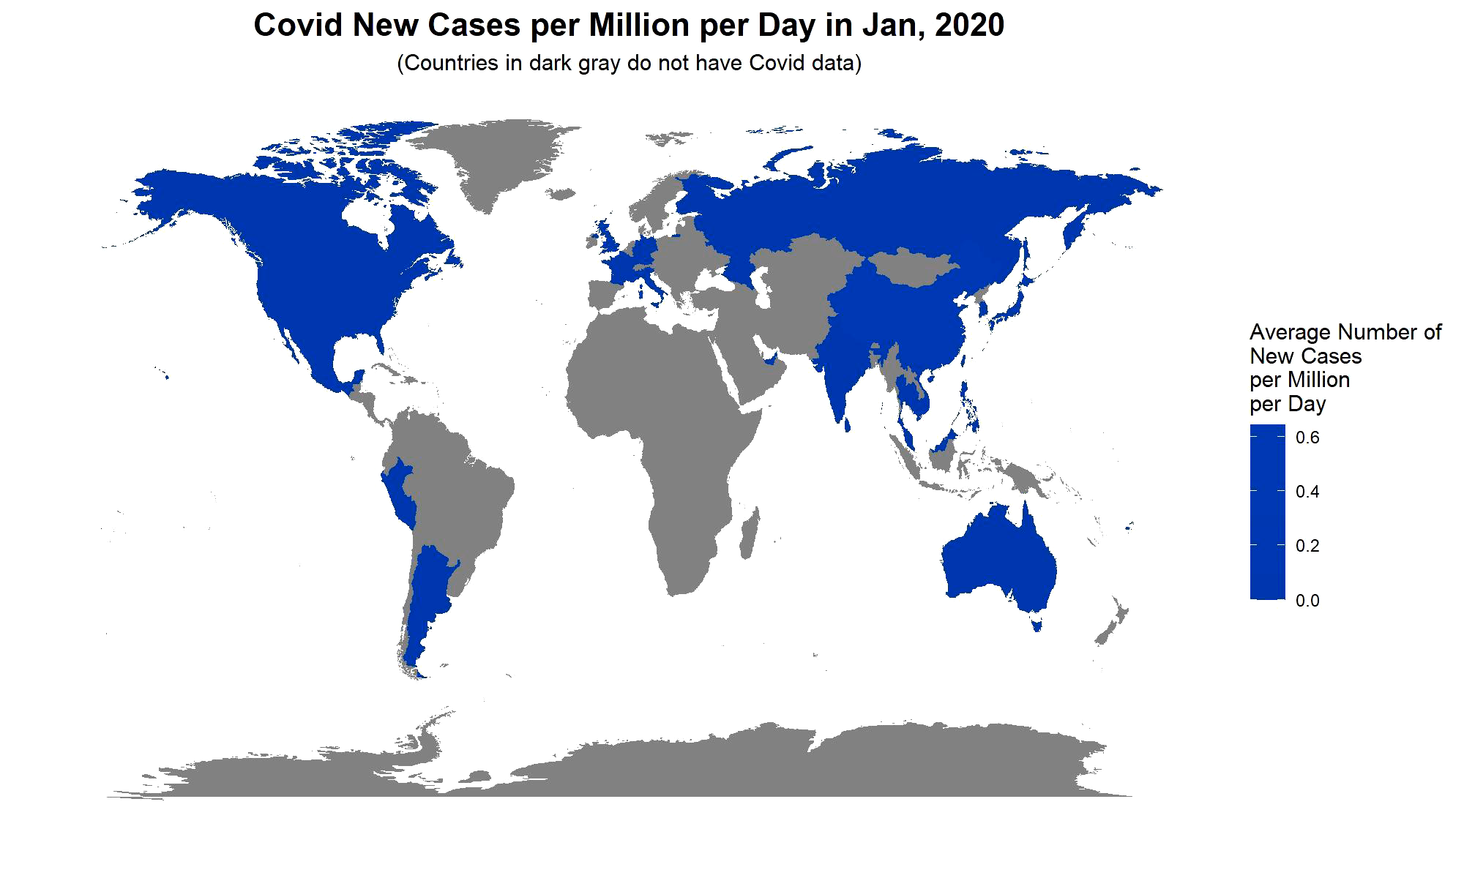
Part I The Covid Situation Since January 2020

Slide 2
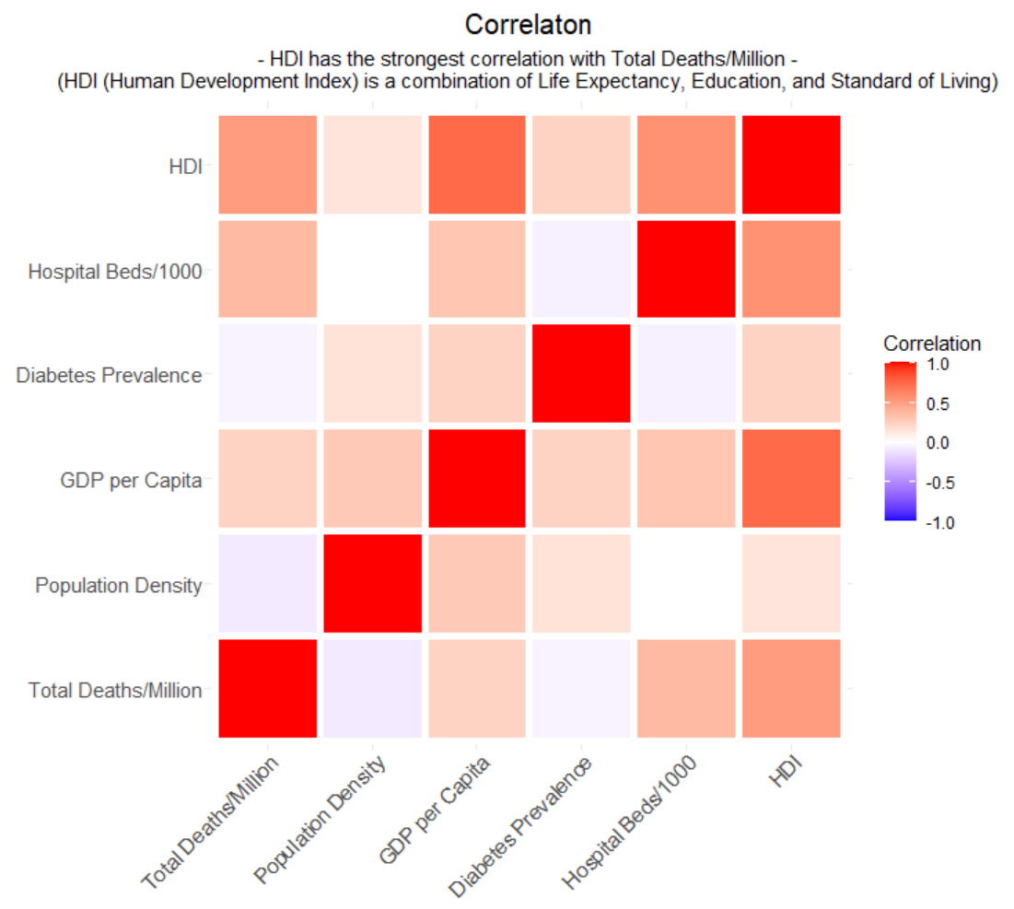
Part II What is Related to Total Deaths per Million?

Slide 3
Part III How is HDI related to Total Deaths per Million?
Click Here to View the Interactive Plot

