Slide 1


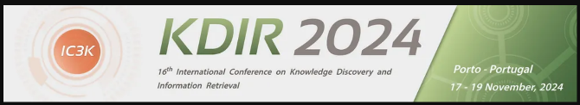
Knowledge Graphs can play together: Addressing knowledge graph alignment from ontologies in the biomedical domain
1
Hanna Abi Akl, Dominique Mariko, Yann-Alan Pilatte, Stéphane Durfort, Nisrine Yahiaoui and Anubhav Gupta

Slide 2

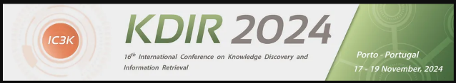
Content
2
Problem Statement
DomainKnowledge Pipeline Overview
DomainKnowledge Modules – Annotator
DomainKnowledge Modules – Aggregator
DomainKnowledge Modules – Merger
Metrics – Coverage
Metrics – Mapping
Metrics – Alignment
Experimental Setup
Results
Conclusion

Slide 3
Problem Statement
3
Construct a generalized domain-specific knowledge graph from domain text and ontological sources
Leverage domain-specific vocabulary to find patterns in different domain texts
Domain of application: Pharmaceuticals
RQ1: Can domain ontological sources be leveraged as a basis for constructing a knowledge graph from unstructured text?
RQ2: Can domain ontological sources be used to align knowledge graphs from different sources?

Slide 4
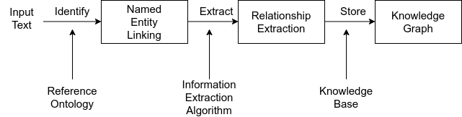
DomainKnowledge Pipeline Overview
4
Leverages document parsing, entity-relation triple extraction and knowledge graph construction modules

Slide 5
DomainKnowledge Modules – Annotator
5
Module to extract triples from document text based on relevant domain entities
Triples of the form (subject, relation, object)
Subject and object entities should be relevant to the domain (e.g., Pharmaceuticals)
Relations of 2 types:
Verbal: relations containing verb as a cornerstone
Prepositional: relations built from adpositions (e.g., as, with, for)
Additional document metadata extracted

Slide 6
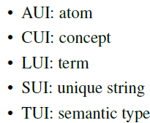
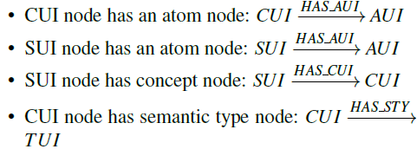
DomainKnowledge Modules – Aggregator
6
Integrates domain ontologies to validate and ground extracted triples from text
Relies on UMLS tables
Table ontologies re-organized into one consolidated knowledge graph based on ontological information for nodes and relations
AUI, CUI, LUI, SUI and TUI nodes included in knowledge graph construction
Node relations created to bind ontological nodes hierarchically

Slide 7
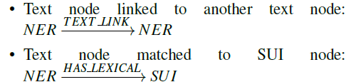
DomainKnowledge Modules – Merger
7
Integrates extracted triples into ontology knowledge graph
Point of entry is SUI node
Comparison based on 2-step string matching:
Exact matching (Levenshtein distance)
Semantic matching (cosine score on 512-dimensional vector embeddings)
Triple entities and relations inserted as nodes (NER) and edges in knowledge graph

Slide 8

Metrics – Coverage
8
3 metrics defined to evaluate efficacy and pertinence of final graph
Some formalization:
Domain Tokens (DT) = set of entities from input texts with a direct relation to an ontology node
Text Tokens (TT) = set of all extracted entities from input texts
Coverage = Percentage of domain vocabulary present in input texts

Slide 9

Metrics – Mapping
9
Some formalization:
Domain Tokens (DT) = set of entities from input texts with a direct relation to an ontology node
Concept Tokens (CT) = set of all extracted entities from input texts with same syntactic name as ontology node
Mapping = Percentage of entities directly found in the ontology knowledge graph

Slide 10

Metrics – Alignment
10
Some formalization:
rNER→TUI = Direct relation from text entity to ontological semantic type
rCUI→TUI = Direct relation from concept to ontological semantic type
rTUI = Relation from a given source node to an ontological semantic type
We define: rTUI = rNER→TUI + rCUI→TUI
Alignment = Overlap score between text entities and ontological semantic types

Slide 11
Experimental Setup
11
2 experiments conducted on 52 Clinical Study Reports (CSR) documents
Goal: Finding maximum direct relations between NER and CUI/TUI nodes
Experiment 1:
Group sentences based on sentence scores
Extract and consolidate relevant NER and CUI/TUI nodes
Promising but computationally heavy
Experiment 2:
Calculate node importance score for NER and ontological nodes
Assign weights to relations between nodes based on cumulative node importance scores
Graph traversal algorithm to find the maximum total weight between NER and TUI source and target nodes

Slide 12
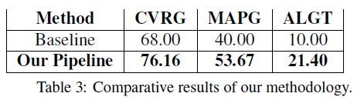
Results
12
Evaluation done against human baseline with domain experts (Clinical Analysts)
DomainKnowledge beats human baseline in all metrics
Alignment score weak – possibility to improve by enriching domain ontologies
Gap in score between metrics highlights difficulty in alignment

Slide 13
Conclusion
13
Initial results on domain show promise
RQ1: Can domain ontological sources be leveraged as a basis for constructing a knowledge graph from unstructured text? Ontologies are key to constructing structured knowledge graphs from unstructured sources
RQ2: Can domain ontological sources be used to align knowledge graphs from different sources? Metrics play an important role in measuring alignment in addition to the right ontological sources
Alignment remains a hard problem
Work lays groundwork for extended experimentation on more domains

Slide 14
Thank You
14
Questions

