Slide 1


The Path to Autonomous Learners
Hanna Abi Akl
Data ScienceTech Institute
hanna.abi-akl@dsti.institute

Slide 2
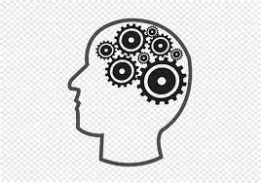
Research Questions
Is it possible to build a system that can learn with minimal input knowledge?
To what extent is such a system capable of reasoning on its own in an explainable and trustworthy manner?
Hypothesis
It is possible to build a framework that relies on an incremental learning mechanism based on higher-order concepts and accumulate new knowledge based on reasoning coupled with its existing data.

Slide 3
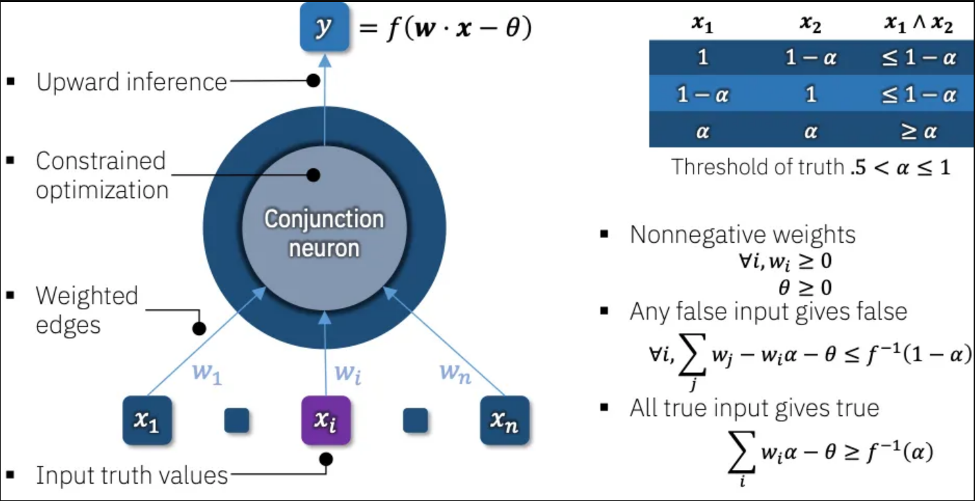

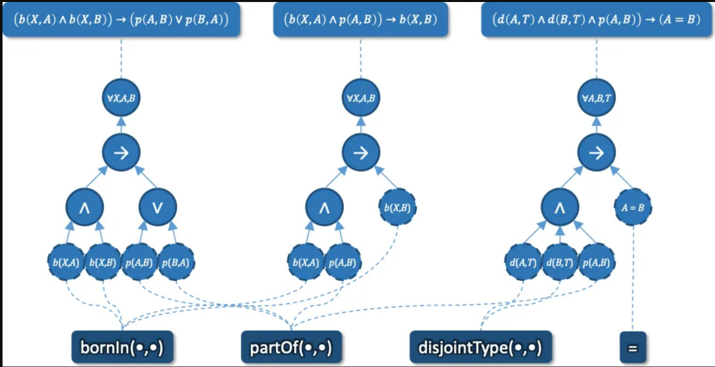


Solution: KD-LNN
Knowledge-Driven Logical Neural Network is a theoretical framework based on:
A model: A LNN base module for reasoning and learning
A weighted, real-valued logical neuron and its associated constraints.
A knowledge base: A graph of concepts and their relations
A minimal input knowledge source: A starting set of concepts that serves as its initial data
An example logical neural network structure modelling three rules.

Slide 4

KD-LNN Architecture
Data Ingestion
Data Modelling
Learning & Reasoning
Top Module
Abstract
ContactInformation
Document
Event
GeneralTerm
Group
Happening
InformationResource
Job Position
Language
Location
Number
Object
Organization
Person
ProductModel
Rôle
Service
Situation
SocialPosition
Statement
Thing
Exists
Quantifier
ForAll
Entity
Property
Unary
Operator
Object
Not
Location
Product
Connective
Formula
Agent
Bidirectional
PoliticalRegion
Person
Binary
Neuron
Group
PoliticalPlace
Implies
City
Man
Connective
Neuron
Country
Woman
Formula
Organization
Or
PoliticalEntity
N-Ary
Neuron
GouvernmentOrg
CommercialOrg
And
ReligiousOrg
Company
Parliament
PoliticalParty
Proposition
Leaf
Formula
MediaCompany
Predicate
TVCompany
Internal Symbolic Modules
External Symbolic Modules

Slide 5
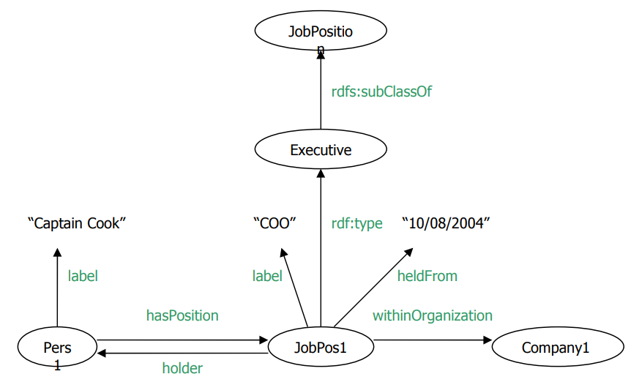
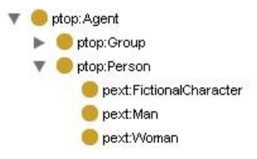
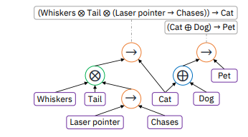
KD-LNN Advantages
Knowledge graph representation preserves entities and relationships
Ontology provides domain-specific knowledge
Neuro-symbolic network models neurons as formulae built as logical (first-order) rulesets

Slide 6
Experiment 1
77 Properties
Proton Ontology
Learning
Ingest the Proton ontology
Model classes as entities and properties as relationships in knowledge graph
Build logical ruleset to capture nodes and edges
Query LNN module to validate learned data
25 Classes

Slide 7
Experiment 2
8 Properties
Basic Formal Ontology (BFO)
Reasoning
Ingest the BFO ontology
Generate BFO knowledge graph
Apply previous ruleset to deduce similarities
Query LNN module to validate correct reasoning over common concepts and properties
34 Classes

Slide 8
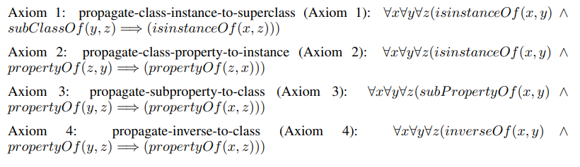
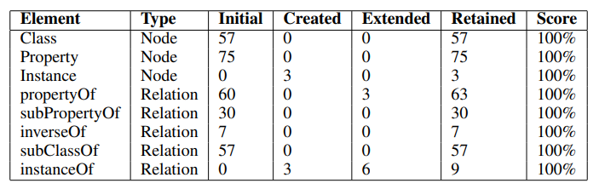
Results
First-Order Logical Experimental Ruleset
KD-LNN learning and reasoning results

Slide 9
Conclusion
KD-LNN leverages the power of Neural Networks to handle large-scale and complex data
KD-LNN uses a rule-based framework to provide transparent, explainable and transferable learning
KD-LNN is domain-agnostic
KD-LNN overcomes the “Big Data” and compute constraints

Slide 10
Research Directions
Domain-specific autonomous learners
Consolidated Upper-Level Universal Ontology
Multi-language conversational agents

Slide 11
Thank You

