Slide 1
ABSOL
Automatic Builder for Semantically Oriented Languages
Specification and Verification of Domain-Specific Languages Through Automated Compiler Generation in Haskell

Slide 2

Why?
Spread of important domain logic throughout software systems
Increasing usage of Domain-Specific Languages (DSLs)
A broad range of DSLs categories in use today
DSLs act to centralise domain logic
DSLs in General-Purpose Languages as sources of bugs
Centralisation -> a single point-of-failure
Notes:
Modern software systems are increasing significantly in complexity
As the complexity of these systems grows, it is becoming apparent that domain-specific logic is becoming integrated in many forms throughout these systems
Studies by Fowler and Mernik, amongst others, have demonstrated that this dispersion of domain logic throughout the system increases the risk of it being incorrect.
As a result, there has been a “significant uptick in interest” in Domain-Specific Languages or DSLs.
The term DSL is a broad one, encompassing a multitude of embedded syntaxes for defining domain logic.
These syntaxes may be integrated into the host language, or as an external API, and range from static configuration to sophisticated and executable programs
The key notion is that the DSL is sufficient for specifying the required domain logic, and no more.
The use of DSLs allows the domain logic in a program to be centralised in one place, and then accessed from other parts of the program.
This means that there is only one place in which domain logic has to be changed.
This project was inspired by observations from during my time at Bloomberg
Certain projects within the company were using General Purpose programming languages for runtime configuration.
This included the use of OCaml for specifying options pricing algorithms and trading strategies at runtime.
However, these languages provided much more power than they needed, and hence an increased potential for system bugs
However, as domain logic becomes centralised into DSLs, these small languages become single points-of-failure within the systems in which they are used.
A bug in your domain logic, while simpler to find, will now have a much larger impact on the software system as a whole

Slide 3
What?
Provably Correct DSLs
Restricted language feature-set
A comprehensive system for creating DSLs
A Metalanguage: Metaspec
A Metacompiler: ABSOL
All in the name of proving each little language to be correct
Notes:
This project aims to prevent the DSL from becoming such a critical failure point in the system through formally specifying its function.
Not only does this prevent certain classes of bug, it is easier to verify the semantics of a specification than an implementation.
By fully specifying the DSL, the project aims to prevent common DSL errors, such as poor implementations leading to domain logic bugs, and programs that can diverge.
Necessarily, being able to provide these guarantees requires the restriction of the types of programs that the DSL can represent.
Doing so restricts the languages to operations on finite data (and hence no codata), and disallows the use of unbounded recursion.
The system provides two main components.
The first component is the Metalanguage: Metaspec
This language provides facility to specify the syntax of the DSL, through an EBNF-variant grammar, and the semantics of each kind of syntactical statement.
This coupling of syntax and semantics forces the DSL makers to carefully evaluate how they want their language to act.
The second component is the Metacompiler: ABSOL
This is a software program that takes in a metaspec specification for a DSL x, and performs a couple of tasks.
The first is to verify that the semantics in the file are complete, meaning that all possible programs in x terminate.
If the analysis phase passes, then the metacompiler will produce a compiler for x, embedding the provided semantic behaviour in the language compiler.
This ensures that mistakes cannot be made in the language implementation that may alter the semantics of the language
Combined, these two elements of the system should provide for the creation of provably correct DSLs.

Slide 4
Prior Work – DSLs and Metalanguages
“DSL – A programming language or specification that offers expressive power focused on a particular domain”
– Van Deursen, Domain-Specific Languages: An Annotated Bibliography
DSLs provide a more appropriate level of abstraction
A focus on executable, external DSLs via Transpilation
Language Grammars based on EBNF
Semantics as a transformation of Big-Step Operational Semantics
Notes:
While many areas in which a DSL is employed could also use a General-Purpose Programming Language most DSL proponents find that they provide a more appropriate level of abstraction for a given problem domain.
They allow for encoding important business logic that may be orthogonal to the GPLs in which the business software is written.
While there are many kinds of DSL in use, ranging from static specification languages (often a better replacement for XML or JSON), to fully-executable programming languages, this project focuses on any kind of DSL that has execution semantics.
It also focuses on what multiple pieces of literature term ‘external’ DSLs. These are those which are not an extension of the host language, but exist on their own and are integrated with other languages via a Foreign-Function Interface.
This choice reflects the desire of the project to have maximum control over the DSL execution environment.
In order to maintain this control, the DSL will be generated via transpilation to Haskell, a form of compilation that targets another high-level language. While compilation to ASM and interpreter approaches were recorded in the literature, it was determined that this would provide the most appropriate trade-off.
Metalanguages are languages used to describe aspects of language, and for this project an investigation into methods of specifying both syntax and semantics was required.
While formal definitions of languages fall into multiple categories: unrestricted, context-sensitive, context-free and regular, this project focused on the use of Extended Backus-Naur form notation for specifying language syntax. This is because it provides multiple extension mechanisms for integrating additional language features.
In contrast to the established standard for specifying syntax, the specification of semantics is a much broader category of work, but all different methods consist of semantic functions: mappings from the abstract syntax of a program to its behaviour.
While the review process involved investigating operational, denotational, axiomatic and hybrid semantics, it was decided that the big-step form of operational semantics provided the best balance between conciseness and expression. The recursive nature of the semantics has proved key in the mechanisms for proving program correctness.

Slide 5
Prior Work – Verification and Generation
“Totally Correct – When a program terminates and performs the operations as defined by its specification.”
– Manna and Pnueli, Axiomatic Approach to Total Correctness of Programs
Impossible to verify arbitrary programs
Must restrict programs to data to enable this
Termination proofs by induction
Compiler generation from the language specification
Notes:
While it would be preferable to prove correctness of arbitrary DSLs, this is generally impossible.
As a result, research into formal verification focused on the duality of data and codata.
Data is captured in inductive data types, that can be constructed in a finite number of steps.
Research by Ralph Hinze shows that it is possible, in general, to prove well-founded recursive programs correct, and hence this is the restriction that the project uses. This ability to prove termination for well-founded general recursion enables the power of the metalanguage in this project.
Barring special-case program semantics for function calls and special features (which are guaranteed to terminate through independent proof), Nordstom shows that big-step semantics can be reasoned about through well-founded induction.
If a restriction is placed on the form of the semantics such that the convergence hypothesis for the semantics depends purely on the sub-terms of the semantics, then it follows that a language terminates as long as each base-case terminates.
To this end, the language focuses on providing trivially terminating base-cases for the semantics, and recursively decomposing more complex semantics until, by the inductive hypothesis, they can be shown to terminate.
Finally, research was conducted regarding the automatic generation of compilers, given the syntax and semantics of a language.
Multiple benefits were found attributed to the approach aimed to be taken by the project, especially surrounding correctness, maintainability and portability in a study by Diehl.
While multiple intermediate representations for this transformation were explored, including LLVM and C--, it was found that generating the target compiler directly in a high-level language would make the task manageable in the project timescale.

Slide 6
The Work So Far
“When asked for a formal semantics of the formal semantics Milner's head explodes.”
– James Iry, A Brief, Incomplete and Mostly Wrong History of Programming Languages
This project involves multiple levels of systems and metasystems
The Metalanguage -> The Language
The Metacompiler -> The Compiler
Notes:
As you can probably already see, this project involves multiple levels of ‘meta’.
It’s a bit brain-twisty.
There are two main elements of the project that have seen progress so far.
The metalanguage, that specifies the DSL
The metacompiler, which verifies the DSL and generates a compiler for it

Slide 7
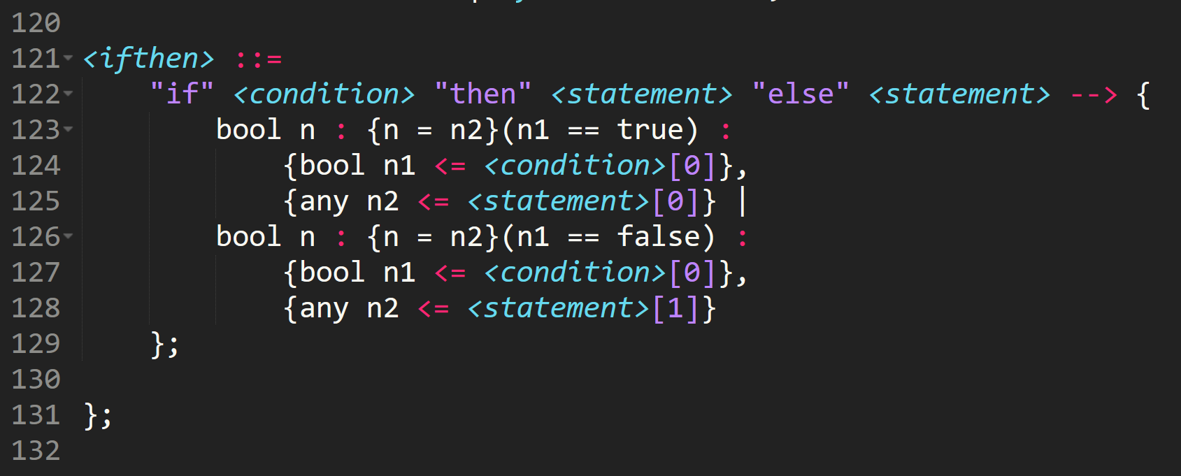
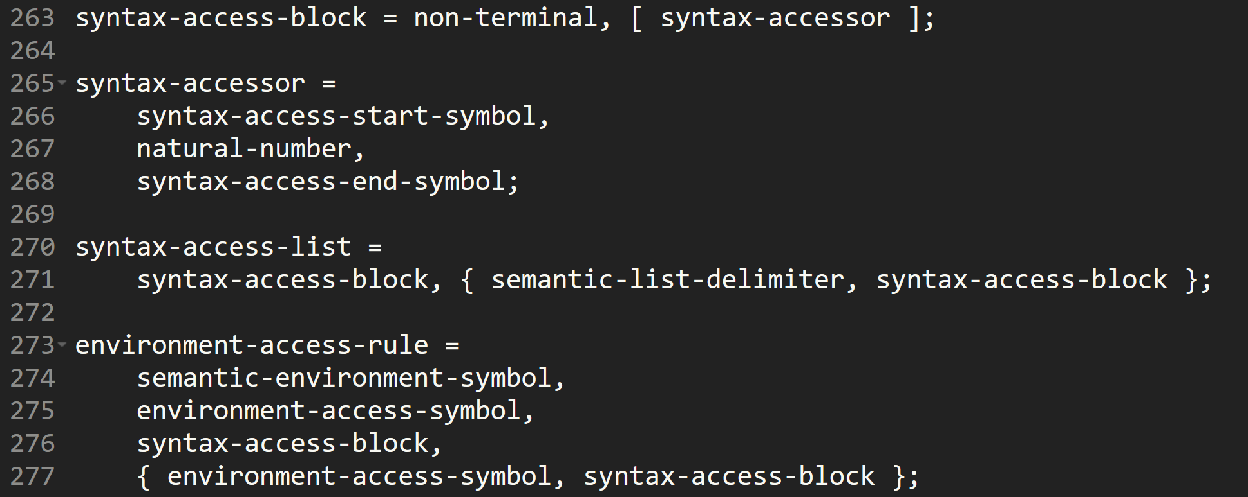
The Work So Far – The Metalanguage
An initial sketch of the syntax
Care taken with semantic form
Grammar Complete
Left-Recursive, but lookahead
Metaspec semantics not yet entirely complete
Notes:
Work on the metalanguage started by sketching how the metaspec syntax was supposed to look.
Much care was taken in designing this syntax, ensuring that it supported the correct language features.
This ensured that it was versatile enough to specify the operations required for a variety of different DSLs.
These included:
Careful examination of how to best specify the big-step operational semantics in a textual format. While the solution to this was arrived on fairly quickly, it went through several iterations over time, adding the ability to restrict evaluation on the result of sub-evaluations, and specify how the evaluated result is produced.
Determining the allowable semantic operations: The language restricts the operations that can be applied as part of the semantics in order to make it reasonable to prove their correctness.
Methods for accessing syntactic elements within the semantics: Use of an array-address-like syntax (draw on the board/point)
Determining the typing discipline: The semantics can operate on a pre-defined set of types. This ensures that, even if the language is not-typed, that the semantics are well-specified.
Determining extension mechanisms: Care was taken to provide the user with useful semantic features such as list traversal, function calls, and environment access through the special syntax system.
Environment handling: Methods for storing and retrieving values in the program environment, allowing for proper operation of function definitions and calls, and also stateful computations.
This system provided a number of special syntactic elements that have already been proven correct, allowing more complex language features to be implemented in a provably correct fashion.
Once the sketch of the metaspec syntax was complete, time was taken in order to fully-specify the grammar of the metalanguage.
Some initial frustration was found around the issue of left-recursive grammars, as transforming these would lead to a difficulty of expression in the metalanguage.
In the end, it was decided to work around this by employing an infinite-lookahead parser, thus ensuring that the parsing process would not diverge.
While the semantics of metaspec are not fully specified, this is intended to occur as the metacompiler is developed.

Slide 8
The Work So Far – The Metacompiler
At a very rudimentary stage
Basic program structure
Partial lexer implementation
Input DSL File
Input Metaspec File
Lex and Parse
Semantic Verification
Code Generation
Parse and Lex DSL
DSL Code Generation
Notes:
The metacompiler is currently at a very rudimentary stage, and will be the main focus of the next stage of the development effort.
It is currently capable of reading in a metaspec file, and lexing a portion of the metaspec grammar.
This means that it is capable of producing valid token streams for the portion of the grammar which it supports, providing a platform on which to base the parser implementation.
The intended mode of operation for the metacompiler pipeline is as follows
Lex and Parse Metaspec File
Verify input language semantics
Generate compiler code
Compile compiler
Run compiler on a DSL program.
Interface with the DSL program from a GPL

Slide 9
Future Plans
Continue work on the metacompiler:
Complete the Lexer
Implement the Parser
Implement the termination proof mechanism
Implement the code generation
Iteratively develop the semantics of metaspec
Notes:
While the project has been proceeding fairly smoothly up to this point, there is still much work to be done!
The metacompiler pipeline has a number of stages to go:
The grammar used to generate the lexer needs to be finished, being manually translated from the EBNF grammar that provides the syntax of metaspec.
Once the lexer is complete, the infinite-lookahead parser will be implemented, reading from the token-stream provided by the lexer.
The parser will be able to generate an AST, which will be filtered to provide the relevant nodes to the semantic verification engine.
This engine will implement the termination proof mechanism through induction on the structure of semantics, combined with the separately-proven special-feature semantics.
This will allow the metacompiler to verify the semantic correctness of the input DSL.
Once this verification is complete, the code-generation segement will be implemented, walking the AST and generating Haskell code from the semantics contained within it.
The unfinished elements of the metalanguage, namely the semantics of some features, will be developed as-needed alongside the implementation of the metacompiler.
There is a lot of work to be done, but with a concerted effort it should be achievable within the remaining project timeframe.

Slide 10

Questions?
(Yes, the project is named after a Pokemon)

