Slide 1
ABSOL
Automatic Builder for Semantically Oriented Languages
Specification and Verification of Domain-Specific Languages Through Automated Compiler Generation in Haskell
Notes:
Heya!
Today I’m going to give you a brief overview of my project: ABSOL, the Automatic Builder for Semantically Oriented Languages.

Slide 2

Why?
Spread of important domain logic throughout software systems
Increasing usage of Domain-Specific Languages (DSLs)
A broad range of DSLs categories in use today
DSLs act to centralise domain logic
DSLs in General-Purpose Languages as sources of bugs
Centralisation -> a single point-of-failure
Notes:
In recent years, modern software systems have seen significant increases in complexity.
As this complexity grows, it has become apparent that Domain-Specific Logic, trivially defined as logic pertaining to how the system operates in an environment, is becoming integrated into many portions of these systems.
However, studies by Fowler and Mernik, amongst others, have demonstrated that this dispersion of logic increases the risk of it being incorrect somewhere in the system.
As a result, there has been a “significant uptick in interest” in Domain-Specific Languages, or DSLs.
The term ‘DSL’ is a broad one, and encompasses many syntaxes for defining domain logic.
These may be internal or external to the host language, and range from static configuration to sophisticated executable programs.
DSLs specify the required domain logic, and no more.
The use of DSLs allows for the centralisation of this domain logic, ensuring that there is only one place where it needs to be changed.
However, as domain logic becomes centralised, this creates a single-point-of-failure within the system in which the DSL is used.
A bug in your domain logic, while simpler to find, now has a greater impact.
This project was inspired by my time at Bloomberg, where I observed certain projects in the company to be using General-Purpose Programming languages (GPLs) for runtime configuration.
This included the use of OCaml for specifying options pricing algorithms and trading strategies at runtime.
These languages provided much more power than required, increasing the potential for system bugs.

Slide 3
What?
Provably Correct DSLs
Restricted language feature-set
A comprehensive system for creating DSLs
A Metalanguage: Metaspec
A Metacompiler: ABSOL
All in the name of proving each little language to be correct
Notes:
This project is concerned with preventing the DSL from becoming such a critical failure point through formal specification.
Not only does doing so prevent certain classes of bug, the formal semantic specification is far easier to verify than the semantics of an implementation.
Full specification of the DSL aims to prevent common errors, such as poor implementations, and divergent programs.
Necessarily, however, being able to provide these guarantees necessitates restriction of the types of programs that these languages can represent.
While this would be an unreasonable restriction for a GPL, in the world of DSLs it is far less limiting.
By restricting the DSLs to operations on finite data and disallowing the use of unbounded recursion, it is possible to prove the DSL correct.
The system has two main components
The first is Metaspec, the metalanguage.
This allows the specification of the syntax and semantics of the DSL, and in doing so forces the DSL creators to carefully evaluate how they want their language to behave.
The second component is ABSOL, the metacompiler.
It is a software program that ingests a specification for a DSL x, verifies the semantics of x (meaning that all programs in x terminate), and then produces a compiler for the language x.
This ensures that mistakes cannot be made in the implementation of the DSL, and thus ensures correct language semantics.
Combined, these two elements of the system should provide for the creation of provably correct DSLs.

Slide 4
Prior Work – DSLs and Metalanguages
“DSL – A programming language or specification that offers expressive power focused on a particular domain”
– Van Deursen, Domain-Specific Languages: An Annotated Bibliography
DSLs provide a more appropriate level of abstraction
A focus on executable, external DSLs via Transpilation
Language Grammars based on EBNF
Semantics as a transformation of Big-Step Operational Semantics
Notes:
This project has been heavily influenced by related literature, so I feel that a brief overview of the material is necessary.
While many uses of a DSL could be replaced by a GPL, proponents of DSLs find that the provide a “more appropriate level of abstraction” for a given problem domain.
This is because they allow for encoding domain logic that may be orthogonal to the business software itself.
There are many kinds of DSLs in use, and these range from static specification to executable programs; this project, however, focuses on executable DSLs.
Furthermore, it focuses on what the literature terms as ‘external’ DSLs: those which integrate with the GPL via a foreign function interface.
This is because it allows maximum control over the DSL’s execution semantics.
Furthermore, the DSL will be generated via compilation to Haskell, a process that transforms one high-level language into another known as Transpilation.
Metalanguages are languages used to describe other languages, so research was conducted into methods for specifying both syntax and semantics.
While there are many kinds of language grammars, the focus was placed on Extended Backus-Naur form, as it provides multiple extension mechanisms for integration additional language features.
While there is a well-established standard for syntax specification, semantics is a much broader category of work.
All types of semantics, however, consist of semantic functions: mappings from a program’s abstract syntax to its behaviour.
While the review examined operational, denotational, axiomatic and hybrid semantics, it was decided to use big-step operational semantics.
This provided the best balance between conciseness and expression, as well as the recursive structure required for the proof engine.

Slide 5
Prior Work – Verification and Generation
“Totally Correct – When a program terminates and performs the operations as defined by its specification.”
– Manna and Pnueli, Axiomatic Approach to Total Correctness of Programs
Impossible to verify arbitrary programs
Must restrict programs to data to enable this
Termination proofs by induction
Compiler generation from the language specification
Notes:
While it would be preferable to prove the correctness of arbitrary DSLs, this is generally impossible.
As a result, research into program verification focused on the duality of data and codata.
Data is captured by inductive data types, and can hence be constructed in a finite number of steps.
It has been shown, generally, that it is possible to prove programs that use well-founded general recursion to be correct.
By restricting programs to this, the project allows for the creation of powerful DSLs.
The general termination proof for the DSLs comes from Nordstrom, who shows that big-step semantics can be reasoned about through induction.
While there are special-case proofs for other language features, this inductive proof operates on the structure of the semantics.
The aforementioned restrictions are placed on the form of the semantics such that the convergence hypothesis for the semantics depends purely on the sub-terms of the semantics.
The metalanguage provides the ability to specify trivial base-cases for the semantics, and the proof engine recursively decomposes more complex semantics until they can be shown to terminate.
Finally, there has been some work on the automated generation of compilers given syntax and semantics.
It is found to offer benefits around correctness, maintainability and portability in study by Diehl, and so the project avoided the use of more complex intermediate representations, instead generating the target directly in a high-level language.
Finally, research was conducted regarding the automatic generation of compilers, given the syntax and semantics of a language.
Multiple benefits were found attributed to the approach aimed to be taken by the project, especially surrounding correctness, maintainability and portability in a study by Diehl.
While multiple intermediate representations for this transformation were explored, including LLVM and C--, it was found that generating the target compiler directly in a high-level language would make the task manageable in the project timescale.

Slide 6
The Work So Far
“When asked for a formal semantics of the formal semantics Milner's head explodes.”
– James Iry, A Brief, Incomplete and Mostly Wrong History of Programming Languages
This project involves multiple levels of systems and metasystems
The Metalanguage -> The Language
The Metacompiler -> The Compiler
Notes:
As you can probably already see, this project involves multiple levels of ‘meta’.
It’s a bit brain-twisty.
There are two main elements of the project that have seen progress so far.
The metalanguage, that specifies the DSL
The metacompiler, which verifies the DSL and generates a compiler for it

Slide 7
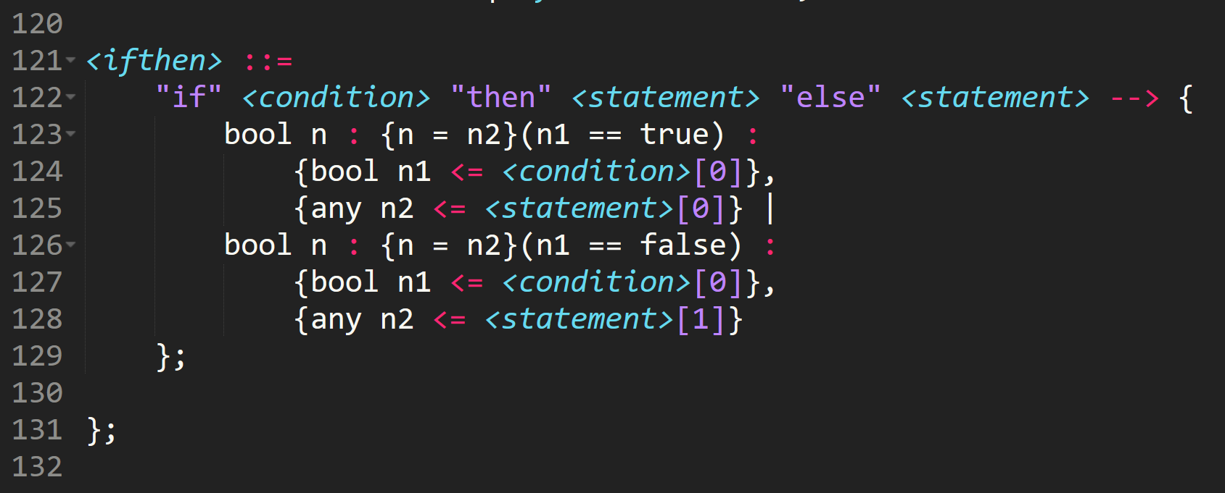
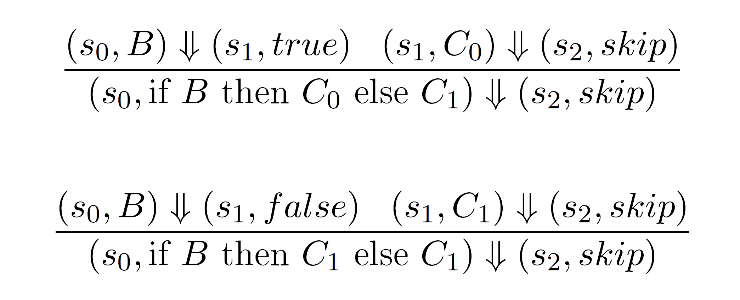
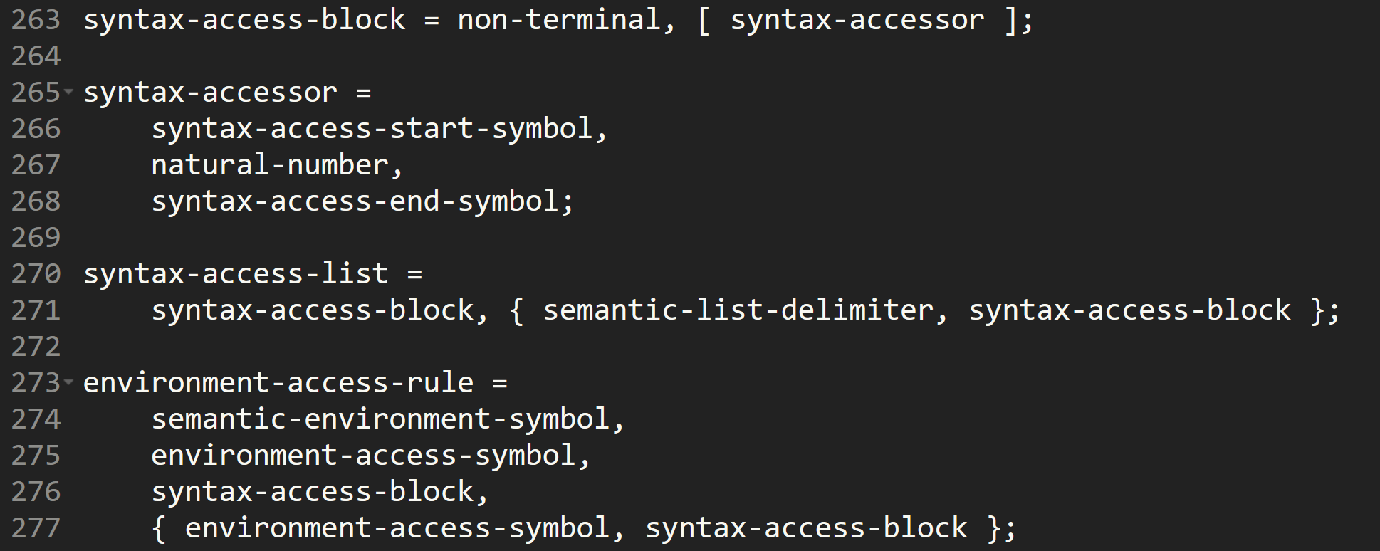
The Work So Far – Metaspec
An initial sketch of the syntax
Care taken with semantic form
Grammar Complete
Left-Recursive, but lookahead
Metaspec semantics not yet entirely complete
Notes:
The initial design of metaspec emerged from a sketch of how the syntax was intended to look.
Significant care was taken designing this syntax, with the major challenge revolving around how to effectively specify both syntax AND semantics in one place.
Significant care was taken with the semantics, providing facilities for directly accessing the syntactic elements within the semantics, tying the two together in an intuitive fashion.
Being able to do this has taken some significant design work, ensuring that the semantics were flexible enough to support the creation of varied DSLs.
As they exist today, the semantics support restrictions on evaluation by the results of sub-evaluations, and specifications of how the semantic result is produced.
The metaspec grammar is now complete, and the resultant language has many features that are important for the project, including:
A restricted set of allowable semantic operations, making it reasonable to prove semantic correctness.
A semantics-enforced typing discipline, freeing the DSL implementer from needing to deal with language types at a syntactic level. AND
Extension syntax to provide useful features such as data traversal, function calls and environment access (for functions and stateful computation).
The resultant grammar caused some initial frustration as it is left-recursive, but it was decided to work around this through use of an infinite-lookahead parser to ensure the parsing process would not diverge.
While it would have been possible to avoid left-recursion, it would have led to significant complications in the metasyntax for accessing syntactic primaries in the semantics.
While the metaspec semantics aren’t entirely specified, this work will take place as the metacompiler evolves.

Slide 8
The Work So Far – ABSOL
At a very rudimentary stage
Basic program structure
Partial lexer implementation
Input DSL File
Input Metaspec File
Lex and Parse
Semantic Verification
Code Generation
Parse and Lex DSL
DSL Code Generation
Notes:
The metacompiler is currently at a very rudimentary stage, and will be the main focus of the next stage of the development effort.
The program architecture is complete
It is currently capable of reading in a metaspec file, and lexing a portion of the metaspec grammar, producing a valid token stream for the grammar sections it supports.
The intended mode of operation for the metacompiler pipeline is as follows
Lex and Parse Metaspec File: This will require finishing the grammar for the lexer and implementing the infinite-lookahead parser on the token-stream.
Verify input language semantics on a subset of the AST through induction on the structure of the semantics.
Once the language has been verified, the metacompiler will perform code generation of the DSL compiler, walking the AST and generating Haskell code from the semantics contained within it.
Compile the DSL compiler
Run compiler on a DSL program.
Interface with the DSL program from a GPL.

Slide 9
Future Plans
Continue work on ABSOL
Iteratively develop the semantics of Metaspec
Notes:
While the project has been proceeding fairly smoothly up to this point, there is still much work to be done!
The metacompiler pipeline has a number of stages still to be finished, as discussed on the previous slide.
The unfinished elements of the metalanguage, namely the semantics of some features, will be developed as-needed alongside the implementation of the metacompiler.
There is a lot of work to be done, but with a concerted effort it should be achievable within the remaining project timeframe.

Slide 10

Questions?
(Yes, the project is named after a Pokémon)
Notes:
Any questions?

