Slide 1

Welcome to our final
Ironhack project presentation:
Predicting the rent in Berlin
by Ahmet & Hanna

Slide 2
Rent prediction model
for a flat in Berlin
- using various input features -

Slide 3

Getting the data
Webscrapping www.immobilienscout24.de on 01.03.2023
Resulted in dataset with 3.5k unique apartments
Features: -
- 10.03.2023 Ironhack final presentation by Ahmet & Hanna -

Slide 4
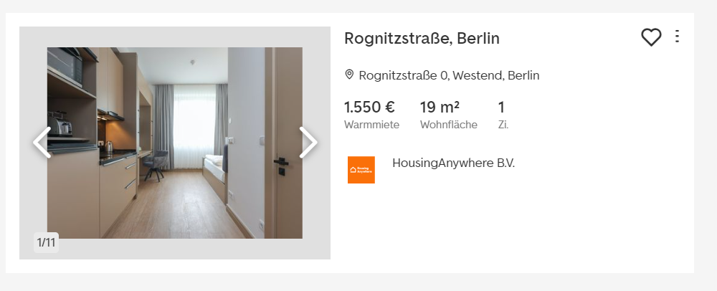
One landlord owns 42% of all available flats and is driving the prices up with fully furnished apartments

Slide 5
Getting the data:
- 10.03.2023 Ironhack final presentation by Ahmet & Hanna -

