Slide 1

Applied Data Science
Hanna Hrekova
30.11.2024

Slide 2



Executive Summary
Slide 3: Introduction
Slides 4-5: Data Collection & Data Wrangling Methodology
Slides 6-7: EDA & Interactive Visual Analytics Methodology
Slides 8-9: Predictive Analysis Methodology
Slide 10: EDA with Visualization Results
Slide 11: EDA with SQL Results
Slide 12: Interactive Map with Folium Results
Slides 13-14: Plotly Dash Dashboard Results
Slide 15: Predictive Analysis
Slide 16: Conclusion
Slide 17: Creativity & Insights

Slide 3

Introduction
Goal:
· Apply data science methods to solve a real-world problem.
· Analysis of successful and failed SpaceX rocket landings.
What was done:
· Collection, processing, and analysis of data.
· Building machine learning models for forecasting.

Slide 4
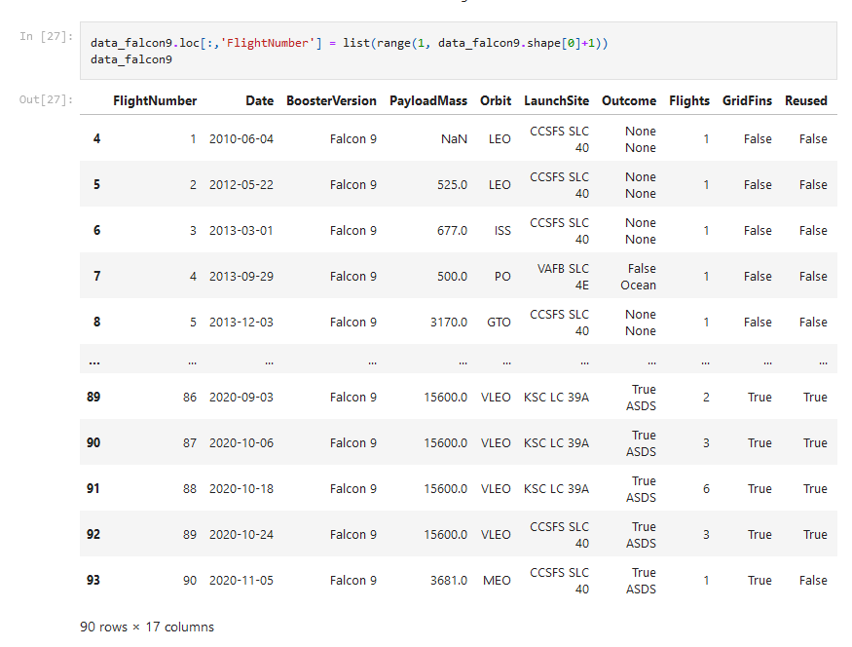
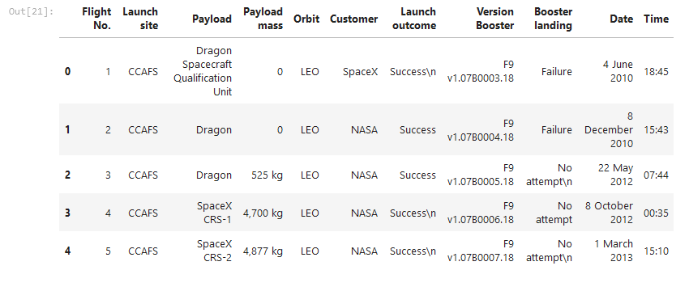
Data Collection & Data Wrangling Methodology
Data sources:
SpaceX API
Web scraping for additional data

Slide 5
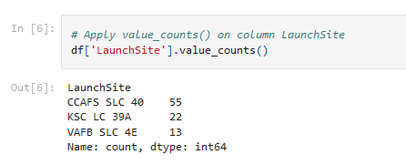
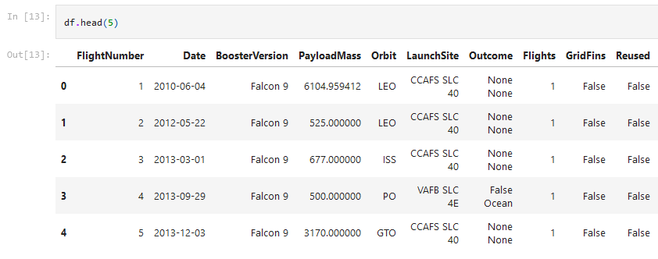
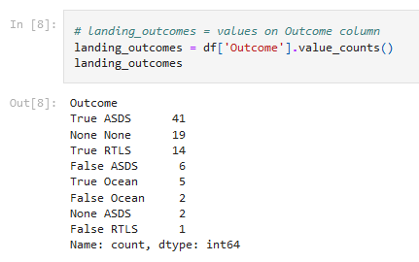
Data wrangling: · Data cleaning, gap filling · Variable transformation for further analysis

Slide 6
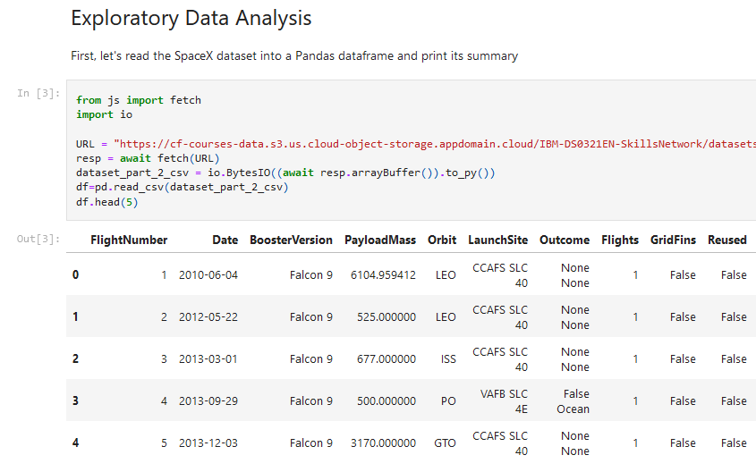
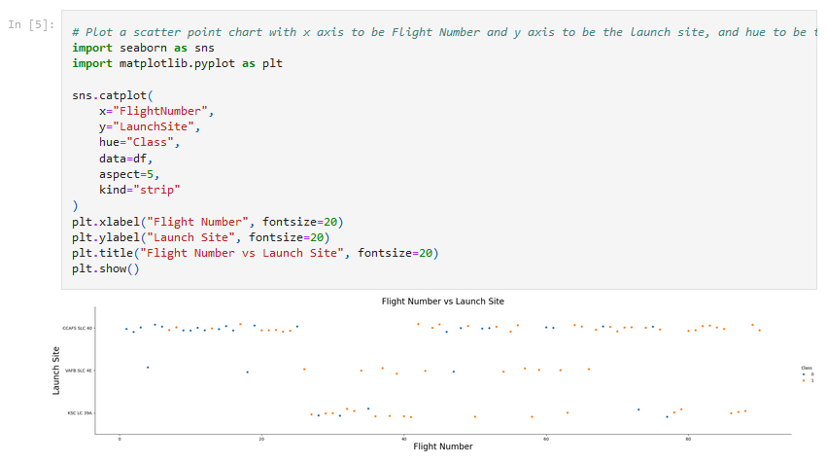
EDA & Interactive Visual Analytics Methodology
EDA & Visualization Methods

Slide 7
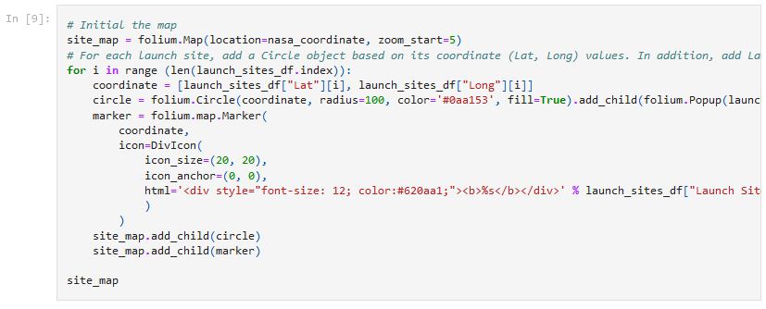
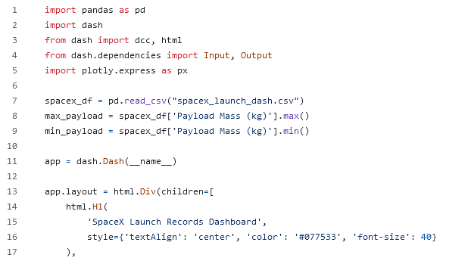
Interactive analysis tools (Folium, Dash)

Slide 8
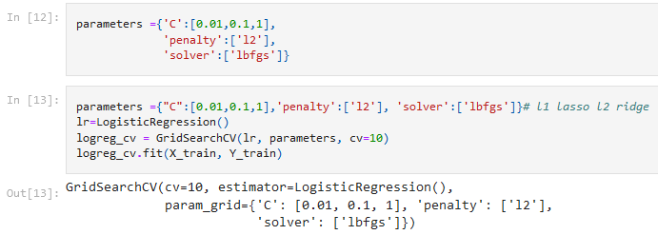
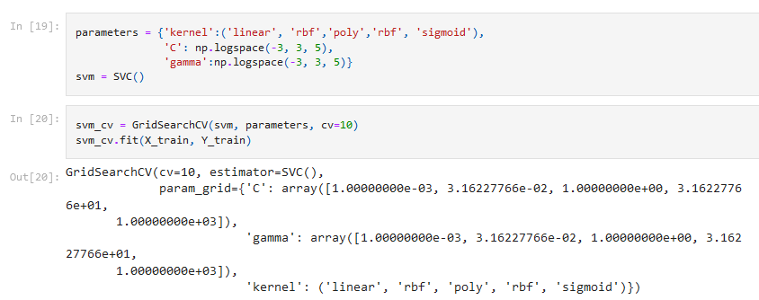
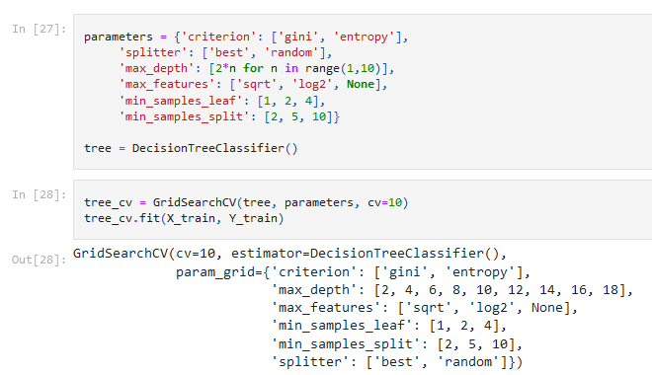
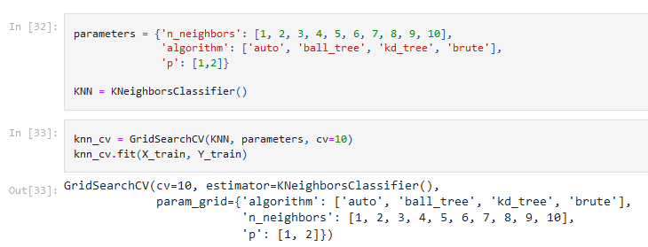
Predictive Analysis Methodology
Used machine learning algorithms (KNN, decision tree, logistic regression, support vector machine)

Slide 9
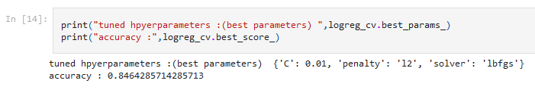
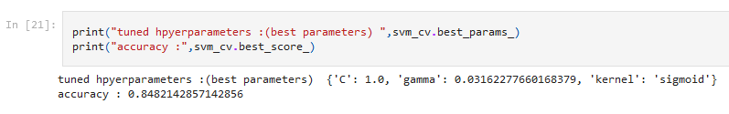
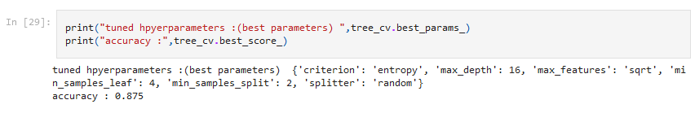
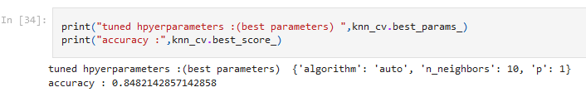
Evaluated the accuracy of the models

Slide 10
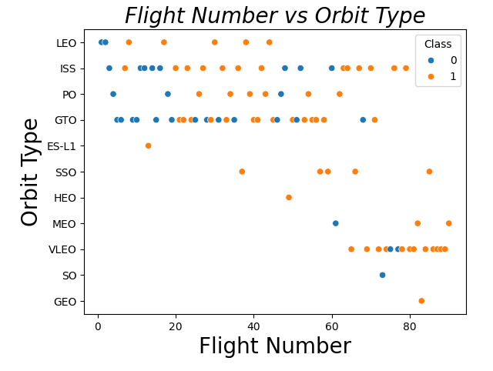
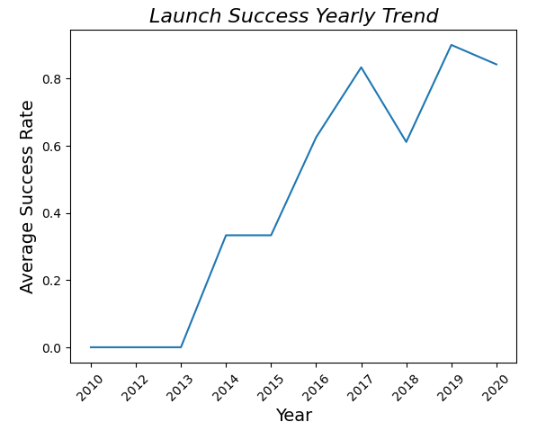
EDA with Visualization Results

Slide 11
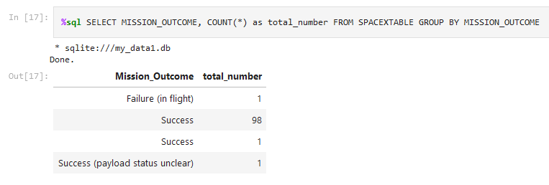
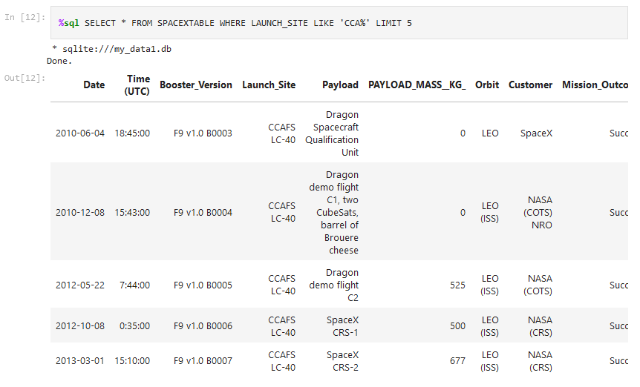
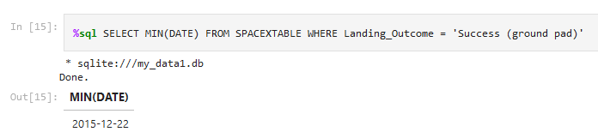
EDA with SQL Results

Slide 12
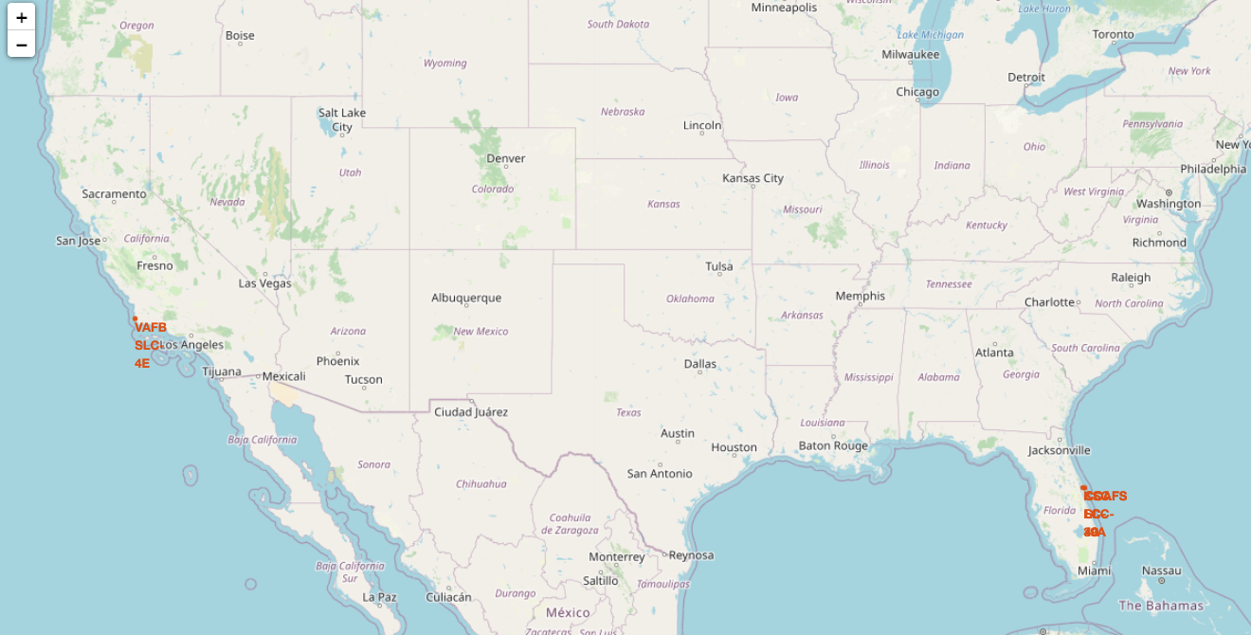
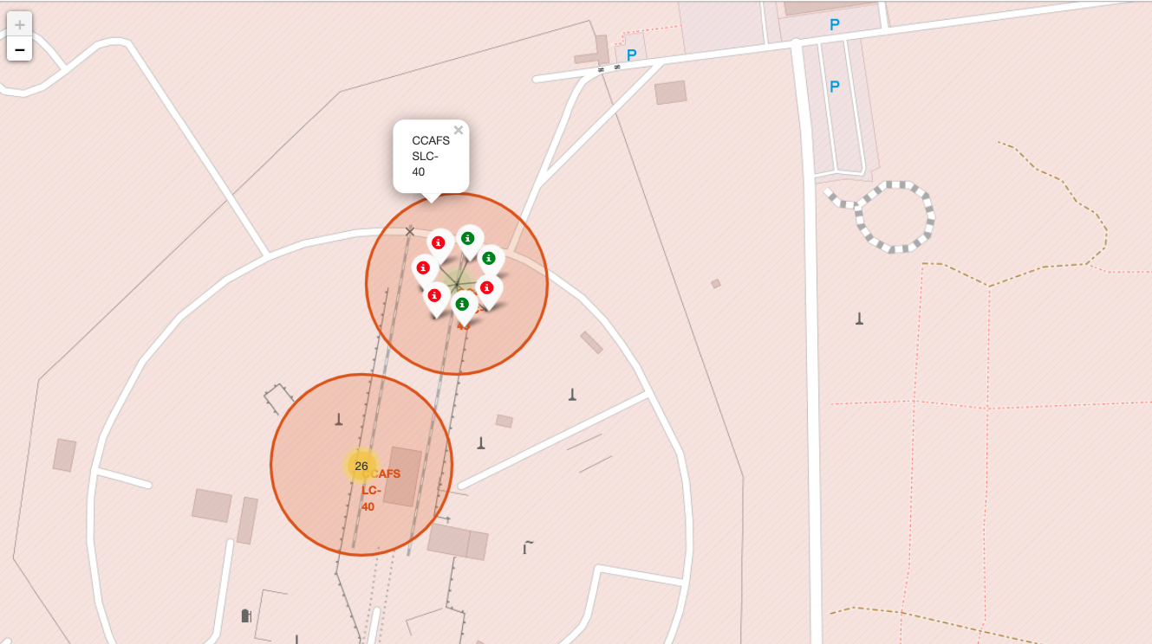
Interactive Map with Folium Results

Slide 13
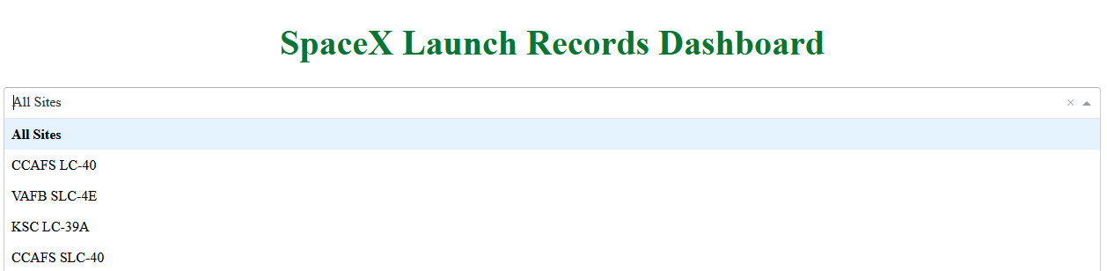
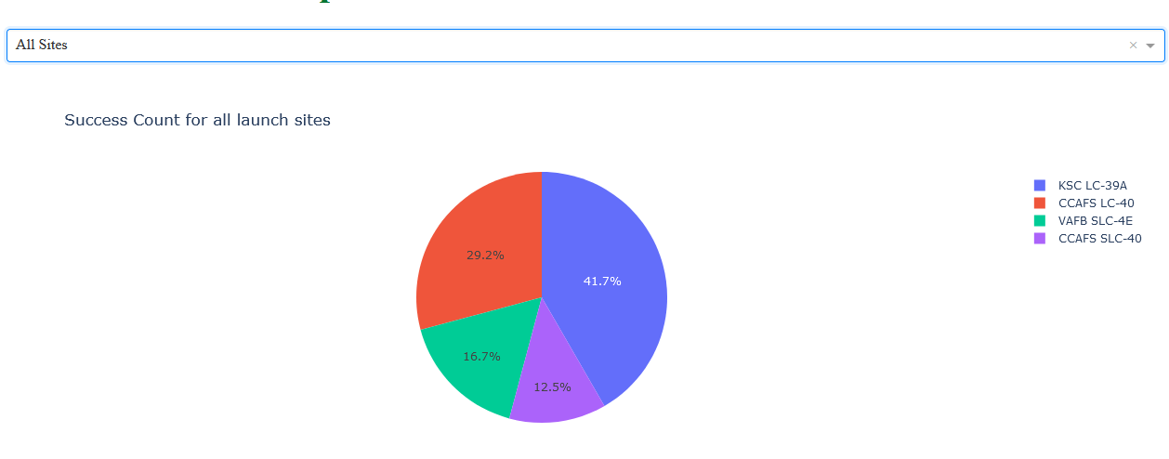
Plotly Dash Dashboard Results

Slide 14
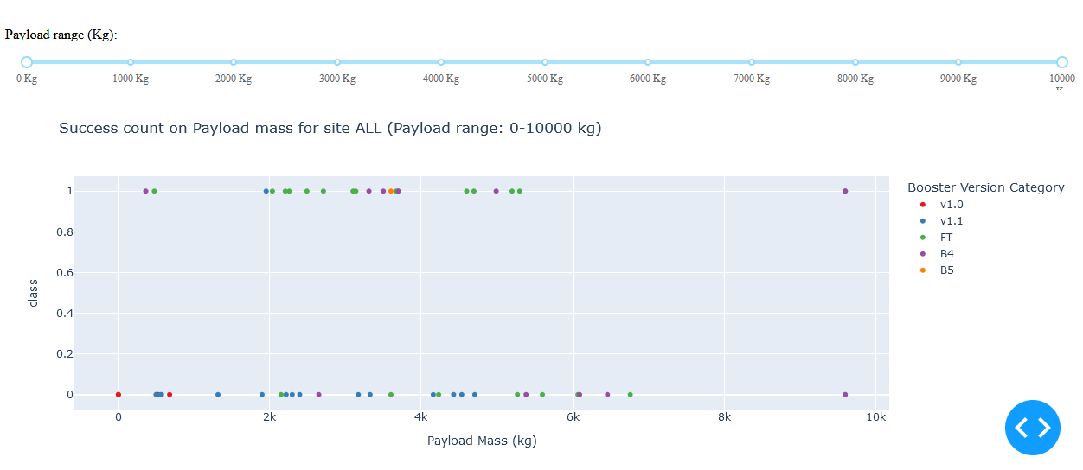
Plotly Dash Dashboard Results

Slide 15

Predictive Analysis
Model | Accuracy The results of the model comparison showed that the Decision Tree algorithm
--------------------------|------------ demonstrated the best accuracy in predicting successful SpaceX rocket landings
Logistic Regression | 0.846 with an accuracy of 87.5%. The Logistic Regression, SVM and KNN algorithms have
Decision Tree | 0.875 similar results, around 84.6-84.8%, which indicates their reliability, but slightly
SVM | 0.848 lower accuracy compared to decision trees.
KNN | 0.848
Decision Tree was found to be the most effective model for prediction, with an accuracy of 87.5%. This algorithm works well due to its ability to handle categorical variables and detect important patterns in the data.

Slide 16
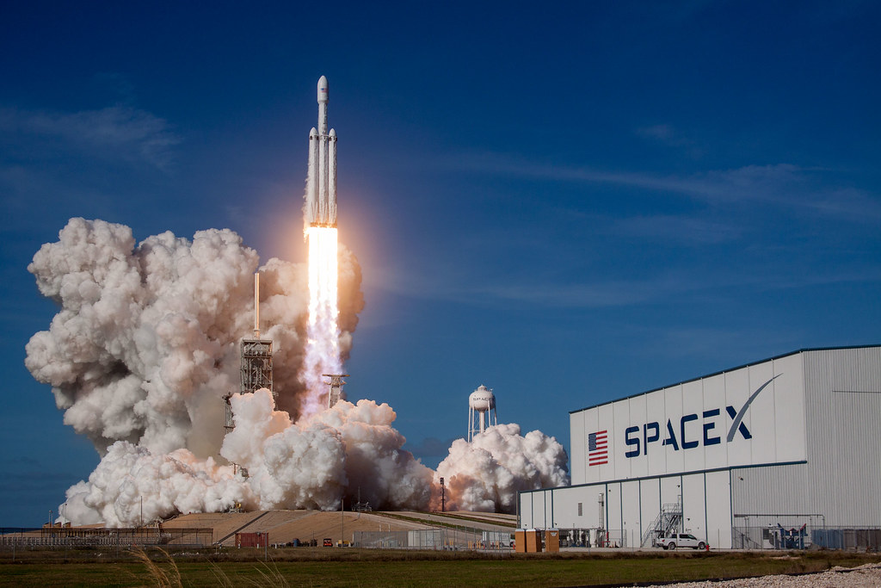
Conclusion
Key insights from the analysis:
The collected and analyzed data allowed us to identify key factors influencing the success of SpaceX rocket landings.
Deep analysis was performed using visualizations, SQL, and interactive tools, which helped better understand launch dynamics.
The best forecasting method turned out to be Decision Tree, which achieved 87.5% accuracy, confirming its effectiveness in similar tasks.
Interactive dashboards and maps significantly simplify the visualization of results for a non-technical audience.
Meaning for SpaceX:
The results can help SpaceX improve launch planning and reduce the risk of unsuccessful landings.
Identifying critical success factors will allow us to optimize mission preparation processes and test new technologies.
Forecasting and analysis provide a basis for automating decision-making and developing more sustainable engineering solutions.

Slide 17
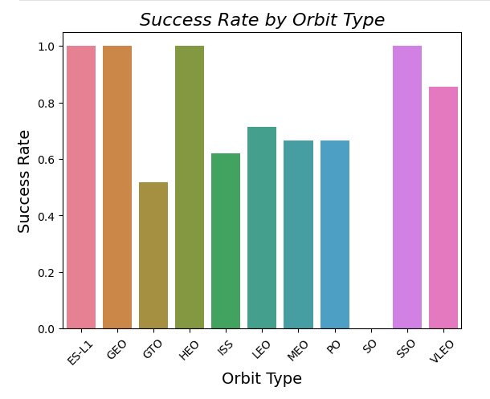
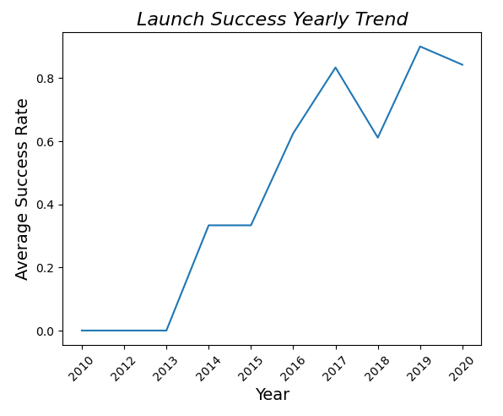
Creativity & Insights
I decided to add color to some of the graphs and changed the font and angle a bit for better readability. This approach improved the overall look of the graphs and emphasized the attention to detail that is important for presenting complex information.

Slide 18

Thank you for your attention!

