Slide 1
Adaptive Cutaways for Comprehensible Rendering of Polygonal Scenes
Christian Brändle and Hanna Huber
¹ Institute of Computer Graphics and Algorithms
Vienna University of Technology
² <insert 2nd affiliation (institute) here>
<insert 2nd affiliation (university) here>

Slide 2
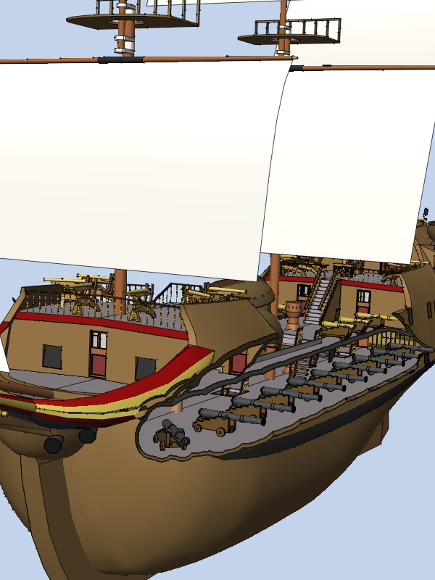
Motivation
Solve occlusion problem
View-dependent
Interactive frame rates

Slide 3
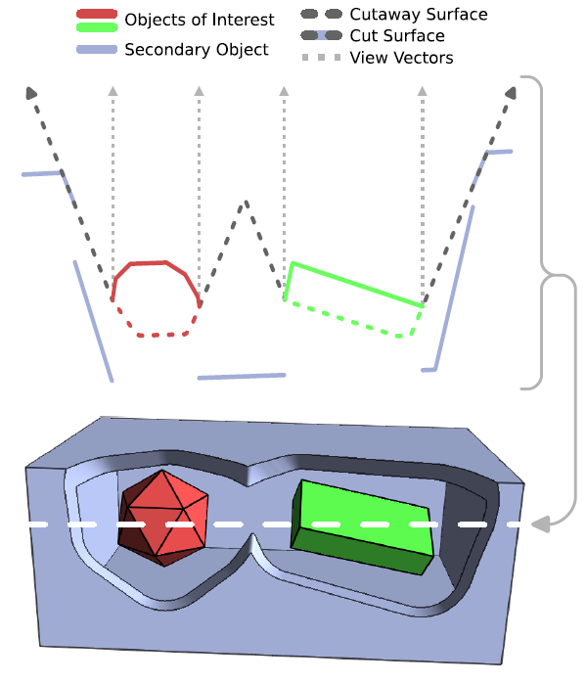

Cutaway Method
Consider scene in screen space
Objects of interest: Store depth and position
Cutaway surface:
Secondary objects: Clip at cutaway surface

Slide 4
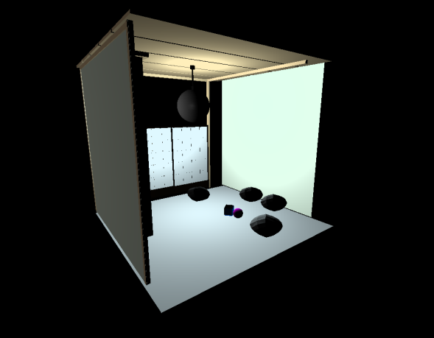
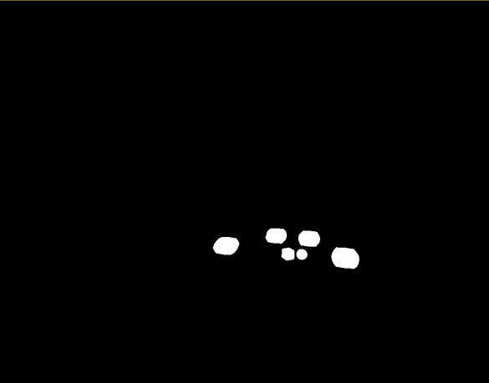
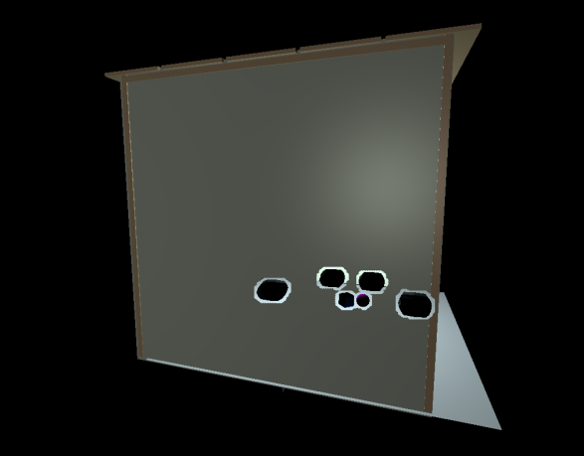
Implementation
C++
TCL: GUI
OpenGL: 3 passes
1. Initial depth map
2. Cutaway surface (jump flooding)
3. Render Scene

Slide 5
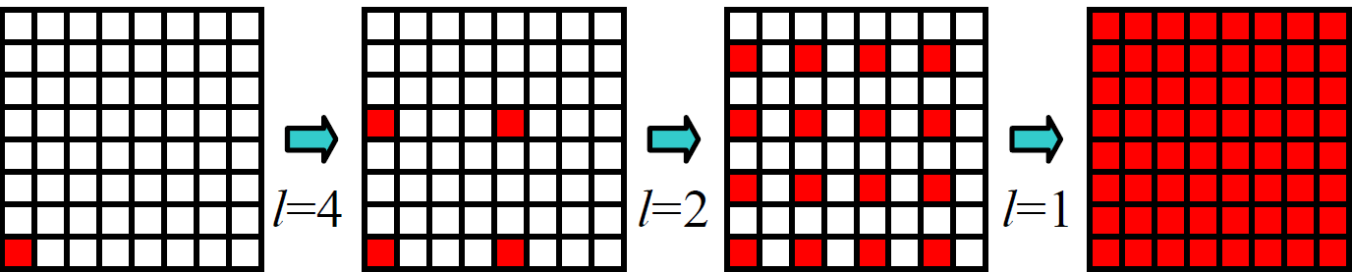
Jump Flooding
Render quad
log(n) iterations: step size = n/2…1
2 textures
Read (from previous iterartion)
Write
Vertexshader: Calculate neighbor coords
Fragmentshader: Compare depth values

Slide 6
Results
Demo…

Slide 7
References
Adaptive Cutaways for Comprehensible Rendering of Polygonal Scenes [Burns + Finkelstein, 2012]
Jump Flooding in GPU with Applications to Voronoi Diagram and Distance Transform [Rong and Tan 2006]

