Slide 1
Adaptive Cutaways for Comprehensible Rendering of Polygonal Scenes
Christian Brändle and Hanna Huber
¹ Institute of Computer Graphics and Algorithms
Vienna University of Technology
² <insert 2nd affiliation (institute) here>
<insert 2nd affiliation (university) here>

Slide 2
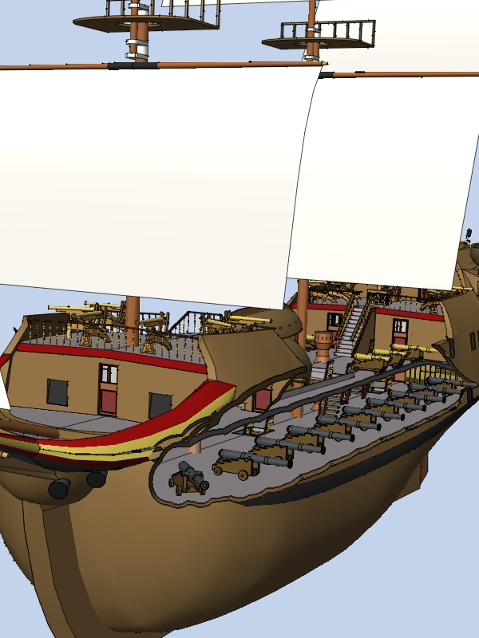
Motivation
Solve occlusion problem
View-dependent
Interactive frame rates

Slide 3
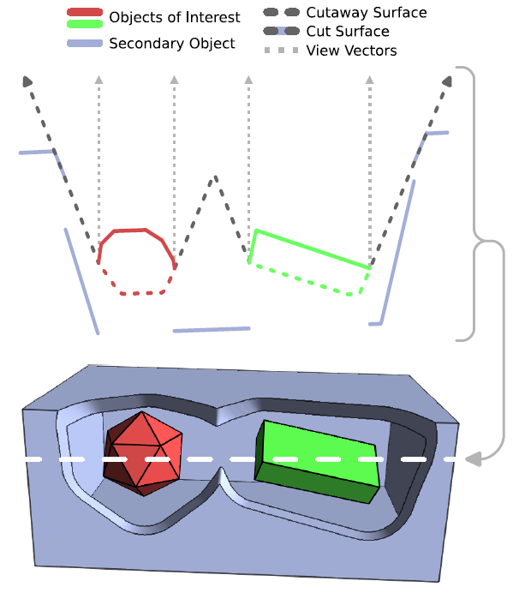
Cutaway Method
Consider scene in screen space
Objects of interest: Store depth and position
Jump flooding:
Compare neighboring depth values
Calculate distance transform
Create cutaway surface
Secondary objects: Clip at cutaway surface

Slide 4
Implementation
C++ with OpenGL + TCL (GUI)
1. Pass: Initial depth map
Render objects of interest to texture
Store screen space coords + depth
2. Pass: Cutaway surface texture

Slide 5
Jump Flooding
Iterate over framebuffer:

Slide 6
Results
Demo…

