Slide 1
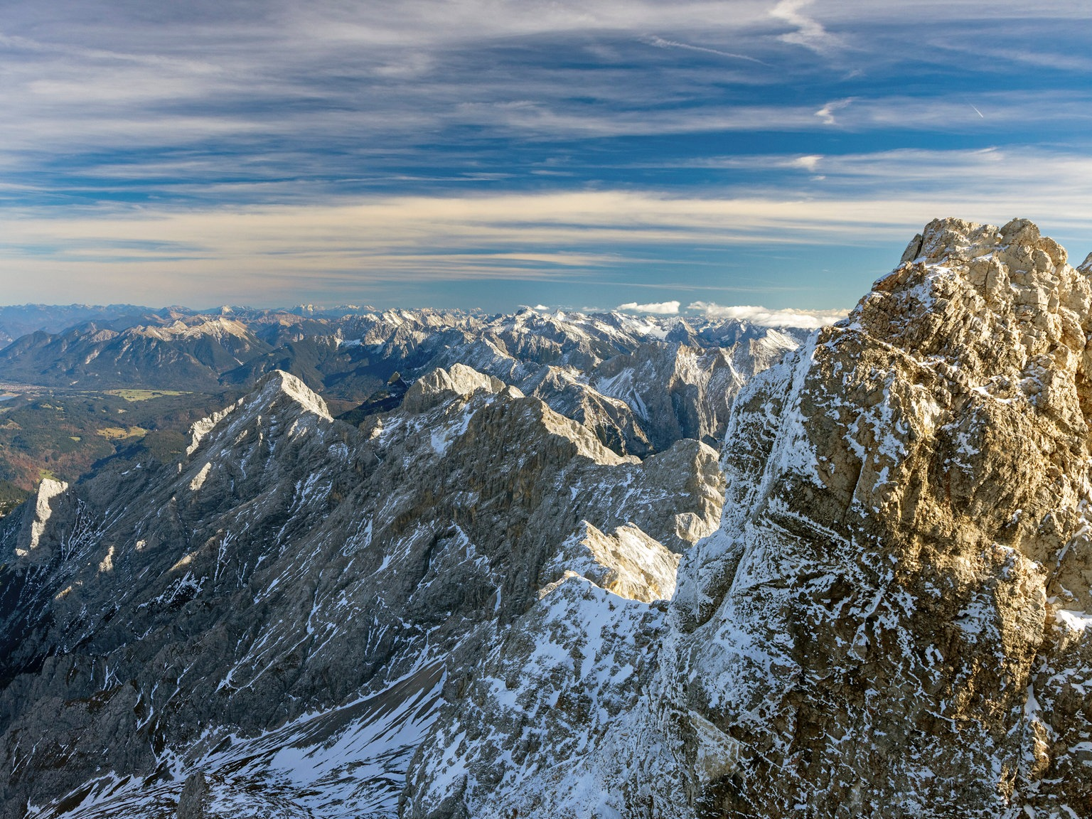
Dolines on the Zugspitze
Hanna Z. Schulten hanna.schulten@stud-mail.uni-wuerzburg.de

Slide 2
Why This Matters
– Dolines cross a maintained hiking route (Sonnalpin–Knorrhütte) — active/growing features are a real geohazard, not just a scientific curiosity
– Scientifically under-studied here as a phenomenon in its own right: well covered for regional hydrogeology (Goldscheider et al. 2014) and permafrost, one palaeoclimate paper on a single doline (Grüger & Jerz 2011) — no standalone geomorphological study yet
– Builds on prior work: collapse-doline dynamics previously studied at the Dead Sea (different setting — evaporite karst vs. alpine glaciokarst, same underlying process family)
– [PHOTO: a doline directly adjacent to or crossing the hiking trail, to make the hazard proximity visible at a glance]

Slide 3
Scope of my Master Thesis
– EAGLE M.Sc. thesis: collapse dolines on the Zugspitzplatt
– Two research threads: (1) doline growth/change over time, (2) a multi-sensor RS detection method (topography + spectral, thermal pending) — deliberately not deep learning
– Testing method transferability to other high-res public data (Alps-wide)
– Permafrost-as-sole-cause de-emphasized — features already visible in 2003 imagery

Slide 4
What is a Doline?
– Closed depression from karst dissolution and/or collapse
– Alpine glaciokarst setting — Wetterstein limestone
– 30–35 features mapped so far along the Sonnalpin–Knorrhütte route
– Not one uniform population: size, depth, water/ice content all vary
– [PHOTO: a clear top-down or oblique UAV shot of one representative doline — ideally one showing visible water/ice at the bottom for contrast]

Slide 5
Doline Classification
– Composite hypothesis — not simply “karst OR permafrost”
– Fault-initiated (inception/seismic dolines): 3 mapped fault sets cross the plateau (Ortner & Kilian 2022)
– Enlarged by snowmelt-timing-driven CO2 corrosion, not simple thermal dissolution (Küfmann 2013)
– Subset reactivated by melting relict ground ice — a local cold-trap effect, not regional permafrost (Gude & Barsch 2005)
– Likely a mixed old/young population: one dated fill = 7415 BP (Grüger & Jerz 2011)
– Field test this trip: joint orientation at rims, ice/cold-air signals, dissolution vs. mechanical wall texture
– [FIGURE: mapped fault traces from Ortner & Kilian (2022) Fig. 7b over the study area, once digitized]

Slide 6
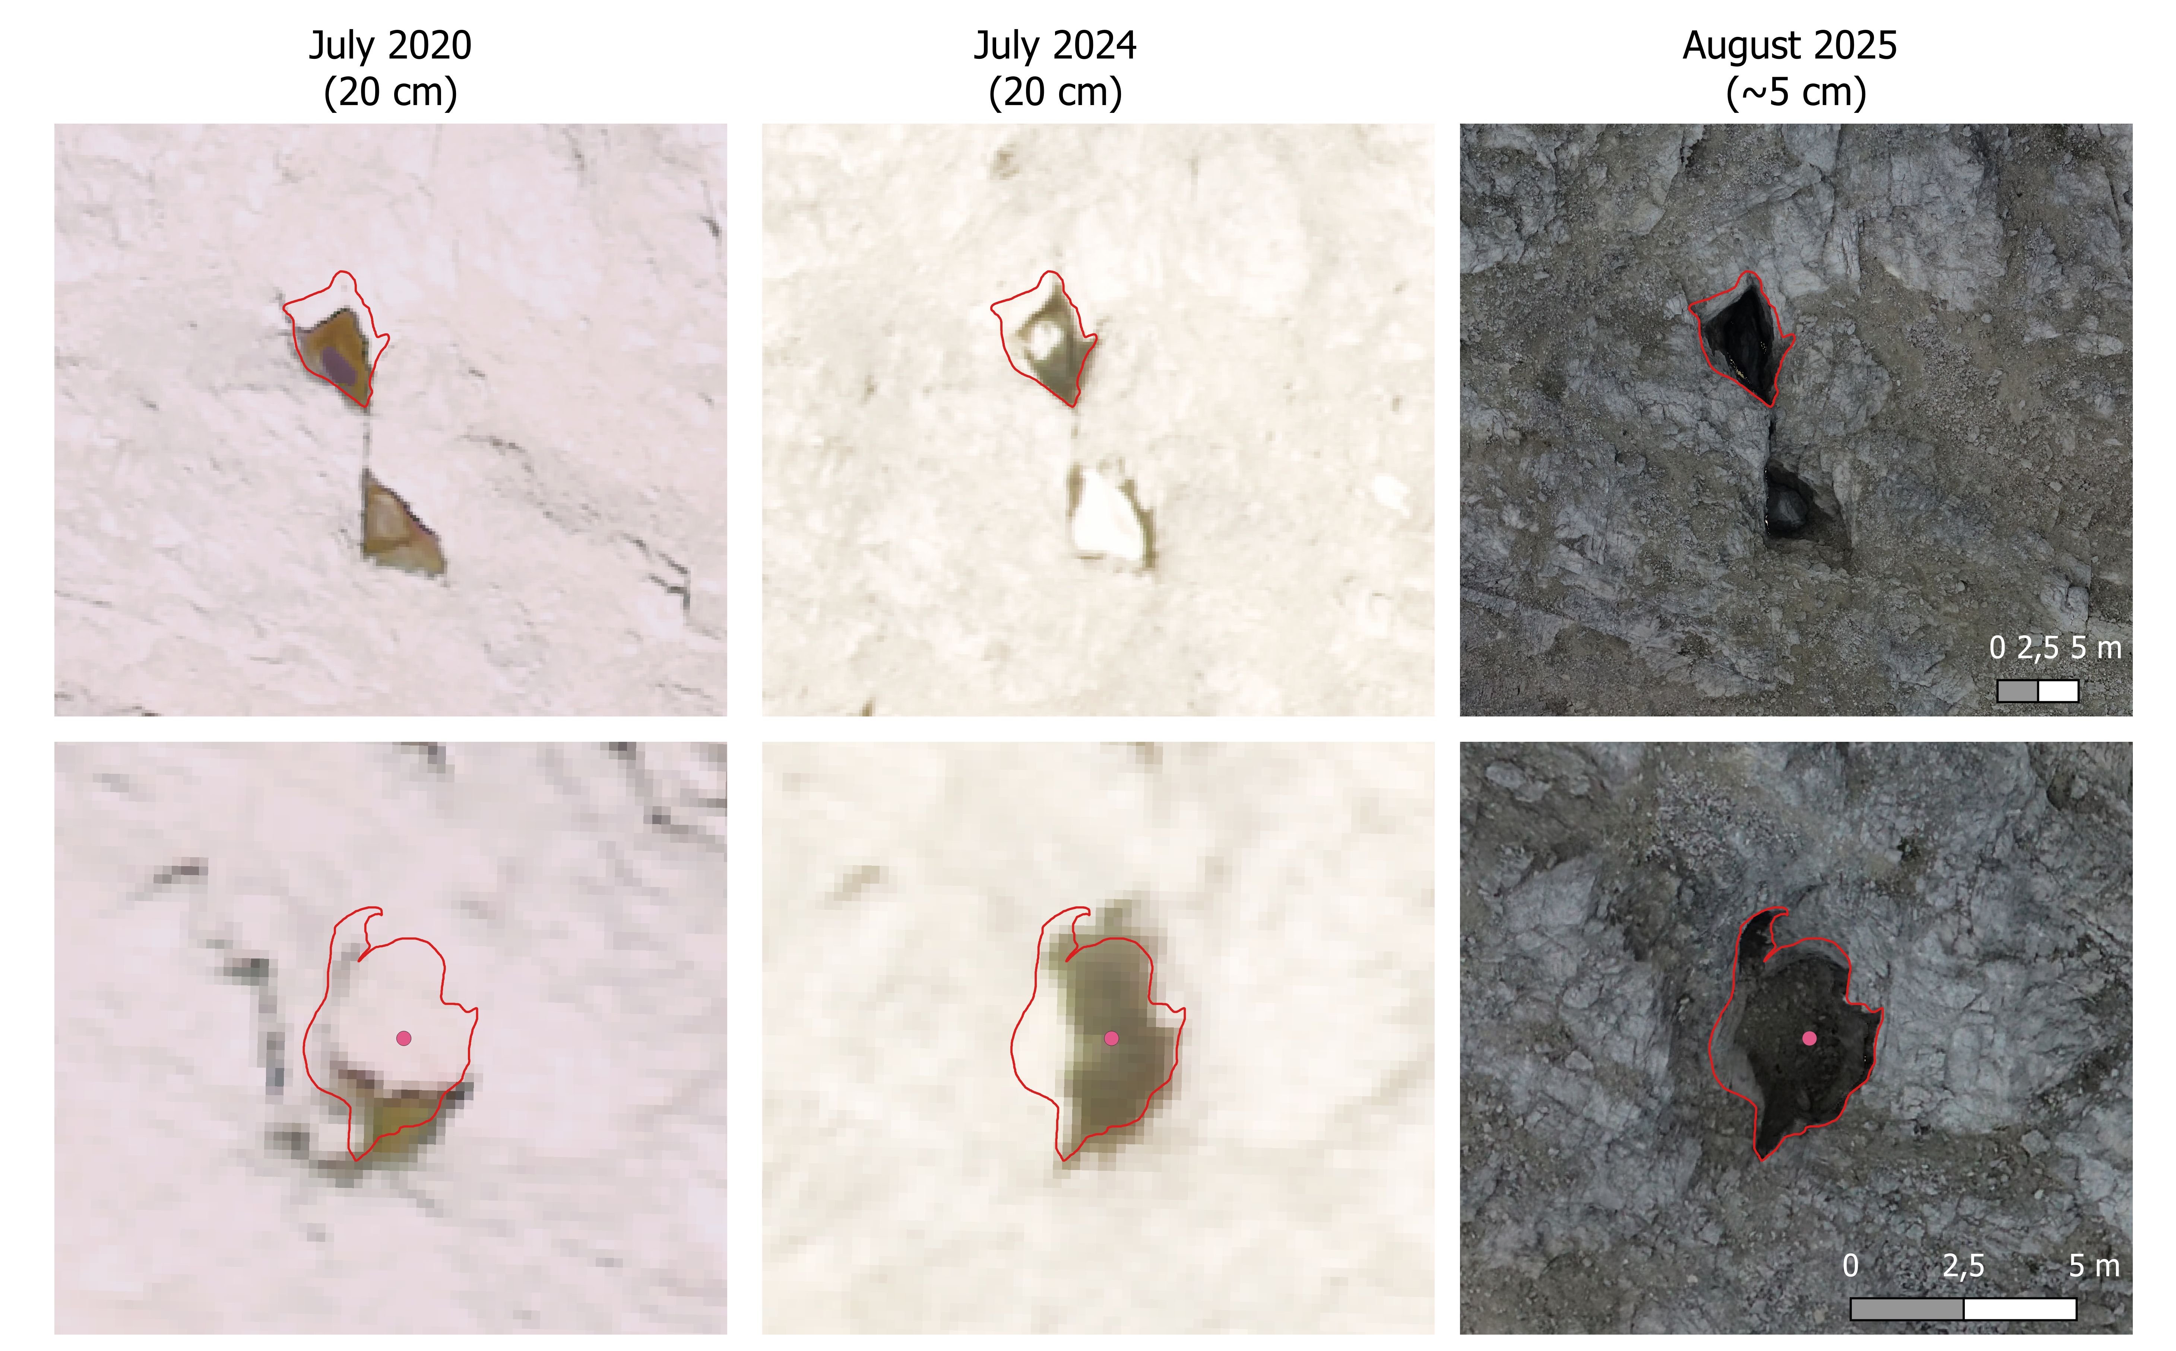
The Dolines are changing
– Same two features, three epochs
– Visible outline growth 2020 to 2025
– Motivates dGNSS rim points this trip as a baseline for future re-survey

Slide 7
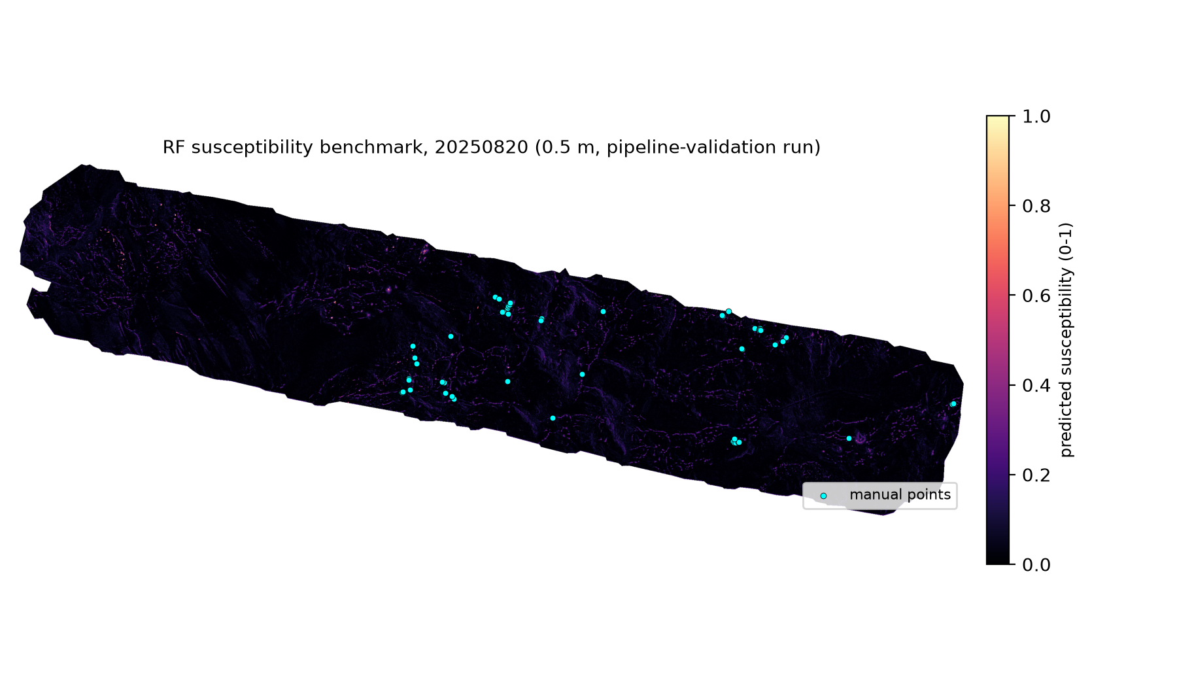
Detection Method Overview
– Goal: multi-sensor detection — topography + spectral (thermal pending field data) — deliberately not deep learning
– Framed as susceptibility modeling: same family as landslide/karst susceptibility mapping, presence-background SDMs (MaxEnt)
– Grounded in DEM-based closed-depression detection literature (Doctor & Doctor 2012; Obu & Podobnikar 2013; Wu et al. 2016)
– First RF benchmark: point-level AUC ~0.97, but the full-raster map hits the same wall as every method tried — reviewable count OR high recall, not both
– Open question: real terrain property, or a fixable modeling gap? Thermal + more field data is the next test

Slide 8
Field Work Goals
– Ground-truth remotely-mapped candidates: manual points + new Suspicious Areas polygons
– Per-feature protocol: dissolution vs. mechanical/ice-loss wall texture, joint/fracture orientation at rims (compass), ice/cold-air/perennial-firn check, rock samples + HCl test for lithology
– dGNSS points at every visited rim — baseline infrastructure for future-season re-survey, independent of what this trip concludes
– New UAV acquisition: photogrammetry + LiDAR + thermal (thermal flown early morning, before solar heating swamps the signal)
– Time-limited: 3 days, 30–35 candidates — prioritize a subset spanning suspected old/stable vs. young/active features rather than a shallow pass over everything
– Tentative, pending Djamil: ERT, passive seismic/HVSR, soil temperature loggers, TLS on steep walls

Slide 9
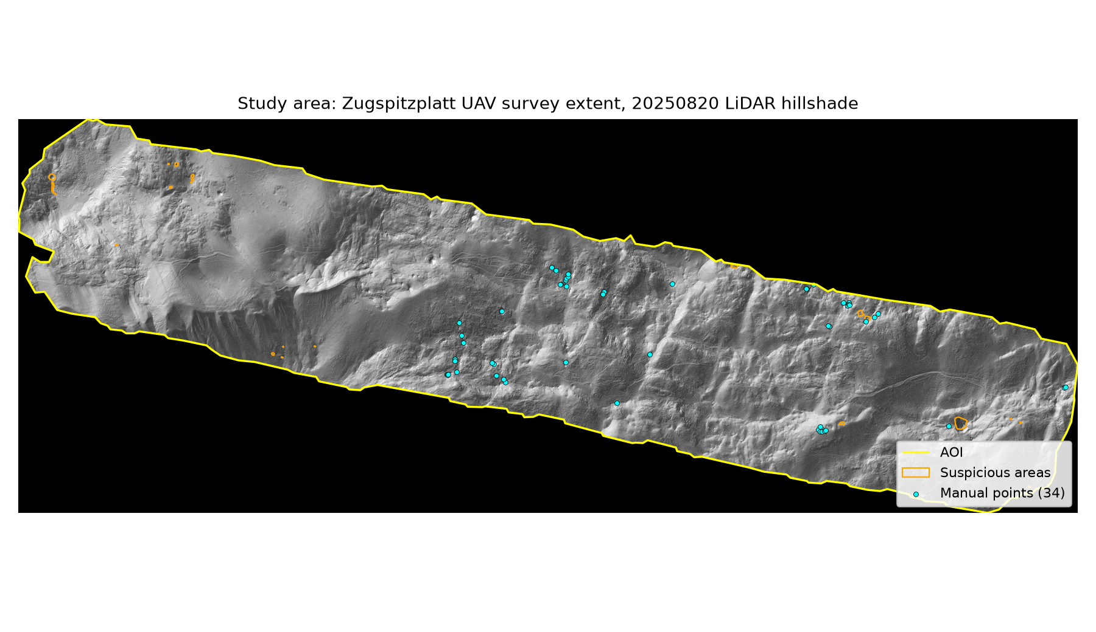
Study Area Overview
– Zugspitzplatt, Sonnalpin–Knorrhütte hiking route, ~2000 m elevation
– Bare alpine karst plateau above treeline — Wetterstein limestone
– Current UAV survey AOI ~1836 × 880 m

Slide 10
QField
– Mobile companion to QGIS — this is how field observations get recorded
– Workflow: sync project to QField before leaving → walk to each candidate point → fill attribute form on-site (water/ice, wall texture, joint orientation, photo) → sync back after
– Replaces a paper recording sheet with structured, geolocated data entry
– [SCREENSHOT: QField app showing the loaded project with candidate points, once the project is set up — happy to build this before the trip]

Slide 11
References — Cited in This Presentation
– Gude, M. & Barsch, D. (2005). Assessment of geomorphic hazards in connection with permafrost occurrence in the Zugspitze area (Bavarian Alps, Germany). Geomorphology, 66, 85–93.
– Grüger, E. & Jerz, H. (2010/2011). Untersuchung einer Doline auf dem Zugspitzplatt. E&G Quaternary Science Journal, 59(1-2), 66–75.
– Ortner, H. & Kilian, S. (2022). Thrust tectonics in the Wetterstein and Mieming mountains, and a new tectonic subdivision of the Northern Calcareous Alps. International Journal of Earth Sciences, 111, 543–571.
– Küfmann, C. (2013). Solution dynamics at the rock/snow interface during the ablation period in the subnival karst of the Wetterstein Mountains. [manuscript — final venue unconfirmed, verify before citing further]
– Goldscheider, N. et al. (2014). [hydrogeology of this karst system — full citation not yet verified, see experiment_log.md]
– Doctor, D.H. & Doctor, K.Z. (2012). [closed-depression/karst detection method — full citation not yet verified]
– Obu, J. & Podobnikar, T. (2013). [DEM local-relief detection method — full citation not yet verified]
– Wu, Q. et al. (2016). [closed-depression detection method — full citation not yet verified]

Slide 12
References — Further Recommended Reading
– Sauro, U. (2003). Dolines and sinkholes: aspects of evolution and problems of classification. Acta Carsologica, 32(2), 41–52.
– Gams, I. (2000). Doline morphogenetic processes from global and local viewpoints. Acta Carsologica, 29(2), 123–138.
– Veress, M. (2017). Solution doline development on glaciokarst in alpine and Dinaric areas. Earth-Science Reviews, 173, 31–48.
– Péntek, K., Veress, M. & Lóczy, D. (2007). A morphometric classification of solution dolines. Zeitschrift für Geomorphologie, 51(1), 19–30.
– Gutiérrez, F., Guerrero, J. & Lucha, P. (2008). A genetic classification of sinkholes illustrated from evaporite paleokarst exposures in Spain. Environmental Geology, 53, 993–1006.
– Krautblatter, M., Verleysdonk, S., Flores-Orozco, A. & Kemna, A. (2010). Temperature-calibrated imaging of seasonal changes in permafrost rock walls by quantitative electrical resistivity tomography (Zugspitze, German/Austrian Alps). Journal of Geophysical Research: Earth Surface, 115, F02003.
– Wetzel, K.-F. (2004). On the hydrology of the Partnach area in the Wetterstein Mountains (Bavarian Alps). Erdkunde, 58(2), 172–186.

