Slide 1
Checkpoint mongoDB

Slide 2
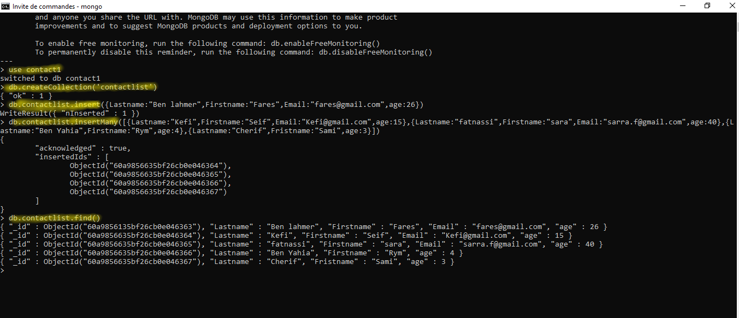

Slide 3


Slide 4
