Slide 1

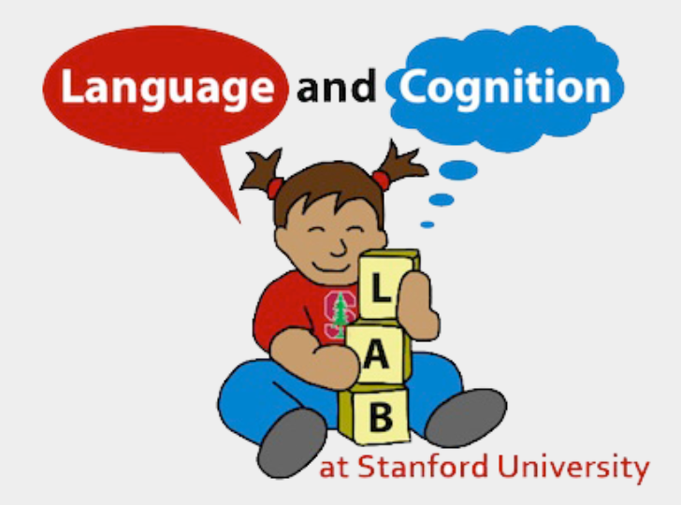
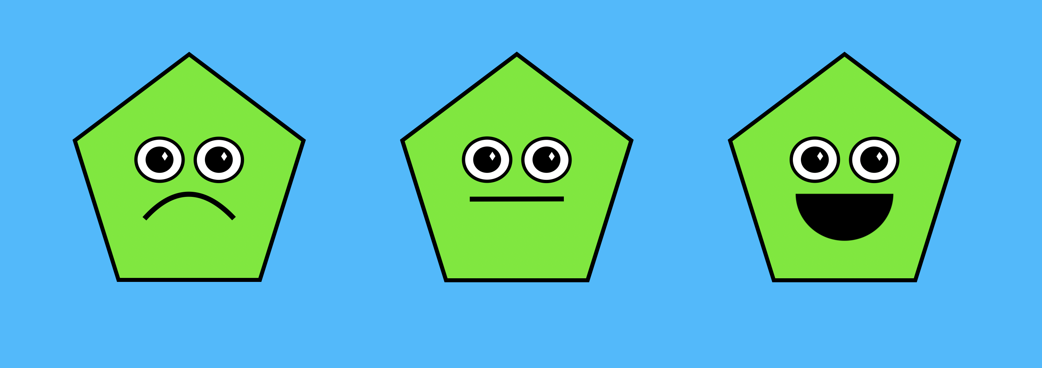
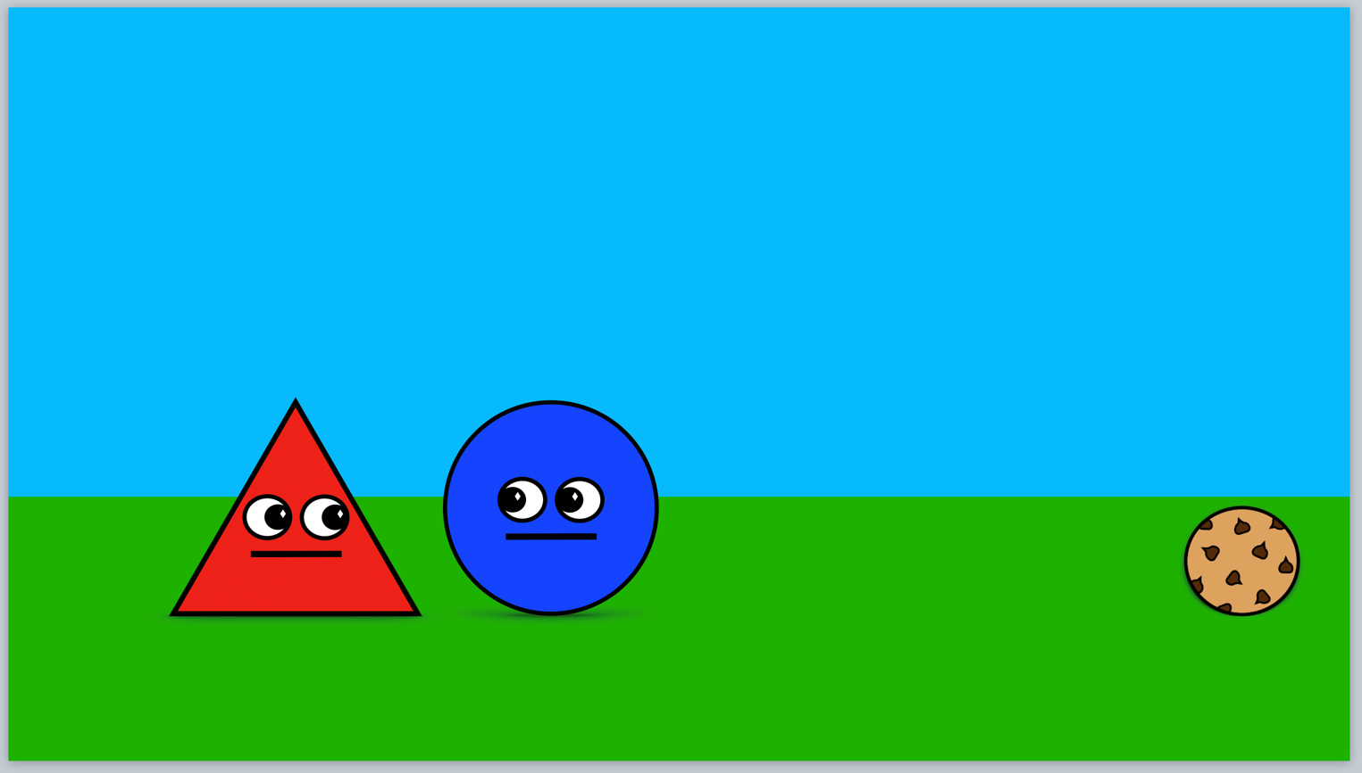
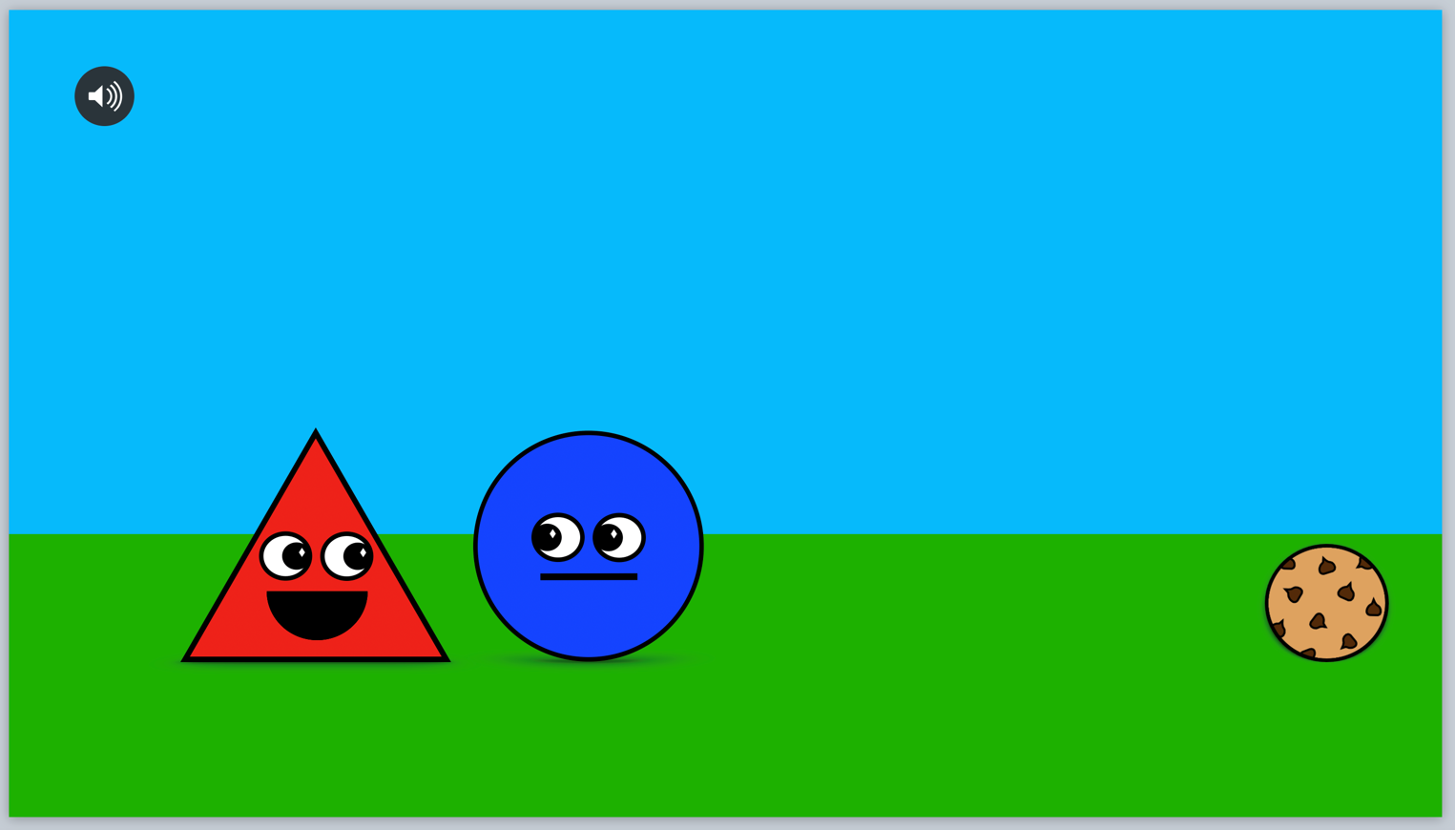
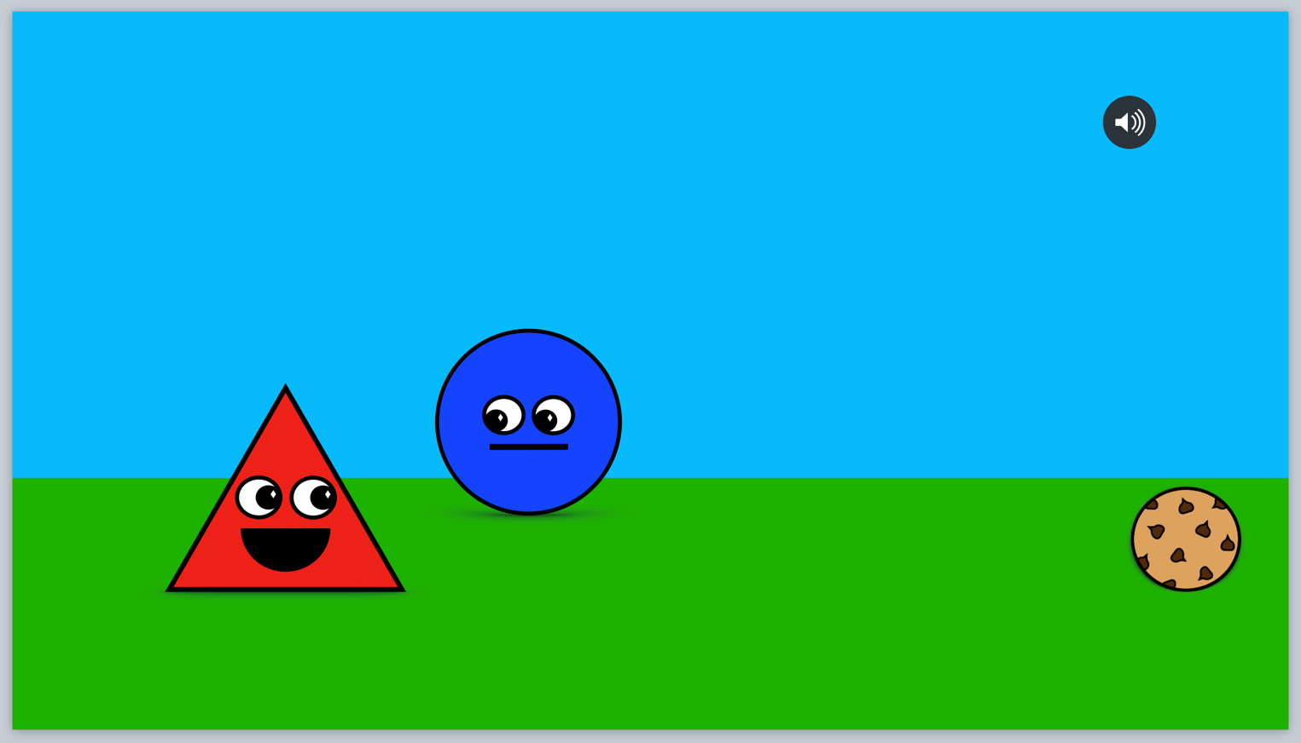
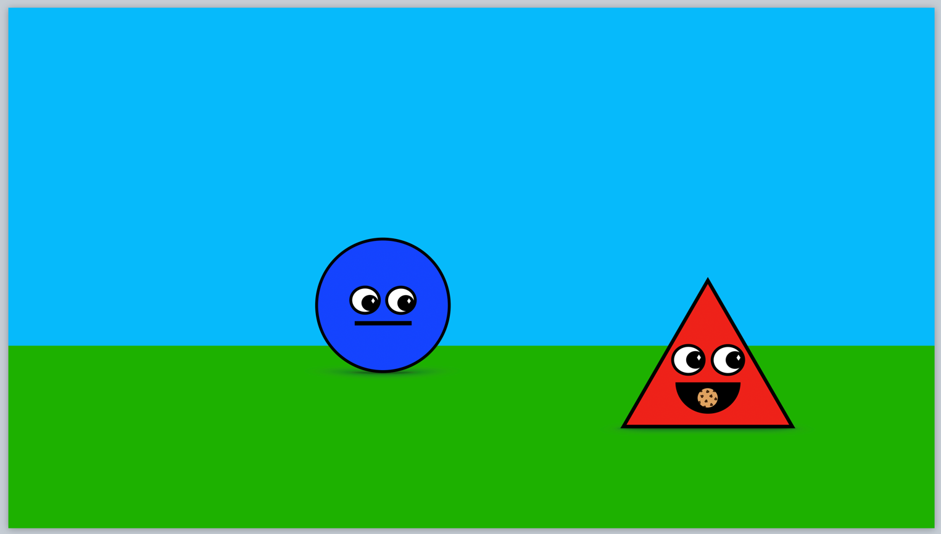

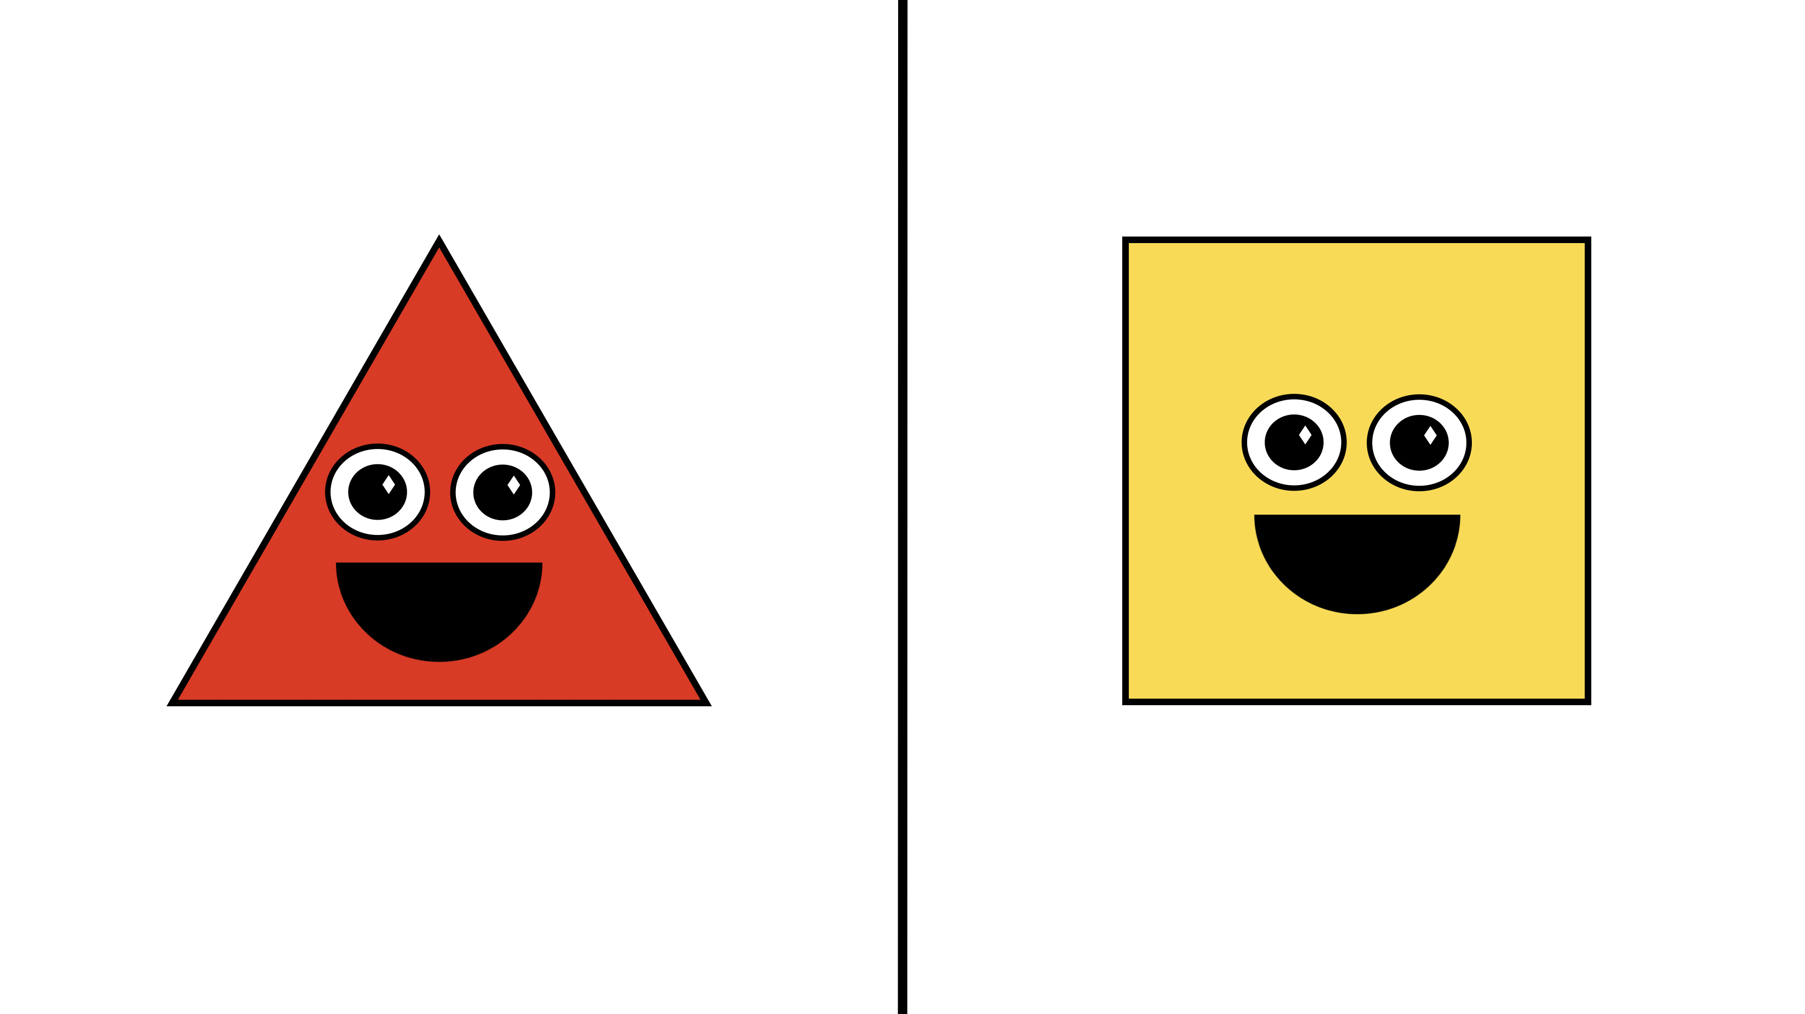
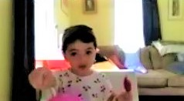

Preferring politeness: Young children’s implicit understanding of polite speech
Hannah E. Marshall, Rondeline M. Williams, and Michael C. Frank
Department of Psychology, Stanford University
Introduction
Previous studies have not observed reliable preference for a polite speaker in children younger than 4 years, potentially due to experimental task demands.
This study proposes a less challenging task (based on existing shape-preference paradigms)^{[2,3]} which may detect preference for a polite speaker in children younger than 4 years.
Production and basic comprehension of polite speech presents early in development:
By 3 years, children can accurately judge whether a speaker is politer, ruder, nicer, or meaner than another.^{[1]}
By 4 years, children reliably opt for play partners who use politeness markers and infer that polite speakers are more likely to have their wishes granted.^{[1]}
Hypotheses
Procedure
Stimuli
We predict:
2-year-olds, 3-year-olds, and 4-year-olds will reliably indicate preference for a polite speaker.
Children will indicate preference for a polite speaker more reliably with increasing age.
4-year-olds will reliably provide logical reasoning for choosing a polite speaker.
PARTICIPANTS 2-year-olds, 3-year-olds, and 4-year-olds (N≈60) living in the U.S., recruited from Children Helping Science, Facebook advertisements, and direct outreach to preschools and daycares in the Bay Area.
1° FAMILIARIZATION PHASE Experimenter explains what shapes look like when they feel “very
sad”, “normal”, and “very happy”.
ANIMATION as detailed in Stimuli.
DV1: “Which friend would you like to play with?”
Forced choice paradigm (counterbalanced). Pointing, reaching, and verbal answers coded equivalently as indication of preference. Dummy coded: 1 = polite and 0 = impolite.
DV2: “Why did you choose that friend?” coded as:
No reasoning (e.g. silence, shrugging, or “I don’t know.”)
Superficial reasoning (e.g. “Because I like him.”)
Illogical reasoning (e.g. polite character is “mean” or “rude”)
Logical reasoning, (e.g. polite character is “nice”)
Other reasoning
2° FAMILIARIZATION PHASE Speaker enters from left, sees cookie, gasps excitedly, approaches cookie, eats cookie, and celebrates by jumping up and down.
TEST PHASE Speaker approaches listener blocking the cookie.
Polite condition: Speaker says, “I am so hungry! May I have a cookie, please?”
Impolite condition: Speaker says, “I am so hungry! Give me a cookie, now.”
Regardless of condition, listener moves out of speaker’s way. Speaker gasps excitedly, crosses in front of listener, approaches cookie, eats cookie, celebrates by jumping up and down.
Shape of speaker (triangle/square), color of shape (red/yellow), and order of conditions (first/second) are counterbalanced.
1
2
3
4
Analysis Plan
Future Directions
Bayesian binomial tests and Bayes factors for confirmatory hypothesis testing.
Additional Bayesian binomial tests to assess whether children exhibit shape, color, order, or side bias.
Bayesian logistic regression models to examine effect of age on children’s preference and reasoning.
Utilize this less challenging task to study more nuanced facets of polite language acquisition.
[1] Yoon, E. J., & Frank, M. C. (2019). Children's understanding of polite requests. [2] Hamlin, J. K., Wynn, K., & Bloom, P. (2007). Social evaluation by preverbal infants. Nature, 450(7169), 557-559. [3] Thomas, A. J., & Sarnecka, B. W. (2019). Infants choose those who defer in conflicts. Current Biology, 29(13), 2183-2189.
Acknowledgements: Special thanks to the Psych-Summer Research Program, Gregg Muragishi, and all families who have participated in our pilot study to date.

