Slide 1
Digital Marketing IoT Data Analysis Platform
Team - 11
Binghan Geng - A20482350
Paul Ojo - A20481173

Slide 2
Platform Introduction
Name: IoT device monitoring system
Brief introduction: The platform is an online monitoring and management system for IoT devices.
Target group: IoT Company
Usage Scenarios: Data acquisition and alarm monitoring of hardware devices.

Slide 3
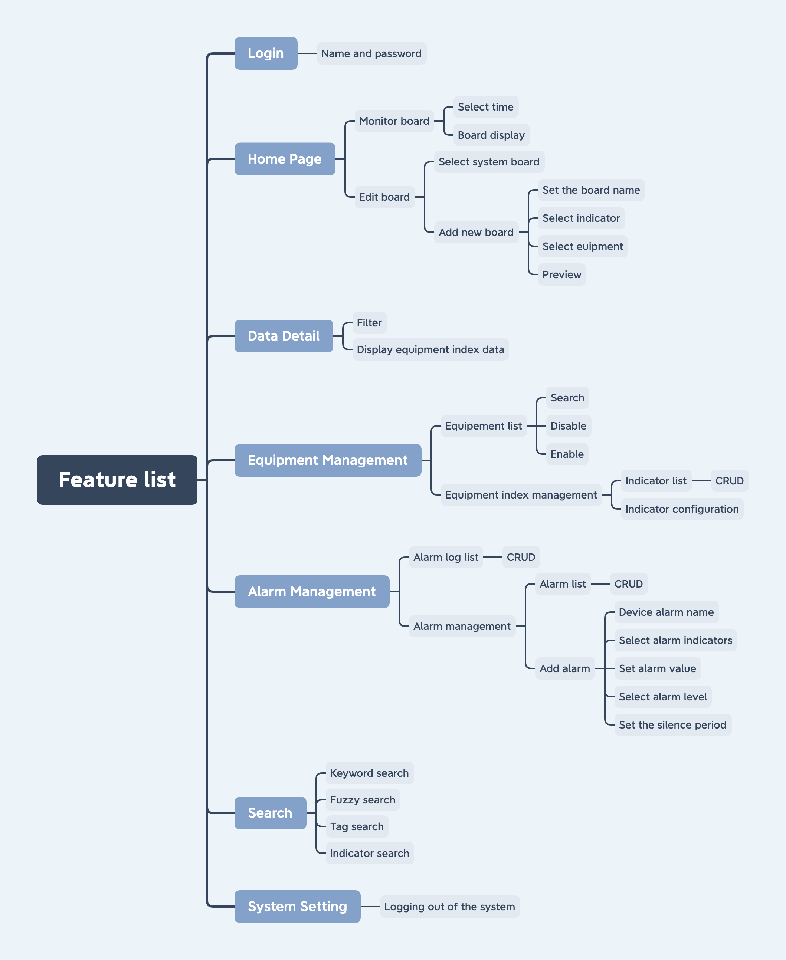

Slide 4
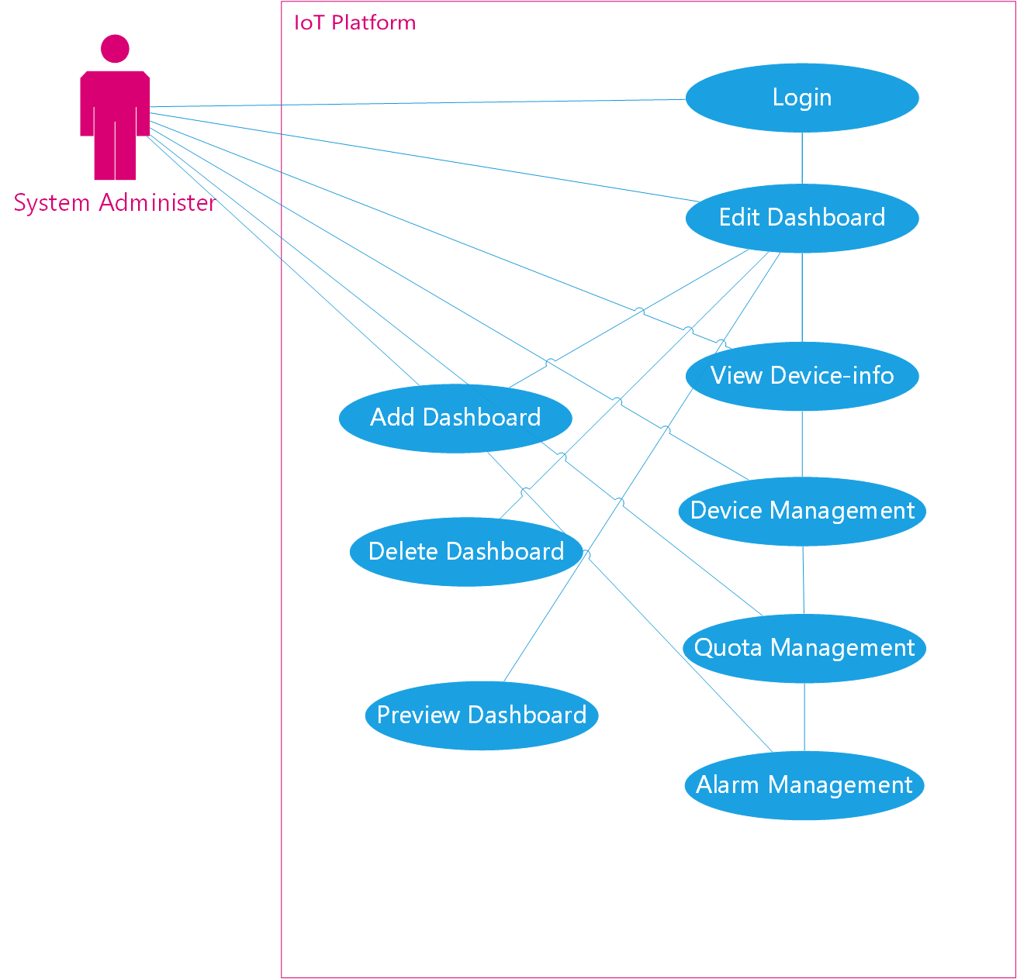

Slide 5
