Slide 1
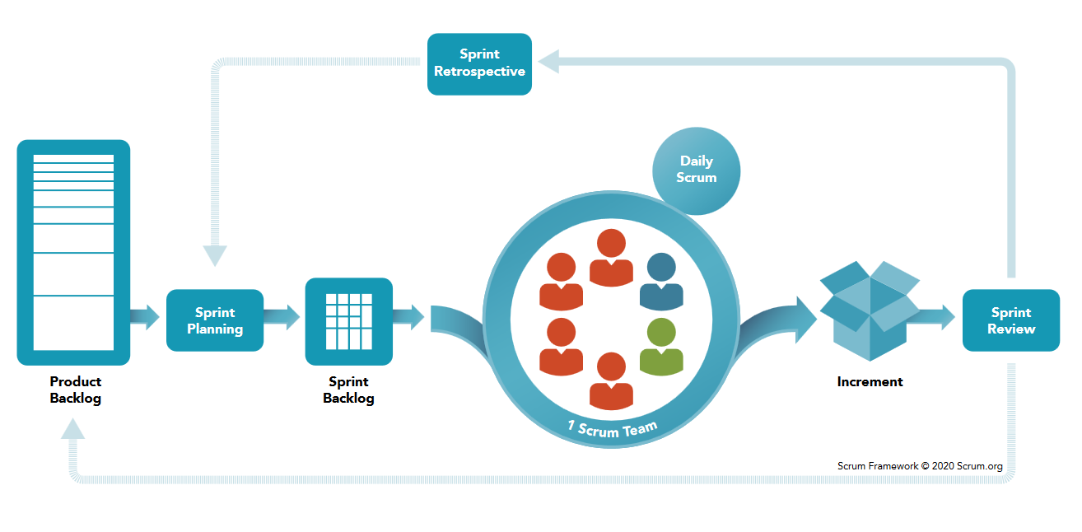
Sprint Planning
Requirements Engineering
EDAP
Sprint Review
Requirements Engineering
Checklist
. . .
. . .
RE
RE
EDAP
EDAP Phases I - VII
EDAP Phase VIII
. . .
. . .
. . .
. . .
. . .
. . .
. . .
. . .

