Slide 1


Introduction & Background
Presentation by: Hannah Marsh, undergraduate: UNH
A Cloud-Scale Characterization of Remote Procedure Calls
Authors: K. Seemakhupt, et al.
Conference: ACM SIGOPS 29th SOSP ‘23
Date and Location: October, 2023, Koblenz, Germany

Slide 2
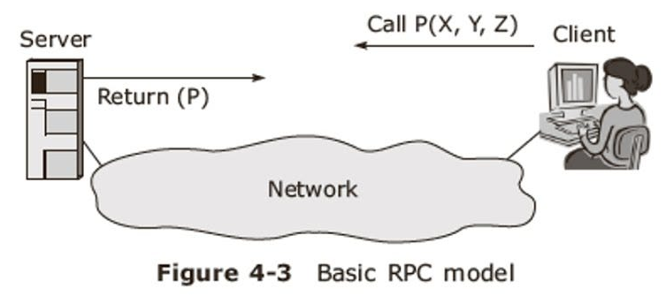




Objective
Introduction & Background
A Cloud-Scale Characterization of Remote Procedure Calls
Modern cloud applications are complex
Importance of RPCs in cloud-scale services
Enable location-independent communication
Lack of studies on RPC characteristics "in the wild".
Analyzed Google’s RPC methods over nearly 2 years
Scope:
Google Search
Google Maps
Gmail
YouTube
Notes:
As emphasized in the paper’s introduction, 🔵 modern cloud computing services
are complex and widely distributed.
Remote Procedure Calls, or RPCs, are 🔵 central to these services,
since they 🔵 enable the location-independent communication requirements of the cloud.
Despite the importance and ubiquity of RPCs,
there's been a 🔵 lack of research characterizing their behavior at cloud-scale.
This study aims to fill that gap,
and over the course of two years, it 🔵 analyzed trends from RPC methods
across several of Google’s services, like
🔵 Search,Maps, Gmail, and YouTube.

Slide 3

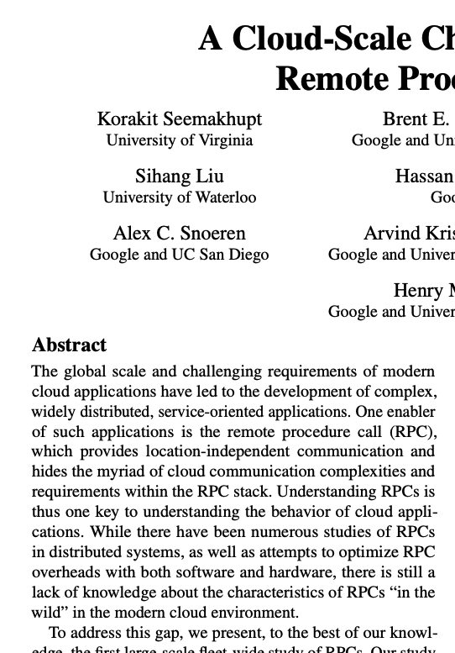
Introduction & Background
Study Methodology
Objective
Understand RPC usage, characteristics, and behavior at Google's scale
Inspire better cloud system optimization.
Notes:
The 🔵 objective of this research was to provide insight
into RPC usage patterns and 🔵 inspire new directions for cloud system optimization. 🔵
The authors highlight the importance of knowledge in this area, since 🔵 “Understanding RPCs is thus one key to understanding the behavior of cloud applications.”

Slide 4
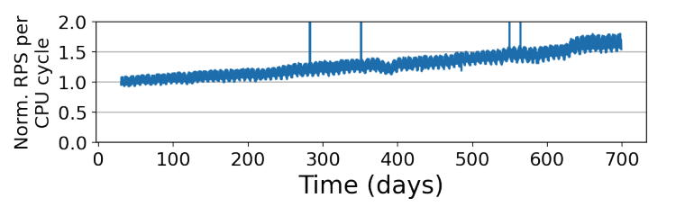
Introduction & Background
Key Findings - RPC Characteristics
Study Methodology
Examination of >10,000 RPC methods across Google’s services.
Data collected from >722 billion RPC samples over 23 months.
Tools used: Monarch, Dapper, and GWP for monitoring and analysis..
Notes:
The team 🔵 analyzed over 10,000 RPC methods
and more than 🔵 722 billion RPC samples over a 23-month period.
They used 🔵 tools like
Monarch for metric collection,
Dapper for trace analysis,
and GWP for CPU profiling.

Slide 5
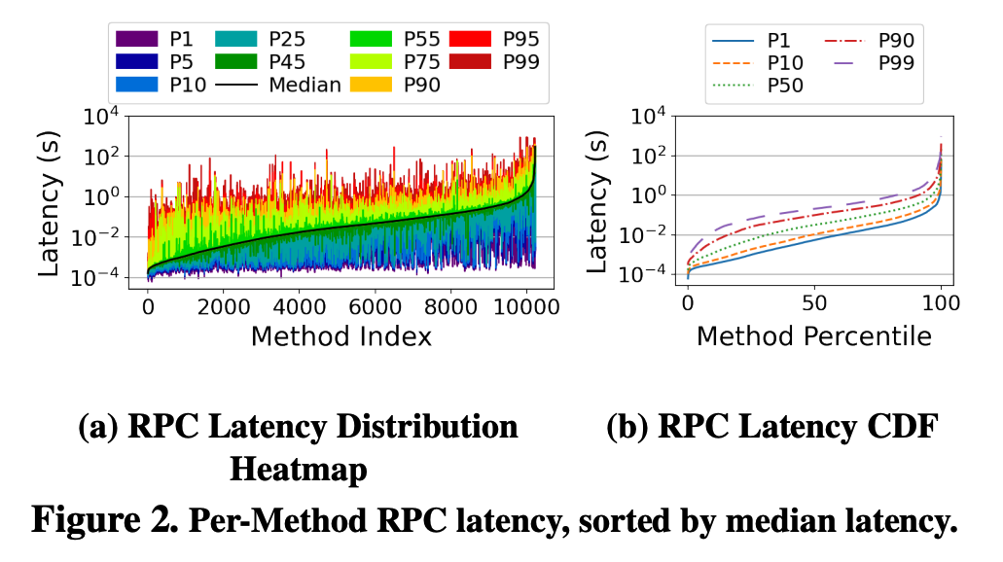

Study Methodology
Latency Insights
Key Findings - RPC Characteristics
Rapid growth in RPC usage, outpacing compute cycle growth.
Millisecond-level operation timescales for most RPCs.
Significant variance in latency and size across different RPC methods.
Notes:
Impressively, their findings challenge some of our pre-existing assumptions about RPCs.
Notably, 🔵 RPC usage is outpacing the provision of compute cycles in the cloud,
with many RPCs operating at 🔵 millisecond timescales—much longer than previously assumed.
There's also 🔵 significant variance in latency and size,
which again underscores the complexity of optimizing RPCs in the cloud.

Slide 6
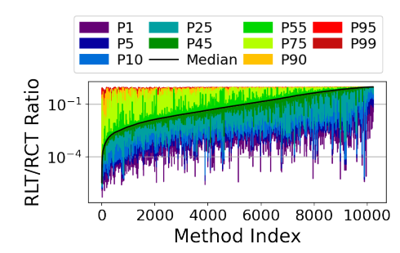



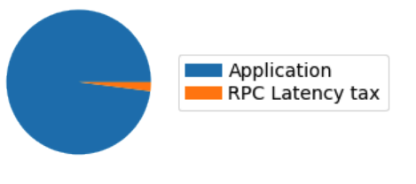
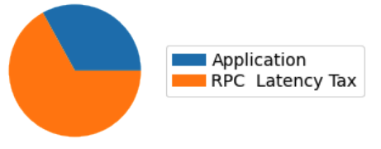
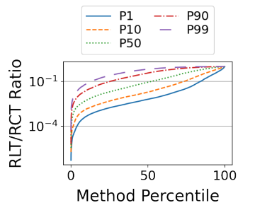


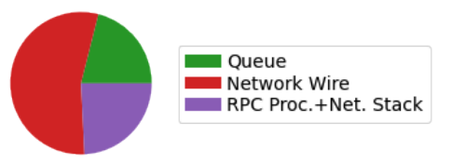

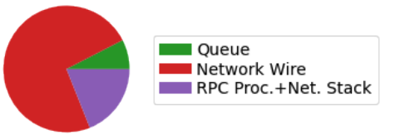
Key Findings - RPC Characteristics
RPC Size Matters
Latency Insights
Application processing dominates average RPC completion time.
RPC tax becomes significant at P95 tail.
Skew toward network-induced delay. Why?
Possibly: network congestion and/or SOL delay
Notes:
A critical insight from this study is the role of 🔵 application processing time,
which was observed to dominate over average RPC latency tax.
🔵 However, at the tail end, these non-processing latencies become significant.
Interestingly, the P95 breakdown shows a 🔵 skew toward network-induced delay, and the authors suggest this could be caused by a combination of 🔵 network congestion
and speed-of-light propagation delays, which may be limiting RPC tail performance.

Slide 7
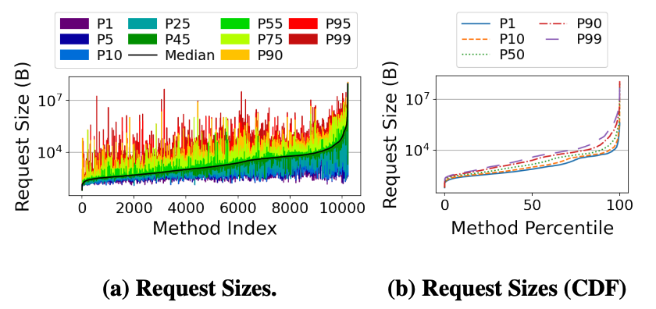
Latency Insights
RPC Access Type Matters
RPC Size Matters
Majority of RPCs are small, within a few kilobytes.
Heavy tail distribution exists with larger RPCs reaching hundreds of kilobytes.
Impact on system performance & network behavior.
Most RPCs are processed quickly, but larger ones can influence overall throughput.
Implications for tailoring system optimizations
Notes:
The study also sheds light on RPC sizes,
finding that while 🔵 the majority of RPCs are within 🔵 a few kilobytes,
there exists a 🔵 heavy tail of larger RPCs that are hundreds of kilobytes.
As noted by the authors, RPC size distribution can have
a significant 🔵 impact on system performance and network behavior,
since while the observed variation implies that the 🔵 majority of RPCs
are processed efficiently, all it takes are a few larger ones to increase
latency and affect the overall system throughput.
The paper emphasizes the relevance of these findings for 🔵 tailoring optimizations to the specific characteristics of a system’s network traffic.

Slide 8
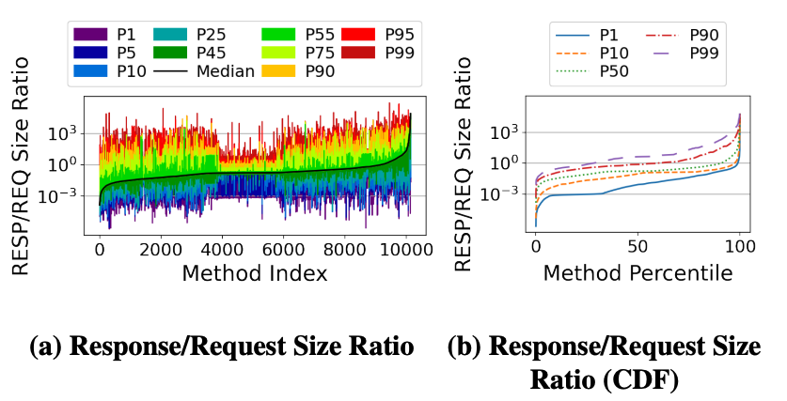
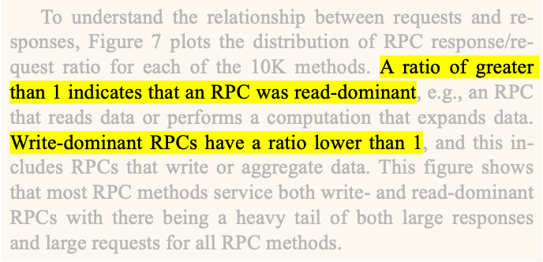




RPC Size Matters
RPC Access Type Matters
Nested RPC Calls
Ingress/egress data flow ratios
Analysis showed a mix of read- and write-dominant operations
Implications for RPC scheduling & system performance
Optimize for data locality
Minimize cross-cluster data movement
Notes:
In addition to size distribution, they also looked at 🔵 ratios of ingress/egress data flow, and found that while the average method serves a 🔵 mix of both read and write operations,
the median response-request-size-ratio 🔵 is below 1.
This indicates that a 🔵 majority of RPCs are write-dominant,
but should expect both ingress and egress data flow.
Managing the interference between read- and write- dominant RPCs
should be an 🔵 important priority for scheduling algorithms
and the authors specifically suggest 🔵 optimizing for data locality
and 🔵 minimizing data movement across clusters.

Slide 9

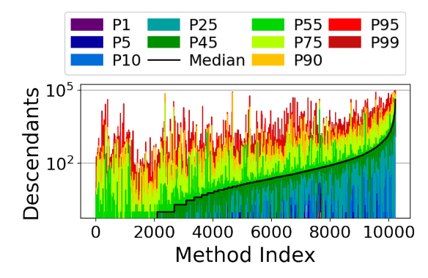

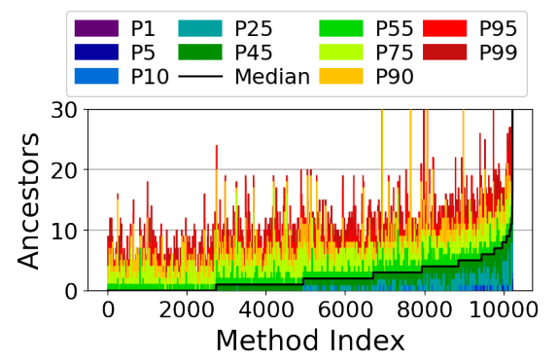


RPC Size Matters
CPU Cycle Utilization
Nested RPC Calls
RPC call trees tend to be wider than they are deep.
Implications for designing benchmarks & understanding distributed computation…
Wider trees: more resource utilization
Deeper trees: higher latencies
S0
S0
S0
S0
S1
S1
S3
S3
S4
S2
S4
S1
S2
S1
S0
S2
S2
S5
S6
S7
S8
S9
S10
S11
S12
S1
S2
S3
S4
S3
S3
Notes:
Another interesting aspect was the structure of 🔵 RPC call trees,
which were observed to be 🔵 wider than they were 🔵 deep.
This essentially means that RPCs tended to 🔵 initiate many parallel calls to other RPC’s rather than a 🔵 long series of sequential calls.
This has significant 🔵 implications for how services are designed and managed,
as a 🔵 wider call tree can involve more services and potentially more resource utilization,
but may not have to deal with the sequential dependencies that a 🔵 deep call tree might encounter due to waiting on a chain of calls to complete.

Slide 10
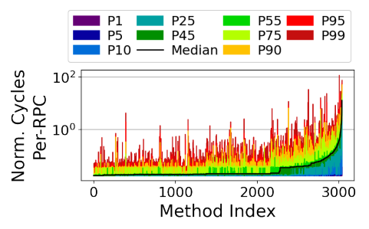
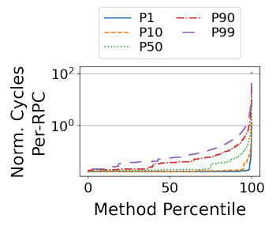

Nested RPC Calls
Resource Utilization and Load Balancing
CPU Cycle Utilization
RPCs consume a significant portion of CPU cycles.
RPC usage is growing faster than compute capacity.
Reflects increasing demands caused by:
Hardware optimization
Microservice-based design
Variance in CPU cycle consumption:
Indicates opportunities for optimization
Notes:
RPCs are not just network-heavy; 🔵 they're also significant consumers of CPU cycles.
In fact, the study found that 🔵 RPC usage is increasing faster than compute capacity.
This 🔵 reflects the increase in demand placed on the infrastructure as cloud services scale up, which the authors note can be attributed to two key trends:
🔵 improved hardware optimization which reduces CPU cost per RPC,
and the rise of 🔵 microservice designs which are inherently more CPU efficient.
This 🔵 underscores the need for more intelligent resource allocation and scheduling
to accommodate CPU variance across different methods.

Slide 11
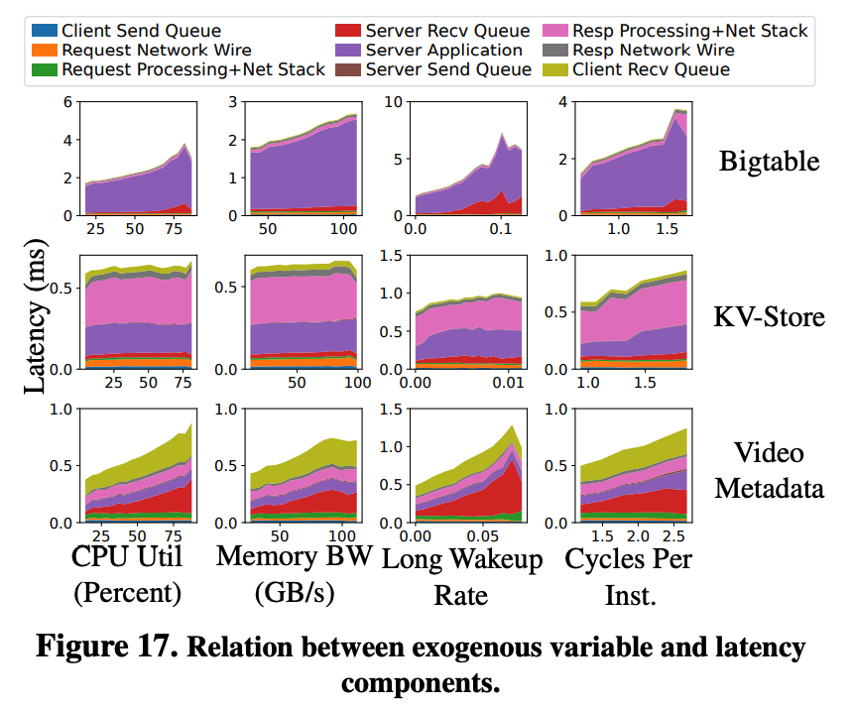


CPU Cycle Utilization
Implications for Software Optimizations
Resource Utilization and Load Balancing
Impact of exogenous variables
Performance varies with CPU load & memory bandwidth
Importance of efficient load balancing across clusters.
CPU variance across RPCs:
Poses challenges for load balancing & scheduling.
Need to consider both network latency and server load
Notes:
The study showed a 🔵 direct correlation between performance
and exogenous variables such as 🔵 CPU load and memory bandwidth.
This again indicates the 🔵 importance of efficient load balancing across clusters
despite the 🔵 variance in CPU cycles observed across RPC’s which 🔵 makes it difficult to maintain service continuity and performance, especially as things scale.
This is because effective load balancing 🔵 must consider both
network latency and server load, which is currently a challenge for many load balancing algorithms.

Slide 12
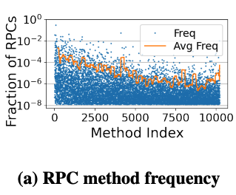
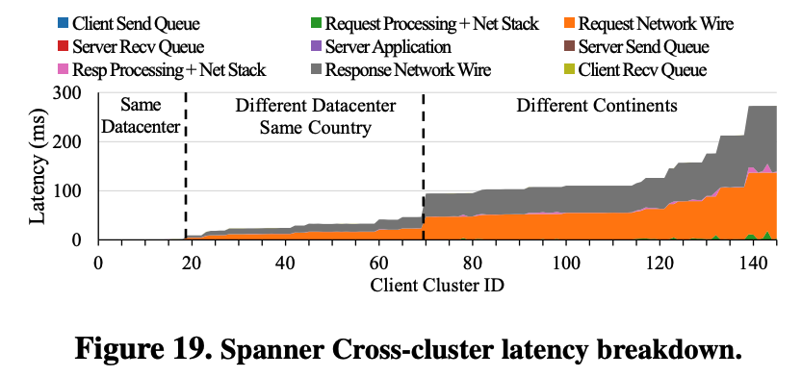
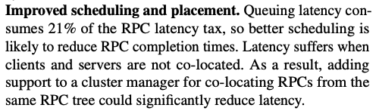
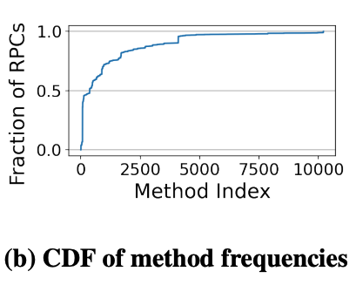

Resource Utilization and Load Balancing
Hardware Optimization Opportunities
Implications for Software Optimizations
Tail latency reduction
Advanced scheduling
Cross-layer load-balancing to manage latency variations
Service-specified optimization
Target the most popular RPC methods.
Addresses each service’s bottlenecks
(Queueing delay, processing time, etc.)
Notes:
The unique characteristics of RPCs at scale suggest that we may have to consider new approaches to software optimization such as 🔵 reducing the RPC latency tax, especially at the tail where it can be the majority of the RPC time. 🔵 Scheduling can be improved by minimizing queuing latency,
which consumes 🔵 21% of the RPC tax, and is especially an issue when clients and servers are separated geographically. Another suggestion was to develop 🔵 cross-layer load-balancing mechanisms that consider both RPC type and system resource states to manage latency variations. Finally, 🔵 the study suggests optimizing 🔵 the most popular RPC methods,
since the top 10 methods account for 58% of all calls, and the top-100 account for 91%.
Therefore a few service-targeted optimizations could 🔵 address the most common bottlenecks such as 🔵 queueing delay for lighter services and processing time for heavier ones.

Slide 13
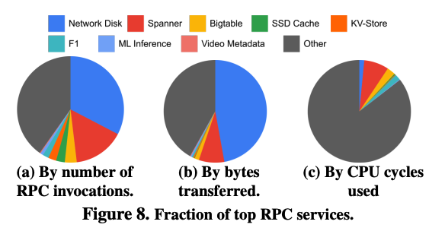
Implications for Software Optimizations
Challenges and Limitations
Hardware Optimization Opportunities
Hardware accelerators for common RPC operations.
Addresses challenges with the Dennard scaling limit
Accelerate essential operations (often under-optimized in the cloud)
Selective RPC library acceleration
Prioritize data-intensive RPC functions for certain services (Network Disk, Spanner).
Focus on method-specific hardware
Notes:
Hardware accelerators could also offer significant benefits,
especially in the face of 🔵 Dennard scaling breakdown,
which refers to the point at which reducing transistor size
no longer improves performance and energy efficiency.
The study suggests accelerating 🔵 essential operations
like compression and encryption, as these services are often under-optimized in cloud environments.
Despite the 🔵 RPC Library consuming only a small percentage of CPU cycles,
another opportunity could be to prioritize acceleration for 🔵 data-intensive applications,
especially significant ones like Network Disk and Spanner.
Finally, the study suggests 🔵 directing hardware acceleration efforts
towards the RPC methods with the highest CPU load for maximum cost-efficiency.

Slide 14
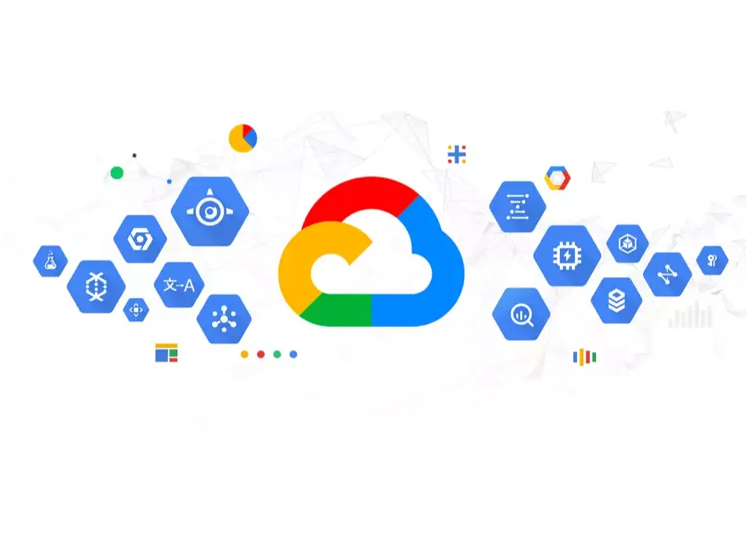
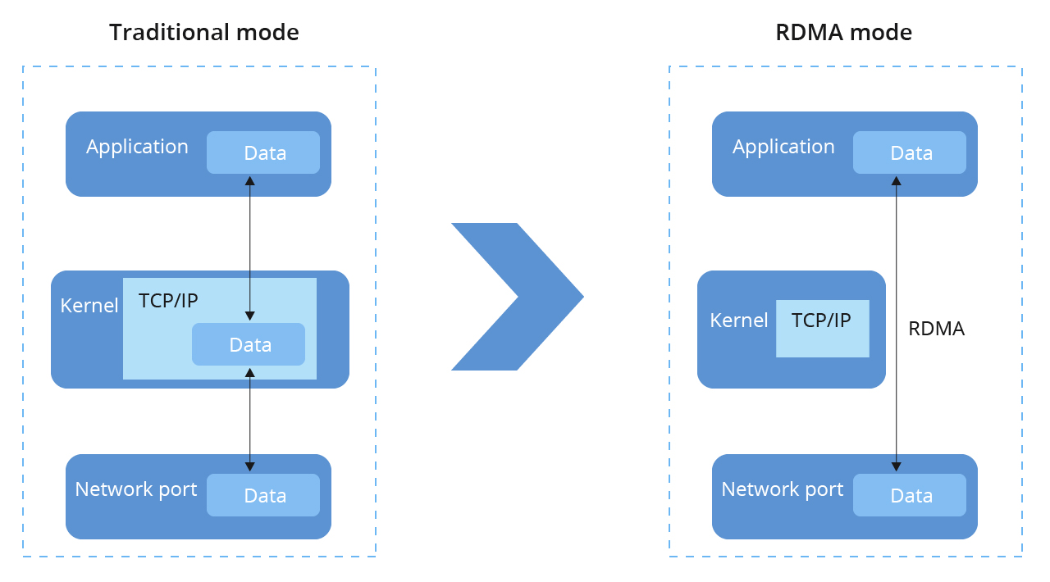


Hardware Optimization Opportunities
Future Research Directions
Challenges and Limitations
Generalizability:
Findings are limited to Google's environment.
Scope of transport protocol:
Only considers RPCs over TCP.
Excludes other types (such as RDMA-based).
Notes:
The authors acknowledges two main limitations of their findings:
🔵 First, their data may not directly apply to all cloud systems since it only reflects the examination of RPCs 🔵 from Google's specific environment.
🔵 Second, the study 🔵 only considers RPCs sent over TCP and so it 🔵 may not apply to RCPs based on other transport protocols like RDMA.

Slide 15
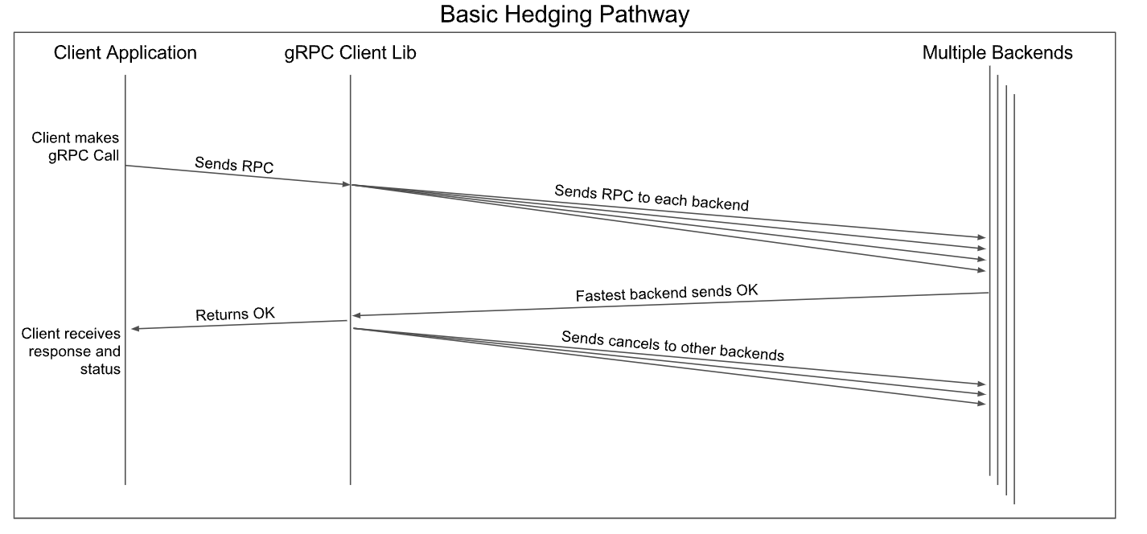
Challenges and Limitations
Conclusion
Future Research Directions
Optimizing for millisecond-level RPCs rather than microsecond-level.
Improving data locality and reducing cross-cluster RPC latency.
Exploring the efficacy of request hedging and its impact on resource utilization.
Notes:
Looking forward, the study points to several directions for future research.
They emphasize the need to 🔵 optimize millisecond-level RPCs, which is where substantial performance improvements can be made.
They also highlight the importance of 🔵 improving data locality to reduce latency for cross-cluster RPCs.
Finally, they suggest 🔵 exploring the trade-offs involved in request hedging, which is an area that could lead to more efficient cloud service operations.

Slide 16
Future Research Directions
Conclusion
Comprehensive analysis: > 700 billion RPC samples
Significant findings:
RPC usage is growing faster than compute resources
Underscores the importance of RPCs in distributed cloud applications
Latency and cycle tax insights
Calls for further research into both software and hardware optimizations.
Questions?
Notes:
In conclusion, this study offers a 🔵 comprehensive analysis
of over 700 billion RPC samples, which has provided valuable insights that refine our current understanding of RPC operations in large-scale systems.
One of their most 🔵 significant findings was the accelerated 🔵 growth rate of RPC usage,
which they observed to be outpacing the provision of compute cycles.
This 🔵 underscores the importance of RPCs and the need to optimize their usage further,
such as developing load-balancing algorithms that reduce both 🔵 latency and cycle taxes.
In fact, they 🔵 call for future research into both software and hardware optimizations to enhance the efficiency and performance of RPC systems at cloud-scale.

Slide 17
Conclusion
Questions?

