Slide 1



Introduction & Background
Presentation by: Hannah Marsh, undergraduate: UNH
A Cloud-Scale Characterization of Remote Procedure Calls
Authors: K. Seemakhupt, et al.
Conference: ACM SIGOPS 29th SOSP ‘23
Date and Location: October, 2023, Koblenz, Germany

Slide 2
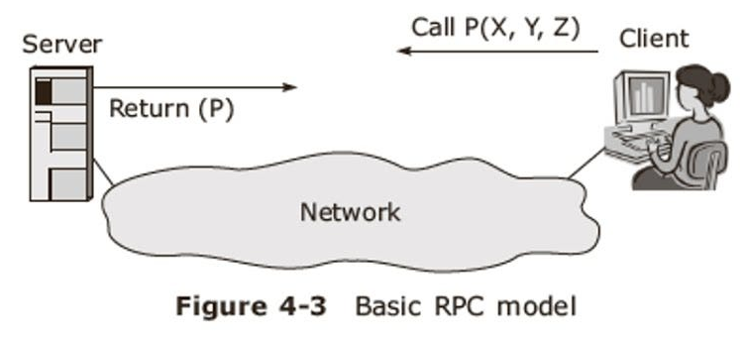
Study Methodology
Introduction & Background
A Cloud-Scale Characterization of Remote Procedure Calls
Modern cloud applications are complex
Importance of RPCs in cloud-scale services
Enable location-independent communication
Lack of studies on RPC characteristics "in the wild".
Scope:
Analyzed Google’s RPC methods over nearly 2 years
Objective:
Understand RPC usage, characteristics, and behavior at Google's scale
Inspire better cloud system optimization.
Notes:
As emphasized in the paper’s introduction, 🔵 modern cloud computing services are complex and widely distributed.
Remote Procedure Calls or RPCs are 🔵 central to these services, since they 🔵 enable the location-independent communication requirements of the cloud.
Despite the importance and ubiquity of RPCs, there's been a 🔵 lack of research characterizing their behavior at scale.
This study aimed to fill that gap, and over the course of two years, 🔵 it analyzed trends from RPC methods across several of Google’s services, like Search and YouTube.
The 🔵 objective of this research was to provide insight into RPC usage patterns in order to 🔵 inspire new directions for cloud system optimization.

Slide 3
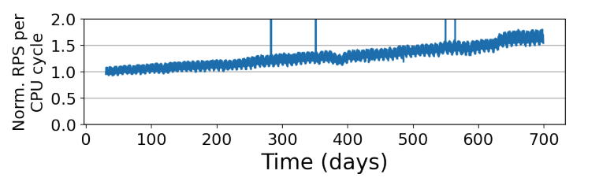
Introduction & Background
Key Findings - RPC Characteristics
Study Methodology
Examination of >10,000 RPC methods across Google’s services.
Data collected from >722 billion RPC samples over 23 months.
Tools used: Monarch, Dapper, and GWP for monitoring and analysis..
Notes:
To understand RPCs at Google's scale, the team 🔵 analyzed over 10,000 RPC methods and 🔵 more than 722 billion RPC samples over a 23-month period.
They used 🔵 tools like Monarch for metric collection, Dapper for trace analysis, and GWP for CPU profiling, which they believe offered a holistic view of RPC behavior.

Slide 4
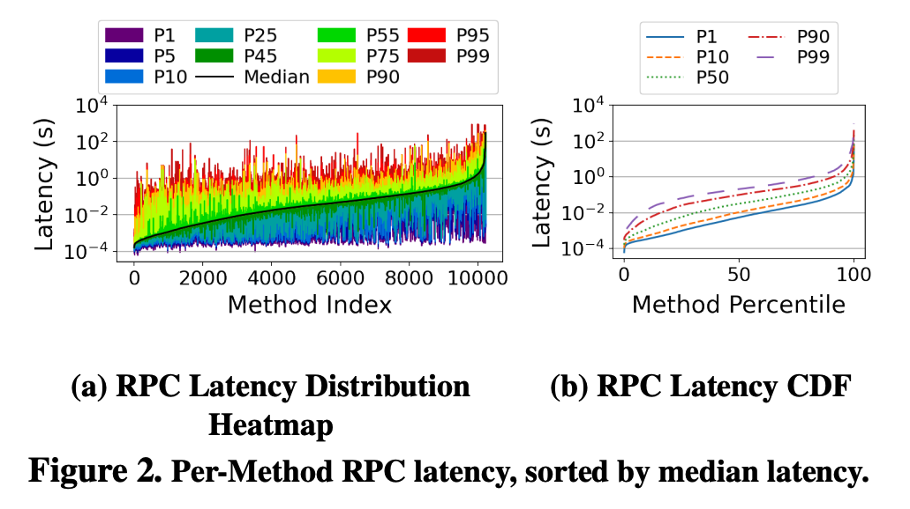
Study Methodology
Latency Insights
Key Findings - RPC Characteristics
Rapid growth in RPC usage, outpacing compute cycle growth.
Millisecond-level operation timescales for most RPCs.
Significant variance in latency and size across different RPC methods.
Notes:
Impressively, their findings challenge some of our pre-existing assumptions about RPCs.
Notably, 🔵 RPC usage is growing faster than compute resources, with many RPCs operating at 🔵 millisecond timescales—much longer than previously assumed.
There's also 🔵 significant variance in latency and size, which again underscores the complexity of optimizing RPCs in the cloud.

Slide 5
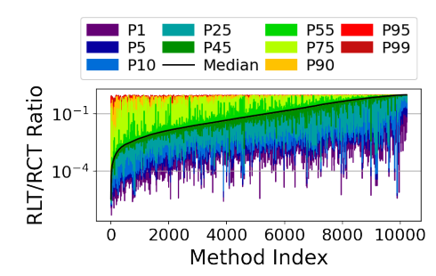



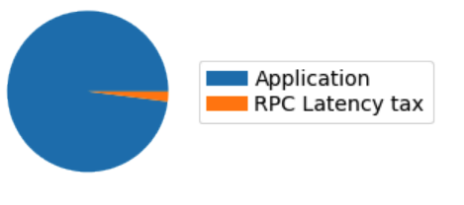
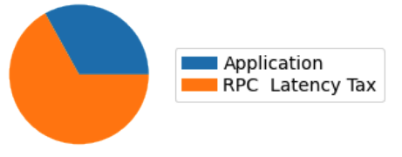
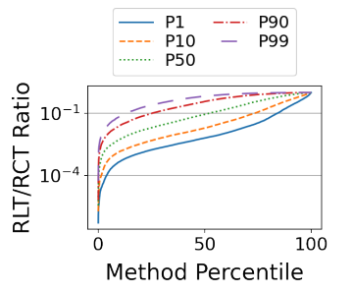





Key Findings - RPC Characteristics
RPC Size Matters
Latency Insights
Application processing dominates average RPC time.
Network and queuing latencies significant in tail latency..
Notes:
A critical insight from this study is the role of 🔵 application processing in average RPC times, which was observed to dominate over network and queuing latencies.
🔵 However, at the tail end, these non-processing latencies become significant, highlighting areas where optimization could greatly impact performance.

Slide 6
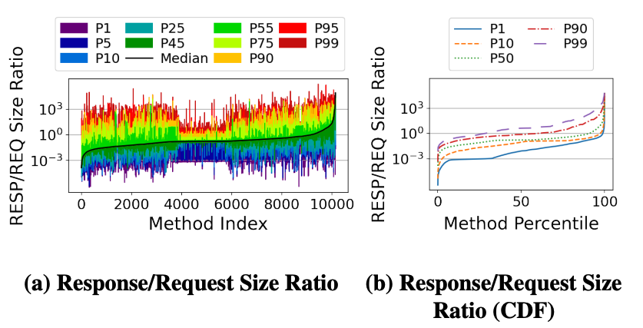
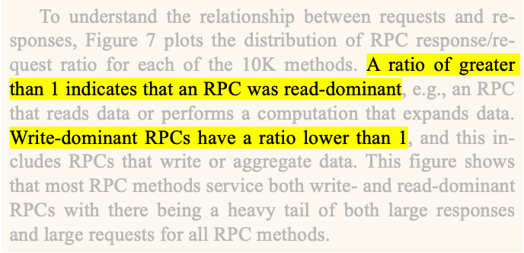
Latency Insights
RPC Size Matters
Nested RPC Calls
Most RPCs are small, but there's a heavy tail of large RPCs.
Read-dominant vs. write-dominant RPCs & their impact.
Notes:
The study also sheds light on RPC sizes, with a 🔵 heavy tail of larger RPCs, and a 🔵 mix of read- and write-dominant interactions. This has profound implications for designing more efficient data handling and processing strategies in distributed systems.

Slide 7

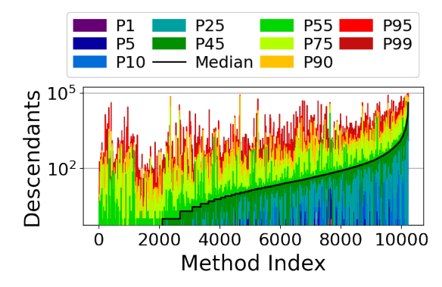

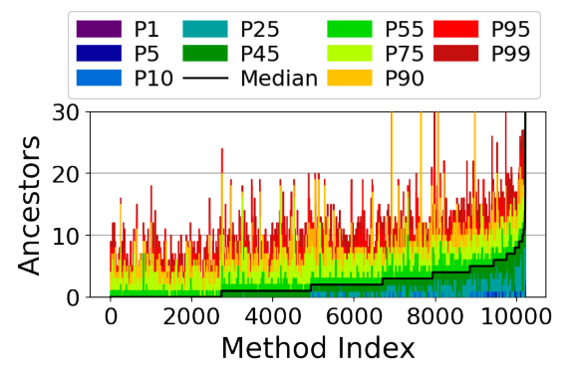
RPC Size Matters
CPU Cycle Utilization
Nested RPC Calls
RPC call trees tend to be wider than they are deep.
Implications for designing benchmarks & understanding distributed computation…
Wider trees: more resource utilization
Deeper trees: higher latencies
S0
S0
S0
S0
S1
S1
S3
S3
S4
S2
S4
S1
S2
S1
S0
S2
S2
S5
S6
S7
S8
S9
S10
S11
S12
S1
S2
S3
S4
S3
S3
Notes:
Another interesting aspect was the 🔵 structure of RPC call trees, which were observed to be 🔵 wider than they were 🔵 deep.
This essentially means that RPCs tended to 🔵 initiate many parallel calls to other RPC’s rather than a 🔵 long series of sequential calls.
This has significant 🔵 implications for how services are designed and managed, as a 🔵 wider call tree can involve more services and potentially more resource utilization, but may not have to deal with the sequential dependencies that a 🔵 deep call tree might encounter due to waiting on a chain of calls to complete.

Slide 8
Nested RPC Calls
Resource Utilization and Load Balancing
CPU Cycle Utilization
RPCs consume a significant portion of CPU cycles.
RPC usage is growing faster than compute capacity.
Reflects increasing demands caused by:
Hardware optimization
Microservice-based design
Variance in CPU cycle consumption:
Indicates opportunities for optimization
Notes:
RPCs are not just network-heavy; 🔵 they're also significant consumers of CPU cycles.
In fact, the study found that 🔵 RPC usage is increasing faster than compute capacity.
This 🔵 reflects the increase in demand placed on the infrastructure as cloud services scale up, which the authors note can be attributed to two key trends:
🔵 improved hardware optimization which reduces CPU costs per RPC, and the rise of 🔵 microservice designs which are inherently more CPU efficient.
This underscore the need for more intelligent resource allocation and scheduling to accommodate the 🔵 variance in CPU utilization across different RPCs.

Slide 9
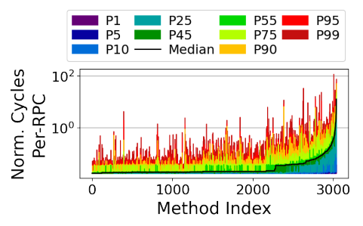
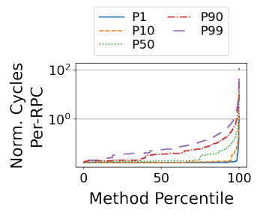
CPU Cycle Utilization
Implications for Software Optimizations
Resource Utilization and Load Balancing
Impact of exogenous variables
Performance varies with CPU load & memory bandwidth
Importance of efficient load balancing across clusters.
CPU variance across RPCs:
Poses challenges for load balancing & scheduling.
Need to consider both network latency and server load
Notes:
The study showed a 🔵 direct correlation between performance and exogenous variables, such as 🔵 CPU load and memory bandwidth.
This again indicates the 🔵 importance of efficient load balancing across clusters despite the 🔵 variance in CPU cycles observed across RPC’s which 🔵 makes it difficult to maintain service continuity and performance, especially as things scale.
This is because effective load balancing 🔵 must consider both network latency and server load, which is is a current challenge for many load balancing algorithms.

Slide 10
Resource Utilization and Load Balancing
Hardware Optimization Opportunities
Implications for Software Optimizations
Tail latency reduction
Advanced scheduling
Cross-layer load-balancing to manage latency variations
Service-specified optimization
Target the most popular RPC methods.
Addresses each service’s bottlenecks
Notes:
The unique characteristics of RPCs at scale suggest that traditional optimization strategies may not suffice, and we may have to consider new approaches such as 🔵 reducing the RPC latency tax, especially at the tail where it can be the majority of the RPC time.
🔵 Scheduling can be improved by prioritizing the minimization of queuing latency, especially when clients and servers are separated geographically.
Another suggestion was to develop 🔵 cross-layer load-balancing mechanisms that consider both RPC type and system resource states to manage latency variations.
Finally, 🔵 the study suggests optimizing 🔵 the most popular RPC methods, which could significantly affect the majority of RPCs
by 🔵 addressing each service's main bottlenecks,
such as processing time for compute-intensive services
and queuing delay for lighter services.

Slide 11
Implications for Software Optimizations
Challenges and Limitations
Hardware Optimization Opportunities
Hardware accelerators for common RPC operations.
Selective RPC library acceleration
Example: prioritize serialization over library functions
Data movement acceleration
Prioritize data-intensive RPC functions for certain services (Network Disk, Spanner, etc.).
Focus on method-specific hardware
Notes:
Hardware accelerators could offer significant benefits, especially for common operations like compression and encryption.
Additionally, 🔵 with RPC Libraries using only a small percentage of CPU cycles, hardware could be optimized to 🔵 prioritize accelerating operations like serialization over library functions.
🔵 Another opportunity could be to 🔵 prioritize hardware acceleration for data-intensive RPC operations, expecially for services like Network Disk and Spanner.
Finally, the study suggests 🔵 directing hardware acceleration efforts towards the most CPU-intensive RPC methods for maximum cost-efficiency.

Slide 12
Hardware Optimization Opportunities
Future Research Directions
Challenges and Limitations
Generalizability:
Findings are limited to Google's environment.
Scope of transport protocol:
Only considers RPCs over TCP.
Excludes other types (such as RDMA-based).
Notes:
The authors acknowledges two main limitations of their findings:
🔵 First, their data may not directly apply to all cloud systems since it only reflects the examination of RPCs 🔵 from Google's specific environment.
🔵 Second, the study 🔵 only considers RPCs sent over TCP and so it 🔵 may not apply to RCPs based on other transport protocols like RDMA.

Slide 13
Challenges and Limitations
Conclusion
Future Research Directions
Optimizing for millisecond-level RPCs rather than microsecond-level.
Improving data locality and reducing cross-cluster RPC latency.
Exploring the efficacy of request hedging and its impact on resource utilization.
Notes:
Looking forward, the study points to several directions for future research.
They emphasize the need to 🔵 optimize millisecond-level RPCs, which is where substantial performance improvements can be made.
They also highlight the importance of 🔵 improving data locality to reduce latency for cross-cluster RPCs.
Finally, they suggest 🔵 exploring the trade-offs involved in request hedging, which is an area that could lead to more efficient cloud service operations.

Slide 14
Future Research Directions
Conclusion
Comprehensive analysis: > 700 billion RPC samples
Significant findings:
RPC usage is growing faster than compute resources
Underscores the importance of RPCs in distributed cloud applications
Latency and cycle tax insights
Calls for further research into both software and hardware optimizations.
Questions?
Notes:
In conclusion, the study we've reviewed today offers a 🔵 comprehensive analysis of over 700 billion RPC samples, which has provided valuable insights that refine our current understanding of RPC operations in large-scale systems.
One of their most 🔵 significant findings was the accelerated 🔵 growth rate of RPC usage, which they observed to be outpacing the provision of compute cycles.
This 🔵 underscores the importance of RPCs and the need to optimize their usage further, such as developing load-balancing algorithms that reduce both 🔵 latency and cycle taxes.
In fact, they 🔵 call for future research into both software and hardware optimizations to enhance the efficiency and performance of RPC systems at cloud-scale.

Slide 15
Conclusion
Questions?

