Slide 1


IMDb
&
Rotten Tomatoes
Hannah M Solima
17 December 2022
Nashville Software School

Slide 2

Motivation
I have noticed and experienced within my own family that one movie reviewing site is exclusively used because they trust it more than other the alternatives. There are two major movie scoring sites: IMDb and Rotten Tomatoes. This drove me to investigate what the differences in movie scoring existed between IMDb and Rotten Tomatoes and analyze findings about the movies as well.
General Information
I am analyzing IMDb’s Top 250 Movies list with Rotten Tomatoes ratings. Since IMDb has classified these movies as the top rated movies, one might expect, if the two scoring sites are similar, Rotten Tomatoes to have the same positive response to these movies.
Important Notices
Rotten Tomatoes and IMDb Scoring System
Rotten Tomatoes separates critics and audience scores (both a percentage of 100). Because IMDb does not include or have its own critics score, I will only be using audience scores.. Also, IMDb is scored on the scale of 1 to 10 stars, and I made this into a percentage to accurately compared the two sites.
Language
For original languages, there are specific dialects or country-specific classification for a common mother tongue. Such as French (France) and French (Canada) or English and English (United Kingdom). In any such instances, I combined them into ‘French’ or ‘English’ for simplicity.
Ratings
Before the modern MPA rating system for movies, there was the Hayes’ Code which basically only decided if a movie was deemed moral or immoral for general audiences. Thus, older movies in this list will have an “approved” or “passed” classification to mean they passed the Hayes’ Code at that time. The two classifications have been combined to be “approved.”
Genre
The genre count could be higher than 250 because movies have more than one.
Sources
IMDb Top 250 Movies
Rotten Tomatoes
Motion Picture Association (MPA)
Technologies
Python
Webscraped
Analyzed Data
Jupyter Notebook Visuals
PowerBI Dashboard

Slide 3
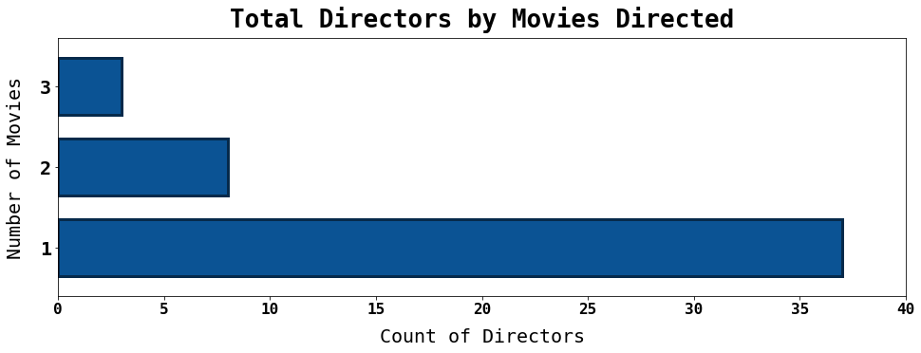
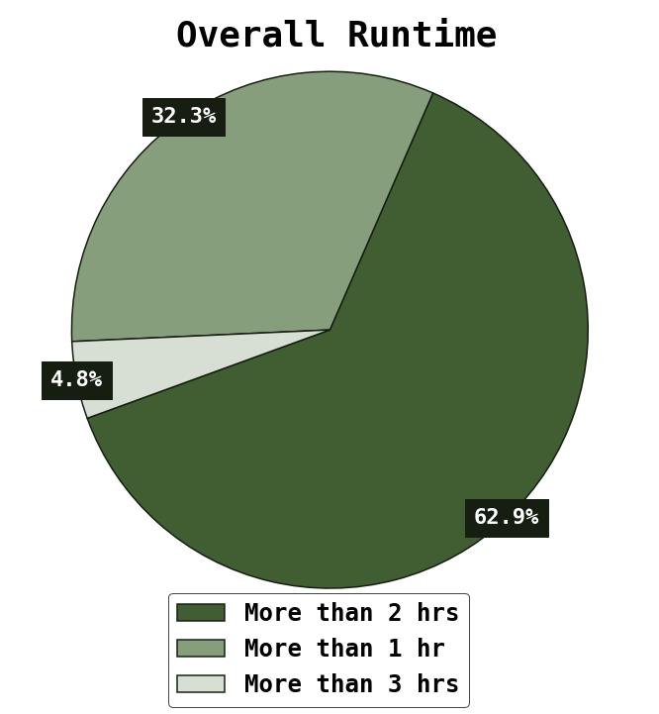
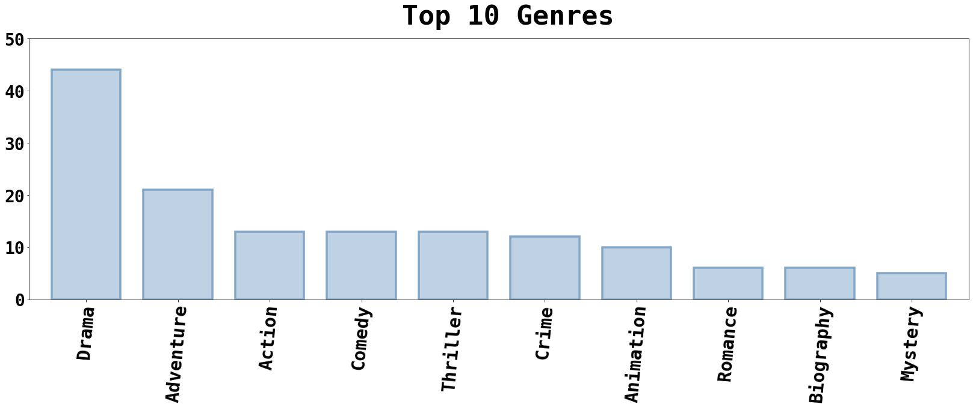
Top 25% of Award Winning Movies
Top 3 Directors:
Peter Jackson
Christopher Nolan
Quentin Tarantino

Slide 4
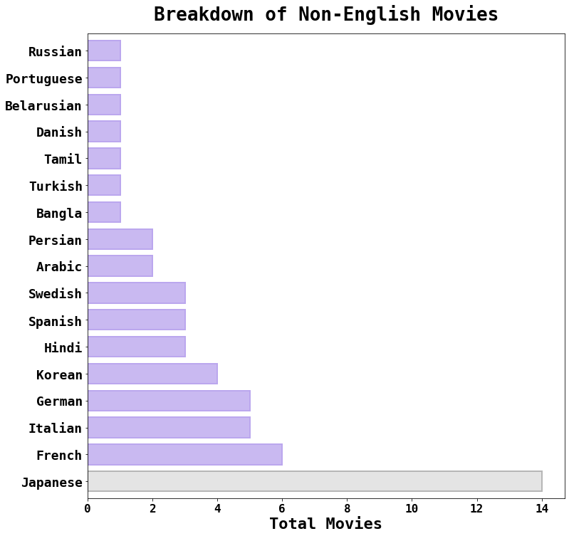
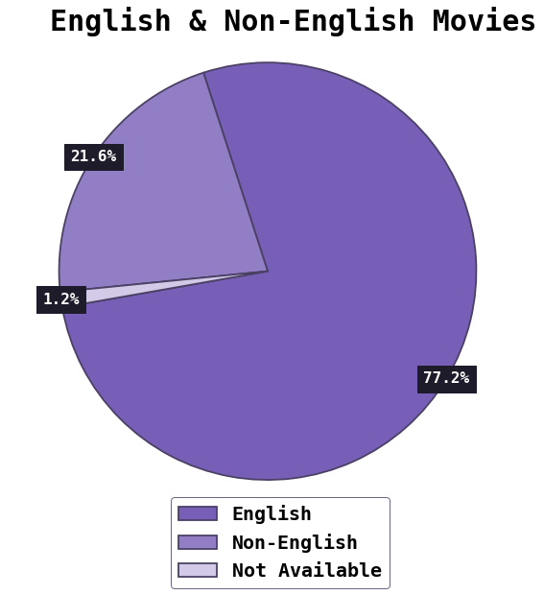







Language
Total Non-English Movies: 54
Notes:
Within this dataset,
Per film, Korean language movies win an AVG of 101 awards & are nominated an AVG of 113 times.
Per film, Spanish language movies win an AVG of 66 awards & are nominated an AVG of 71 times.

Slide 5
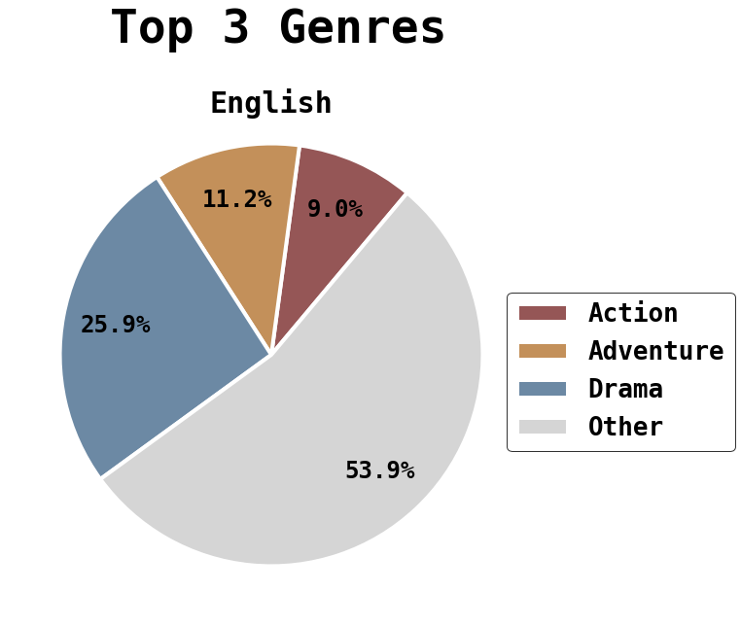
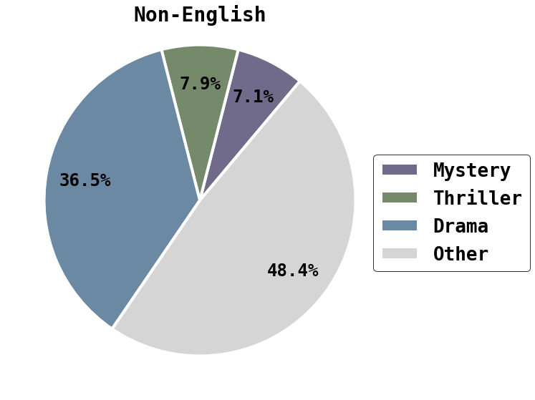




Language Continued…
Notes:
While a threshold still exists, the movies with a higher count will most likely have a more accurate depiction of reality

Slide 6

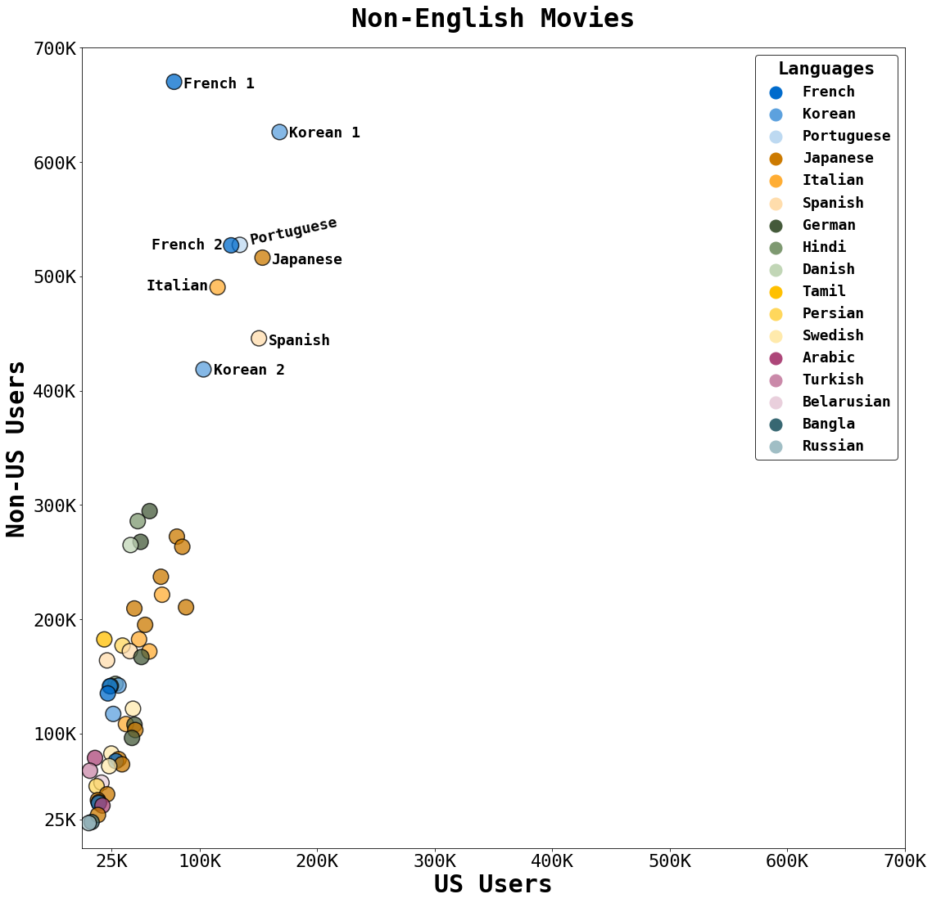
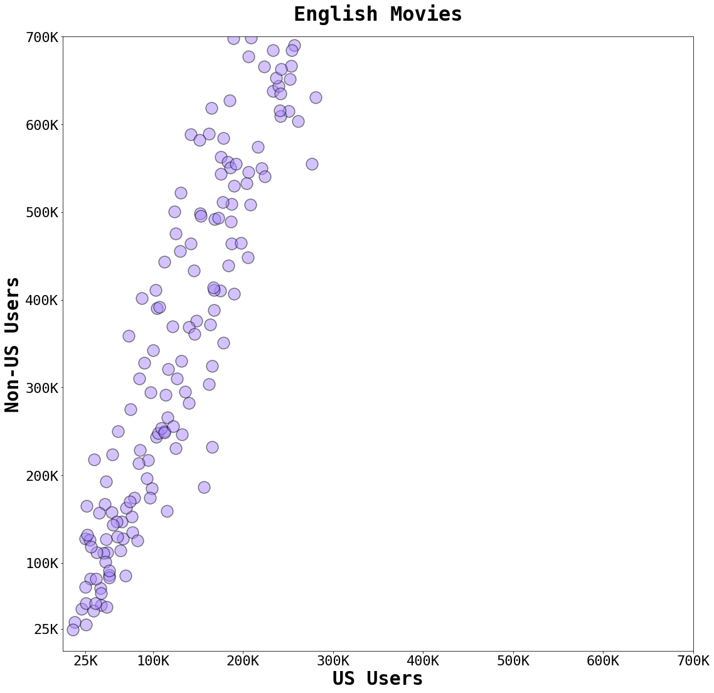
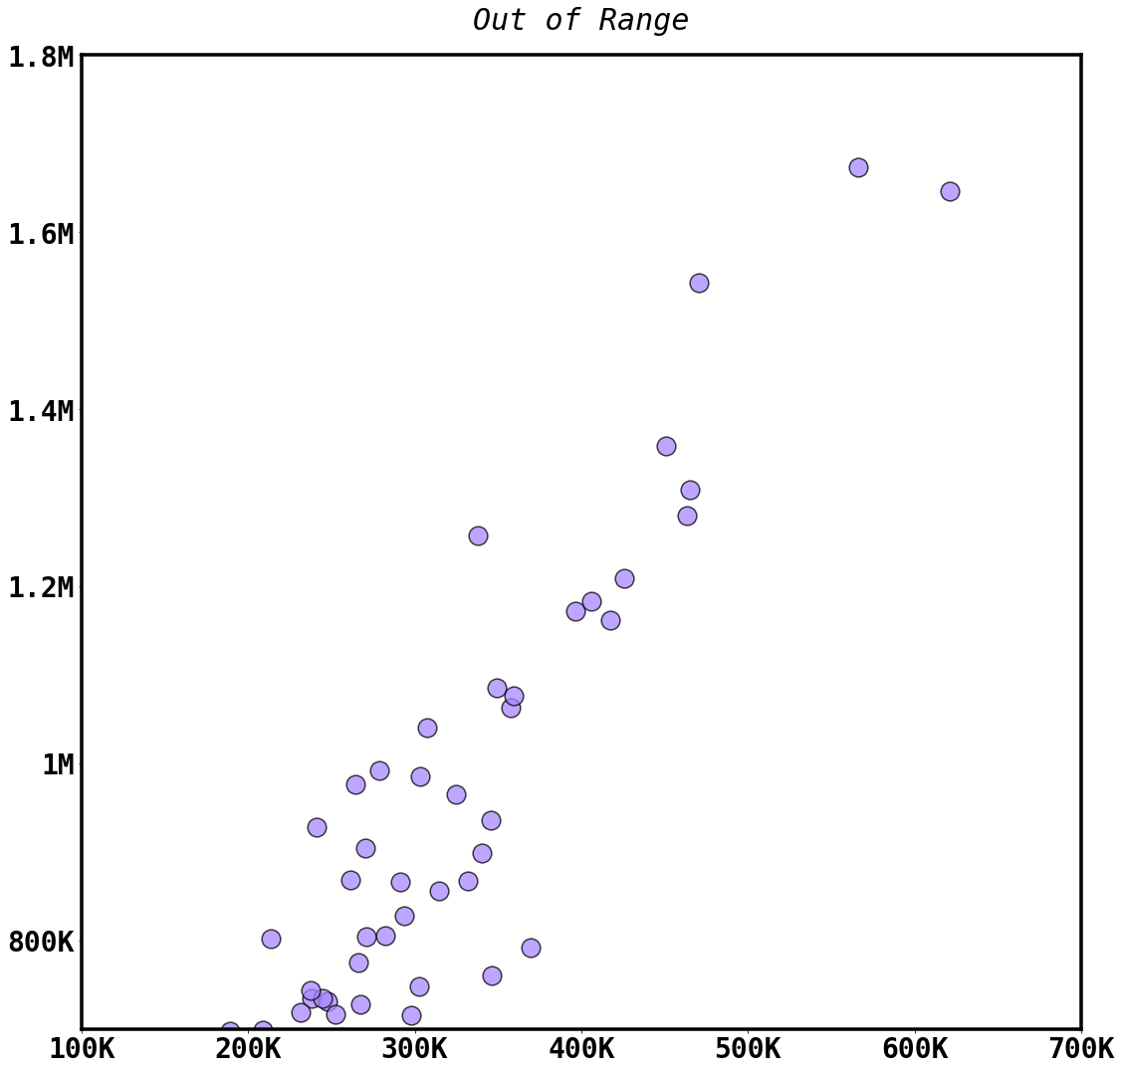
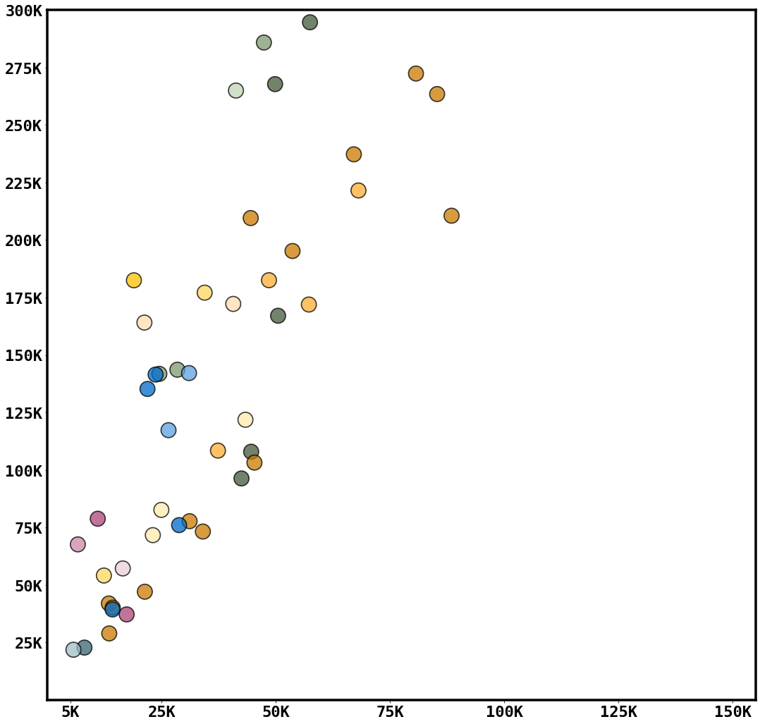

US v Non-US
IMDb Reviewers
French 1: The Intouchables (2011)
Korean 1: Parasite (2019)
Portuguese: City of God (2002)
French 2: Amélie (2001)
Japanese: Spirited Away (2001)
Italian: Life Is Beautiful (1997)
Spanish: Pan’s Labyrinth (2006)
Korean 2: Old Boy (2003)
The Great Dictator (1940)
Avengers:
Infinity War (2018)
Notes:
245 Russian
218 Bangla
22 port

Slide 7



THE 3 ‘R’S
RUNTIME
RELEASE
RATING

Slide 8
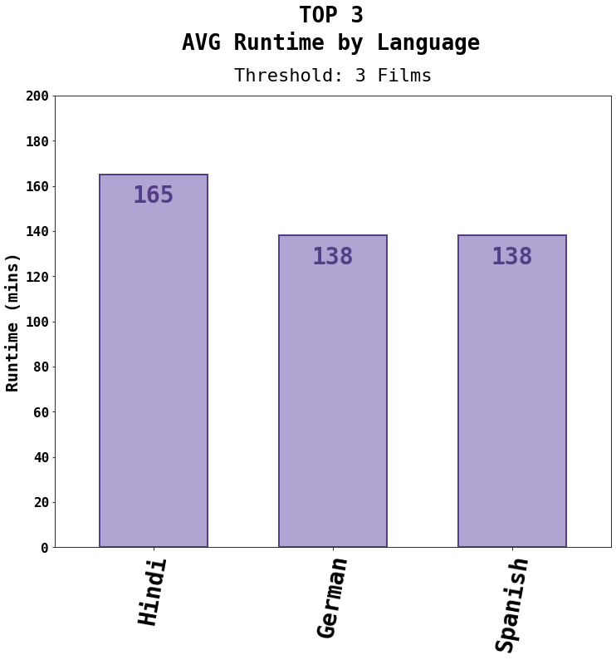
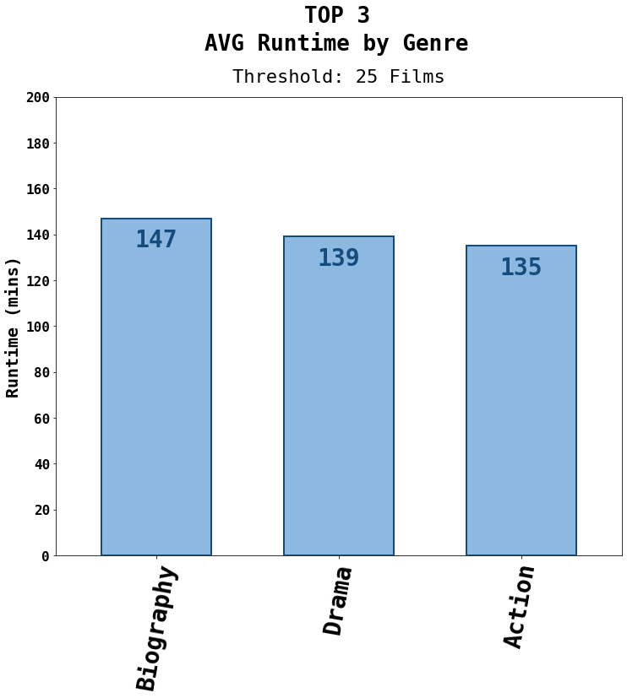
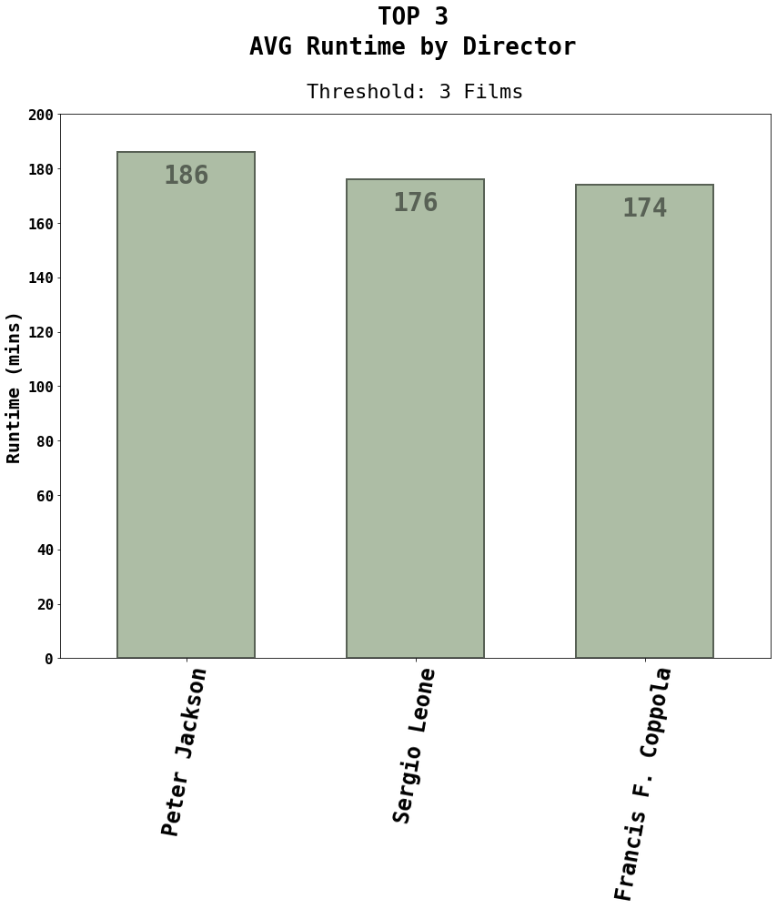
Runtime
Average
Runtime
Longest Movie
238 mins
Gone with the Wind (1924)
Shortest Movie
45 mins
Sherlock Jr.
(1924)
129 mins

Slide 9
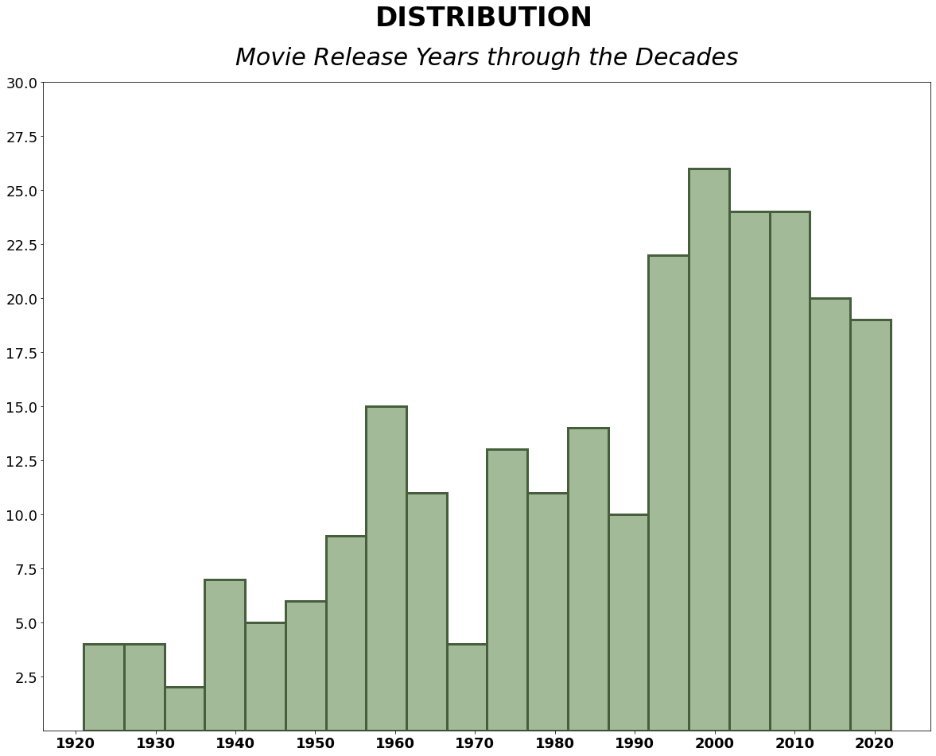

Release
Range of Years 1921-2022
Notes:
Most films were release from 2000-2009

Slide 10
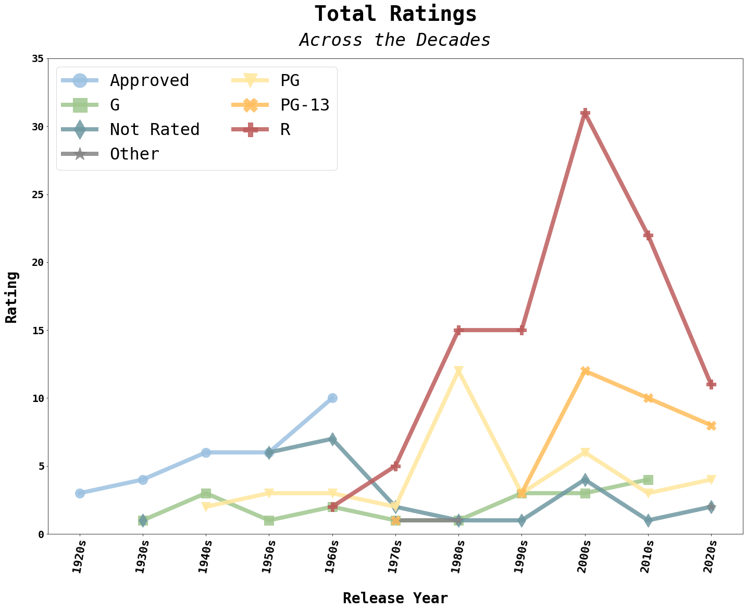
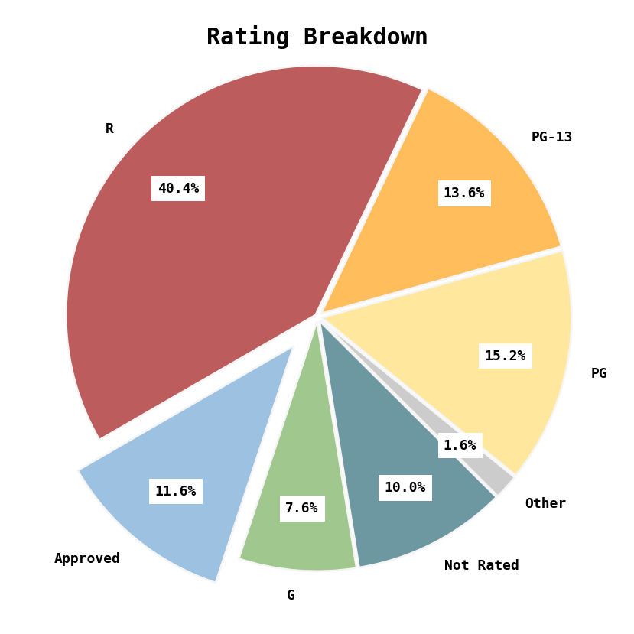

Rating

Slide 11


SHOW DOWN

Slide 12
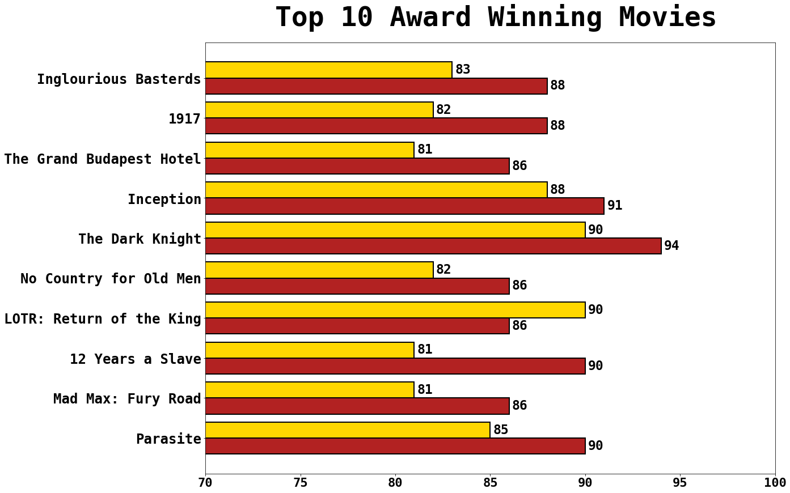
Award Winning
Greatest Difference: 12 Years a Slave 9%
Least Difference: *Inception 3%
Highest Rotten Tomatoes: The Dark Knight 94%
Highest IMDb: The Dark Knight & LOTR (tie) 90%
*The only example where IMDb has a higher score than Rotten Tomatoes

Slide 13
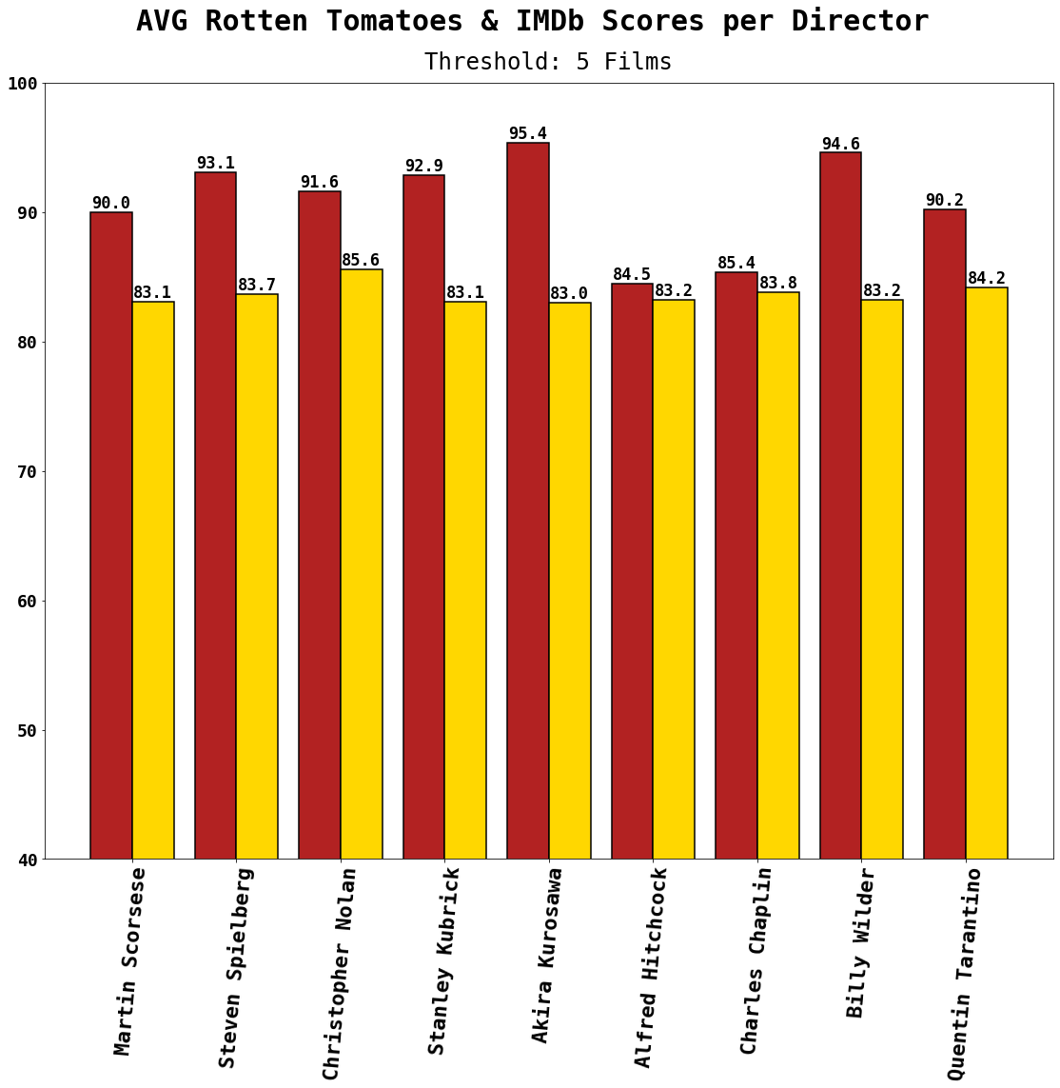
Director
Greatest Difference: Akira Kurosawa 12.4%
Least Difference: Alfred Hitchcock 1.3%
Highest Rotten Tomatoes: Akira Kurosawa 95.4%
Highest IMDb: Christopher Nolan 85.6%

Slide 14
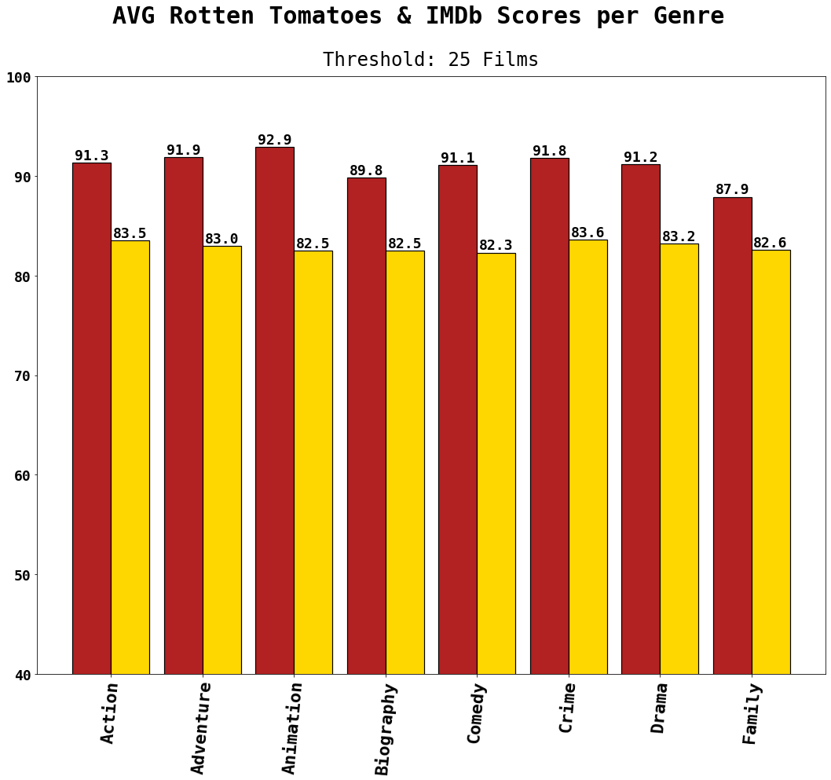
Genre
Greatest Difference: Biography 9.4%
Least Difference: Family 6.4%
Highest Rotten Tomatoes: Action 92.0%
Highest IMDb: Crime 83.6%

Slide 15
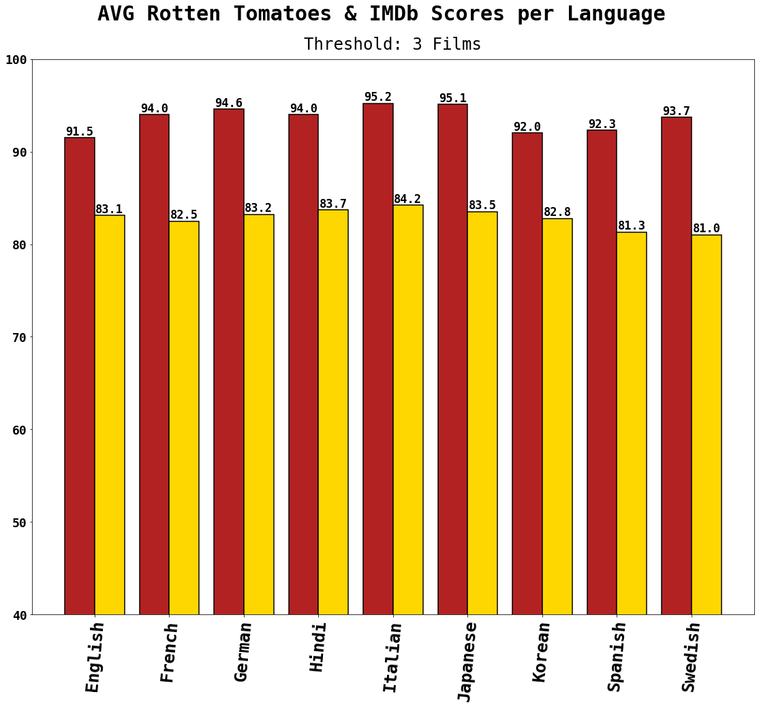
Language
Greatest Difference: Swedish 12.7%
Least Difference: English 8.4%
Highest Rotten Tomatoes: Italian 95.2%
Highest IMDb: Italian 84.2%

Slide 16
FINAL ANALYSIS
IMDb
Rotten Tomatoes
More Detailed
Breakdown of Reviewers
& IMDb Pro
Critic & Audience Scores
PRO
No Critic Scores (uses Metascore)
Contains More Errors
i.e. Typos, Incomplete Information
& Review Counts Not Exact
CON

Slide 17

…and the winner is…

Slide 18
Thank You

Slide 20
US Box Office
Area graph with middle being the average gross and which movies maded above or below this through the decades(beased on release year)

Slide 21
Directors
Create line chart with top 3 directors and see awards won with each additional movie made

