Slide 1


IMDb
&
Rotten Tomatoes
Hannah M Solima
17 December 2022
Nashville Software School

Slide 2

Project Focus
I am analyzing IMDb’s Top 250 Movies list with Rotten Tomatoes ratings.
Sources
IMDb Top 250 Movies
Rotten Tomatoes
Motion Picture Association (MPA)
Technologies
Python
Webscraped
Analyzed Data
Jupyter Notebook Visuals

Slide 3





Important Notices
Rotten Tomatoes and IMDb Scoring System
Rotten Tomatoes separates critics and audience scores (both a percentage of 100). Because IMDb does not include or have its own critics score, I will only be using audience scores.
IMDb is scored on the scale of 1 to 10 stars; this was turned into a percentage.
Ratings
Before the modern MPA rating system for movies, there was the Hayes’ Code which basically only decided if a movie was deemed moral or immoral for general audiences. Thus, some movies have an “approved” or “passed” rating, which was combined as “approved.”
Language
French (France) & French (Canada) = ‘French’
English (American) & English (United Kingdom) = ‘English’, etc.
Genre
The genre count could be higher than 250 because movies have more than one.

Slide 4
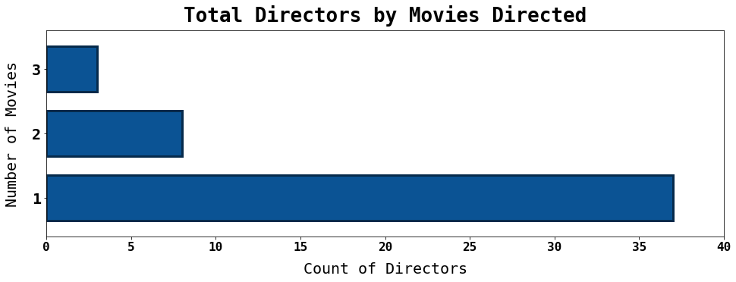
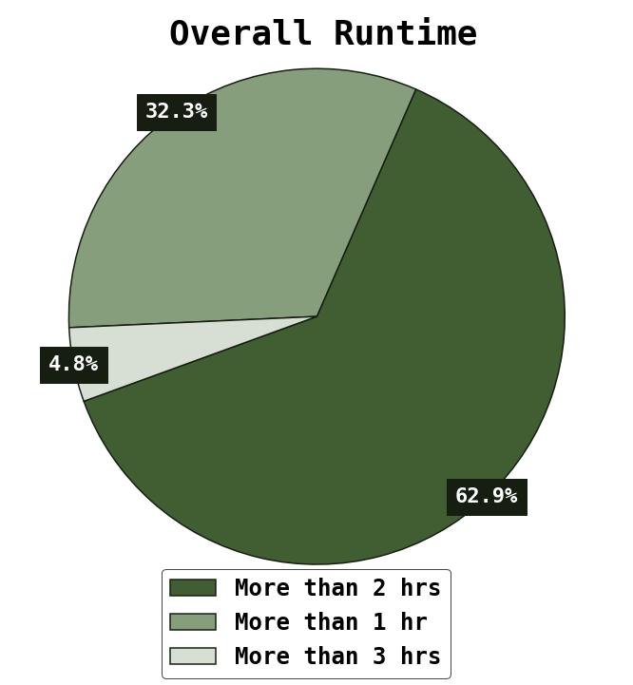
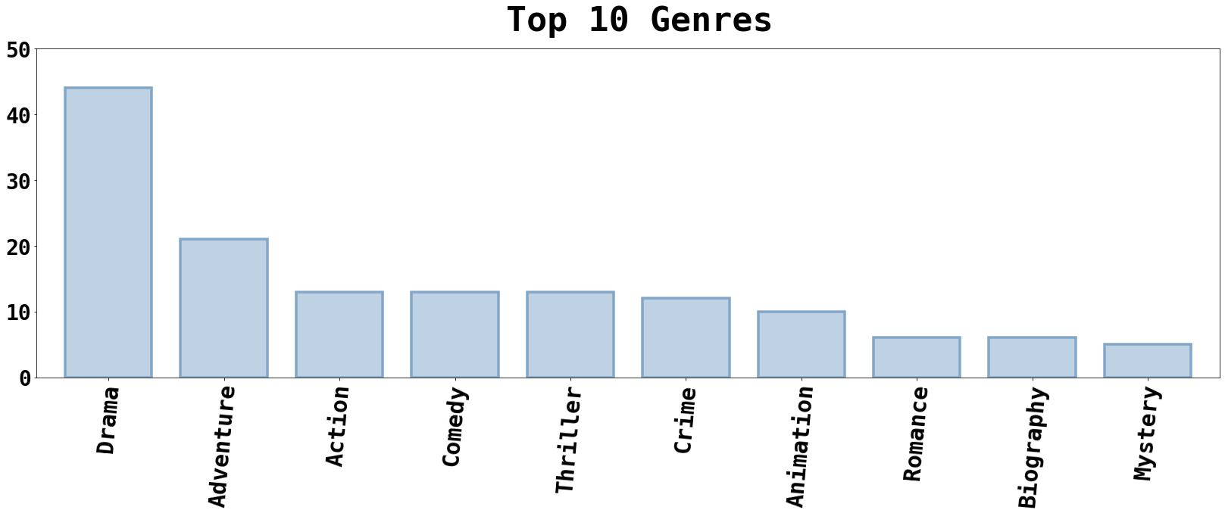
Top 25% of Award Winning Movies
Top 3 Directors:
Peter Jackson
Christopher Nolan
Quentin Tarantino

Slide 5
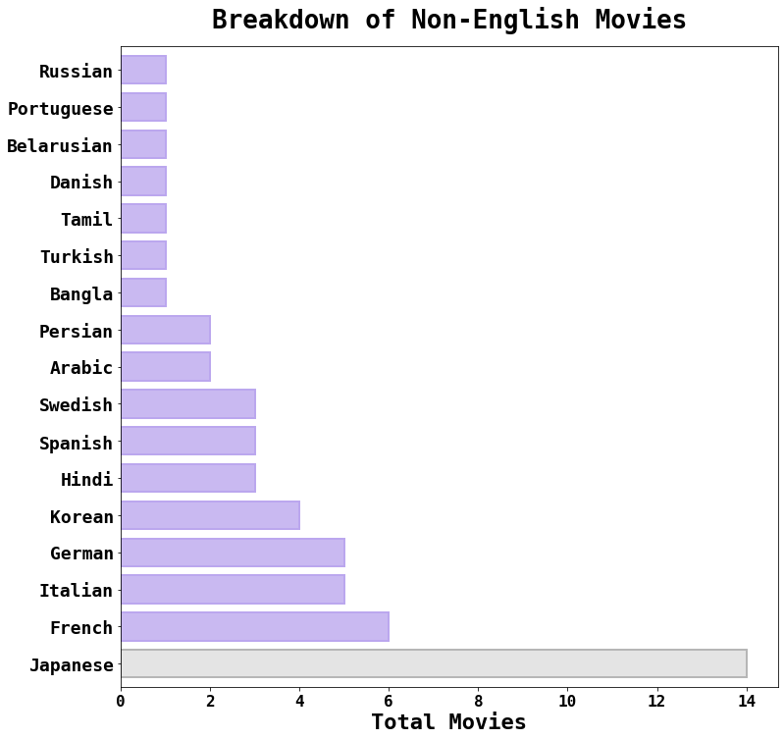
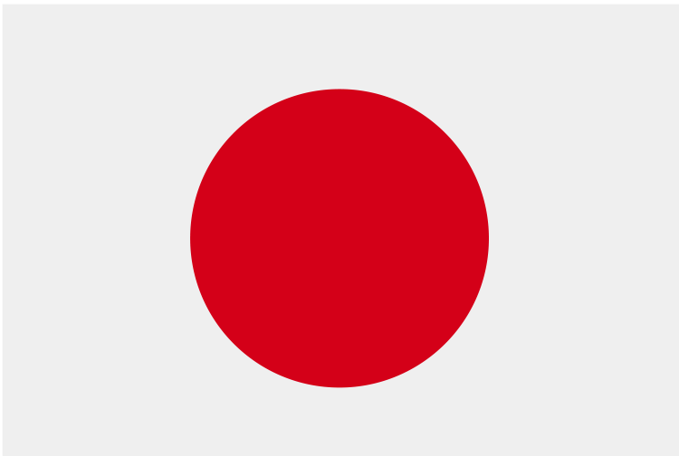






Language
Total Non-English Movies: 54
Notes:
Within this dataset,
Per film, Korean language movies win an AVG of 101 awards & are nominated an AVG of 113 times.
Per film, Spanish language movies win an AVG of 66 awards & are nominated an AVG of 71 times.

Slide 6
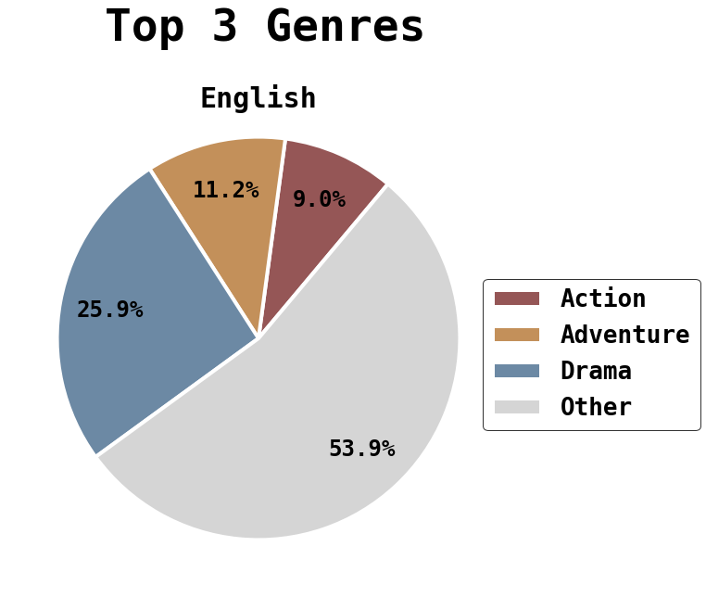
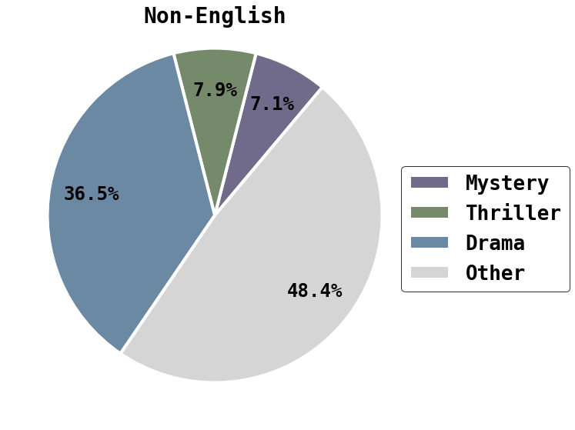

Language Continued…
Notes:
While a threshold still exists, the movies with a higher count will most likely have a more accurate depiction of reality

Slide 7

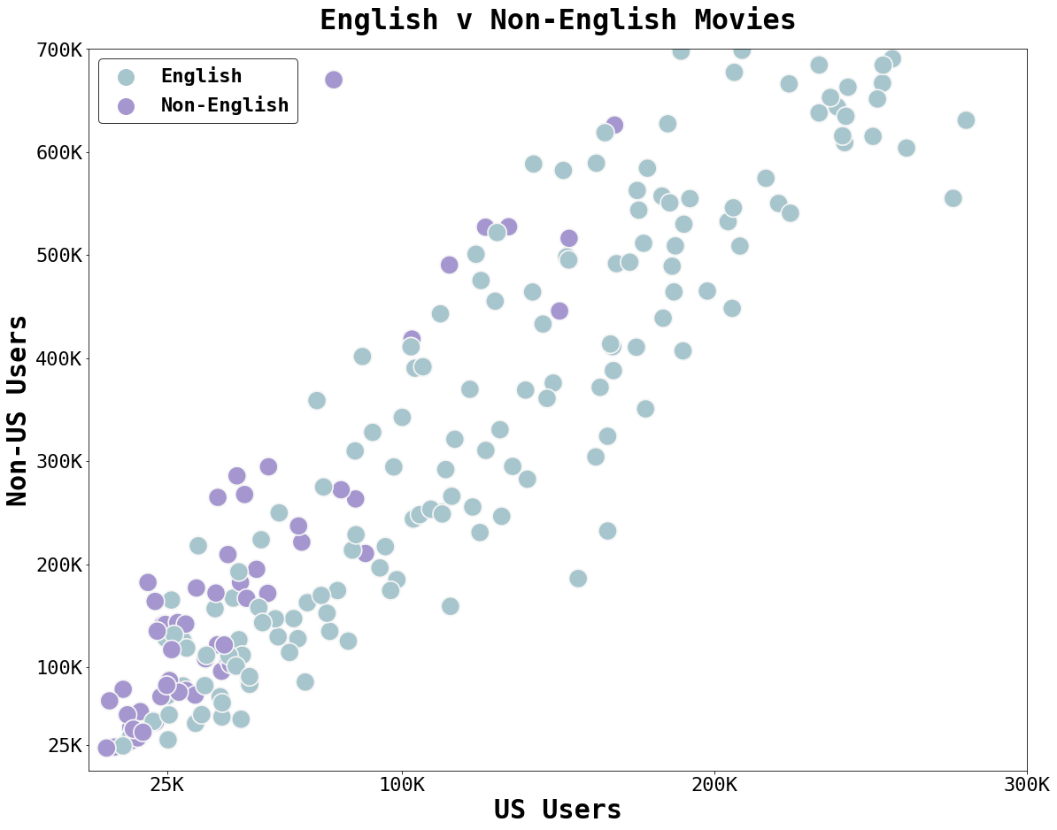
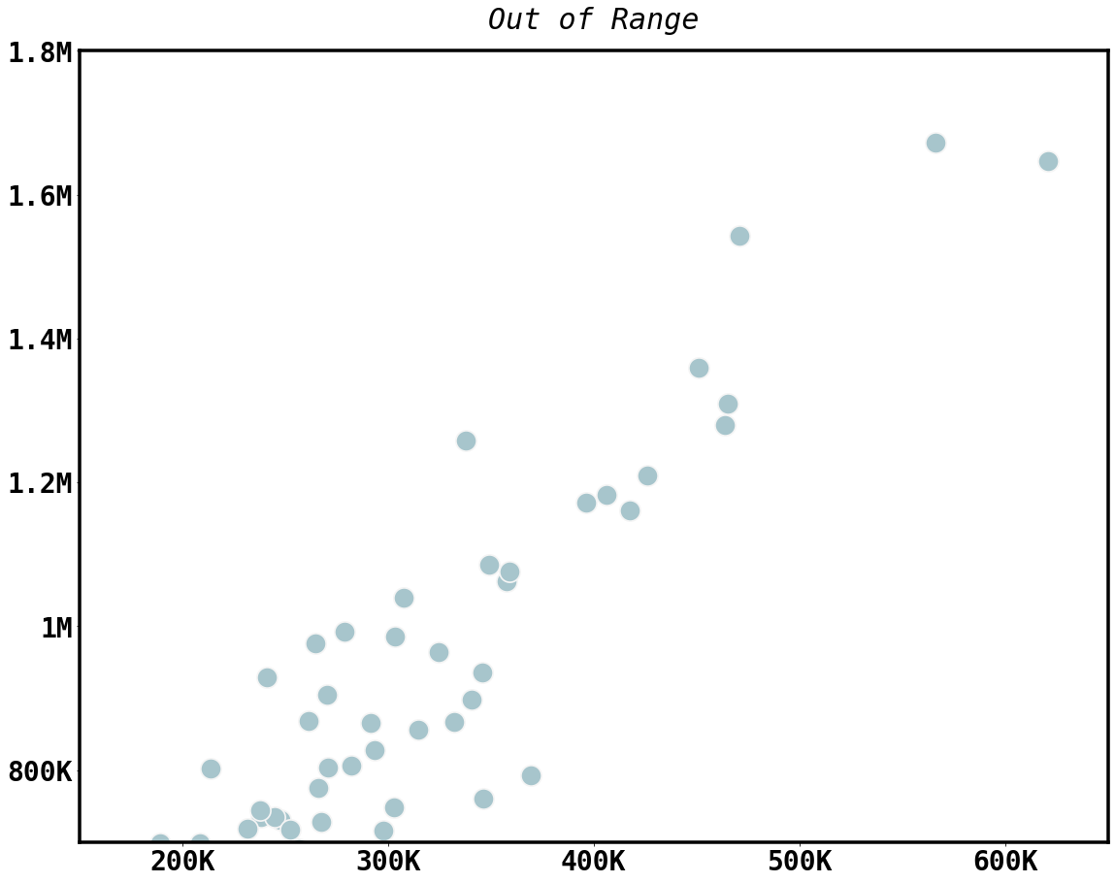

US v Non-US
IMDb Reviewers
NOTE: This based on reviewer location, not citizenship.
French
The Intouchables (2011)
The Great Dictator (1940)
Avengers:
Infinity War (2018)
Notes:
245 Russian
218 Bangla
22 port

Slide 8



THE 3 ‘R’S
RUNTIME
RELEASE
RATING

Slide 9
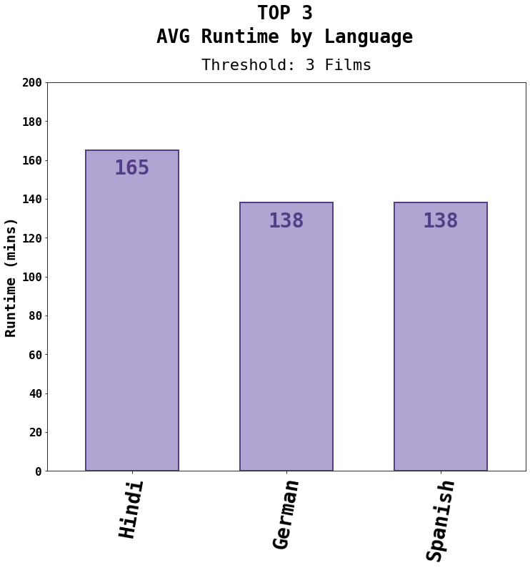
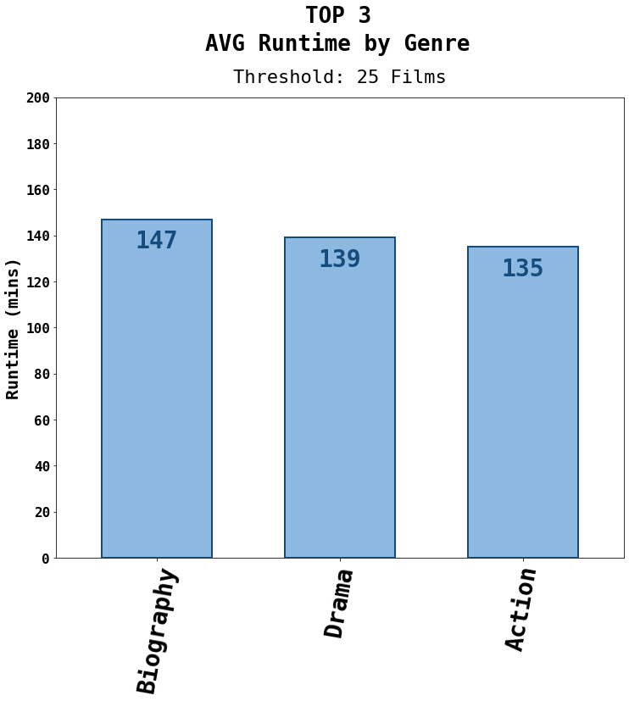
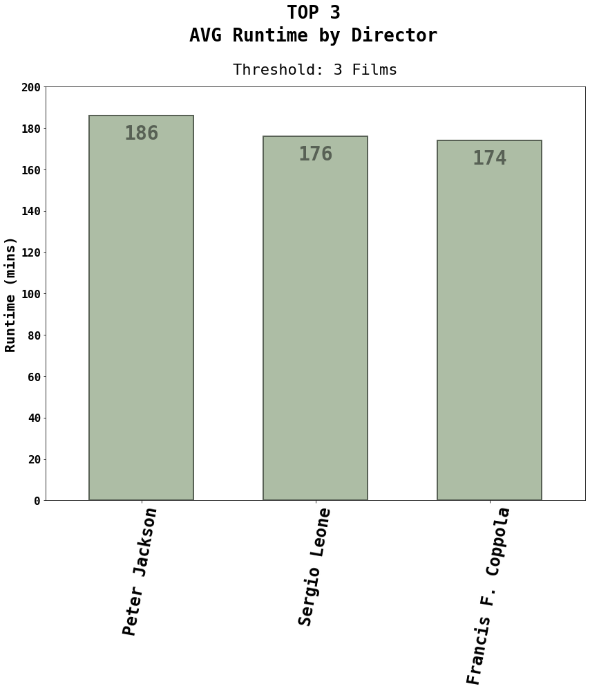
Runtime
Average
Runtime
Longest Movie
238 mins
Gone with the Wind (1924)
Shortest Movie
45 mins
Sherlock Jr.
(1924)
129 mins

Slide 10
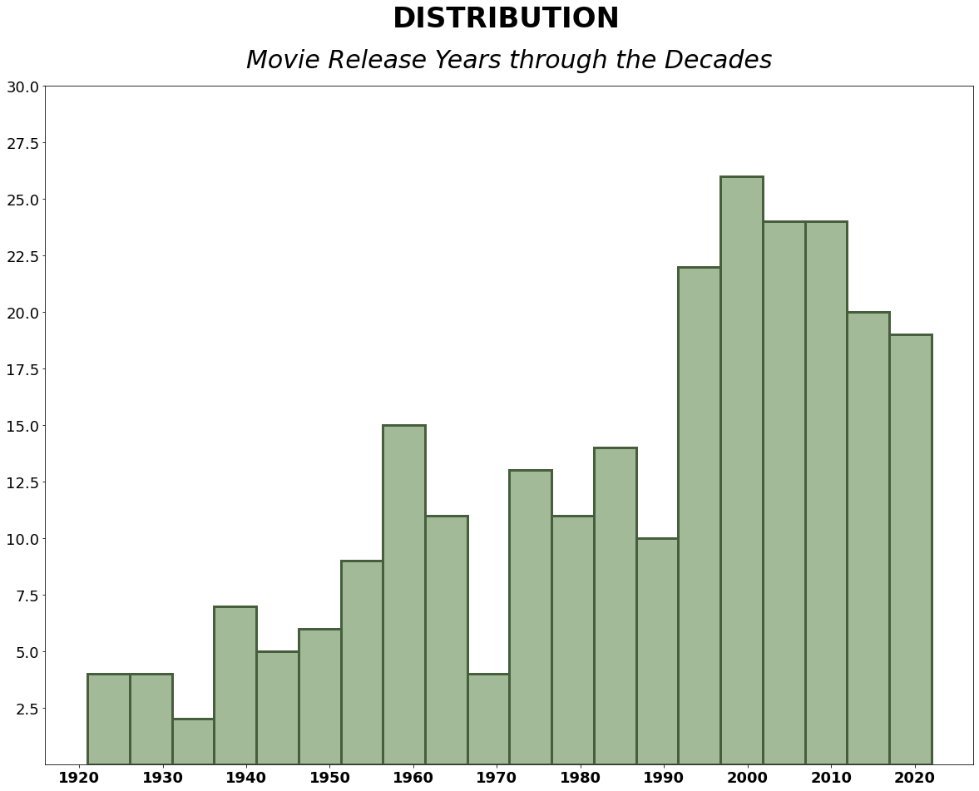

Release
Range of Years 1921-2022
Notes:
Most films were release from 2000-2009

Slide 11
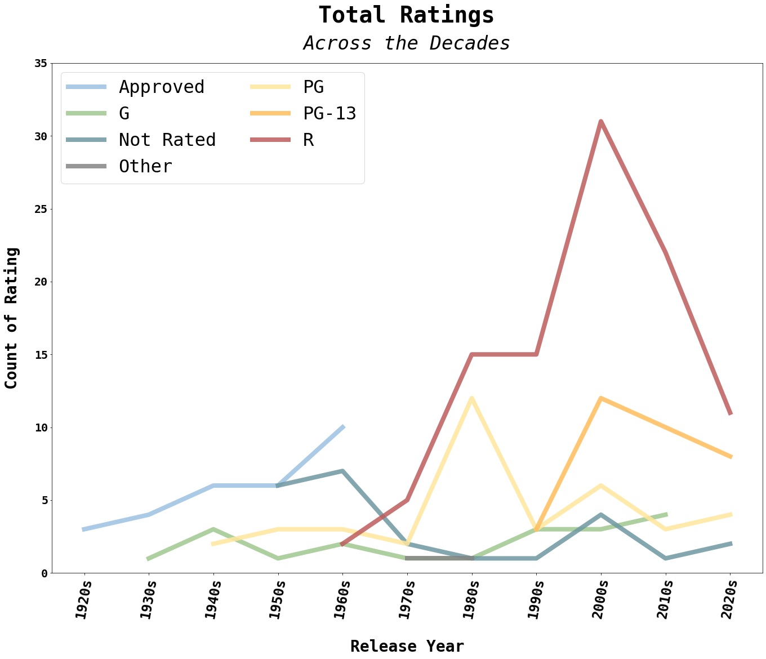
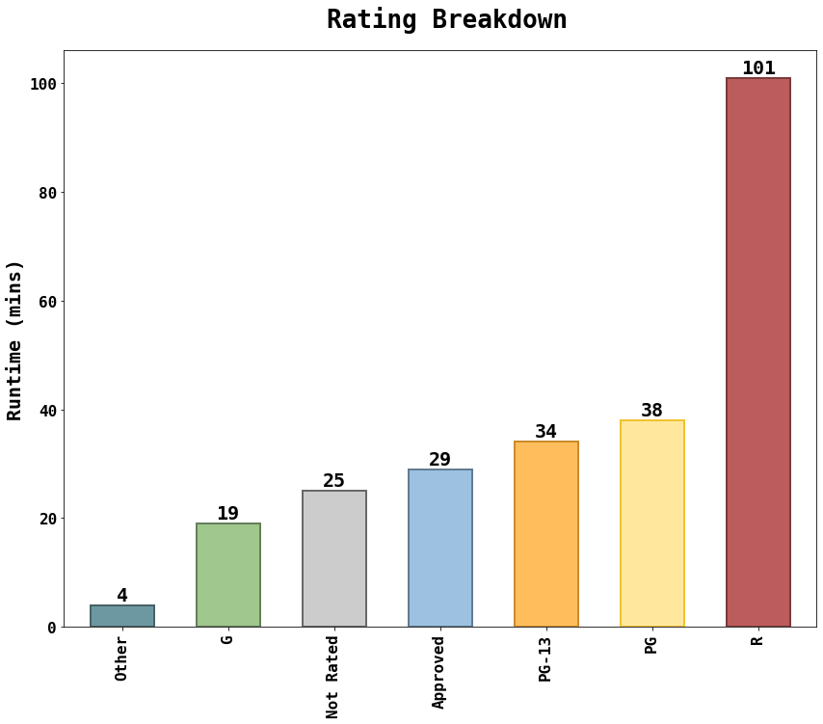

Rating
40.4%

Slide 12


SHOW DOWN

Slide 13
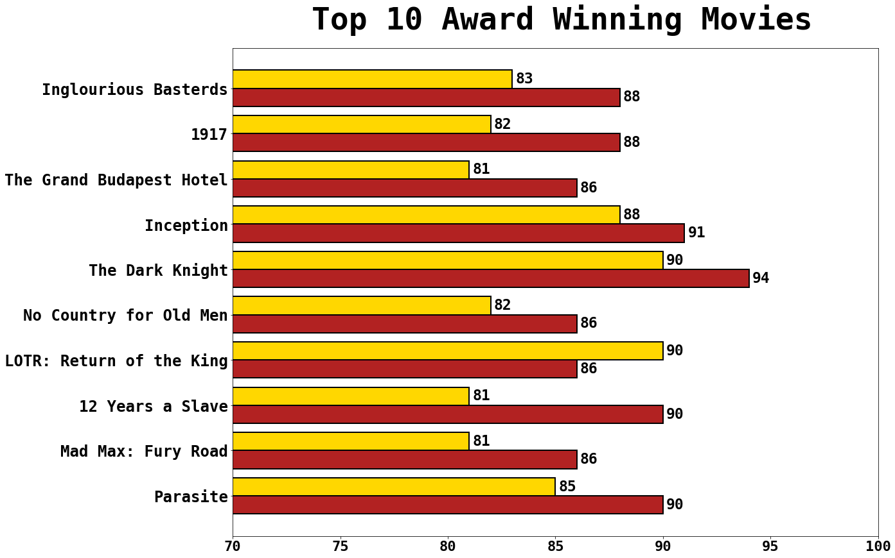
Award Winning
Greatest Difference: 12 Years a Slave 9%
Least Difference: *Inception 3%
Highest Rotten Tomatoes: The Dark Knight 94%
Highest IMDb: The Dark Knight & LOTR (tie) 90%
*The only example where IMDb has a higher score than Rotten Tomatoes

Slide 14

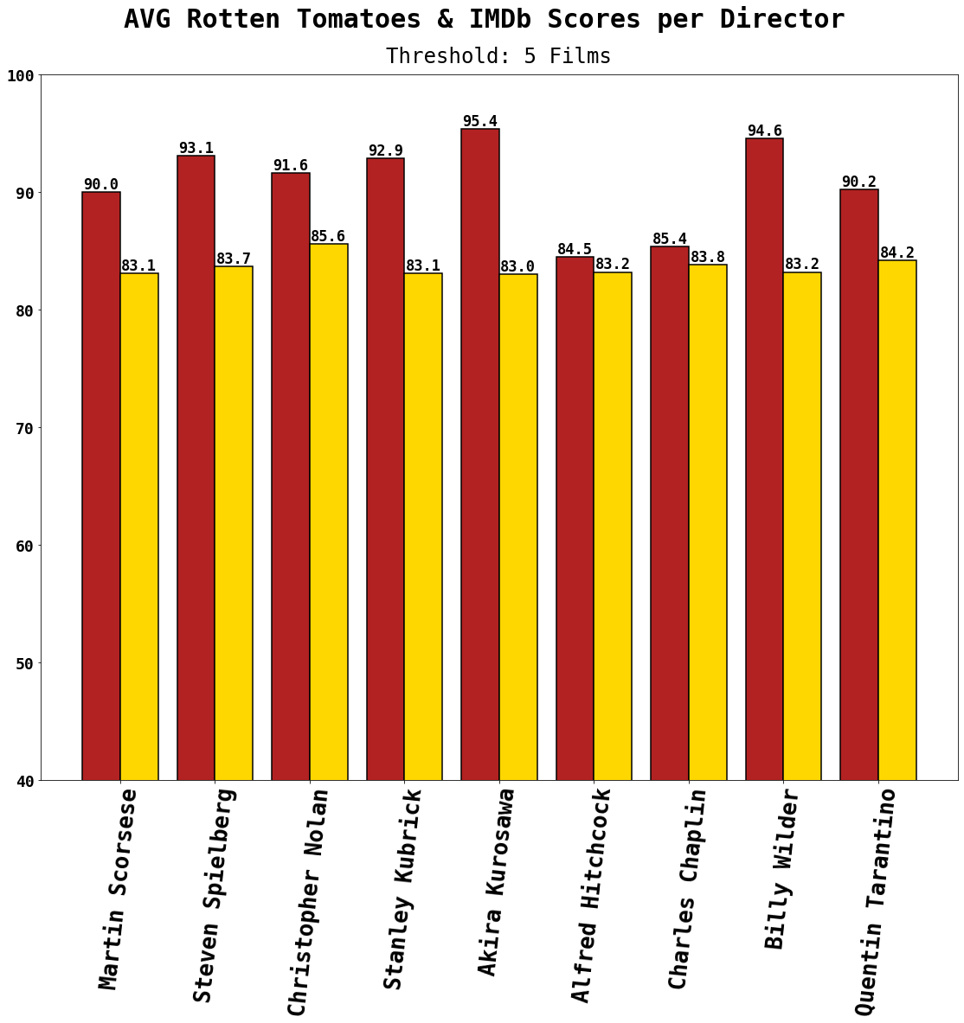

Director
Greatest Difference: Akira Kurosawa 12.4%
Least Difference: Alfred Hitchcock 1.3%
Highest Rotten Tomatoes: Akira Kurosawa 95.4%
Highest IMDb: Christopher Nolan 85.6%

Slide 15
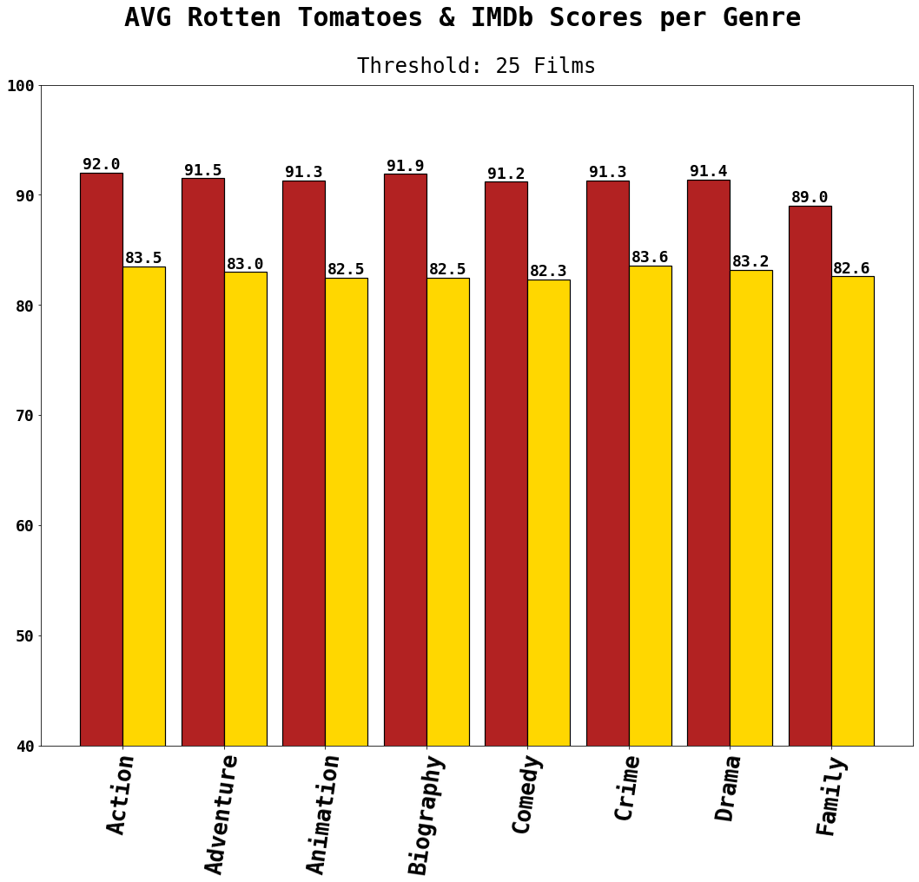
Genre
Greatest Difference: Biography 9.4%
Least Difference: Family 6.4%
Highest Rotten Tomatoes: Action 92.0%
Highest IMDb: Crime 83.6%

Slide 16

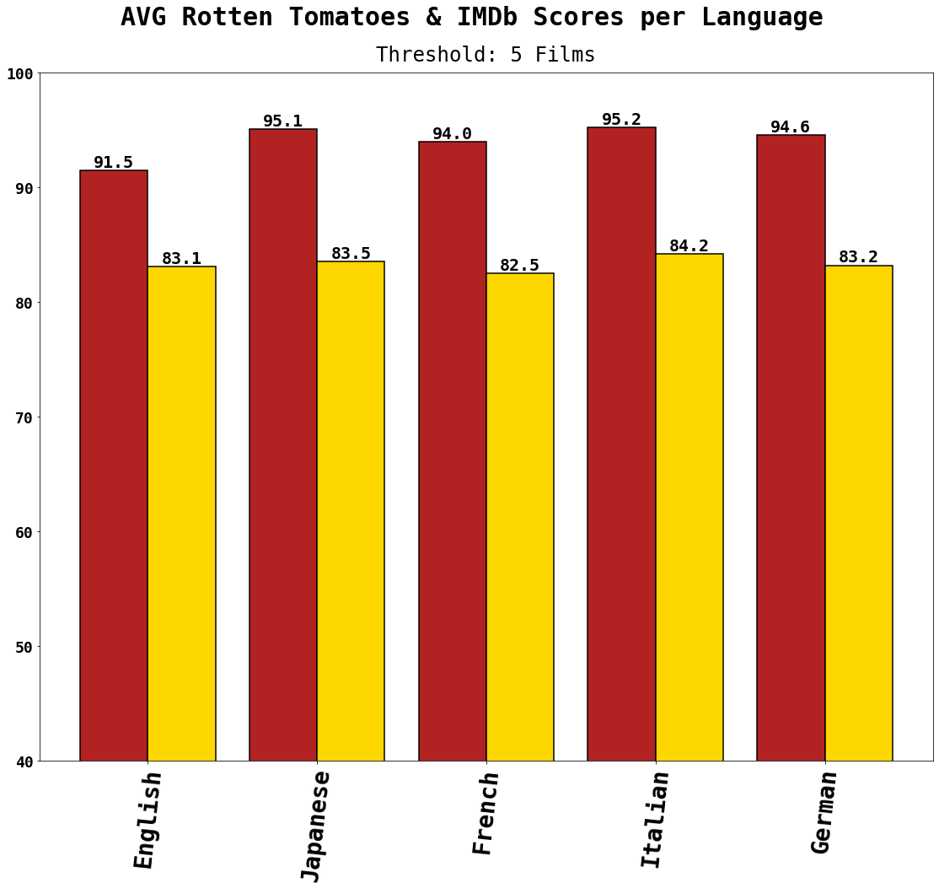
Language
Greatest Difference: Japanese 12.7%
Least Difference: English 8.4%
Highest Rotten Tomatoes: Italian 95.2%
Highest IMDb: Italian 84.2%

Slide 17

Is one score site “better” than the other?
IMDb
Rotten Tomatoes
More Detailed
Breakdown of Reviewers
& IMDb Pro
Critic & Audience Scores
PRO
No Critic Scores (uses Metascore)
Contains More Errors
i.e. Typos, Incomplete Information
& Review Counts Not Exact
CON

Slide 18

Through this analysis, if there had to be a site that comes out on top…
…the winner would be…

Slide 19
Thank You

