Slide 1

Mid-project
Analyzing Customers Spending Habits Dataset

Slide 2

STP framework Segmentation Target Positioning

Slide 3
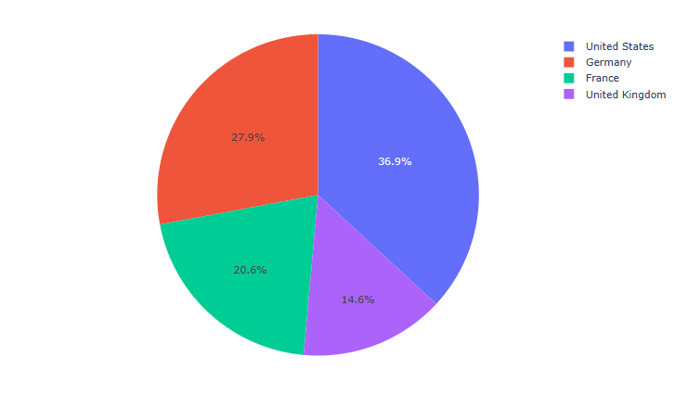
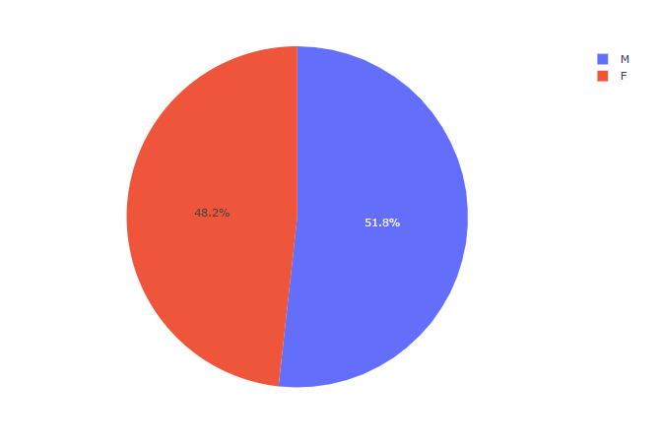
Population distribution

Slide 4
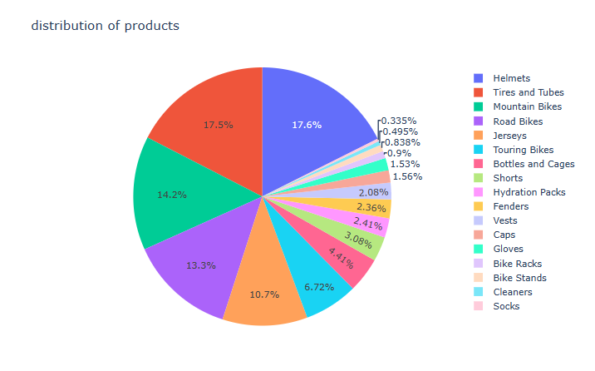
Sub Product distribution

Slide 5
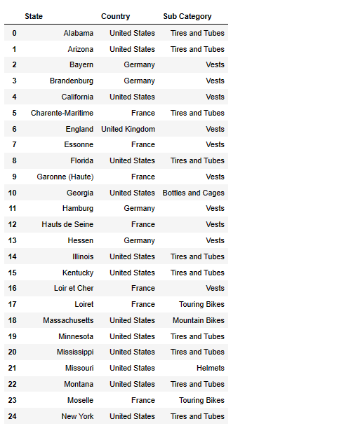
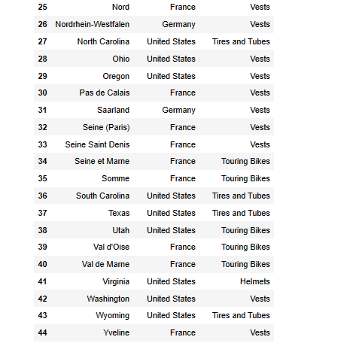
Best selling in each state

Slide 6
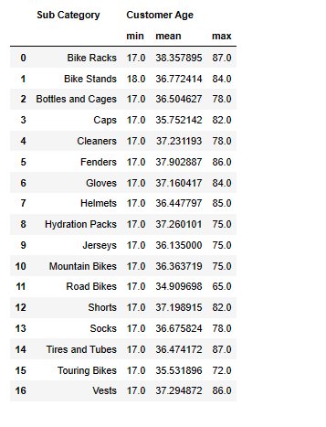
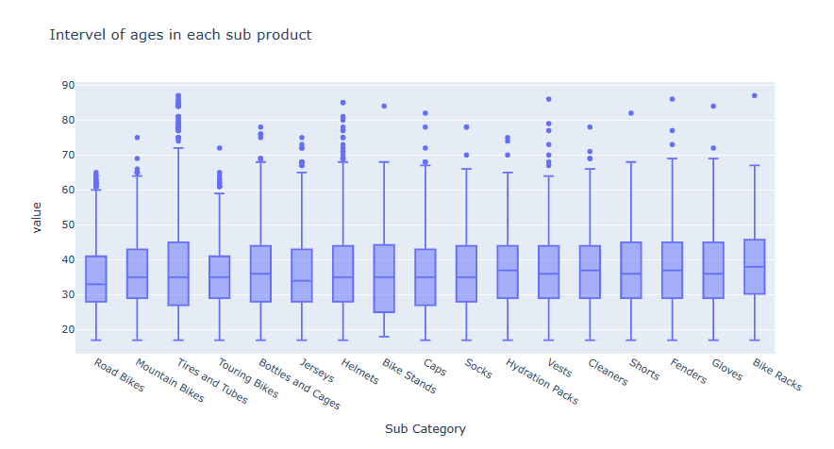
Interval of ages for each Sub category

Slide 7
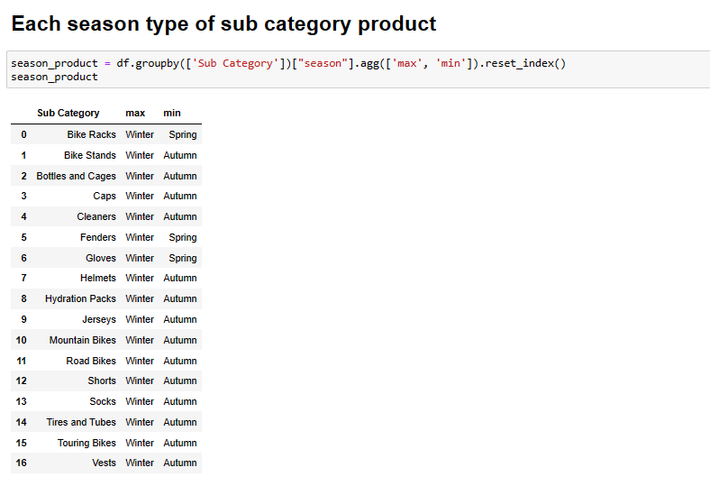
Each season sub category

Slide 8
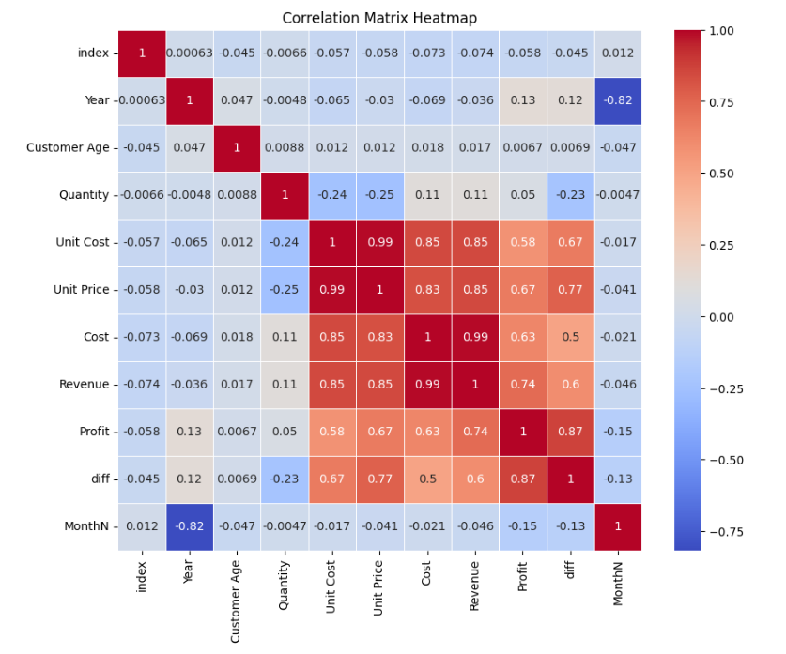
HeapMap

Slide 9
Pre Processing Steps
1# Split the data into input & output
1
2# dealing with categorical data
2
3# split data into train and test
3
4# Scaling by RobustScaler
4

Slide 10
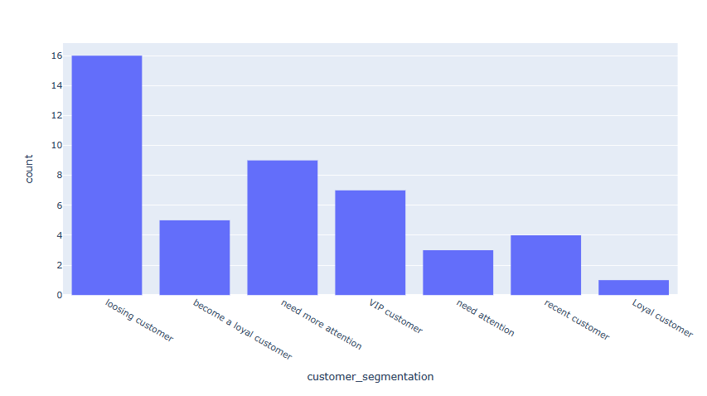
State segmentation

Slide 11
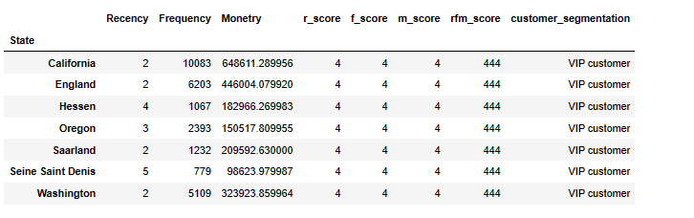
TOP States

Slide 12
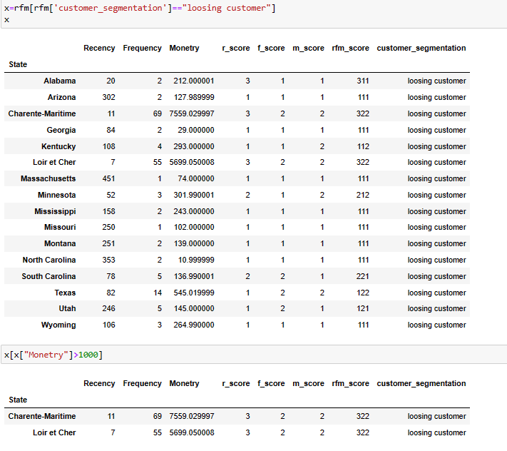
Lossing Customer

Slide 13

Recommendations

Slide 14
Since that the profit of top 5 states { California , England ,Hessen ,Oregon , Sarraland } was from Vests although those states was in different countries
So I recommend for those states { Wyoming , Mississippi ,Arizona , Alabama , Kentucky , South Carolina , Texas } to increase their profit is to import vests and to add it to their market beside tires & tubes
For the Vest target ages from 17 years old to 38 years old in their marketing campaign while for the Tiers & Tubes target ages from 27 years old to 40 years old in their marketing campaign

Slide 15
THANK YOU ☺

