Slide 1

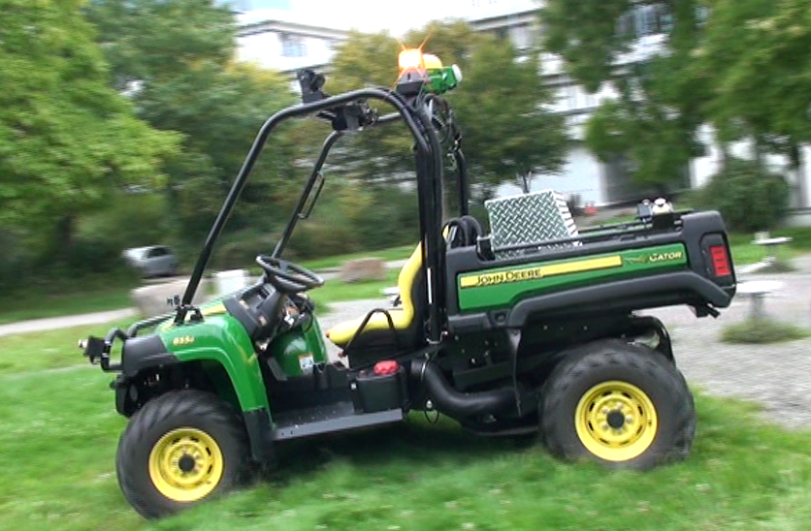
Drive on Pedestrian Walk. TUK Campus Dataset
HANNAN EJAZ KEEN, QAZI HAMZA JAN, KARSTEN BERNS
Robotics Research Lab
Department of Computer Science
Technische Universität Kaiserslautern, Germany
Notes:
Hello Ladies and Gentlemen. I am Hannan Ejaz Keen working as PhD. Student in Robotic Research Lab TU Kaiserserslautern. Today, I am presenting a work which I, along my coauthors, have done recently entitled as “Drive on Pedestrian Walk. TUK Campus Daataset”.

Slide 2
Introduction
A multisensor dataset is presented (captured in university campus area within the speed of 5-7km/h) to facilitate the ongoing research towards autonomous driving in pedestrian zones.
Sensors
Trimble GPS/INS Microstrain IMU
Ouster OS0-128 Sick Front and Side scanners
Bumblebee Stereo camera Ricoh Theta S
Available at: https://seafile.rlp.net/d/cbc4ac140f824863b35f/
Notes:
We have collected a novel dataset on our Technische Universitaet Kaiserslautern campus using visual, inertial and laser scanners. This dataset is captured on Ackermann steering based four wheeled vehicle driven over walking speed of 5-7 km/hour in pedestrian zones.

Slide 3
Salient Features
State-of-the-art multi-sensor data
360 degree visual and lidar coverage
Variable Weather Conditions
Day-Night Data
Pedestrian Volume
Loop Closures
Parking Areas
Ground Truth
Notes:
Multiple state-of-the-art sensors are attached to cover vehicle from all sides for safe navigation. The dataset is recorded over variable weather conditions such as sunny, cloudy, rainy and variable light intensity time such as day as well as night time. This dataset includes variable pedestrian volumes and loop closures in each sequence which proved to be very helpful for learning and SLAM algorithms. The data is captured in parking areas of campus. The ground truth of each sequence is physically measured with a precise Starfire 6000 GPS and is provided with each sequence.

Slide 4
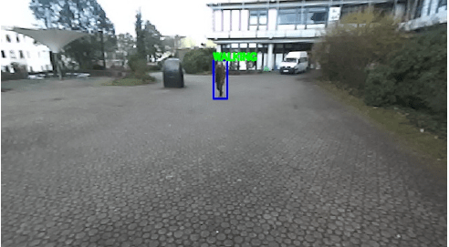
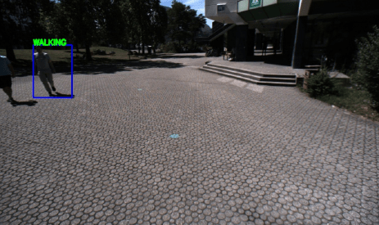
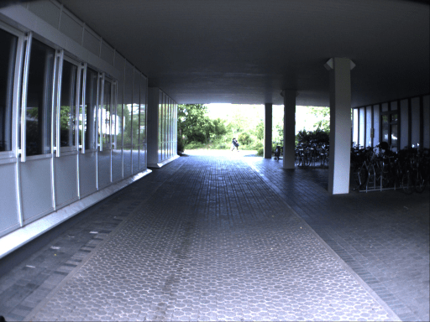
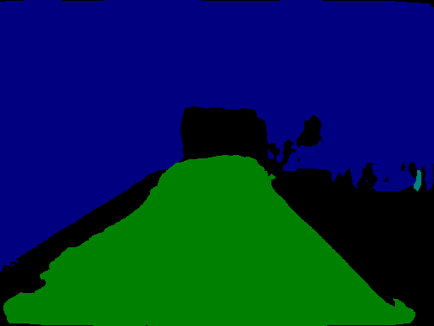
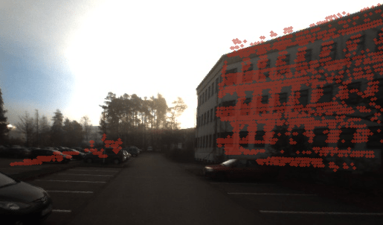
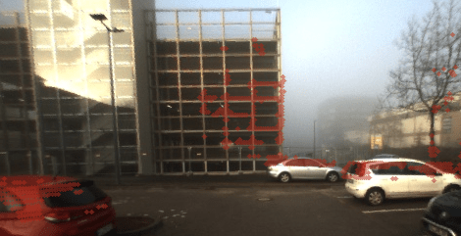
Evaluation
Pedestrian Activity Detection
3d to 2d mapping
Pixel-wise segmentation
Notes:
We have evaluated our dataset on few algorithms to show the validity of data. Here we have implemented pedestrian avtivity detection where the algorithm detects if the pedestrian is walking, sitting or standing.
To show the validity of our transformation values we have preprocessed the laser scans and projected them over stereo images using the calibration values provided in the data. The figures presented here have shown the accurate mapping of laser scans on images.
Finally we have performed pixel-wise segmentation over 500 labeled and 2000 synthetically created labeled images. The results have shown 92 percent accuracy in finding six major classes.

Slide 5
Conclusion
For easy mobility in lengthy pedestrian zones, autonomous vehicles are under cosideration.
These zones include campus areas, city centers and airports. Therefore, execeptional attention is required for safety of the people.
This paper provides a dataset taken in Technische Universitaet Kaiserslautern (TUK) premises which includes state-of-the-art sensors‘ data in different conditions.
For validity, several well-known algorithms are implemented.
Notes:
Use of Autonomous vehicles for the ease in locomotion is now inevitable. We propose a novel dataset for pedestrian zones and validate it over multiple algorithms to facilitate the ongoing research in this field. Thanks for your time.

