Slide 1

AeroLink Platform
Cloud-Native Architecture Migration
CB011286 Eshan Dineth
AWS
KUBERNETES
TERRAFORM
JWT AUTH

Slide 2


The Problem & Business Goal
The legacy monolithic flight booking system presented critical architectural limitations that made it unsuitable for modern, global-scale operations.
Single Points of Failure
A single service crash could bring down the entire platform — no isolation, no graceful degradation.
Scaling Bottlenecks
Vertical scaling only. Under peak load (e.g., holiday bookings), the monolith could not scale horizontally to meet demand.
Deployment Risk
Every release required a full-system redeploy, increasing downtime risk and slowing feature velocity.
Business Goal: Architect a cloud-native, globally distributed platform achieving 99.999% availability with sub-100ms latency for passengers across all regions.

Slide 3
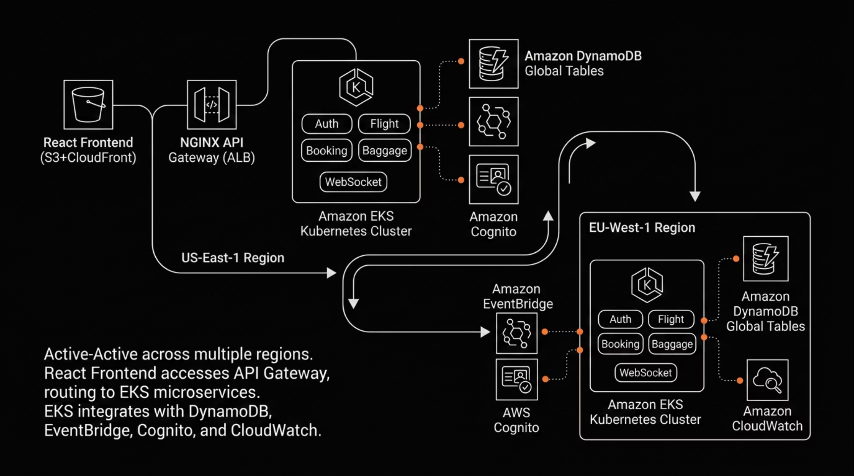
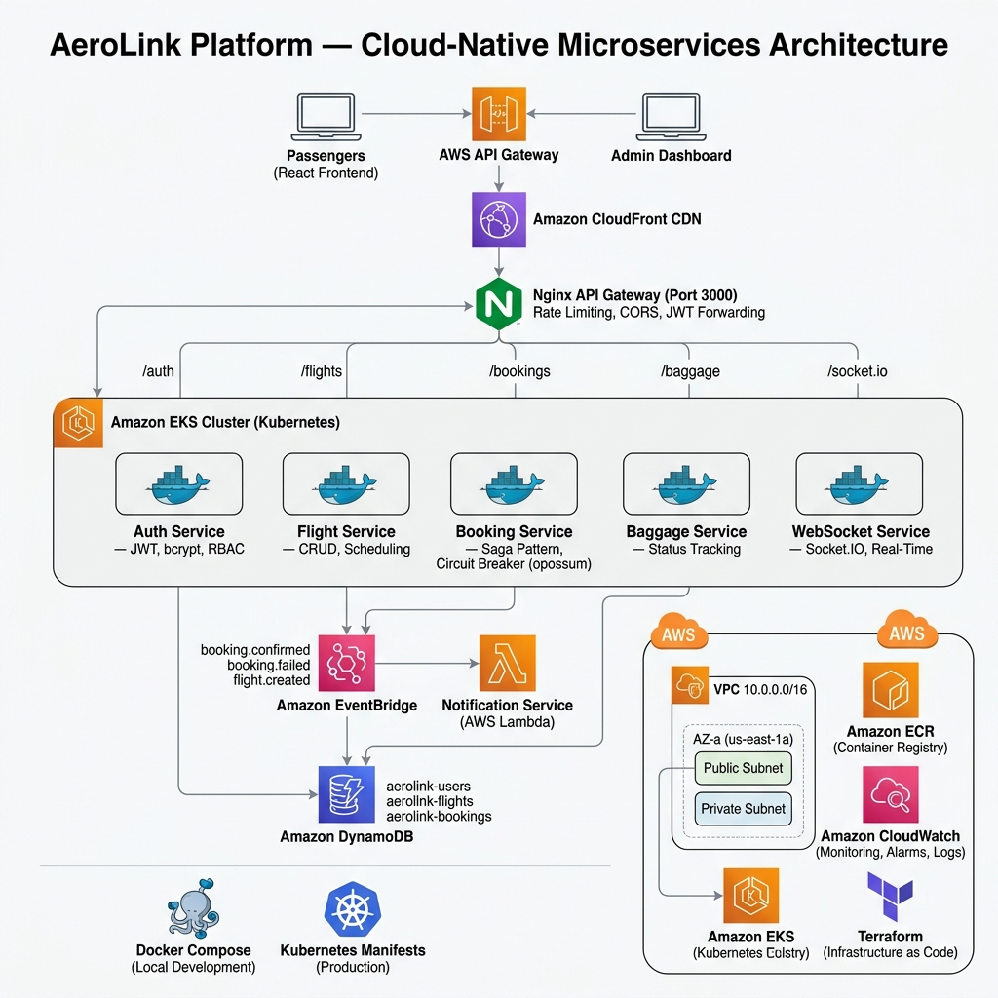
High-Level AWS Architecture
AeroLink's architecture follows a clean separation of concerns — from the React SPA frontend through a centralized API Gateway, into a containerized EKS cluster, and out to purpose-built AWS managed services. Traffic flows through a multi-AZ VPC with public and private subnets, ensuring network isolation and high availability across all tiers.
This layered architecture ensures that each tier can scale independently. The NGINX API Gateway acts as the single entry point, performing request routing, rate limiting, and TLS termination before forwarding traffic to the appropriate EKS service.

Slide 4
Core Microservices & Containerization
AeroLink decomposes the monolith into five independently deployable microservices, each owning its domain logic and data. Docker ensures environment parity; Amazon EKS provides production-grade orchestration with auto-scaling and self-healing.
Auth Service
Flight Service
Booking Service
JWT issuance, refresh tokens, bcrypt password hashing, and RBAC enforcement.
Flight search, schedule management, and availability queries against DynamoDB.
Reservation lifecycle, payment coordination, and Saga-driven distributed transactions.
Baggage Service
WebSocket Service
Baggage allowance rules, tracking, and event-driven updates via EventBridge.
Real-time seat-map synchronization and live booking notifications without page refresh.
Serverless Notification Service
WebSocket Service
Real-time seat-map synchronization and live booking notifications without page refresh.
In parallel with the EKS-based microservices, a Serverless Notification Service runs on AWS Lambda as a lightweight complement to the container platform. EventBridge events trigger Lambda functions to send emails, SMS, and push notifications automatically — without provisioning or managing servers. Because Lambda scales on demand, the notification layer stays responsive during traffic spikes and integrates seamlessly into the event-driven architecture.

Slide 5

Security & Custom Authorization
JWT-Based Authentication Layer
Security Principles Applied
AeroLink implements a custom-built JWT authentication system — avoiding vendor lock-in while maintaining full control over token claims, expiration policies, and refresh flows. Tokens are signed using RS256 asymmetric keys, with short-lived access tokens (15 min) and rotating refresh tokens.
Zero-trust network model
Least-privilege IAM roles per service
TLS 1.3 in transit
Encrypted secrets via AWS Secrets Manager
Rate limiting to prevent brute-force attacks
Password Hashing
All credentials are hashed using bcrypt with a cost factor of 12 before storage in DynamoDB.
Stateless RBAC
Role-Based Access Control is encoded in JWT claims — each microservice independently validates permissions without a central auth lookup.
API Gateway Enforcement
NGINX validates JWT signatures at the edge, rejecting unauthorized requests before they reach the EKS cluster.

Slide 6

Database & Multi-Region Strategy
AeroLink uses Amazon DynamoDB as its primary datastore — a fully managed, serverless NoSQL database offering single-digit millisecond latency at any scale. The critical differentiator is DynamoDB Global Tables, which provide Active-Active multi-region replication.
<10ms
99.999%
Read Latency
Availability SLA
Local region reads via Global Tables replication
Multi-AZ + multi-region redundancy
3
0
Regions Active
Downtime for Failover
us-east-1, eu-west-1, ap-southeast-1
Automatic cross-region failover via Global Tables
Why Global Tables? Passengers in London, Singapore, and New York all write to their nearest region. Changes replicate asynchronously within seconds, eliminating cross-ocean latency for booking operations.

Slide 7

Event-Driven & Real-Time Sync
AWS EventBridge — Async Event Bus
WebSocket — Live Seat-Map Sync
AeroLink uses Amazon EventBridge as a central event bus to decouple services. When a flight status changes, the Flight Service publishes an event — Booking, Baggage, and Notification services consume it independently without direct coupling.
The dedicated WebSocket Service maintains persistent connections with clients. When a passenger selects a seat, the change broadcasts in real time to all other viewers of that flight — no polling, no page refresh.
Flight Status Updates
Booking Confirmations
Propagated to all dependent services asynchronously
Triggers baggage allocation and email notifications
Dead Letter Queues
Failed events captured for replay and audit

Slide 8

Resilience & Fault Tolerance
Distributed systems introduce failure modes that monoliths never faced. AeroLink implements two critical patterns to ensure graceful degradation and data consistency under partial failure.
Saga Pattern — Distributed Transactions
Circuit Breaker — Cascading Failure Prevention
Booking a flight involves multiple services (Flight → Booking → Payment → Baggage). If any step fails, compensating transactions roll back prior steps — e.g., releasing a held seat if payment fails. Sagas are orchestrated via EventBridge with explicit compensation logic in each service.
Using the opossum library, each service wraps outbound calls with a circuit breaker. When a downstream service exceeds an error threshold, the circuit opens — returning a cached response or graceful fallback instead of waiting on a failing dependency. This prevents a single degraded service from collapsing the entire platform.
Open
Closed
Half-Open
Monitor
The circuit breaker transitions through three states — Closed during normal operation, Open when failures exceed the threshold, and Half-Open to probe for recovery — ensuring the system self-heals without manual intervention.

Slide 9
DevOps & Infrastructure as Code
AeroLink's entire AWS infrastructure is provisioned via Terraform, enabling reproducible, version-controlled environments. The GitOps pipeline automates everything from code commit to production deployment.
01
02
Code Commit
Build, Scan & Publish
Developer pushes to GitHub — pipeline triggers on main branch.
GitHub Actions builds Docker images, runs Trivy security scans, and pushes approved images to Amazon ECR.
03
04
Terraform Provisioning
ArgoCD Sync
Terraform defines and provisions AWS resources such as VPC, EKS, DynamoDB, EventBridge, and supporting IAM and networking components. State is managed centrally so infrastructure changes are repeatable, reviewed, and reproducible.
ArgoCD follows a declarative GitOps model, automatically syncing Kubernetes manifests from Git to the cluster so the live state matches the repository.
05
Production Deployment
ArgoCD keeps the cluster continuously aligned with Git, supports rollbacks to a known-good revision, and ensures infrastructure and application versions remain consistent across environments.
How it works: Terraform manages infrastructure state and versioning for AWS resources, while ArgoCD continuously reconciles Kubernetes workloads with the Git repository. Together, they provide a fully reproducible platform from commit to production.

Slide 10




Performance Testing & Monitoring
Load Testing with Artillery
AeroLink conducted extensive load testing using Artillery to simulate real-world traffic patterns and peak booking scenarios. Tests simulated concurrent users during holiday seasons, flash sales, and global traffic spikes.
Key Load Test Results:
10,000%
45%
50,000%
Concurrent Users
Avg. Response Latency
Requests/Second
Sustained for 30 minutes
(p95: 120ms, p99: 250ms)
Peak throughput
0%
<2%
Errors Under Load
Failover Time
AWS CloudWatch Monitoring
Zero errors under sustained load
Multi-region failover validated
Real-time dashboards track critical metrics across all layers:
Microservices Metrics:
Database Metrics:
Infrastructure Metrics:
Request latency per service (Auth, Flight, Booking, Baggage, WebSocket)
Error rates and HTTP status code distribution
Container CPU and memory utilization in EKS
DynamoDB read/write capacity consumed
Global Tables replication lag (<100ms)
Query latency percentiles
EKS node health and pod status
EventBridge event throughput and dead-letter queue depth
Lambda invocation count and duration
CloudWatch Alarms & Auto-Scaling
Automated alerts trigger when thresholds are breached:
Latency exceeds 500ms → SNS notification to on-call team
Error rate >1% → Auto-scale EKS pods horizontally
DynamoDB throttling detected → Increase provisioned capacity
Lambda cold starts >5s → Provision reserved concurrency
99.999% SLA Maintenance
With 5 nines availability (52.6 seconds downtime per year), AeroLink relies on:
Continuous monitoring to detect issues before they impact users
Multi-region active-active deployment with automatic failover
Circuit breakers and graceful degradation to isolate failures
Regular chaos engineering tests to validate resilience
Post-incident reviews to improve observability and response times

