Slide 1
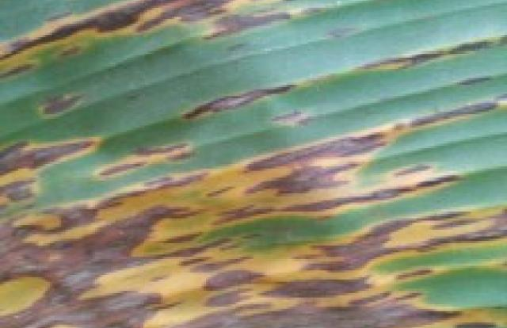
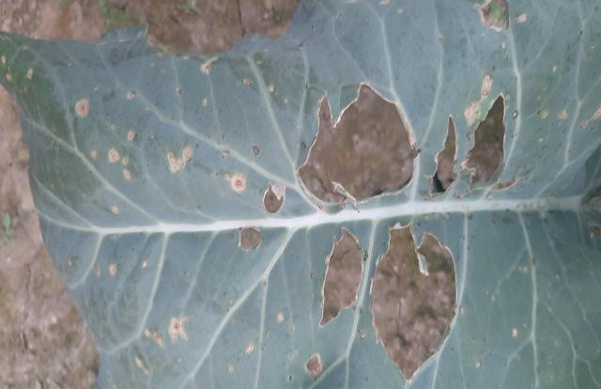
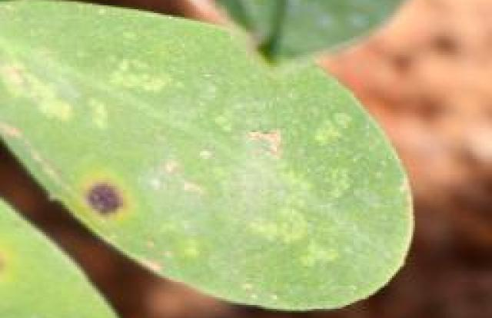
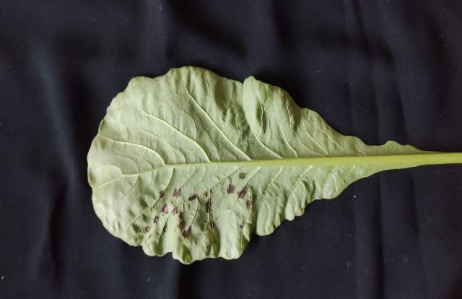
FINAL YEAR PROJECT / SEMINAR
Federated learning for crop-disease detection
BANANA
CAULIFLOWER
GROUNDNUT
RADISH
AGRI VISION
Detecting crop symptoms. Comparing lightweight one-stage detectors.
Hannan Rehman • Fuzail Talpur • Ali
Supervisor: Dr Rabeea Jaffari
ABSTRACT
Agri Vision investigates crop-disease and pest-symptom detection using bounding boxes and disease labels. A three-client federated-learning simulation trains a shared detector across separate data partitions. The revised study covers banana, cauliflower, groundnut and radish across 24 classes. SSDLite, SSD–MobileNetV3 and EfficientDet-D0 are being compared with the retained historical YOLOv8n baseline.
PROBLEM STATEMENT
• Small lesions and similar symptoms make visual diagnosis difficult.
• Uneven class representation and variable image quality affect detection.
• A useful detector must balance precision, recall, localisation and computing cost.
AIM AND OBJECTIVES
Develop and assess an efficient federated crop-symptom detector.
• Use one verified 24-class dataset with fixed train, validation and test splits.
• Compare four complete one-stage detectors through separate experiments.
• Measure precision, recall, mAP, inference speed and model size.
METHODOLOGY
Shared 24-class dataset → fixed three-client partitions → independent detector experiments
CLIENT 1 • LOCAL TRAINING
CLIENT 2 • LOCAL TRAINING
CLIENT 3 • LOCAL TRAINING
TRAINING-IMAGE-WEIGHTED FEDAVG → GLOBAL DETECTOR
YOLOv8n
SSDLite
SSD–MobileNetV3
EfficientDet-D0
Train locally → aggregate → validate → save best/latest checkpoint → repeat
Each architecture has its own weights and run. Clients are simulated sequentially on one GPU; this is not a deployed multi-device network.
RESULTS AND CURRENT PROGRESS
PROVISIONAL 24-CLASS VALIDATION
Detector
Round
Precision
Recall
mAP50–95
SSDLite
10
66.44%
51.17%
39.06%
SSD–MobileNetV3
10
57.92%
47.61%
30.30%
EfficientDet-D0
2
56.75%
68.36%
46.68%
Banana
Cauliflower
Same 4,157-image pooled validation split. P/R: confidence 0.25, IoU 0.50. EfficientDet has completed only two rounds; these scores do not establish a final winner.
Sigatoka
Black Rot
HISTORICAL YOLOv8n • ROUND 40
Precision 66.27% Recall 57.43%
mAP50 59.55% mAP50–95 38.81%
30-class training; validation-image-weighted native client summaries. A common 24-class evaluation of this checkpoint is pending; the scores above are not directly comparable.
Groundnut
Radish
Early Leaf Spot
Black Leaf Spot
Labelled validation examples • yellow boxes are ground truth
TECHNOLOGIES USED
SUMMARY
Python
PyTorch
The revised study contains four crops and 24 classes. The historical round-40 YOLO baseline is retained. The other three detectors will continue toward round 30. Final conclusions require completed runs, common evaluation and measured deployment cost.
Data & experiment tools
Detector implementations
Ultralytics
Colab + Drive
Historical YOLOv8n
GPU runs & checkpoints
NEXT: complete training • evaluate retained YOLO on 24 classes • compare accuracy, speed and size
DATA: 14,514 train / 4,157 validation / 2,091 test • 3 simulated clients • Progress snapshot: 10 October 2026

