Slide 1
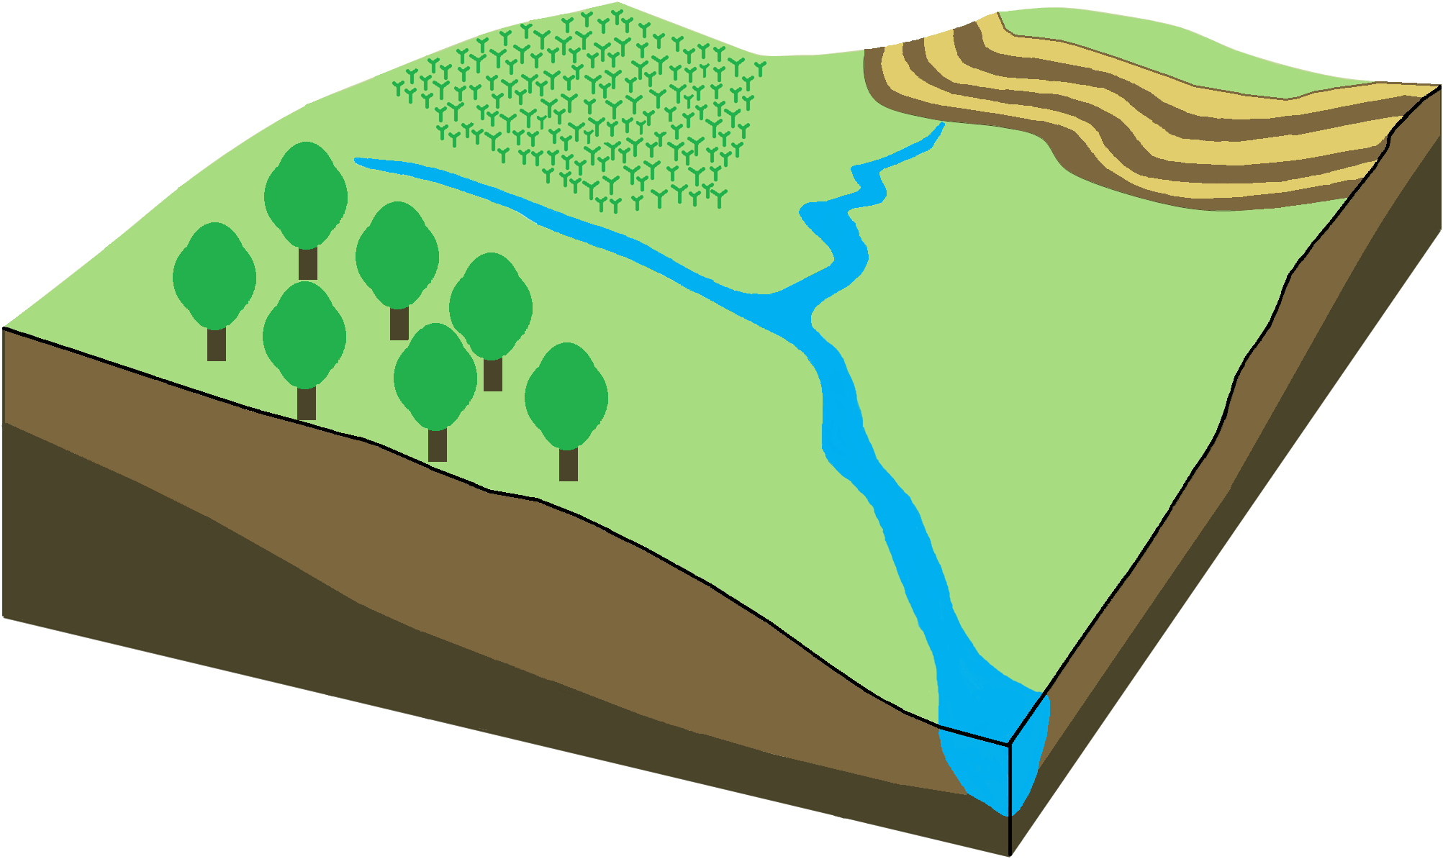
Introduction
Chapter 1
Field Scale
AquaCrop model development and evaluation (RO1)
Chapter 2
Chapter 3
Chapter 4
Model application for scenario analysis (RO2)
Chapter 5
Catchment Scale
AquaCrop-Hydro model development and evaluation (RO3)
Chapter 6
Model application for scenario analysis (RO4)
Chapter 7
Conclusions and Recommendations
Chapter 8

