Slide 1

sFish User Manual
Version 1.0.1

Slide 2
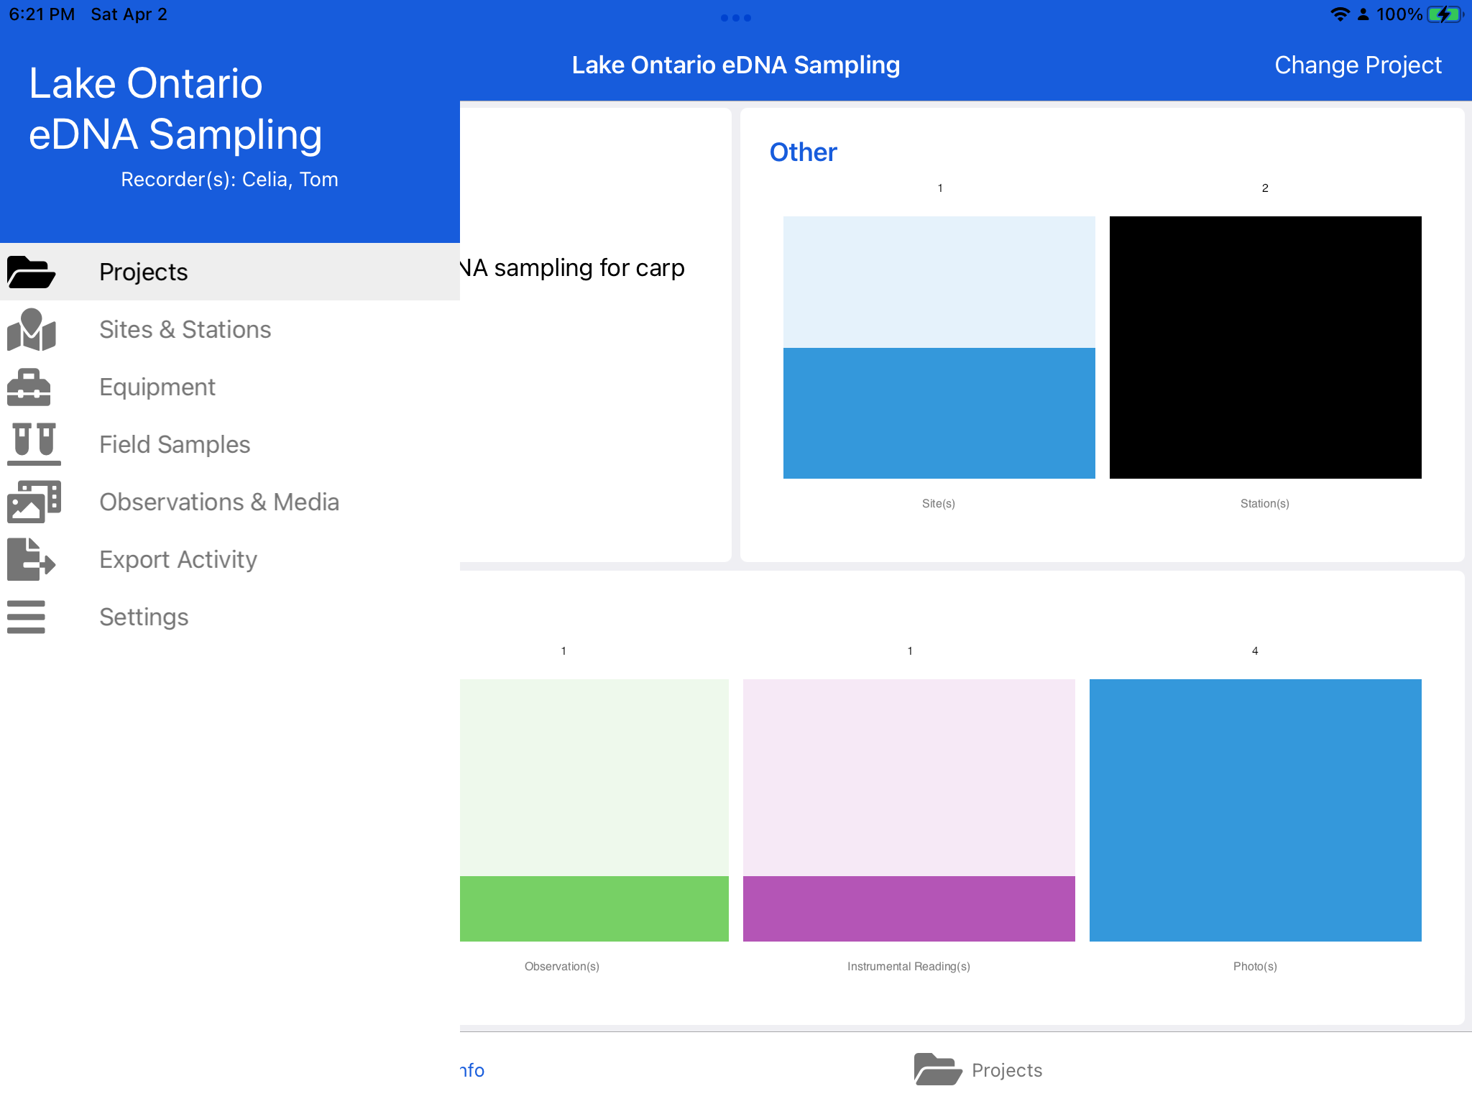
Overview
Name of the active project
Name(s) of the current app operators/data recorders
Project page:
View project dashboard
Change active project
Manage projects
Data entry pages:
- Add, delete, or modify collected data
Export page:
Export data
Manage and view previous exports
Settings page:
- manage user app settings and cloud sync

Slide 3
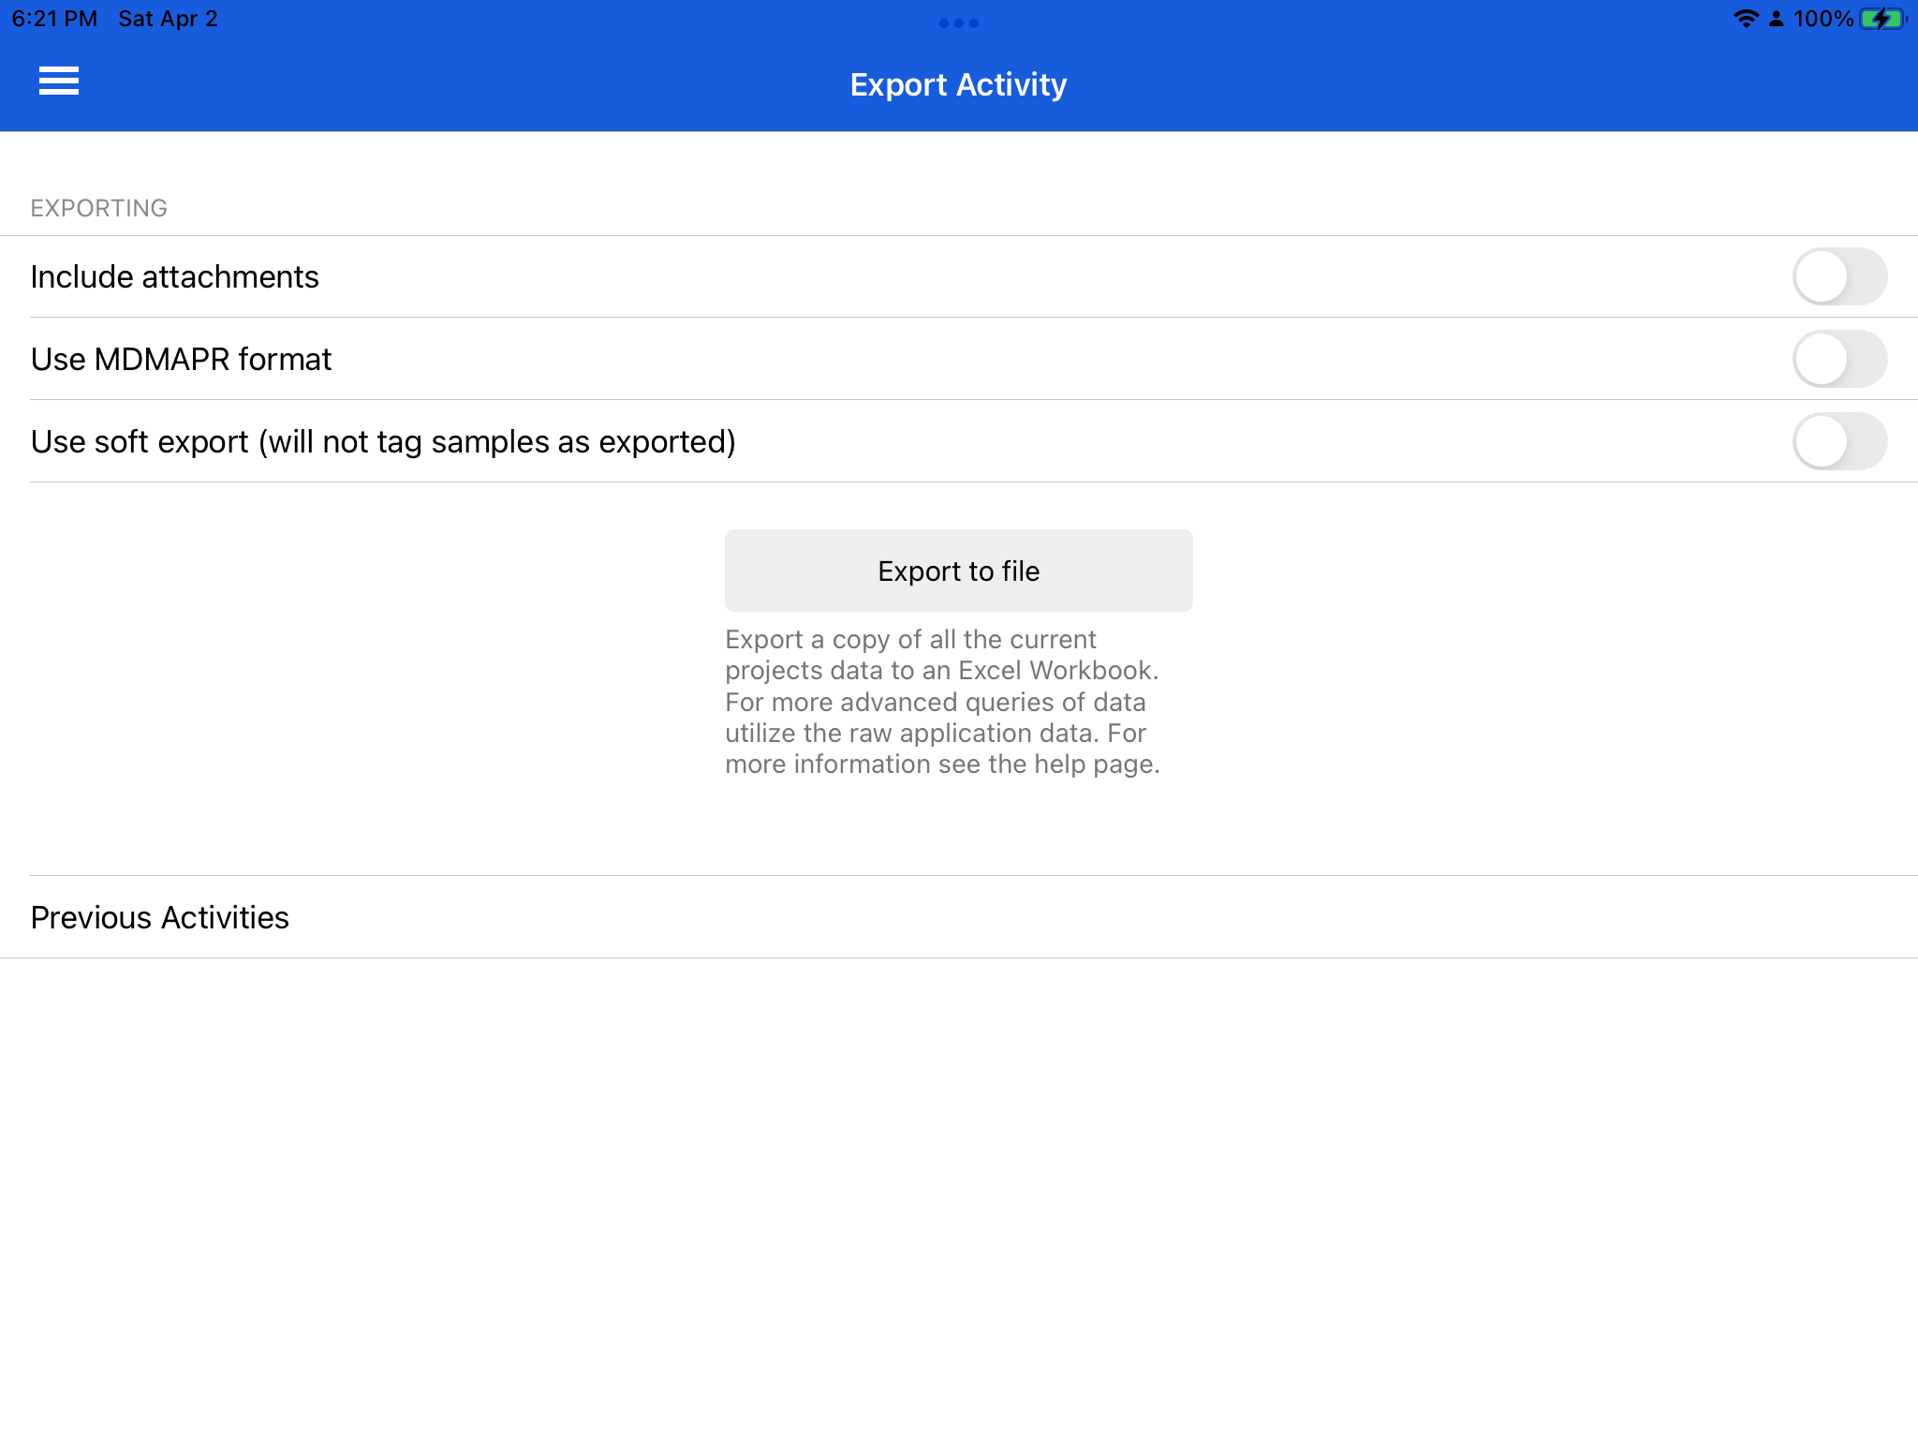
Exporting
If selected, the export file will contain a copy of all attached photographs. Selecting this option will increase export time and size.
If selected, an MDMAPR compatible format will be used. Defaults to the normal sFish format otherwise.
If selected, exporting will no longer have side effects on the applications data. Select this option if you would like to export the same data multiple times or would like to export data without tagging them as exported.
Opens an export activity menu to create an export.
View all previous exports (soft exports will not show up)

Slide 4
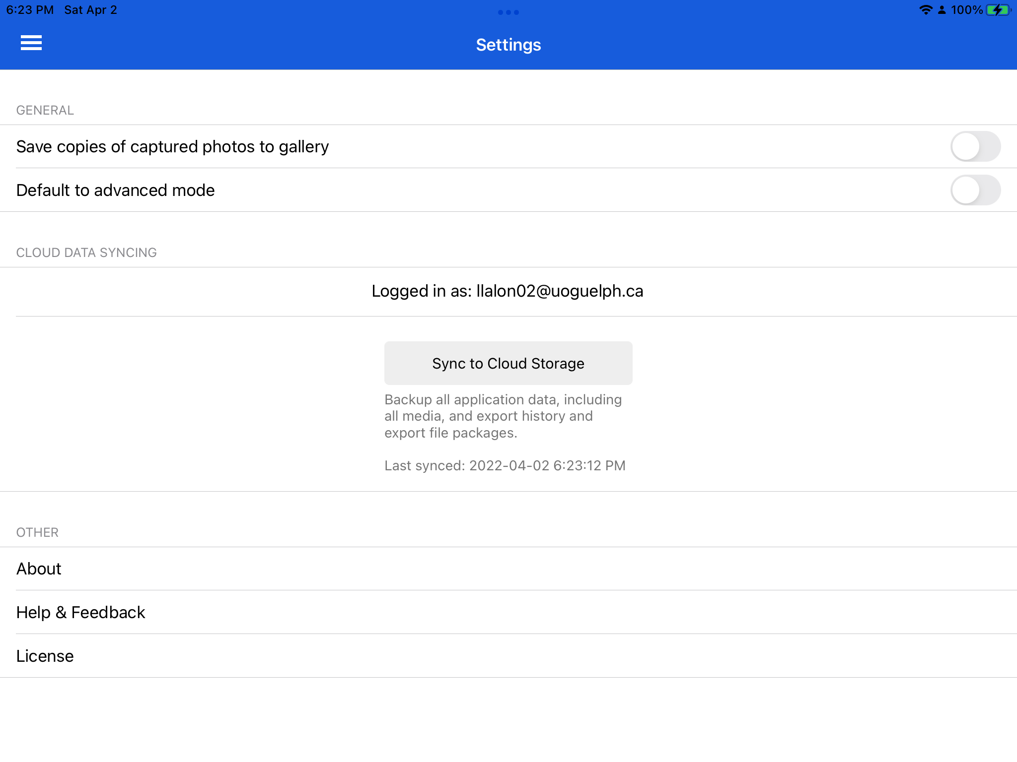
Settings & Sync
If selected, a copy of all captured photos will be saved to the device photos.
If selected, all new entities will open in advanced mode.
Username of currently signed in Dropbox user (tap to sign-out).
Sync data to Dropbox

Slide 5
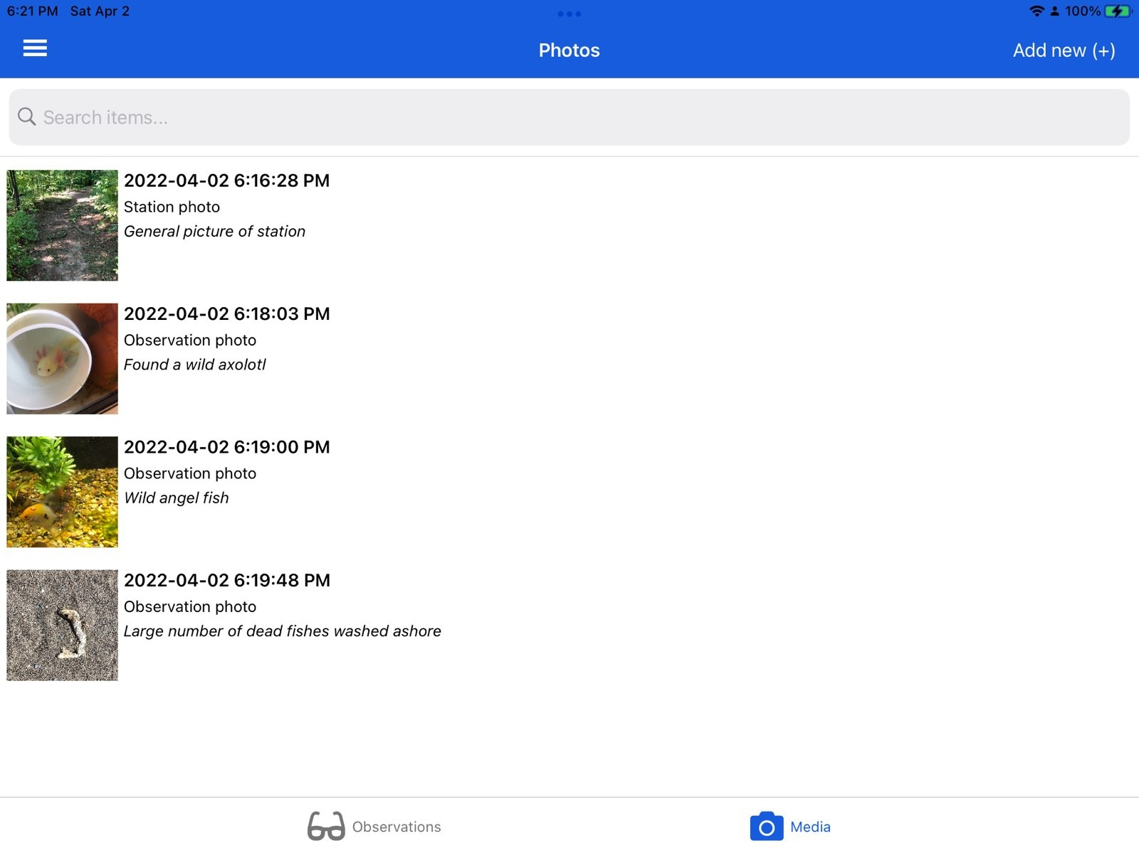
Entity List
Each of the available collectable entities (sites, stations, samples, observations) has a similar flow. The entity list pages show a list of all the currently added and un-exported entities.
Add a new entity of the specific type
Search bar: filter list by query
Entity list: all the currently collected items of the specific type
Specific entity: tap to open/edit

Slide 6
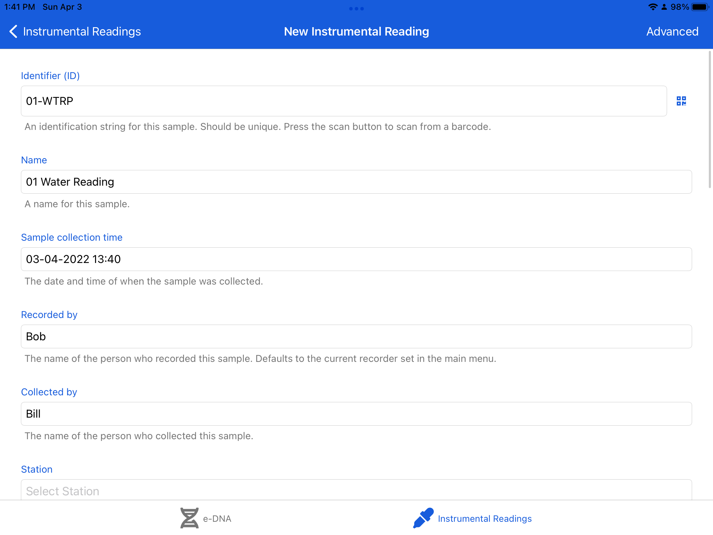
Entity Form
Each of the available collectable entities (sites, stations, samples, observations) has a similar flow. The entity form allows for creating, editing, or deleting an entity.
Toggle advanced and basic view mode
Scan ID from barcode
Entity fields: add the required data in the form

Slide 7
Helpful Links
Homepage
Issues and support

