Slide 1

Deploying a Static Website Using GitHub

Slide 2
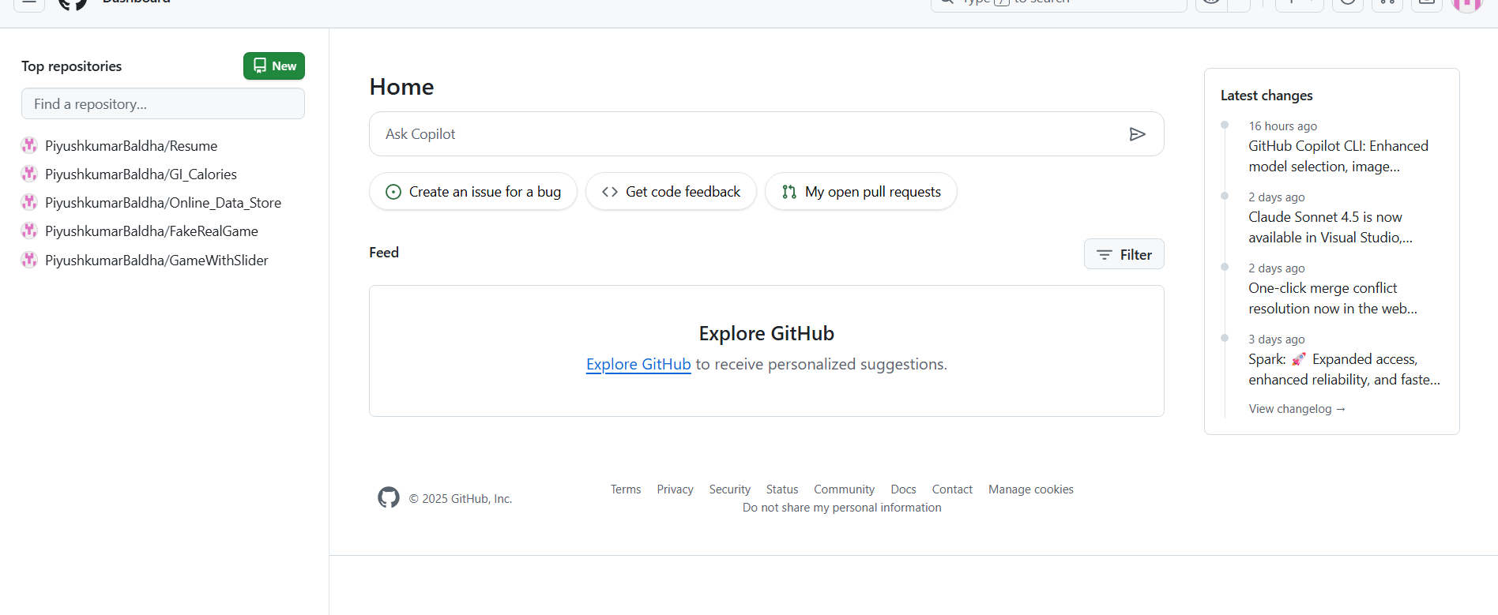
Home Page
The current image shows the homepage of your GitHub account.
Here, I have selected Online_Data_Store as my project.

Slide 3
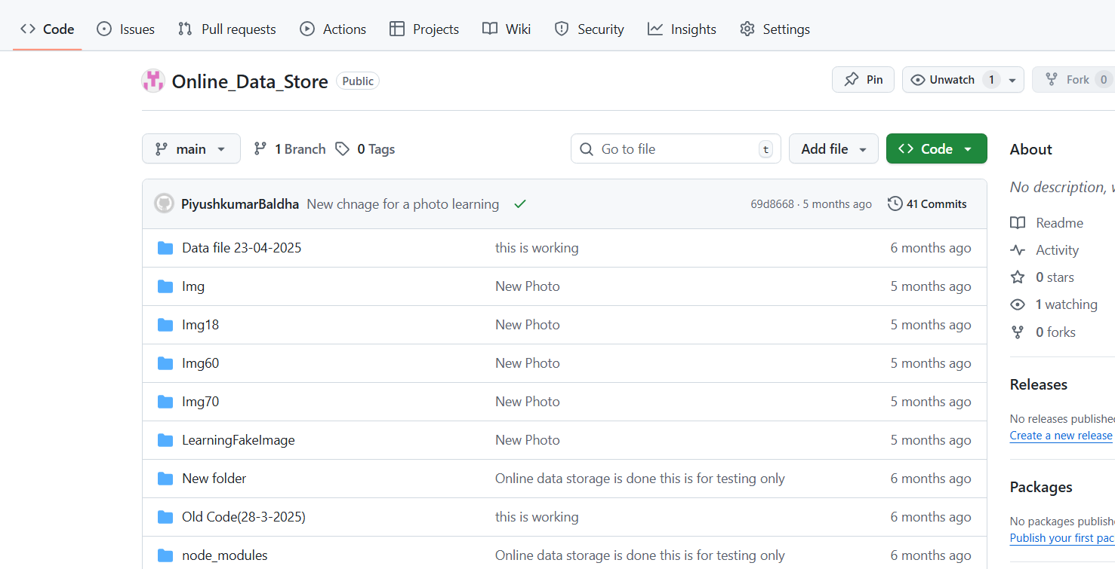
Settings
Now, you can see your project files.
Next, go to Settings.

Slide 4
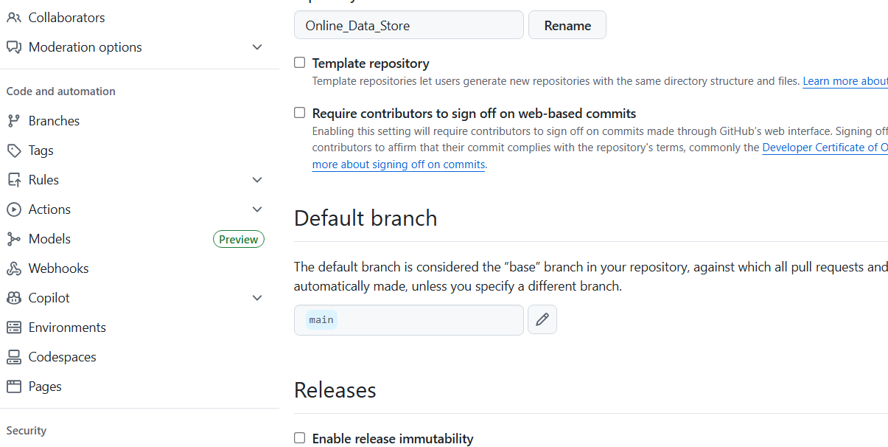
Selection of Page Option
In Settings, you can see several options on the left-hand side.
Go to Pages.

Slide 5
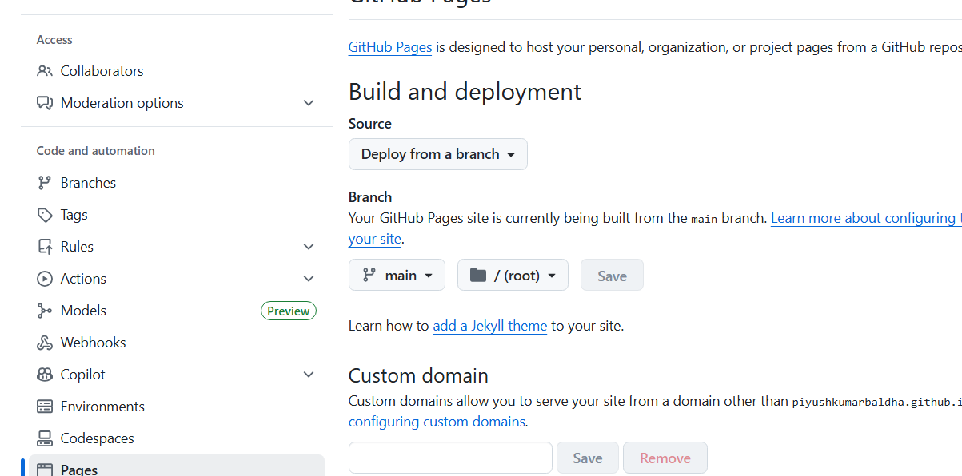
Selection of Branch
In the Pages option, you need to select a Branch.
At this stage, you can only publish your main branch, so please make sure all the files you want online are stored in the main branch.
For the folder selection, choose / (root).
Finally, click Save.

Slide 6
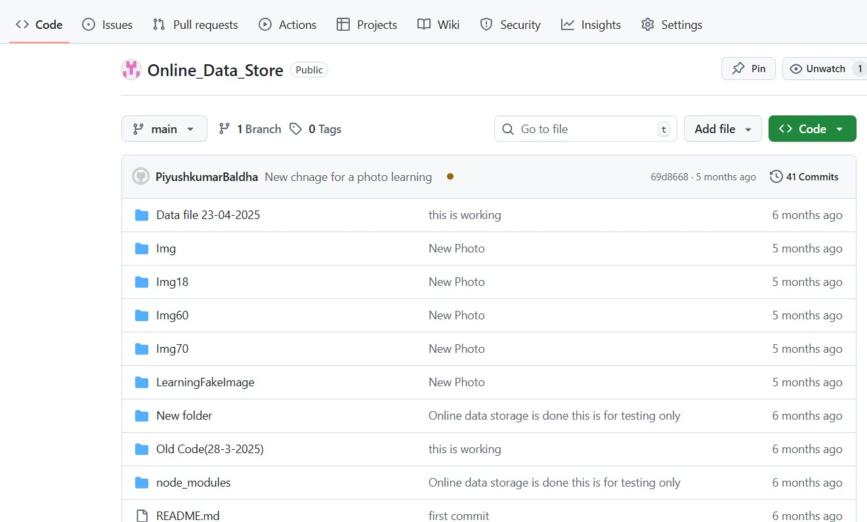
Deployment
1.
When you press save as shown in last slide. the deployment process start automatically.
To see this now you have to got to in code option on top bar as shown in figure. after goes into the code you can see the brown dot in the heading of your project.
To see how deployment is going on you can click on the brown button and the pop up message is available you can see in next slide.
2.

Slide 7
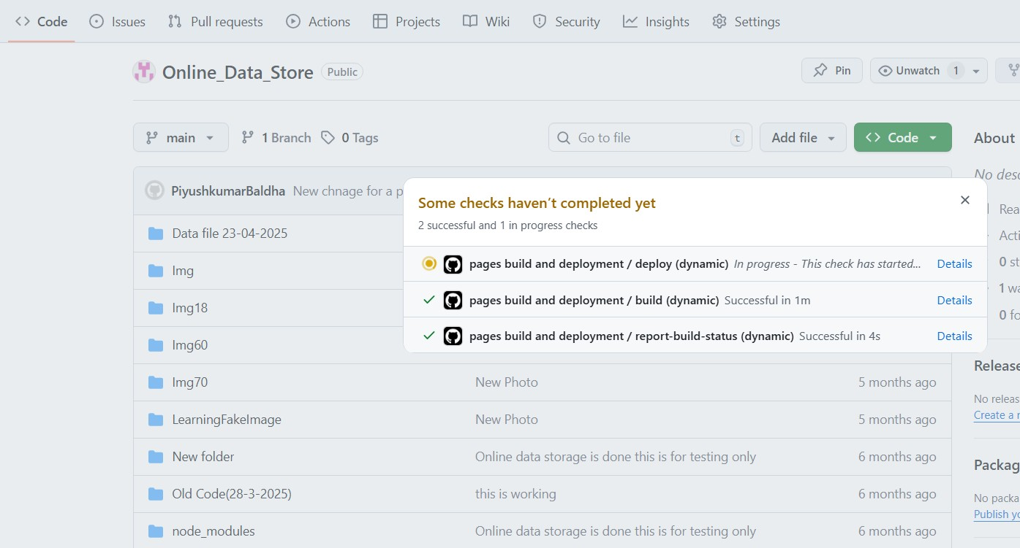
Deployment Cont.
As described in the previous slide, you can see the message block.
If you want to know more, you can view the details inside.

Slide 8
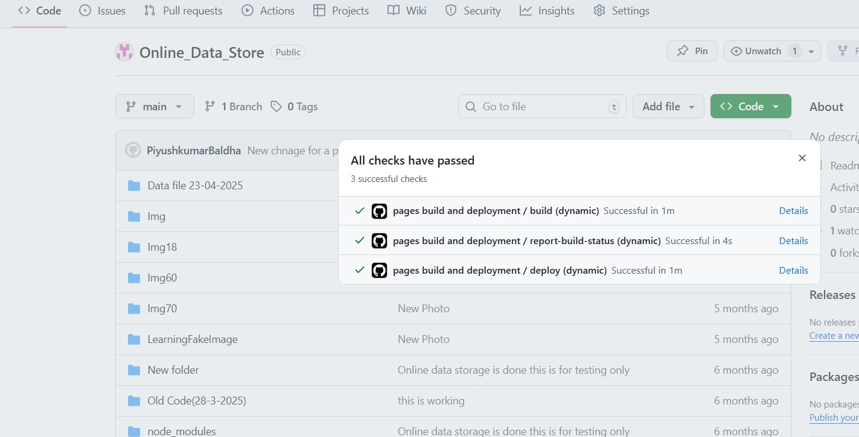
Deployment Cont.
As described in the previous slide, you can see the message box.
All items are now checked and green, indicating success.
You can go ahead and close this message box.

Slide 9
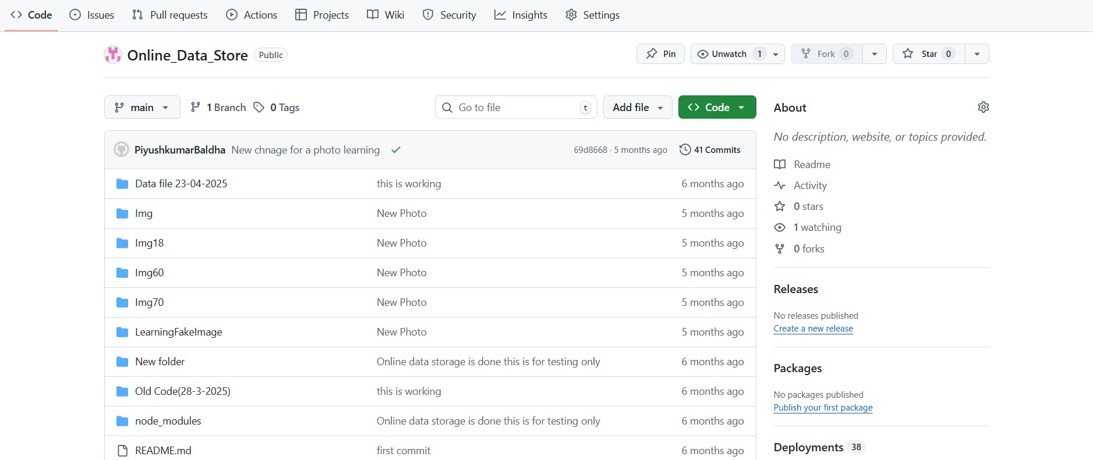
Deployment Cont.
After closing the box as described in the previous slide, you will see a green check mark.
The brown dot will change into a green check mark, which indicates that the deployment is complete and there are no errors.

Slide 10
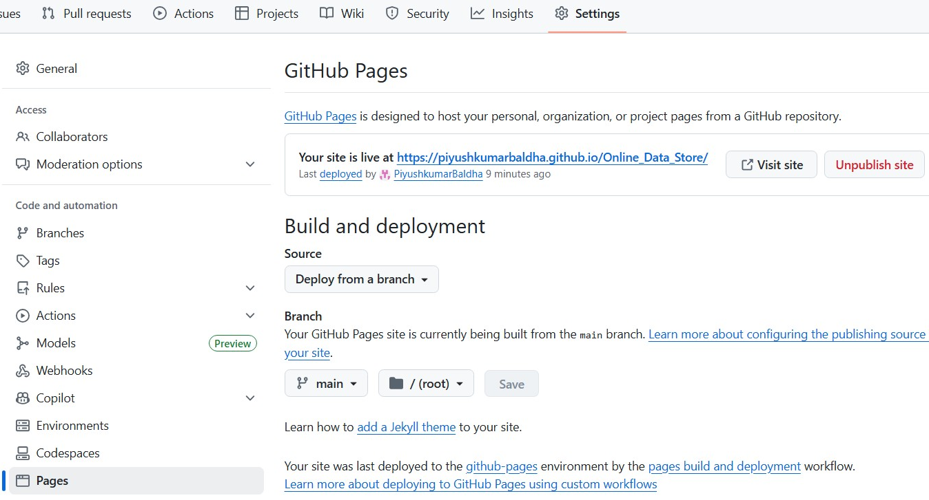
Deployment Cont.
Now, go to Settings as shown in the image, and select the Pages option on the left-hand side.
Here, you will see the site link. You can now visit your own static website. Simply copy and share the link with anyone you like.
If at any point you want to remove the site from being online, you can simply unpublish the website.
1.
3.
2.

Slide 11
Thank You

