Slide 1

Deploying Google sheet to collect a data.

Slide 2
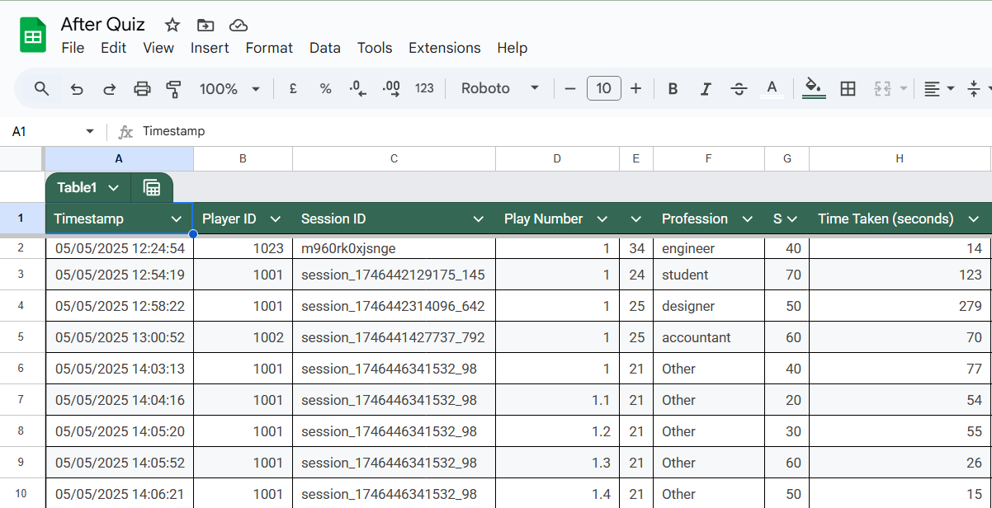
Home Page
Open the Google Sheet where you want to store your data.
Then, go to Extensions.

Slide 3
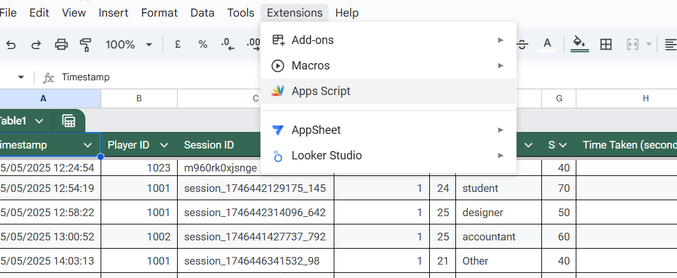
Apps Script
When you open Extensions, you need to select Apps Script.

Slide 4
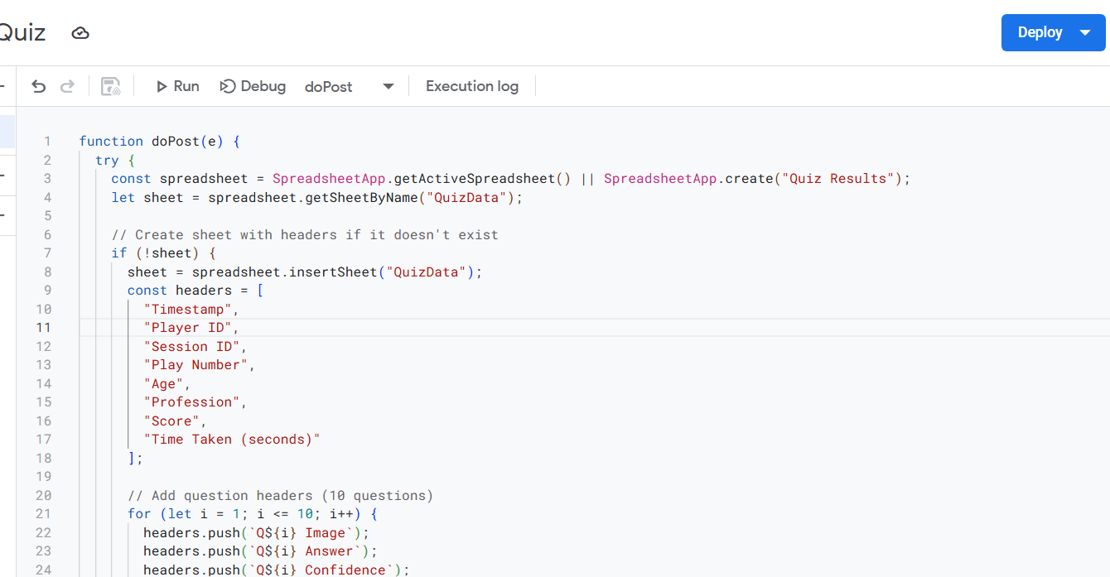
Deploy the Code
Now you can write your script in this area, as shown here.
Enter a script based on your needs.

Slide 5
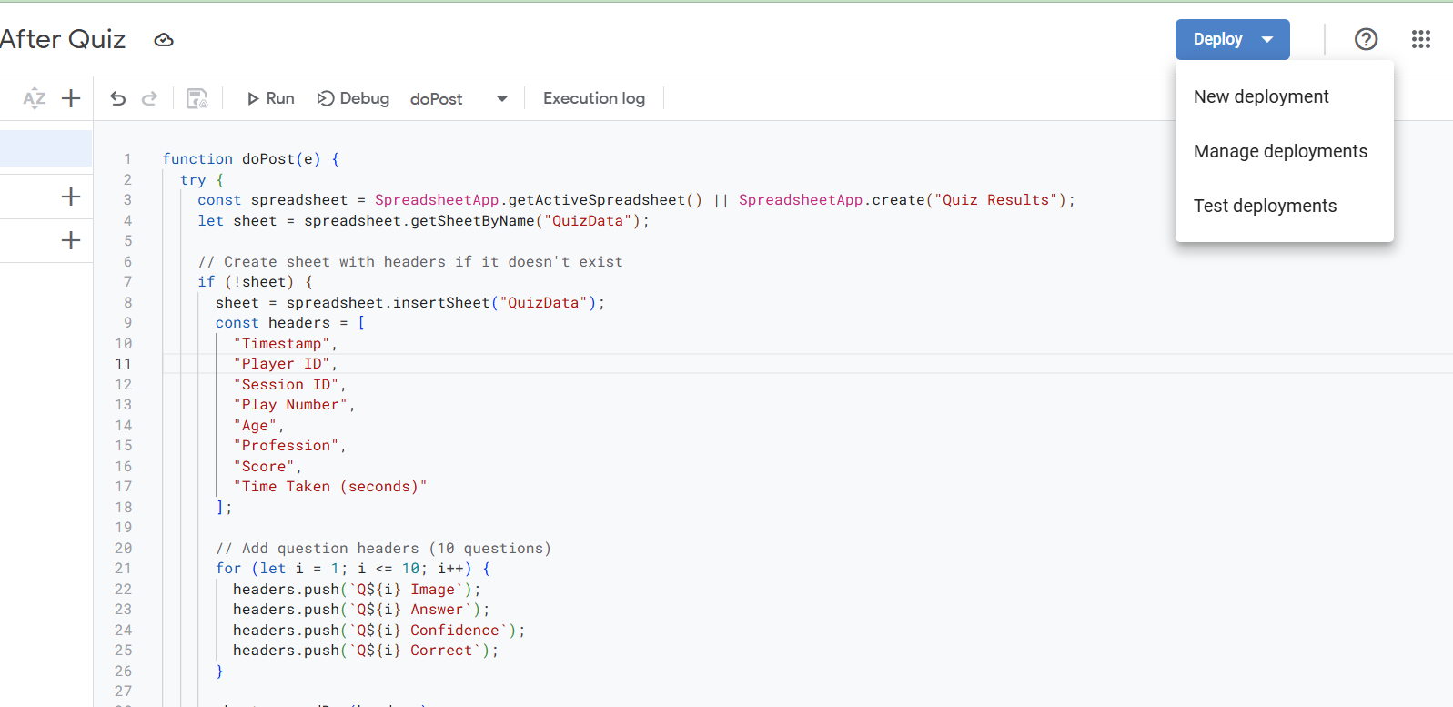
Deploy the Code Cont.
1.
Click Deploy, as shown in the figure.
Then select New Deployment.
2.

Slide 6
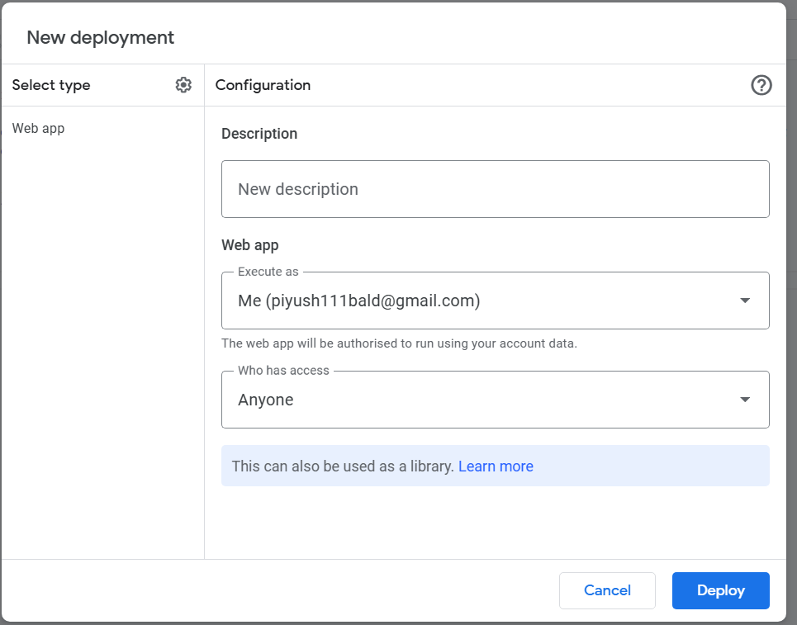
Deploy the Code Cont.
After clicking Deploy, a pop-up message box will appear.
As shown in the image, select the same option as in the figure.
After that, you can click Deploy to proceed.

Slide 7
Deploy the Code Cont.
After deployment, you can run your script.
If there is any error or mistake in the code, it will be shown.
You can also view the details in the execution log.

Slide 8
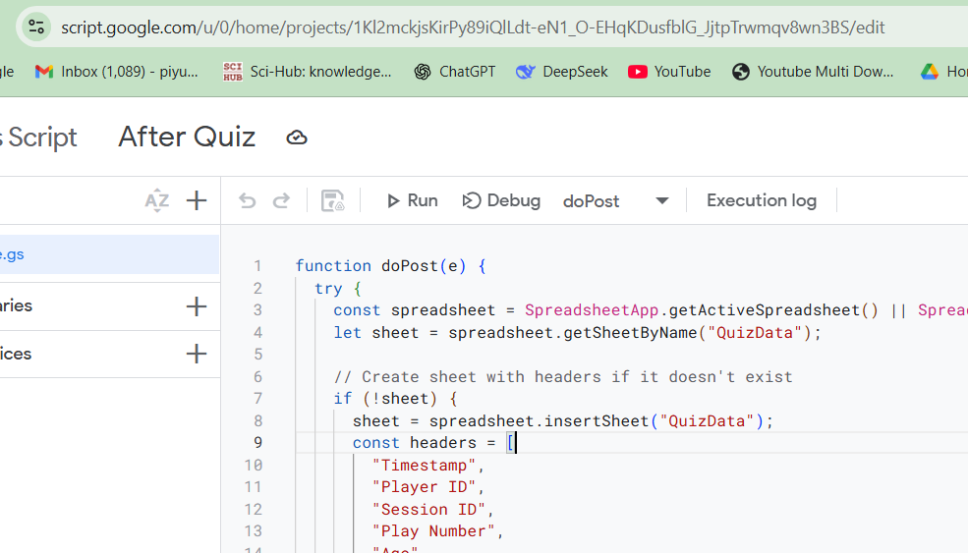
URL to use in code
After executing the code, copy the entire URL from the top.

Slide 9
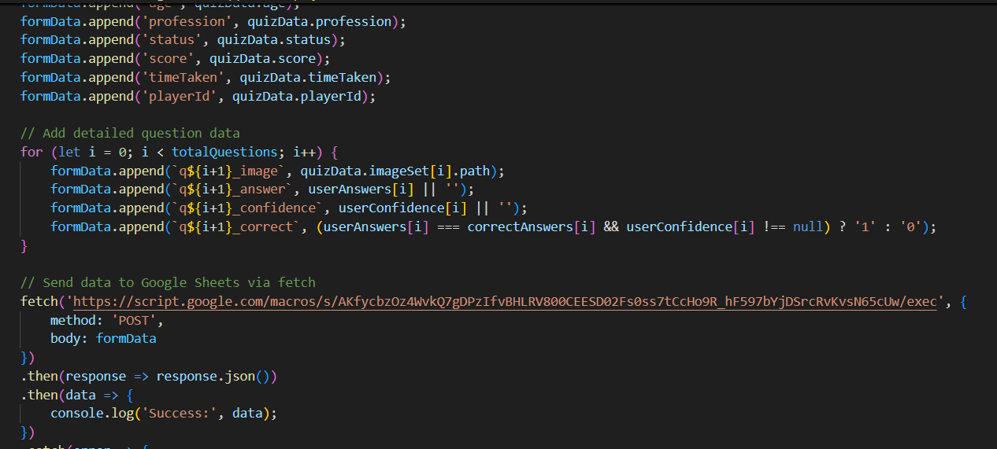
URL to use in code
Now paste that link into your code, so the data will be stored in the Excel sheet according to your needs.

Slide 10
Thank You

