Slide 1
StakeYieldFinance
Fixed-Rate Yield on Ethereum Staking — Powered by Actuarial Science
Hannes Zühlke · May 2026
StakeYieldFinance — Confidential

Slide 2
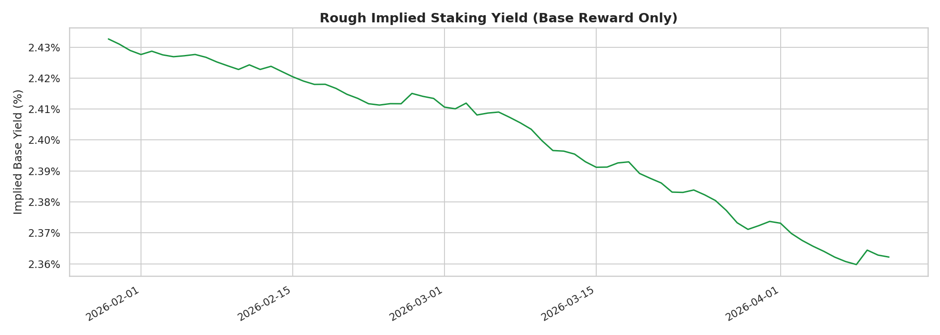
The Problem
Ethereum staking APR floats between ~2.5–4.5% — unpredictable
Validators & LST holders bear full yield variance
No native fixed-income instrument for staked ETH
Existing protocols (Pendle, Notional) rely on AMM-implied rates — opaque pricing
Institutions need predictable cash flows, not floating rewards
Historical implied staking yield — volatile and hard to plan around
StakeYieldFinance — Confidential

Slide 3
The Solution: StableYield Protocol
Deposit wstETH → receive a fixed-rate yield token (syLST)
Locked rate at deposit time, redeemable at maturity
Protocol reserve absorbs variance between floating & fixed yield
Dynamic spread adjusts automatically based on reserve health
Actuarial-grade risk pricing — transparent, on-chain solvency ratio
No counterparty — the reserve IS the counterparty (insurance model)
How It Works
①
User deposits wstETH, selects maturity
②
Vault locks deposit, mints syLST at fixed rate
③
Floating yield accrues; surplus → reserve, deficit ← reserve
④
At maturity: redeem syLST for principal + fixed yield
StakeYieldFinance — Confidential

Slide 4
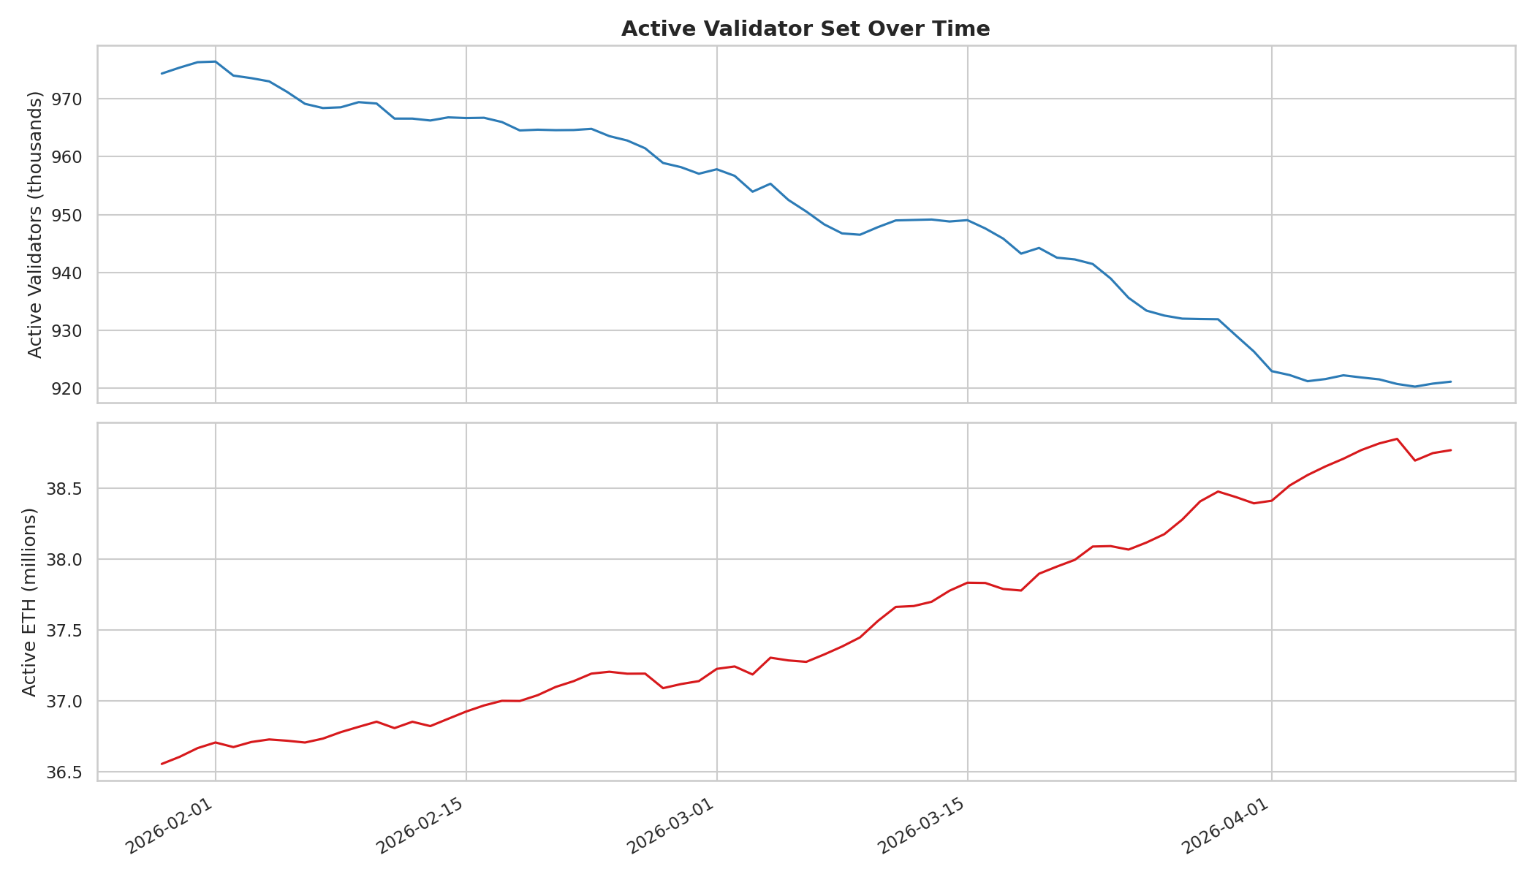
Yield Model — From Beacon Chain to Fixed Rates
APR = f(total staked ETH) — deterministic issuance formula
r = p × 5,256,000 / √B_total (p ≈ 0.99 participation)
Future APR depends on validator count trajectory
Phase 1: Deterministic queue unwind (entry/exit queues → N_active)
Phase 2: Merton jump-diffusion for stochastic arrivals/exits
Monte Carlo → distribution of future APR paths
Calibrated from 326k+ rows of beacon-chain history
Active validator count over time — the key state variable
StakeYieldFinance — Confidential

Slide 5
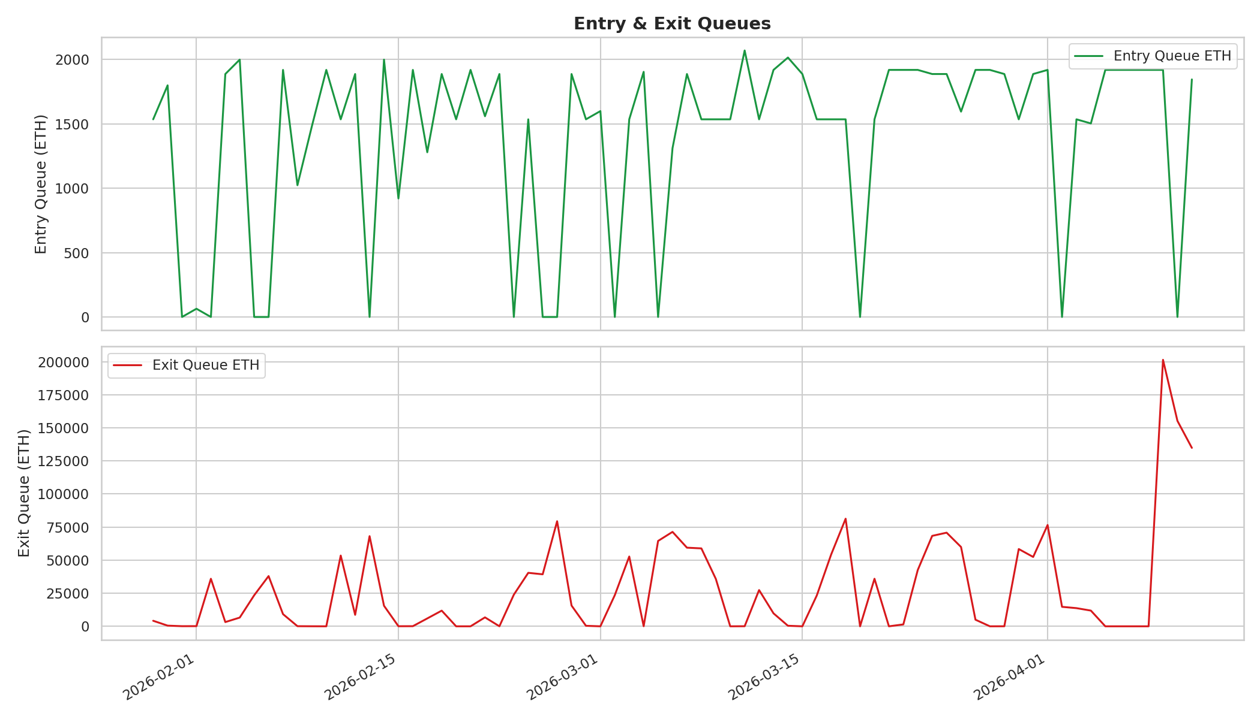
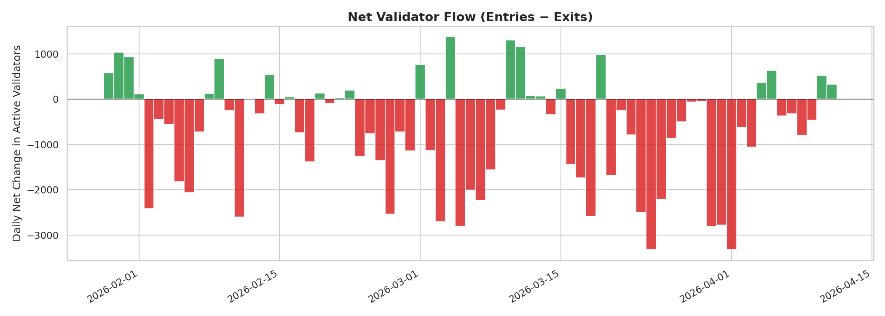
Queue Dynamics & Churn Limit
Entry/exit queues govern validator activation & withdrawal
Churn limit: max(4, ⌊N/65536⌋) validators per epoch (capped at 8 post-Deneb)
Queues create near-term deterministic APR trajectory
Once queues clear, stochastic dynamics dominate
Net flow currently exit-heavy → upward-sloping yield curve
StakeYieldFinance — Confidential

Slide 6
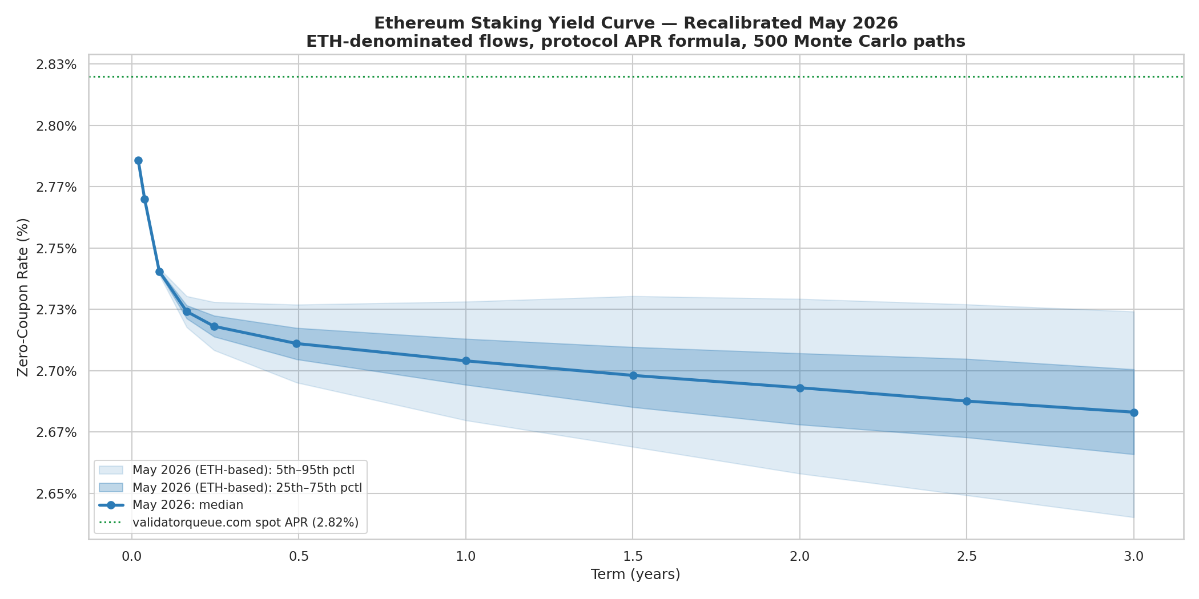
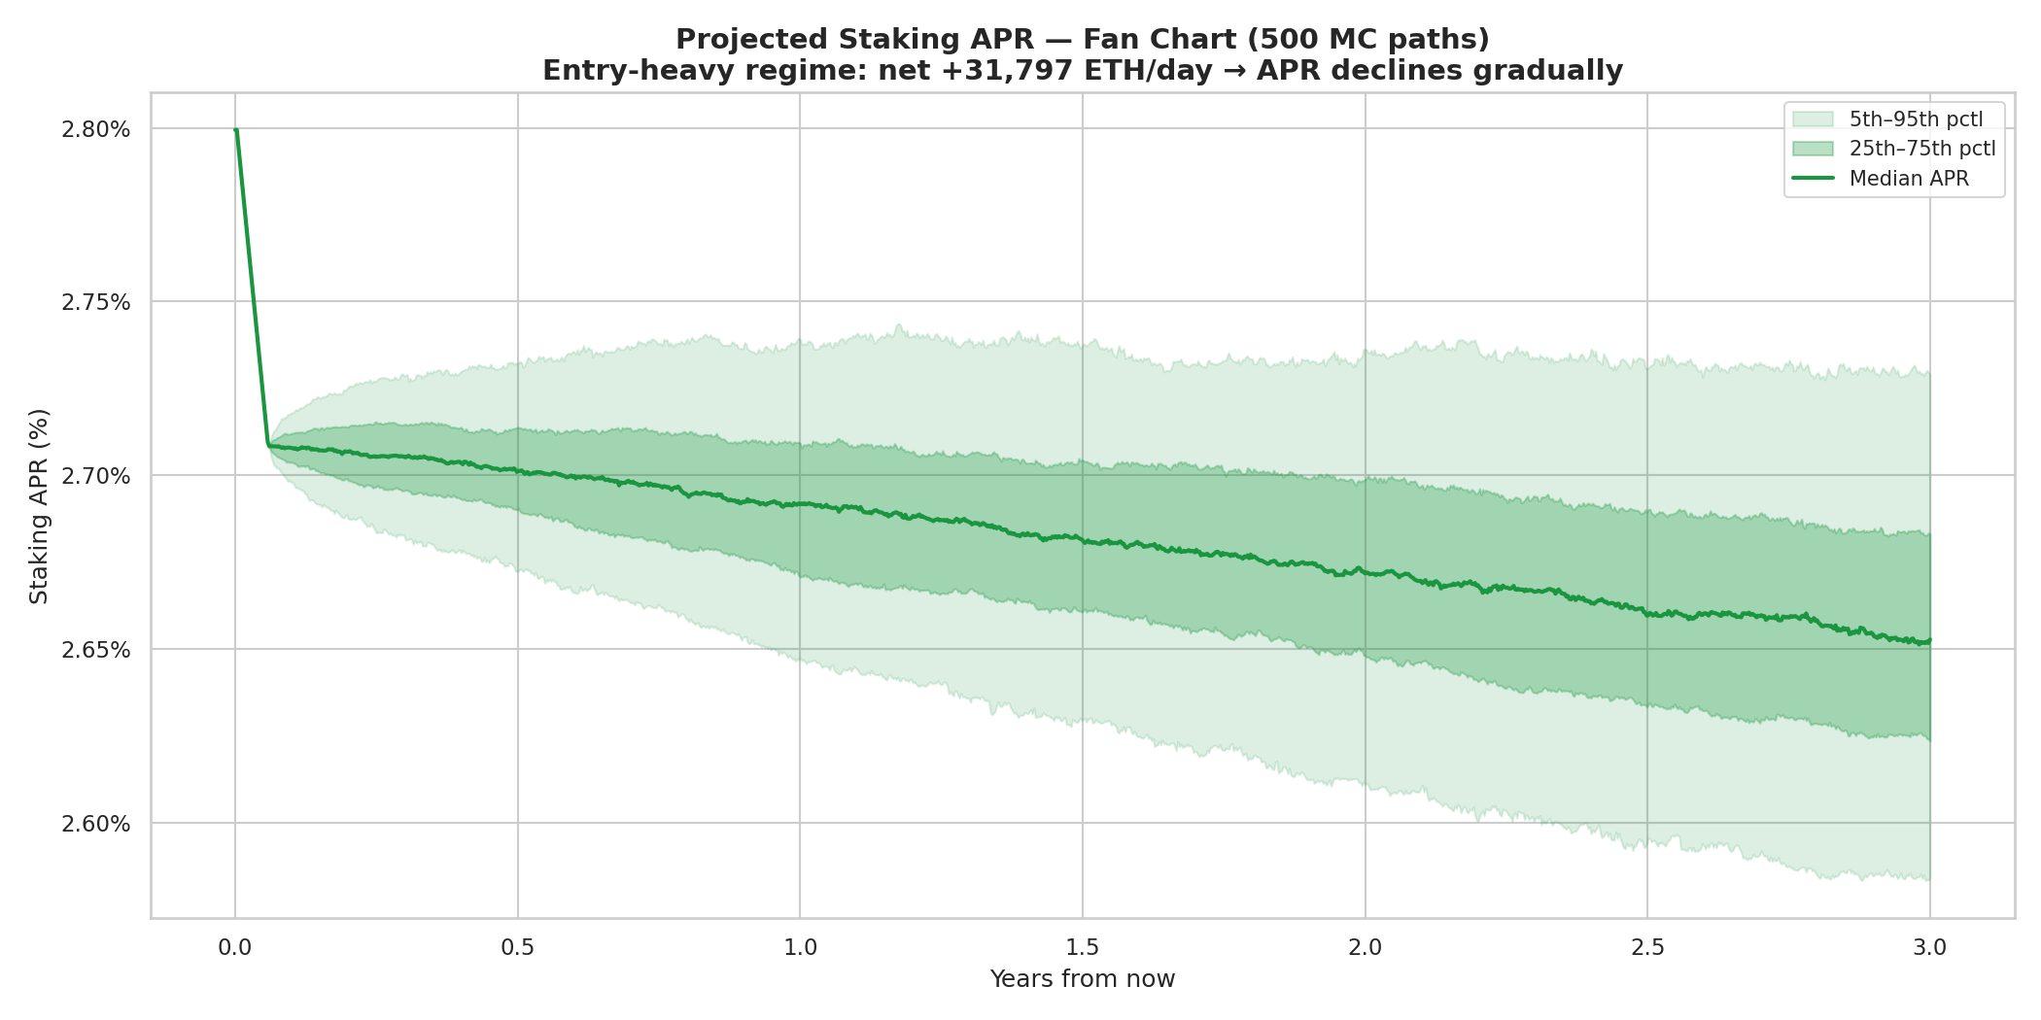
Constructing the Ethereum Staking Yield Curve
Monte Carlo simulation → 10,000 APR paths
Discount factors: D(T) = E[exp(-∫₀ᵀ r(t) dt)]
Zero-coupon rates extracted from discount factors
Fan chart shows uncertainty bands (p5–p95)
Foundation for pricing fixed-rate instruments
StakeYieldFinance — Confidential

Slide 7
Protocol Architecture
StableYield Vault
Main entry: deposit, redeem, harvest Holds all escrowed wstETH
Frontend (Swap GUI)
Rate display, deposit flow HTML/JS interface
syLST (ERC-1155)
Fixed-yield tokens One ID per maturity series
Reserve Manager
Solvency tracking Surplus/deficit management
Spread Calculator
Dynamic spread from κ Pure math, no state
SYLD Token (ERC-20)
Governance + backstop Residual claim on reserves
StakeYieldFinance — Confidential

Slide 8
Dynamic Spread — Self-Stabilising Risk Pricing
s(κ) = s_base × (1 + α × max(0, κ_target/κ − 1)^β)
Key Parameters
s_base
50 bp
Base spread
κ = Reserve / Liabilities (solvency ratio)
κ ≥ 1.5 (target): spread = 50bp — attractive rates
κ = 0.7: spread ≈ 115bp — gentle deterrent
κ = 0.5: spread ≈ 470bp — strong deterrent
κ = 0.3 (critical): spread ≈ 5,050bp — effectively closed
No governance intervention needed — pure math
Smooth transition, no cliff edges
α
10
Stress multiplier
β
3
Convexity (cubic)
κ_target
1.5
Target solvency
κ_critical
0.3
Emergency threshold
StakeYieldFinance — Confidential

Slide 9
Reserve Management — Actuarial Framework
Reserve absorbs variance: surplus → reserve, deficit ← reserve
Inspired by Swiss Solvency Test (SST) / Solvency II
Explicit SCR (Solvency Capital Requirement) from Monte Carlo
SYLD token = subordinated backstop (MakerDAO MKR model)
syLST holders are senior — claims always honoured first
Initial Reserve Sizing (10k wstETH TVL)
Annual yield variance: ~7bp (from model)
Tail risk (p1 scenario): ~15bp below expected
1-year SCR: ~15 wstETH (0.15% of TVL)
Target reserve (150%): ~22.5 wstETH
Conservative with buffers: 3–5% of TVL
Remarkably capital-efficient due to low model uncertainty
Credit Hierarchy
SENIOR: syLST Depositors — fixed yield guaranteed by reserve
JUNIOR: SYLD Holders — residual claim, bear tail risk via dilution
StakeYieldFinance — Confidential

Slide 10
Token Design
syLST — Stable Yield LST
SYLD — Governance Token
ERC-1155: one token ID per maturity series (Q3-26, Q4-26, …)
Claim to (1 + r_fixed × T/365) wstETH at maturity
Fully transferable — tradeable on DEXes
Composable: usable as collateral in lending protocols
No early exit from vault — sell on secondary market
ERC-20 with fixed supply + emergency mint
Governance votes on protocol parameters
Stake to receive excess reserve distributions
Emergency backstop: mint & auction to recapitalize
Subordinated to syLST (bears tail risk)
vs. Existing Protocols
StableYield: model + actuarial pricing · Pendle: AMM-implied · Notional: pool-based Only protocol with explicit actuarial reserve & transparent on-chain solvency ratio
StakeYieldFinance — Confidential

Slide 11
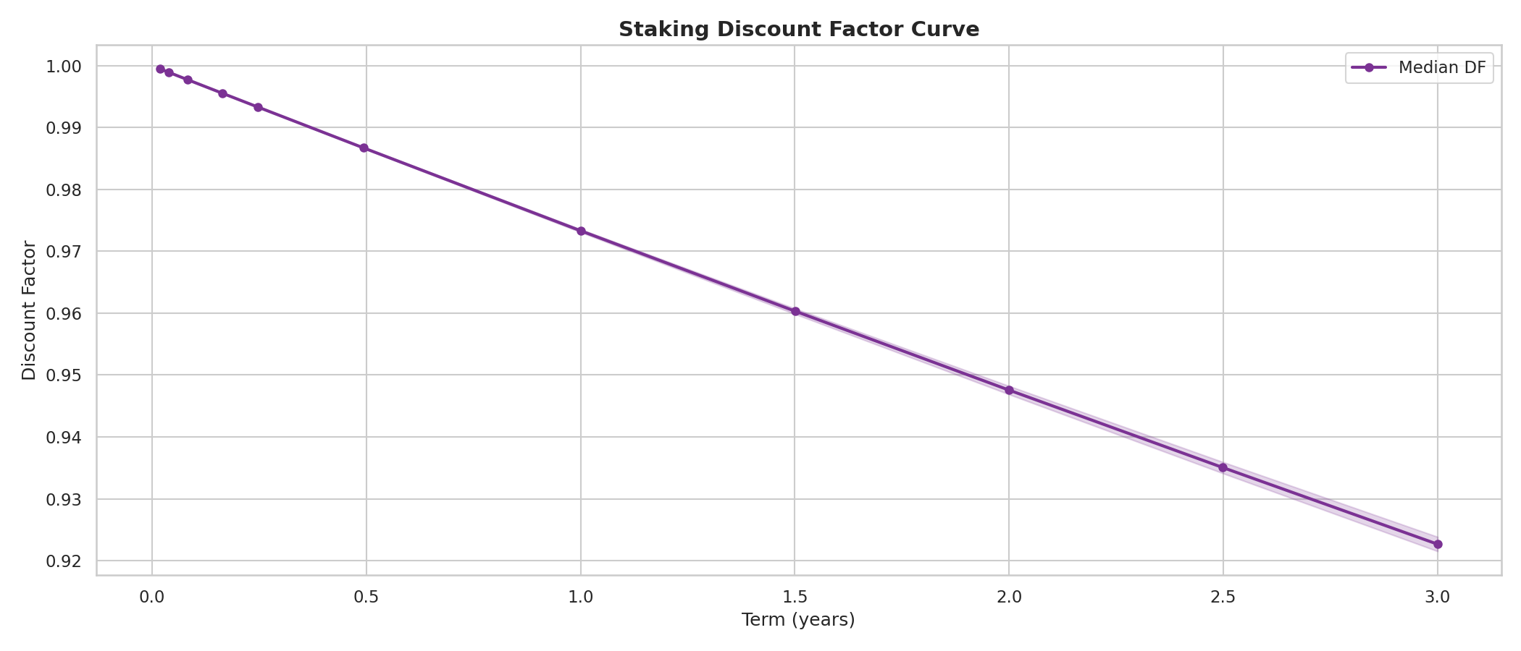
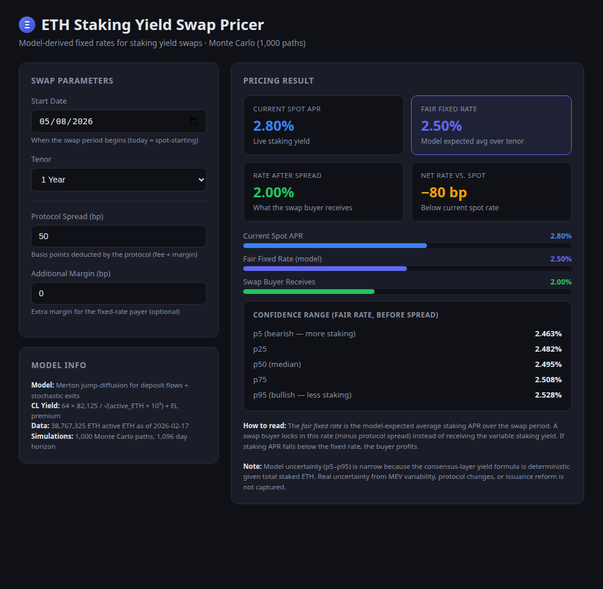
From Yield Curves to Products
Discount factors from MC simulation → zero-coupon rates
Fixed-rate quotes derived directly from the term structure
Interest rate swap pricing: pay fixed, receive floating staking yield
Interactive swap pricer GUI built for exploration
StakeYieldFinance — Confidential

Slide 12
Roadmap
Phase 1 — Testnet
Core contracts, single maturity, Hardhat tests, GUI integration
Phase 2 — Audit & Beta
Professional audit, Holesky deployment, bug bounty, multi-series
Phase 3 — Mainnet
Conservative launch, initial reserve, SYLD token, short tenors (≤6m)
Phase 4 — DeFi Integration
On-chain yield model, syLST as collateral, L2 deployment, multi-LST
StakeYieldFinance — Confidential

Slide 13
Why StakeYieldFinance?
🔬
Model-Driven Pricing
Actuarial yield model, not AMM guesswork — transparent, verifiable rates
🛡️
Explicit Risk Management
On-chain solvency ratio, SCR, dynamic spread — SST/Solvency II inspired
💰
Capital Efficient
Reserve requirement ~3–5% of TVL — low model uncertainty = small buffer
🔗
DeFi Composable
syLST tradeable, usable as collateral — yield curve arbitrage opportunities
⚖️
Clear Credit Hierarchy
syLST senior, SYLD junior — well-understood waterfall structure
🤖
Self-Stabilising
Dynamic spread adjusts automatically — no governance fire drills
StakeYieldFinance — Confidential

Slide 14
Thank You
Hannes Zühlke · johanneszuehlke@fastmail.com · github.com/HannesZ
StakeYieldFinance — Fixed-Rate Yield Meets Actuarial Precision
StakeYieldFinance — Confidential

