Slide 1
Bachelor Thesis
Hanno Iwasaki Hennighausen
Group of Prof. Schwarz
ITP
Supervisor: Julia Jaeger

Slide 2

Idea for the simulation

Slide 3
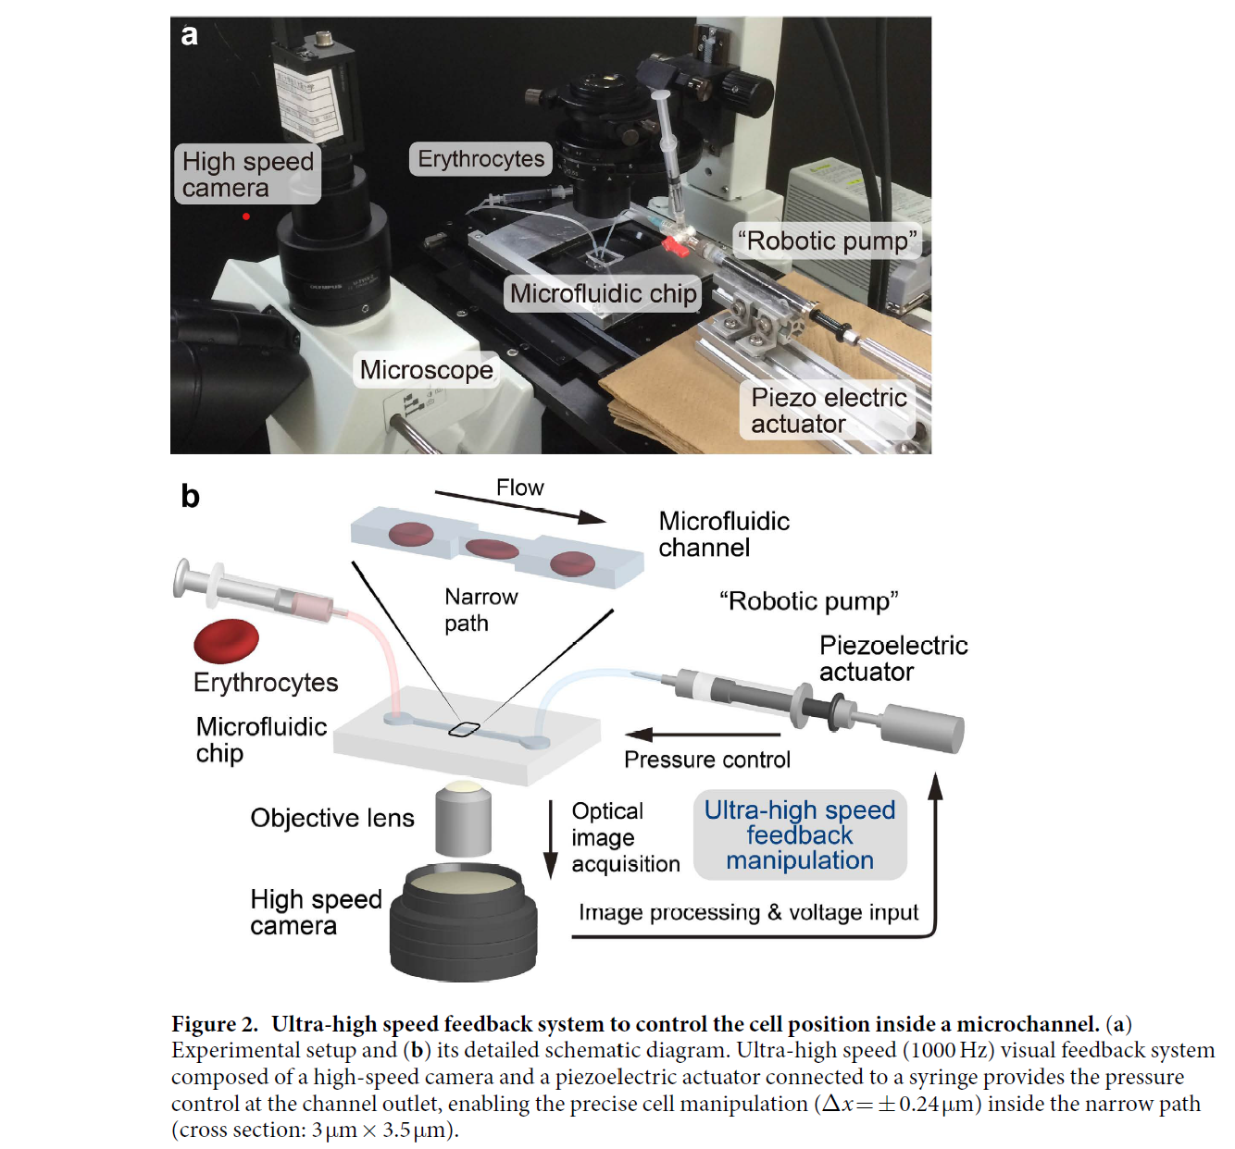
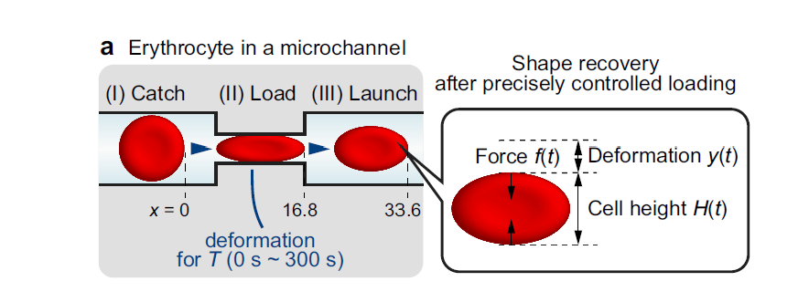
Experimental setup
Determine height of RBC to study the elasticity

Slide 4
Create a simulation for hydrodynamic flow in a microchannel
Simulate a 2d RBC
Implement RBC in hydrodynamic flow and calculate shape deformation

Slide 5
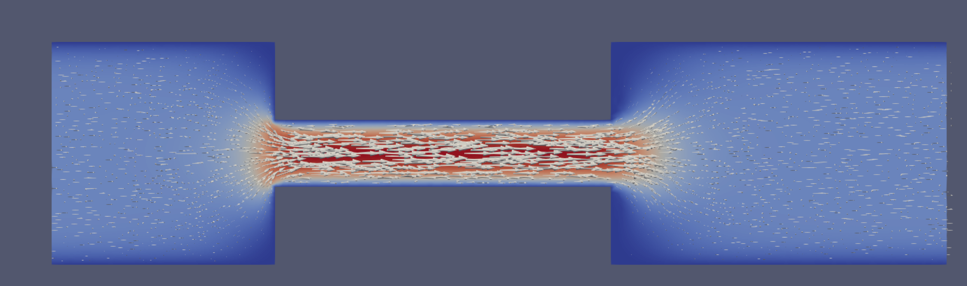
Step I.
Create chamber with Stokes flow

Slide 6
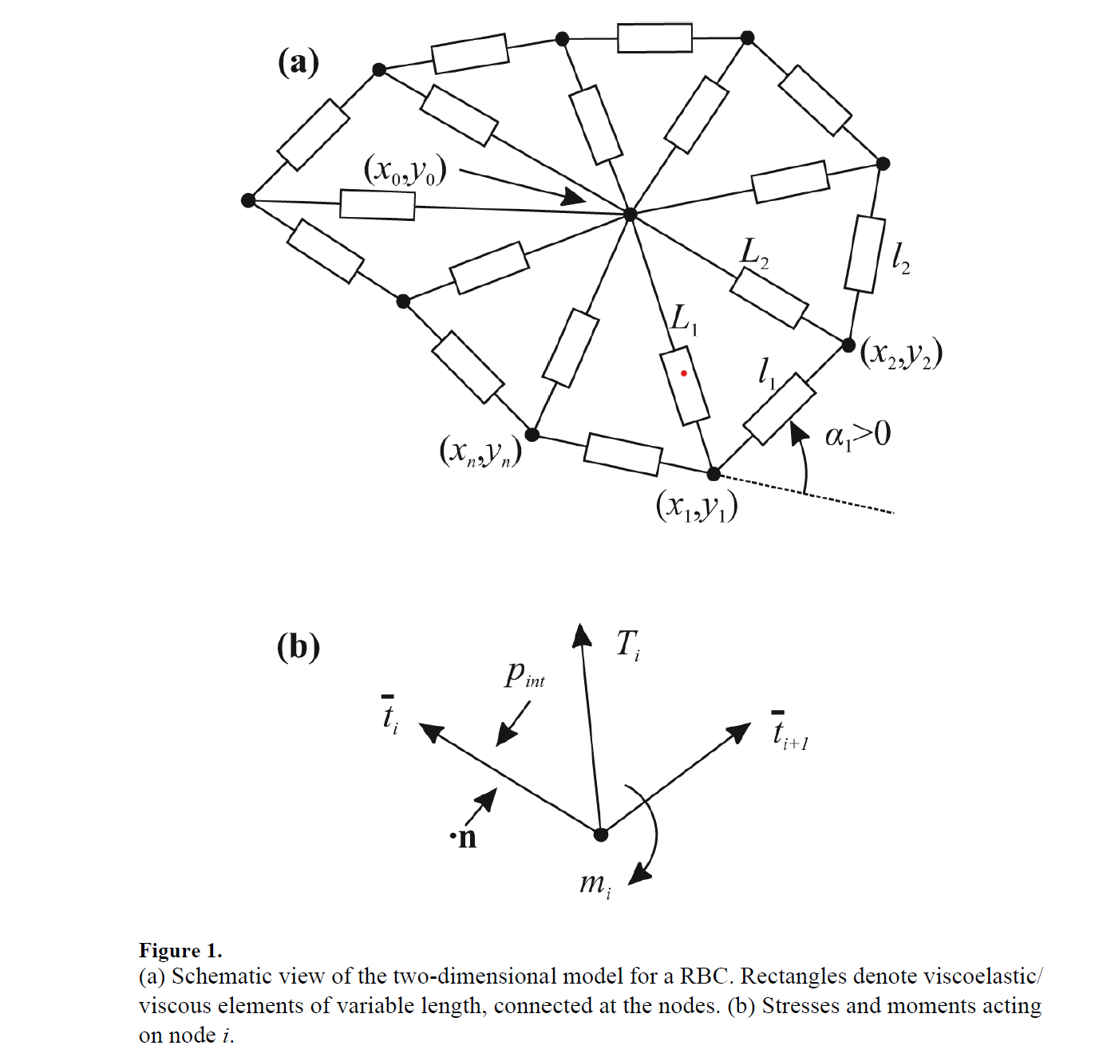
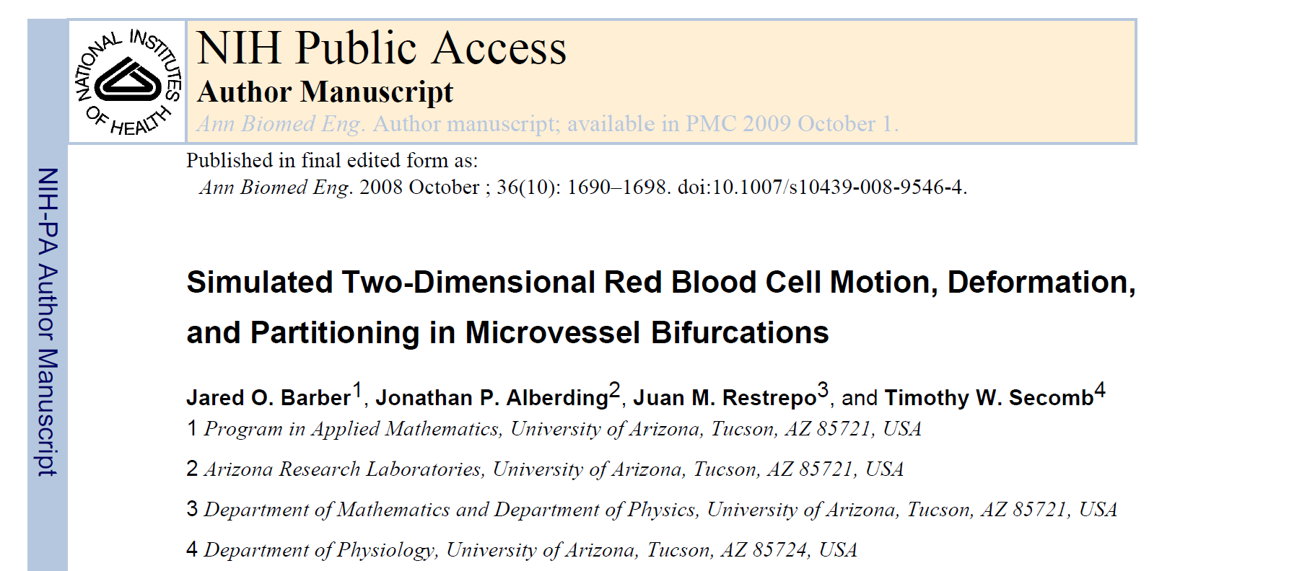
Step II.
Model RBC with PDE‘s

Slide 7
Outer Ring: viscoelastic elements
Inner Elements: purely viscous elements
At every node: enforce mechanical equilibrium

Slide 8
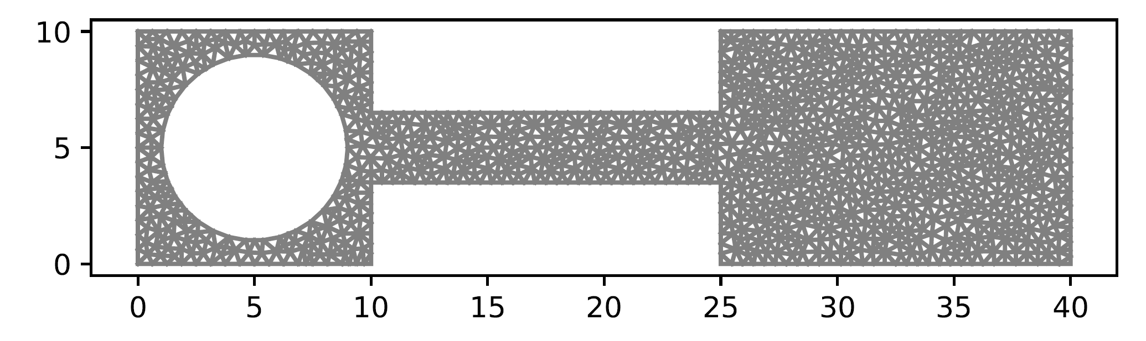
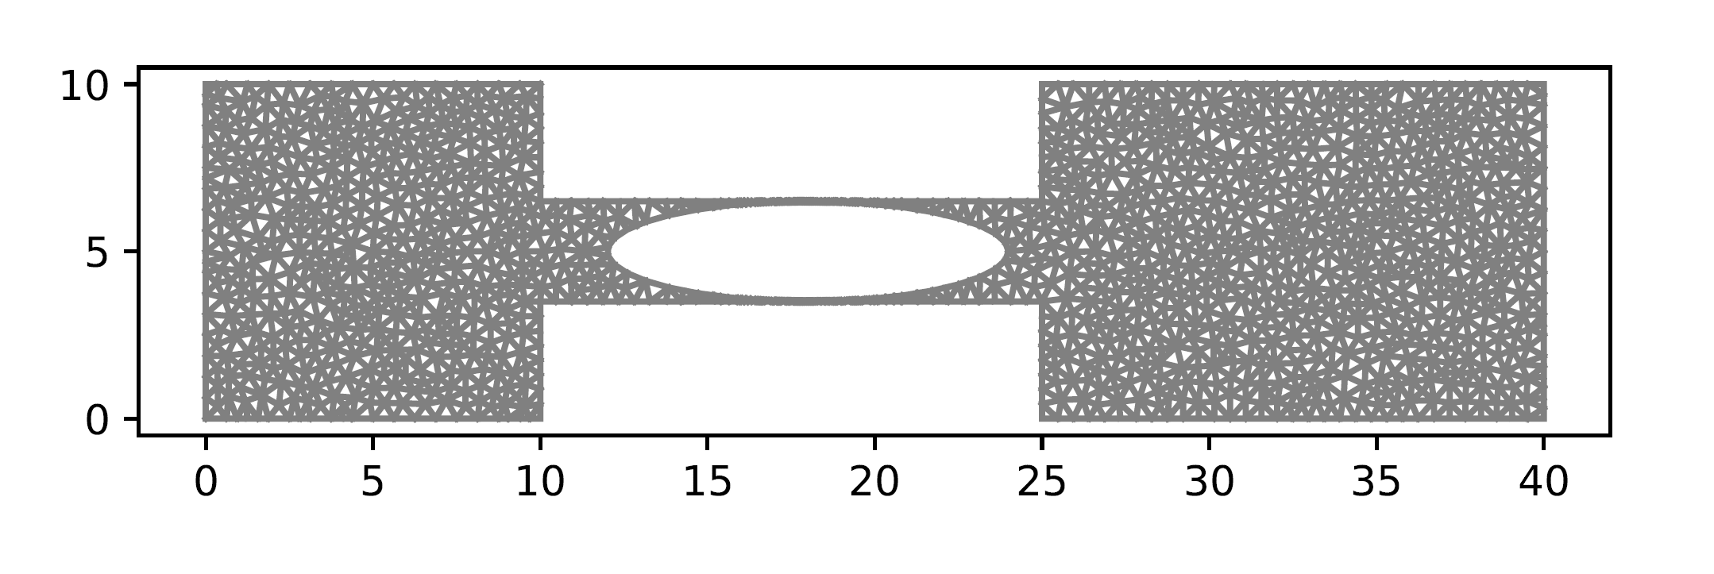
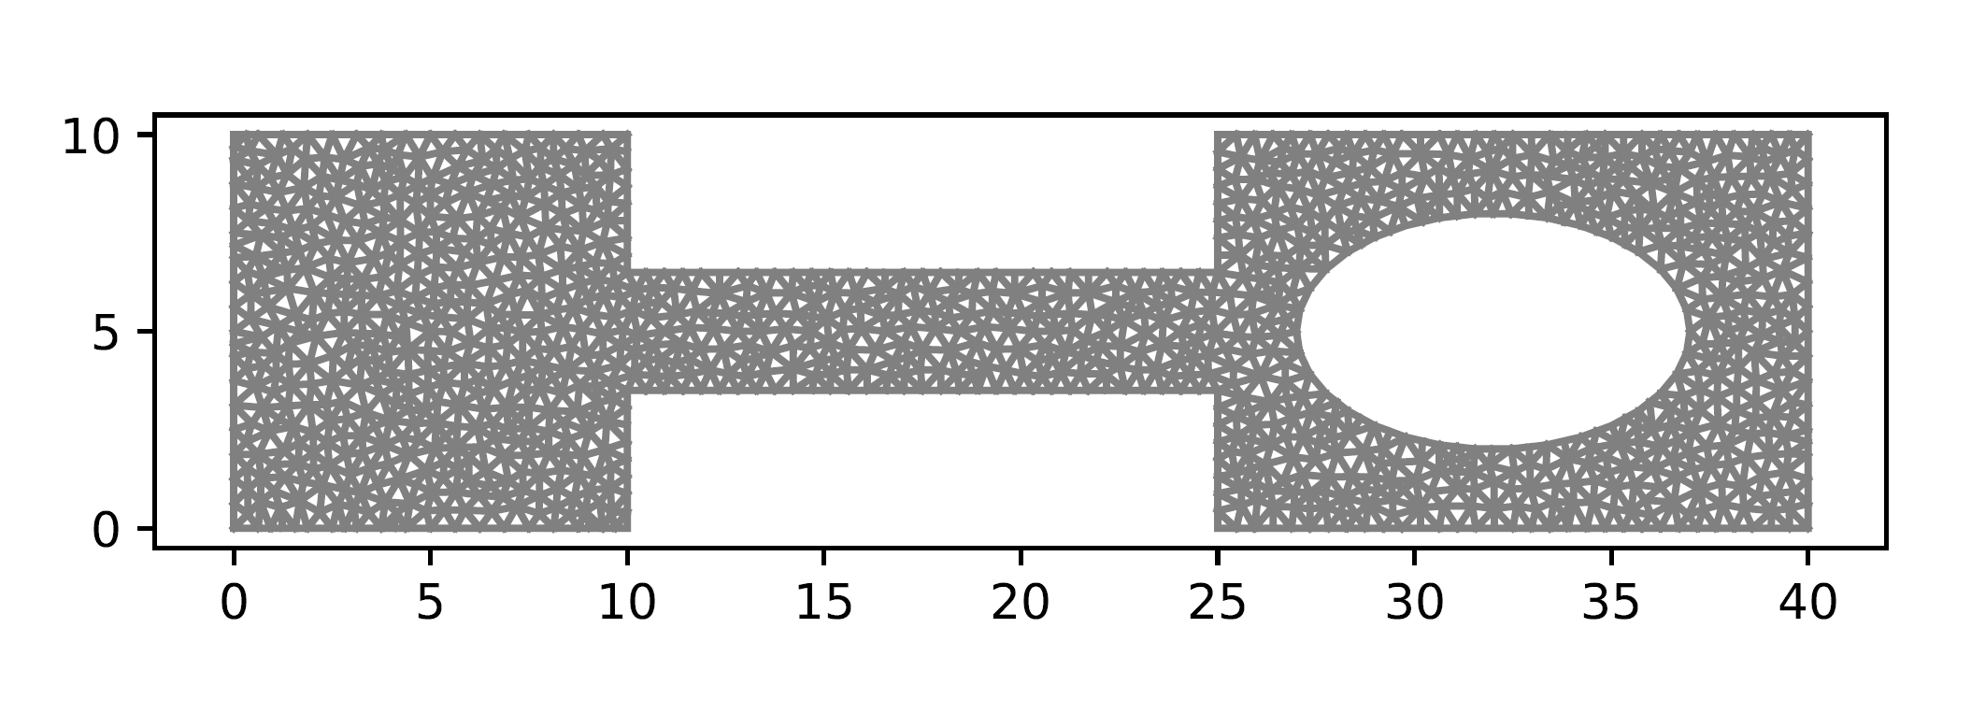
Step III.
Calculate bearing on each node
Advance RBC in time
recalculate shape

