Slide 1
Music and Lyrics
Yinxiang Gao
yg2424

Slide 2
Idea
Sound features
Sound features: rhythm, pitch, timbre, …
Lyrics: I, the, you, to, and, …
No apparent relationship between sound features and lyrics.
?
Lyrics

Slide 3
Idea
Sound features
Sound features: rhythm, pitch, timbre, …
Lyrics: I, the, you, to, and, …
No apparent relationship between sound features and lyrics.
Something in between that connects them
Could be lyrics topics.
?
Lyrics

Slide 4
Topic Model
The latent Dirichlet allocation (LDA)
Topics are a assumed to be uncorrelated.
Words within a topics tend to appear together. Words between topics tend not to appear together.
A quick LDA( ) on our lyrics data with number of topics = 20.

Slide 5
Topic Model
Topic 3 : French
Topic 12: German
Topic 13: Spanish
Sensitive to languages
Top words | Topic 3 | Topic 12 | Topic 16
1 | la | ich | que
2 | de | und | y
3 | et | du | de
4 | je | die | no
5 | les | der | me
6 | le | in | la
7 | a | das | te
8 | pas | ist | el
9 | des | nicht | en
10 | que | es | a
11 | un | mich | tu
12 | qui | auf | mi

Slide 6
Topic Model
English words
Not clear
Top words | Topic 4 | Topic 5 | Topic 6 | Topic 7 | Topic 8 | Topic 9
1 | you | you | oh | we | the | a
2 | to | do | my | you | and | of
3 | be | not | love | are | a | your
4 | will | to | you | the | on | you
5 | that | me | i | and | you | the
6 | and | babi | are | not | your | my
7 | the | on | yeah | all | world | hey
8 | never | come | in | to | to | to
9 | love | what | the | it | danc | in
10 | would | know | and | do | in | that
11 | i | i | is | us | come | and
12 | your | it | how | is | who | for

Slide 7
Topic Model
Topic 15 (Top 100 words)
1-10 | the | a | he | and | in | that | my | not | it | to
11-20 | like | is | got | they | with | on | get | up | nigga | his
21-30 | for | shit | him | man | what | yo | when | but | ya | out
31-40 | do | no | em | was | your | at | yall | down | fuck | off
41-50 | of | niggaz | back | them | keep | wit | money | ai | then | see
51-60 | from | if | how | yeah | bitch | you | hit | all | be | ass
61-70 | now | one | caus | or | so | had | did | street | head | just
71-80 | make | who | cuz | way | some | call | right | big | know | more
81-90 | boy | gon | ima | this | never | we | good | about | fuckin | talk
91-100 | gangsta | where | high | bout | these | hell | wanna | dog | move | motherf

Slide 8
Idea
Sound features
Sound features: rhythm, pitch, timbre, …
Topics: I, the, you, to, and, …
No apparent relationship between sound features and topics.
Topics
Lyrics

Slide 9
Idea
Sound features
Sound features: rhythm, pitch, timbre, …
Topics: I, the, you, to, and, …
No apparent relationship between sound features and topics.
Something in between that connects them.
Could be music styles.
?
Topics
Lyrics

Slide 10
Time Signature
Time signature: how many beats are to be contained in each bar and which note value is to be given one beat.
Time signature | Music styles
4/4 | Widely used in most forms of Western popular music. Most common time signature in rock, blues, country, funk, and pop
2/4 | Used for polkas or marches
3/4 | Used for waltzes, minuets, scherzi, country & western ballads, R&B, sometimes used in pop
6/8 | Double jigs, polkas, sega, salegy, tarantella, marches, barcarolles, loures, and some rock music

Slide 11
Tempo

Slide 12
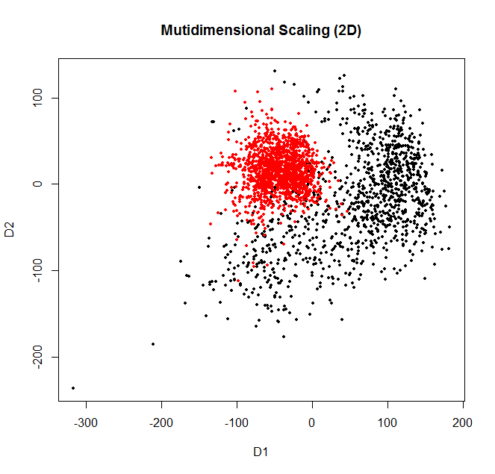
Timbre
The timbre feature is a 12 dimension vector for each segment.
Each song has about 200 to 1500 segments
Multidimensional scaling visualization.
Jazz segment timbre
Metal segment timbre

Slide 13
Timbre
Jazz: saxophone, trumpet, trombone, piano
Metal: bass, drums, guitar
Good for separating songs with different style.
Jazz segment timbre
Metal segment timbre

Slide 14
Summary
Sound features
Time signature, tempo, timbre, …
Music Styles
Rock, jazz, blues, country, …
?
Lyrics Topics
Love, life, friends, …
Lyrics

