Slide 1
Internship Out-Brief
Hannselthill Camacho, 412 RANS/ENRT
hannsel101@mail.fresnostate.edu
Notes:
Hello, My name is Hannselthill Camacho and I’ll be going over my experience over the last 9 weeks of being an intern with the air force.

Slide 2
Internship Overview
6-week Virtual Premiere College Intern Program (VPCIP)
Air Force University
Facilitated Discussions
Time with supervisor and mentors
Networking
Group Project
3-week extension with TSPI
Mentor
Supervisor
Intern Project
Interactive Training Program (ITP)
Notes:
6 of those weeks were spent being a part of the virtual premiere college intern program. Which I will be referring to as VPCIP for the rest of the presentation.
The weekly schedule of the VPCIP consisted of a combination of self paced learning, discussions involving a facilitator, time with my TSPI assigned mentor and supervisor, time spent with my VPCIP leadership mentor, expanding our network of contacts, and working on a group project.
After the VPCIP came to an end, TSPI offered a 3-week extension period in which I had daily meetings with my TSPI assigned mentor and supervisor, worked on software development projects, and got to experience the Interactive Training Program created at TSPI.
Before I continue further, I would just like to make one thing clear. There were things I liked and things I that I personally didn’t benefit from. With that said I truly appreciate the effort that the Airforce Personnel Center put into making this internship come to fruition.
Many of my peers from Fresno State had their internships completely cancelled as well as job offers put on hold. The Airforce truly showed adaptability by moving forward with the internship.

Slide 3
VPCIP: Software tools
Flooded with Emails
Who do I ask my questions to?
Canvas for assignments
A familiar platform for students
Video Telecommunication
Webex audio issues
Zoom Gov participant limitations
Air Force Civilian Service Application
Loaded with features that I don’t use
Chat notifications did not work as expected
Notes:
Before the internship I was flooded with emails from many different sources.
When I had a question, I was utterly confused on who to contact. Was it my mentor and supervisor? Was it my career field point of contact? Was it the Human Resources staff? Who should I ask?
During the internship, the confusion was fading away week by week.
The PCIP schedule was initially sent through email on a daily basis. Later it was being posted on canvas, which provided a familiar interface for university students.
As a student I have personally used canvas for about 5 years. I was glad to hear we were using the platform.
The canvas would have the day listed and a dropdown menu with all the items for that day. This included articles on morality, ethics, the history of the Airforce, links to relevant ted talks, and links to video meetings.
Video Conferencing tools provided a healthy medium for communication, but issues were encountered.
When presenting a video through Web-ex, there was no sound from the video. The quick solution was to provide a link to the video and for everyone to come back after watching it.
Another solution was to use Zoom Gov. But during some of the Zoom meetings, the restriction on the number of participants allowed was met a few times.
Verifying our presence at a meeting meant typing in your name and assigned base. This created 400 distracting sounds from chat notifications while some people were presenting.
All PCIPs were asked to download and install the Air Force Civilian Service Application.
The application was to be used as a social hub for the interns. The application itself has many features which I’m sure are useful but some of the features are lagging when compared to industry standard applications.
One feature that completely turned me away from the application was the notifications. When a user post a question or comment, I receive a notification with part of the post. When I see one that interest me, I tend to open the notification expecting it to take me to that post. But instead it just opens the group chat and I have to go find out where the message is hidden. After a few times of experiencing this, I stopped using the application apart from taking questionnaires provided by the AFPC through the app.
Some suggestions I have with regards to communication
If possible, before the internship begins, centralize all the emails to go through the career field point of contact. Now I say if possible, because I do foresee that shifting the flood of emails and responses to the POC might cause a substantial increase in the workload that they now must perform on top of their normal duties.
Some of the Interns created a Discord channel. This was heavily used as a social hub for the interns and a dedicated place to network with our peers. I think that encouraging the interns to create their own social hub provides benefits that we cannot experience through the more professional channels provided by the Air Force. This can be used as an alternative to the Airforce Civilian Service App.
The scientist and Engineering career field solved the issue of signing in via chat by instead using the log information after a meeting to verify an individual was present. In the future, the general meetings should consider doing the same thing.

Slide 4
Scheduling
5-weeks through AFPC
Discussions, mentoring, and group work
1-week either AFPC or virtual on-site
TSPI provided virtual on-site
Suggesting an improved schedule
Air Force University on week 1
1-week either AFPC or virtual on-site to week 2
Last 4 weeks focused on Discussions, mentoring and groupwork
Maxi-flex advertised but only partial-flex was experienced
Notes:
The 6-week schedule for the virtual internship included 5-weeks through the AFPC and 1 week that was optionally through the AFPC or through your assigned air force base.
Week 1 was mostly introductions, getting questions answered, and some discussions with the PCIP staff.
Week 2 was focused on the Air Force University through canvas.
The next two weeks was a mix of discussions, group project work, and mentoring sessions.
Week 5 was a unique week and was my favorite week of the entire experience. We had opportunity to spend the entire week “On-site”. Only if it could be supported virtually or physically by your base. That was first week I got to focus on engineering specific training and get further acquainted with TSPI.
The 6th week consisted of some more discussions and the COVID19 project presentations.
I believe that changing the schedule around would provide a greater benefit to future interns.
Spend the first day of week one focused on introductions and answering questions. Then spend the next four days of the first week going through the Air Force University lessons. At this point interns should have an idea of the important role the Air Force plays in keeping the united states a dominant force.
Moving the week I got to spend with TSPI down to week 2, would have allowed me to better understand my role in the Air Force earlier on the internship.
The other four weeks can be spent doing the discussions, group work, and mentoring sessions.
I had run into an issue with the Maxi-Flex advertised schedule. The schedule was advertised to be flexible and accommodating of summer courses. The actual day to day meeting schedule was not disclosed to the interns until the internship started. I was taking a graduate engineering course during the summer. I had to drop the course because I couldn’t make it to the zoom meetings once the internship had started. The course had cost me $1200 out of pocket and after the first week it was too late to get a refund.
My suggestion in regards to maxi-flex, is to avoid advertising it for the internship unless it truly is maxi-flex.

Slide 5
Supervisor and Mentors
Leadership
Larry Jones (Supervisor)
Ryan Glazner (Mentor)
Dr. Gerald Curry (Leadership Mentor)
What do they all have in common?
They would make terrible salesmen
Invested the most important commodity
Notes:
Fortunately, everyone I work with at TSPI has made themselves accessible when I require assistance or clarification. I say fortunately because it has been brought to the AFPC’s attention that some people had issues receiving timely responses from their base assigned supervisor and mentor.
This was not my experience. Larry and Ryan have been easy to get a hold of through Microsoft teams and through email. They have also been very flexible with my hours to ensure they don’t encroach on the schedule the AFPC had planned for the interns. They continue to guide me towards developing as a professional and increasing my value for the Air Force.
Dr. Curry was assigned by the AFPC to instill some of the knowledge and experiences that shaped him. Dr. Curry would have me answer questions such as “What are my goals in life?, “Why do those goals matter to me?”, and “What do I value the most in life?”. He also presented scenarios that encouraged discussion on issues of morality and character.
Dr. Curry also offered his professional contacts for those of us that wanted further mentoring from a professional in our desired field. His goal was to help us shape our goals and find a path we desire.
What do all three of these individuals have in common?
Well, they would all make terrible salesmen. Now why do I say that? It sounds bad because the word terrible is in there. It’s not a lack of charisma. It’s not a lack of presentation skills. It’s instead the fact that they all display a great amount of integrity. They have all been honest about their time in the Air Force. Both the benefits and the drawbacks.
They all made a conscience decision to invest in my growth. By doing so they invested the scarcest commodity in life. A manmade measurement known as time.

Slide 6
Opportunities to Network
Discussions from decorated Air Force Personnel
Gaining breadth on the mission of the Air Force
A benefit of the pandemic
No one from Edwards?
Advocate for a timeslot next year
PCIP Colleagues
Edwards intern Group Me chat
PCIP Discord
COVID19 Group Project
Notes:
The entire experience has given a healthy amount of chances to network.
Different bases and professions in the Air Force would brief us daily on their contributions and what they are looking for in potential new hires. This was a uniquely positive consequence of the new virtual environment.
But to my surprise I don’t recall anyone presenting from Edwards. Maybe next year, Edwards can have someone go out and give a briefing.
Now, For the Edwards PCIP interns we have a “Group Me” chat that was very active during the internship.
For the PCIPs as a whole, we had the discord channel to trade linked In's and have community discussions.
For the Covid19 project I had the pleasure of working with others that are from completely different career fields. Having access to these types of networking opportunities has allowed me the chance to get my ideas across to a diverse audience.

Slide 7
COVID19 Group Project
Skills required
Creativity
Initiative
A common goal
Being Innovative
Hydrogen Peroxide stations
A new workplace environment going forward
Adding sanitation necessities to vending machines
Presentations
Peer feedback
Watching others present
Notes:
The COVID19 project allowed the interns to think creatively, show initiative, improve presentation skills, and exhaust resources towards a common goal.
I will be the first to tell you that I never enjoyed presenting group projects, in my general education classes of the past. The reason being I typically have experienced teammates that either lack motivation or pride in their work. And when one teammate falls behind, everyone looks bad. But this project was different.
My teammates were all supportive of one another. Everyone contributed to the project and this could very well be due to the fact that the PCIP accepts students with a GPA of 2.95 and above.
One of the goals of the project was to think of creative solutions to some of the problems encountered when transitioning to the new virtual work environment. This type of work fosters innovation.
The best idea our group presented was the use of Hydrogen Peroxide stations. The inspiration for this idea came to one of my group members from his most recent visit to the dentist. The Hydrogen Peroxide kills COVID19 very rapidly as such dental hygienist use it to clean their tools.
My idea was to change the normal working schedule once the pandemic was over. Instead of being in the office all week, half of the week would be mandatory telework. In the face of any future global crisis, this would make the transition to a purely virtual environment less painful.
Another teammate proposed that an issue encountered by many is forgetting your mask at home or running out of masks. Her solution was to add sanitation items such as masks and hand sanitizers into currently existing vending machines. This would allow workers a convenient place to purchase required items without having to drive all the way home.
Public speaking is a skill which I personally aspire to improve in.
The feedback I receive from others and watching others present are the two best tools I have utilized to fine tune any future presentations.
COVID19 is unique situation that caught us all by surprise, but I believe having similar scenario-based projects like this one can benefit future interns.

Slide 8
6-Week VPCIP Feedback
Pros:
Canvas, Zoom Gov
Intern organized and ran Discord Channels
Discussions
Briefings from different Air Force Bases
Supervisor and Mentors
Cons:
Initial flood of emails
Organization of schedule
Air Force Civilian Service application
Webex audio and Zoom participant limit
Maxi-flex advertised schedule
Notes:
So just to recap on what worked and didn’t work for me during the 6-week experience.
I benefitted from the use of familiar tools such as Canvas and Zoom.
The unplanned but much needed Discord channels ran by the PCIPs, is in most ways better than the other tools when it comes to collaboration.
The facilitated discussions benefited me by broadening my knowledge.
Had the internship not been fully virtual, I would have missed out on learning about space force, Eglin, hill, and all the others that ended up presenting.
Moving on to the last Pro on the list. This is my first experience having a mentor. I been picking both of my mentors' brains in the hopes of avoiding any pitfalls they may have experienced when working towards their goals. The inclusion of timeslots dedicated to the Supervisor and Mentors, in my opinion were the most beneficial timeslots of the internship.
As stated previously the initial flood of emails made for a confusing new experience. I believe the schedule could be improved to flow more synergistically. The Air Force Civilian Service phone app requires more work on the group chat functionality. Web-Ex worked well for everything except audio when presenting a video. And Zoom did well for audio but was limited to 300 participants. While Maxi-flex is the schedule the professionals in the Air Force currently have, interns should be made aware that they will have a mostly strict schedule during the internship.

Slide 9
3-Week Extension Period
Exposing me to the different departments at TSPI
Extended Education Opportunities
Interactive Training Program (ITP)
Projects
Presentations
Notes:
I will be going over the 3-week extension period at TSPI.
My mentor has been setting up meetings left and right to get me exposed to the different career paths one can take at TSPI.
I had a talk with the Flight Chief Kevin Montoya about the educational opportunities that are available. He provided me with advice on how to further myself professionally in the short and long term.
Half of the extension involved working on a software development project that I will be going into more detail later in the presentation. So for now I’ll just focus on the top three points.

Slide 10
Learning About TSPI
What do I want to specialize in at TSPI?
Embedded Systems Development
Real Time/Situational Awareness Software Development
Application Software Development
Cyber Security
Data Analysis
System Installation
Project Management
Notes:
TSPI has a wide range of skills associated with its mission. This gives me the opportunity to find a career field that will benefit both me and the 412th Test Wing. The list provided shows some of the areas that I may consider specializing in.
I was involved in many meetings with current subject matter experts in most of the fields listed above. This gave me more insight on some of the projects I can be involved in and some of the coworkers I will get to work with.

Slide 11
Extended Education Opportunities
Individual Developmental Plan (IDP)
Defining goals and a path to achieve them
Long Term Full-Time Training (LTFT)
Mission-related technical skills and expertise
Air War College
Developing strategic leaders
The Palace Acquire Program (PAQ)
Conversion from PCIP to PAQ
3-year program
Notes:
The educational opportunities offered by the Air Force are great opportunities for individuals such as myself to avoid stagnating professionally
The Individual development plan helped me realize the importance of setting a concrete set of goals and a strategy towards achieving those goals.
The Long-Term Full-Time Training program would allow me to enhance my specialized training to further benefit the mission.
The Air War College is a great opportunity to develop my leadership and critical thinking skills outside my field of expertise.
The LTFT and Air War college are opportunities I may consider in the future but currently, I plan on utilizing the Palace Acquire Program. Next year I will be converting from a PCIP to a PAQ. This entails a 3-year program, where the first and third year are focused on work experience. While the second year will be spent pursuing a masters degree full time.

Slide 12
Interactive Training Program
Standalone Version
Purely Offline
Self Verified Progress
Online Version
Mentor Verified Progress
Notifications
Role Playing Game (RPG) View
Area and personnel familiarization
Task View
Roadmap of tasks to accomplish
Notes:
The Interactive Training Program offers an engaging and software organized way for new hires to become familiar with the office space and go through a series of steps before having the knowledge required to contribute to the mission.
Due to the virtual environment, an offline standalone version of the Interactive Training Program was made accessible to me thanks to Wyatt Emery and Ryan Glazner. It involved most of the functionality provided by the version used in the office, apart from a few differences.
The offline version is purely self verified progress. Meaning I go through the tasks and mark the completion of the task myself.
The online version, offers mentors the convenience of checking the interns progress before clearing them to advance. The online version also notifies the new hire when new tasks have been assigned.
The program offers an RPG view as its main view. This shows the layout of the office from a top down view, with sprites located where the coworkers are stationed in the office.
The task view provides a directed graph of the tasks an intern must complete for their initial on the job training.

Slide 13
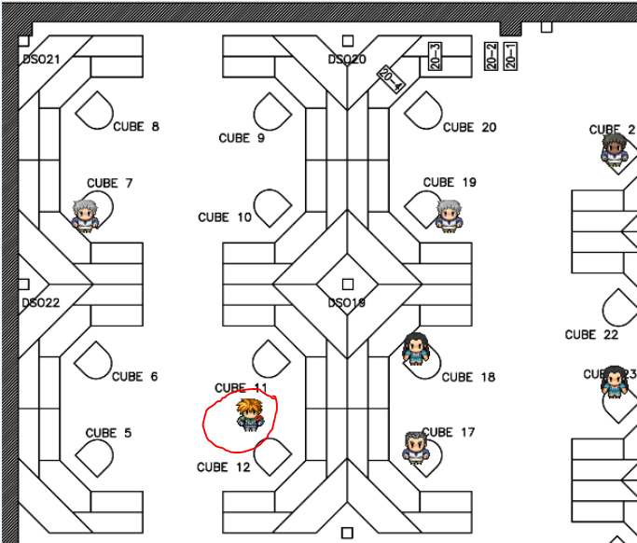
ITP: RPG View
Notes:
This is one corner of the office I would be working in during normal working conditions. It is important to note that this is not the final release for the program. The background textures and other features are still in the works. In its current state it does provide the functionality required to train a new hire and get familiar with the office layout.
In red I circled the character sprite the user controls to navigate the office. The controls are intuitive and easy to learn. I can walk up to a coworker and prompt them for a dialog and other options. If I am searching for my supervisor's office, I can quickly walk around the RPG view to find it without leaving my desk.

Slide 14
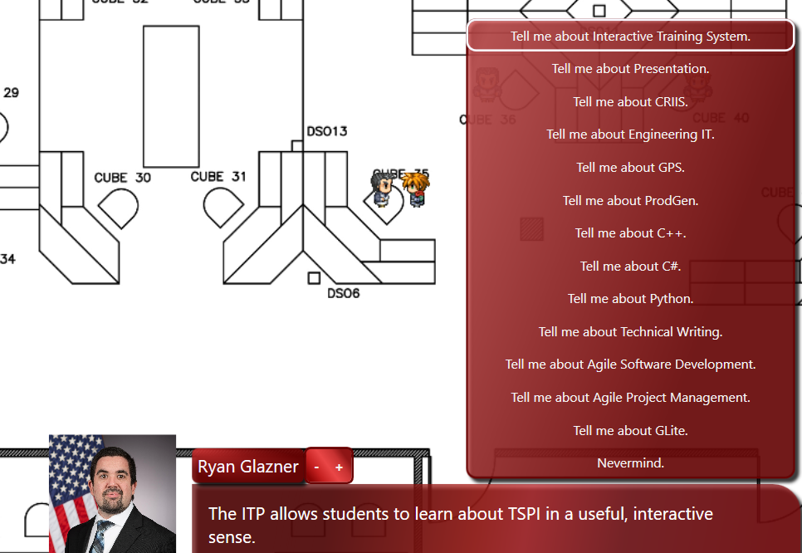
ITP: RPG View (cont.)
Notes:
Here is an example conversation prompt. By initiating conversation with a coworker's character, I can learn more about them and some of the work they are involved in.

Slide 15
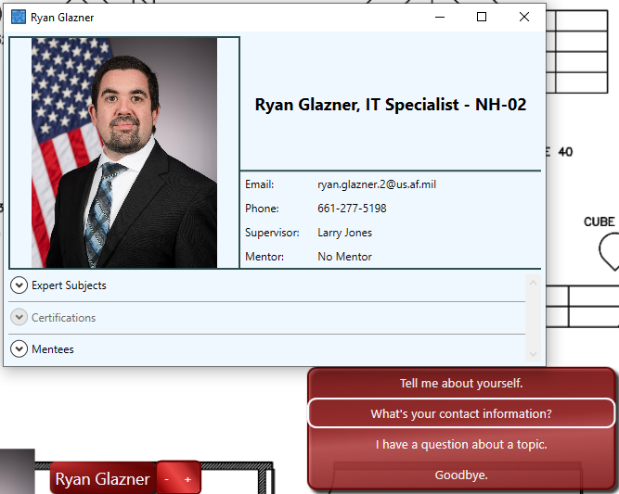
ITP: RPG View (cont.)
Notes:
Another option allows me to see the persons earned certificates, areas of expertise, as well as contact information so I can email them if I have a question.

Slide 16
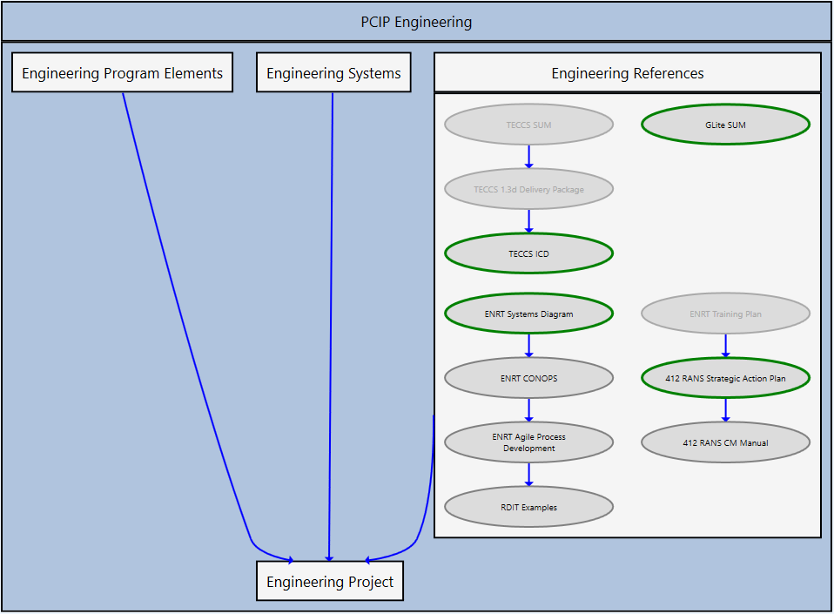
ITP: Task View
Notes:
The task view provides an easy to follow guideline specified by the mentor for the new hire to follow. I was assigned a PCIP Engineering main task, it contained 3 subtasks which I can complete in any order. But I cannot progress onto the engineering project until the three subtasks that are directed towards it are completed. The same holds true to the modules inside the subtasks as can be seen in the engineering references.
These visually directed graphs are generated by the software. The person assigning the tasks to the trainee is only required to decide the order in which things need to be completed and what to store in each tasks such as a pdf for the trainee to read or a person to setup a meeting with.

Slide 17
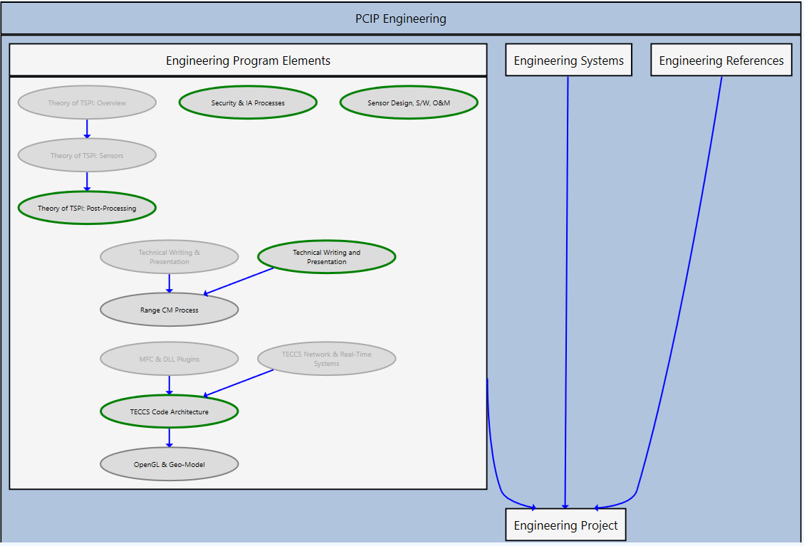
ITP: Task View (cont.)
Notes:
Here I am providing a second example to highlight one point.
In the center you can notice that two modules can be prerequisites for starting another module. This means the graphs can become more complex than a simple linear graph. Allowing for more flexibility on the mentor's side when creating a curriculum.
That was a brief talk about the Interactive Training Program. It is easy to use and is very easy to navigate. This tool has been useful in expediting my training process. I waste less time trying to figure out what my next objective is and more time working on it.

Slide 18
Projects
BestXYZ Processor
NovAtel GPS data processor
Used for positional accuracy analysis
T5 Prod v2
Test Evaluation Command and Control System (TECCS) data conversion utility/product generator
Involvement in initial design phase
Notes:
Over the course of the 3-week extension period, I had the opportunity to work on two projects.
The BestXYZ Processor was an intern project in which I was given a set of requirements. After taking in the requirements, I Was tasked with choosing the tools I deemed fit for the task at hand. During development I Created documentation that falls in line with the TSPI agile development process. And provided a presentation.
T5 Prod version 2 is a project in the early stages of development. It is a Test Evaluation Command and Control System data conversion utility and product generator. I was briefly involved in the design phase which included considerations for how the GUI would be organized. As well as some high-level organization for data structures that will be implemented in code.
I’ll be going over both projects briefly to give a little more context on what they do.

Slide 19
BestXYZ Processor
Global Positioning System (GPS) receivers
Validation of data sources
Positional Accuracy
Why use the BestXYZ Processor?
Notes:
TSPI relies on GPS receivers for its operations.
An important part of the operations involves validating that the data sources are providing accurate values.
If the Positional accuracies are not within a certain margin of error, then further investigation and possible recalibration is required.
The BestXYZ processor allows the differences between a user entered position and collected messages to be compared for potential issues.

Slide 20
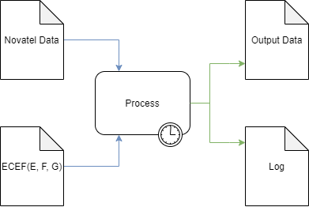
High Level Overview
Inputs
NovAtel Data File
GPS Antenna Coordinates
Earth Centered Earth Fixed
(ECEF)
Processing
Parse the input file
Extract and calculate
Write results to outputs
Outputs
Output Data file
Log file
Notes:
The BestXYZ Processor accepts two inputs:
A Novatel Data File containing Range, Time, and BestXYZ messages.
And a user entered, Earth Centered Earth Fixed coordinates in meters. The axis for this coordinate system are labeled E, F, and G
The application parses messages for useful data that is then formatted into a tabular spreadsheet. A running log file is populated with post runtime statistics such as start time and end time for the current run.

Slide 21
Development Environment
Qt Creator
GUI
QThreads
C++
File parsing
Ring Buffer implementation and management
Populating output files
GitHub
Source control
Agile
User Stories
Requirements, Design, Implementation, and Testing Document (RDIT)
Notes:
Qt was used to create an interactive GUI interface. Qt was also used to handle the background processing thread without locking the GUI
C++ was the primary language used with QT.
The file parsing, ring buffer implementation, and to store the results into output files
The project did not contain any sensitive information. As such the use of GitHub was purely for the emulation of a version control environment.
A subset of the TSPI Agile methodology was used during the development process.
The User Stories helped to ensure requirements were being met
The Requirements, Design, Implementation, and testing documents were used to extract a more concrete set of requirements from the User Stories.
They were also used to go into more detail on the Design and implementation.
The documentation provided one more benefit.
It gives a set of steps for future users and developers to follow when testing the program for error conditions such as an incorrectly specified file paths

Slide 22
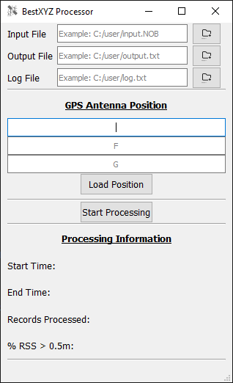
Using the Application
Notes:
This slide shows the GUI Interface.
On top you will notice that there are three entry fields for specifying input and output files. To the right of the entry fields are 3 buttons that allow the user to browse for the files instead of typing in the file path.
Under the file selection, the user can enter the Earth Centered Earth Fixed E, F, and G coordinates in meters. The user also has the option of loading these coordinates from a file by clicking on the “Load Position” button.
The bottom of the GUI has a “Processing Information” section that is updated with some of the log data from the most recent run. In this case it is empty since the application was just started.

Slide 23
T5 Prod v2
T5 Prod creates products from TECCS recording data files
Previous versions only supported FAA (Type 1, 2, and 3A) and tracking radar (Type 6) data
The new version will also support Acquisition (2061 and 3072) data
This need is driven by programs using the new network Acquisition capabilities
Mobile Emitter (MOB-E)
MIT Lincoln Labs (MITLL)
Notes:
-MOB-E currently uses the data provided by TECCS in real-time and for post-mission diagnostics.
-MITLL are potential users of the acquisition data

Slide 24
Presentations
BestXYZ Processor
Presented to the TSPI Flight
Operation
Code
Documentation
Internship Out-Brief
In Progress…
Notes:
During my time at the TSPI I had the chance to apply and improve my presentation skills.
For the BestXYZ Processor I presented the Operation, Code, and Documentation to the TSPI Flight.
The documentation presented was the user manual. This shows how to install, run, and use the application in a simple step by step guide. Other documentation that was part of the project development life cycle but not presented was the RDITs and the user story master list.
The Operation was shown through a demo run. The demo followed the steps outlined in the user manual.
When presenting the code, we went through different sections with a Q & A type of discussion for some of the design decisions involved.
And as you may have already guessed we are living and breathing the second presentation on this list.

Slide 25
3-Week Extension Feedback
Due to the pandemic I was only able to experience a shortened offsite internship.
Pros:
Growth oriented
Family business like work environment
Work life balance
Cons:
No current computer architecture specific projects
Notes:
TSPI values the professional growth of their employees. This is obvious by the opportunities available for pursuing higher level education and certificates. This is also evident from the initiatives put in place to acquire individuals of quality.
From the short time I have been with TSPI, the culture resembles that of a small business. As opposed to a corporation that treats individuals like a tool to be used and abused.
A little bit of background on the why the work life balance means so much to me.
I’ve worked since the age of 11. Mostly in manual labor type jobs like factories and construction. I have also been exposed to an embedded systems industry position last year. These experiences in industry made me realize, there isn’t enough pay in any salary for me to put up with excessive overtime for 30 plus years. For this reason, the work life balance is in my opinion the most important item on that list.
I didn’t have negative experiences to share that were specific to the TSPI flight. The only con I can think of comes from a computer engineering standpoint. The bread and butter of computer engineering is the design of computer hardware. Unfortunately TSPI did not currently have computer architecture projects in the works but this could very well change in the future.
With that being said, I really look forward to coming back next year as a PAC.
Are there any questions?

Slide 26
Questions?

