Slide 1
BestXYZ Processor
Hannselthill Camacho, 412 RANS/ENRT
Hannsel101@mail.fresnostate.edu
(650)307-3916
<Event if applicable>

Slide 2
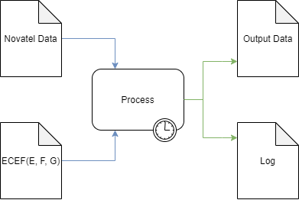
What is BestXYZ Processor?
Inputs
Novatel Data File
GPS Antenna Coordinates
Processing
Parse the input file
Extract and calculate
Write results to outputs
Outputs
Output Data file
Log file
GUI

Slide 3
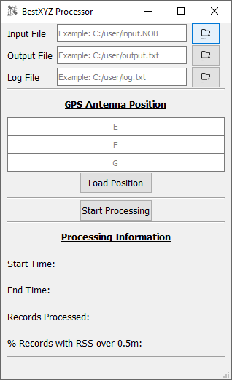
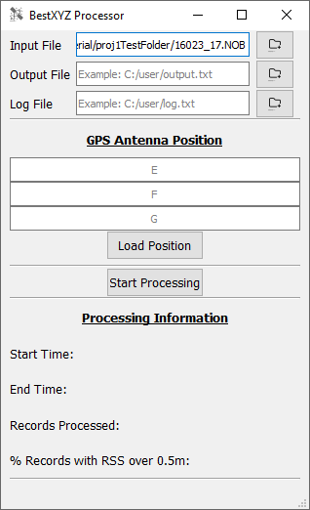
Specifying An Input File
File Selection
File Browsing
Direct Entry

Slide 4
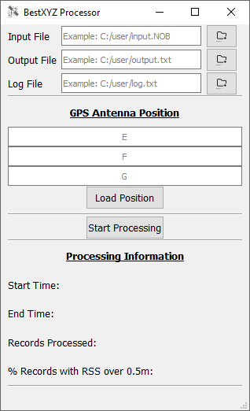
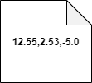
GPS Antenna Position
The user can input E, F, and G in meters
Direct Entry
Browsing for an input GPS Antenna Position file
The contents of the input file are required to be 3 comma separated floating point values on the same line. An example is shown below.

Slide 5
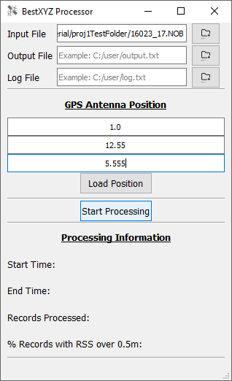
Ready to Processing
The user program is ready to process the input Novatel data file and GPS antenna positions.

Slide 6
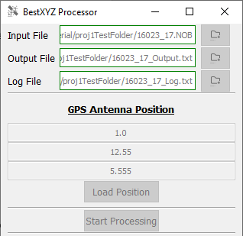
During Processing
Output files are generated
GUI elements are disabled

Slide 7
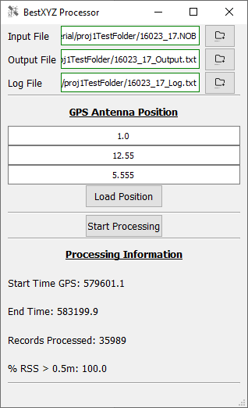
Post Processing
GUI elements are re-enabled
Processing information is updated

Slide 8

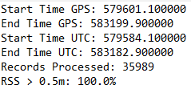
Post Processing(cont.)
The extracted and calculated information has been written into the output files.
Output Data File
Log File

Slide 9
Software Languages & Tools
Qt Creator
GUI
QThreads
C++
File parsing
Ring Buffer implementation and management
Populating output files
GitHub
Source control
Microsoft Office
Word for RDITs and User Manual
Excel for user story list
PowerPoint for presentation

Slide 10
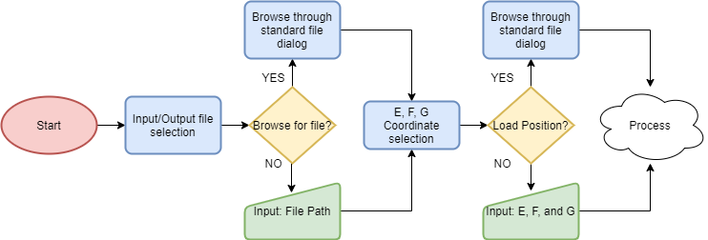
Pre-Process Flow Diagram

Slide 11
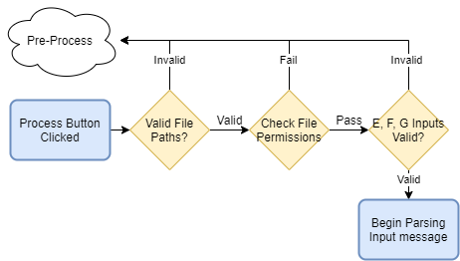
Error Checking Flow Diagram

Slide 12
Message Parsing Flow Diagram

Slide 13
Buffer Implementation
Ring Buffer Design
Read Pointer
Write Pointer
Max Buffer size of 8192
How is a Ring Buffer different from a linear buffer?
Wrap around
Edge Case 1: Reading up to the write pointer
Edge Case 2: Writing up to the read pointer
Edge Case 3: Wrapping around back to the beginning

