Slide 1
BestXYZ Processor
Hannselthill Camacho, 412 RANS/ENRT
Hannsel101@mail.fresnostate.edu
(650)307-3916
Notes:
My name is Hannselthill Camacho and I am going to present the BestXYZ Processor Application

Slide 2
Introduction
Global Positioning System (GPS) receivers
Validation of data sources
Positional Accuracy
Why use the BestXYZ Processor?
Notes:
TSPI relies on GPS receivers for its operations.
An important part of the operations involves validating that the data sources are providing accurate values.
If the Positional accuracies are not within a certain margin of error, then further investigation and possible recalibration is required.
The BestXYZ processor allows the differences between a user entered position and collected messages to be compared for potential issues.

Slide 3
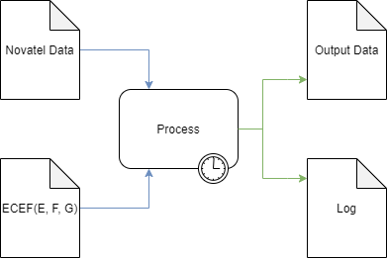
High Level Overview
Inputs
NovAtel Data File
GPS Antenna Coordinates
Earth Centered Earth Fixed
(ECEF)
Processing
Parse the input file
Extract and calculate
Write results to outputs
Outputs
Output Data file
Log file
Notes:
The BestXYZ Processor accepts two inputs:
A Novatel Data File containing Range, Time, and BestXYZ messages.
And a user entered Earth Centered Earth Fixed coordinates in meters. The axis for this coordinate system are labeled E, F, and G
The application parses messages for useful data that is then formatted into a tabular spreadsheet. A running log file is populated with post runtime statistics such as start time and end time for the current run.

Slide 4
Development Environment
Qt Creator
GUI
QThreads
C++
File parsing
Ring Buffer implementation and management
Populating output files
GitHub
Source control
Agile
User Stories
Requirements, Design, Implementation, and Testing Document (RDIT)
Notes:
Qt was used to create an interactive GUI interface. Qt was also used to handle the background processing thread without locking the GUI
C++ was the primary language used with QT.
The file parsing, ring buffer implementation, and to store the results into output files
The project did not contain any sensitive information. As such the use of GitHub was purely for the emulation of a version control environment.
A subset of the TSPI Agile methodology was used during the development process.
The User Stories helped to ensure requirements were being met
The Requirements, Design, Implementation, and testing documents were used to extract a more concrete set of requirements from the User Stories.
They were also used to go into more detail on the Design and implementation.
The documentation provided one more benefit.
It gives a set of steps for future users and developers to follow when testing the program for error conditions such as an incorrectly specified file paths

Slide 5
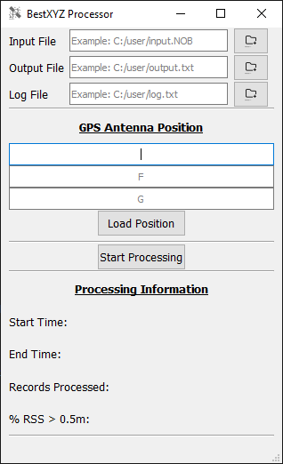
Using the Application
Notes:
Next Ill be going over how simple it is to use the application
This slide shows the GUI Interface.
On top you will notice that there are three entry fields for specifying input and output files.
Under that the Earth Centered Earth Fixed E, F, and G coordinates
The bottom of the GUI has a “Processing Information” section that is updated with some of the log data from the most recent run.

Slide 6
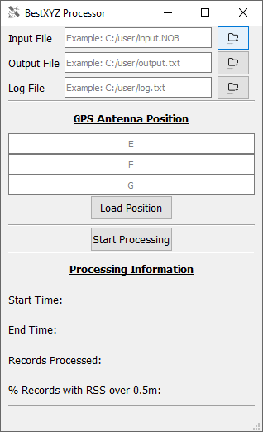
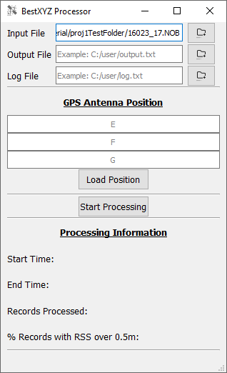
Specifying An Input File
File Selection
File Browsing
Direct Entry
Notes:
So Back to the very top of the application, the user can specify input, output, and log file paths through two methods.
One The user has the option to browse for a file. Upon browsing for a file the file path will populate the appropriate text field.
And two The user also has the option to manually enter the file path.
Only the Input file path is required. If no output or log file paths are specified, then they will automatically be generated for the user during the processing stage of the application. The naming and location of the generated files will be based on the input file path.

Slide 7
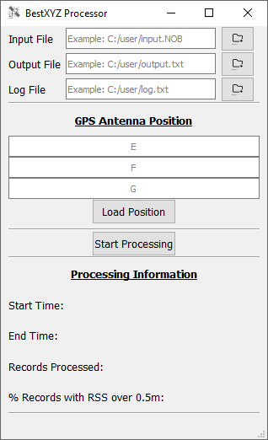
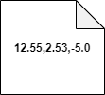
GPS Antenna Position
The user can input E, F, and G in meters
Direct Entry
Browsing for an input GPS Antenna Position file
The contents of the input file are required to be 3 comma separated floating point values on the same line. An example is shown below.
Notes:
The user is required to enter a GPS Antenna position that will be used for calculating positional differences.
The Earth Centered Earth Fixed E, F, and G Coordinates must be specified in meters.
Much like the input and output files, the position can be manually entered into the E, F, and G text entry fields. Or they can be loaded from a file.
If they are loaded from a file, then there is a format that the file must follow. The file must contain three comma separated floating point values that are all on the same line.
An example is shown below.

Slide 8
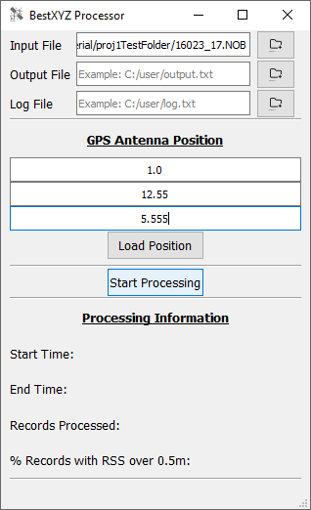
Ready to Processing
The program is ready to process the input NovAtel data file and GPS antenna positions.
Notes:
At this point the user will be ready to click the “Start Processing” button and allow the program to start processing records.

Slide 9
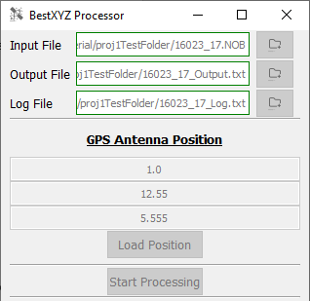
During Processing
Output files are generated
GUI elements are disabled
Notes:
As the program is processing the user specified input file as well as performing calculations, the GUI disables the interactive buttons and text entry fields until it is completely done processing the information

Slide 10
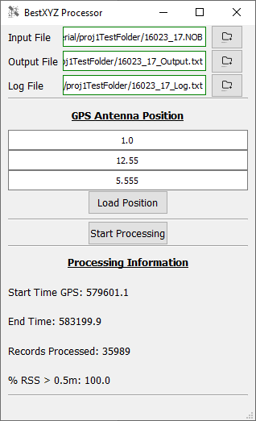
Processing Complete
GUI elements are re-enabled
Processing information is updated
Notes:
Once it is done processing, An output data file is populated with the GPS time, positional differences, and the Root Sum Squared of the magnitude of those differences.
A log file is generated with the Start and end times in UTC time as well as GPS time. The log also contains the number of records processed and the percentage of positional differences with a Root Sum Squared greater than half a meter. Some future considerations for the project would be to allow the margin of error to be determined by the user as opposed to locking it at half a meter.
The GUI is also updated with some of the Log data for the most recent run.

Slide 11

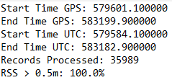
Processing Complete(cont.)
The extracted and calculated information has been written into the output files.
Output Data File
…
…
…
Log File
Notes:
Here is an example of the output data and the Log file for a successful run.
It is important to note that the Output Data File example is truncated to allow it to fit in a PowerPoint slide.
The log file on the other hand, fits very nicely
The next couple of slides will be going more into the flow diagrams and some light technical aspects of the design.

Slide 12
Questions?
Notes:
But Before I continue, does anyone have any questions up to this point?

Slide 13
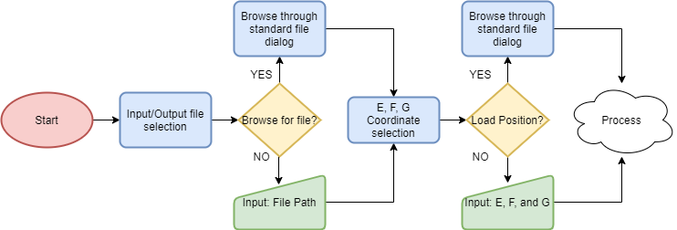
Pre-Process Flow Diagram
Notes:
This diagram shows the flow of the program before the “Start Processing” button has been clicked.
The user specifies input/output files, they must make a decision between browsing for a file or manually inputting the file path.
The user then repeats this step with the E, F, and G coordinates by either typing in the individual values or loading them from a properly formatted file.
The user then begins the processing stage.

Slide 14
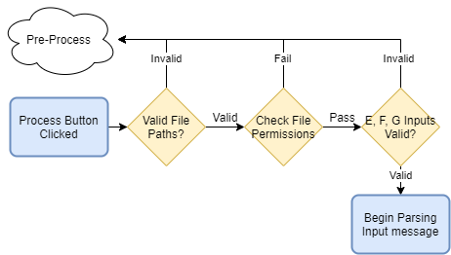
Error Checking Flow Diagram
Notes:
Initially a series of checks will occur to determine if the user specified inputs are valid. If any of the checks fail, then the user must go back and fix the errors.
With that said lets walk through the flow diagram.

Slide 15
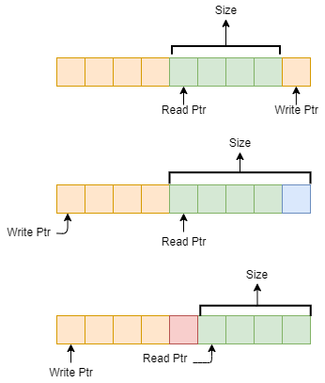
Buffer Implementation
Ring buffer
Write one byte
Read one byte
Notes:
But before we get into the meat of the application. I will be briefly going over the buffer implementation. The buffer was used to read in a chunk of data from the input file and then handle that data before performing another read.
A ring buffer was used for this purpose and it has subtle differences to a standard buffer.
The ring buffer requires keeping track of the read and write indexes.
The write ptr indicates the next value to store a value into.
The read ptr indicates the first index that non-processed data is located
The size specifies the total size of currently buffered data. Not the maximum size of the ring buffer.
When writing or reading to the end of the ring buffer, the pointers wrap around to the beginning.
When the read and the write pointers meet this indicates that either there is no more data stored in the buffer or the buffer is full

Slide 16
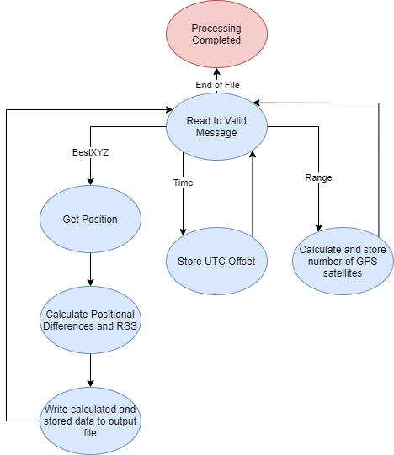
Message Parsing State Machine
Notes:
So now that I went over the ring buffer implementation, I will move on to how the message parsing works.
For this diagram we are going to start at the “Read to Valid Message” state.
In this state we are reading the data stored into the ring buffer until a sync message is found.
Upon finding a sync message the size of the header is compared to the size of the buffer to ensure there is enough data to parse the header. The same is done for every message type encountered.
Another check that is necessary is comparing the extracted checksum to the calculated checksum for each message and header found. If they do not match, then the message is not a valid message.
For each Range that is found, the number of observed GPS satellites is collected and stored. Only the most recent range message information is used when parsing a BestXYZ message.
Similarly when a time message is found, the UTC Offset is extracted for calculating the UTC time of the BestXYZ messages.
When a BestXYZ message is found, The E, F, and G coordinates of the position is extracted in meters. This is used along with the user specified E, F, and G coordinates to calculate the positional differences as well as the Root Sum Squared of those differences.
After each BestXYZ message the calculated and extracted values are stored into the Data output file in a human readable form.

Slide 17
Conclusion
Successfully read NovAtel data
Parsed Range, Time, and BestXYZ messages
Formatted the data into a human readable form
Can be plotted in a spreadsheet program
Notes:
In conclusion, The BestXYZ Processor successfully reads in NovAtel data to parse Range, Time, and BestXYZ messages.
The extracted and calculated data can be used to identify and debug sensor issues

Slide 18
Questions?

