Slide 1
BestXYZ Processor
Hannselthill Camacho, 412 RANS/ENRT
Hannsel101@mail.fresnostate.edu
(650)307-3916
<Event if applicable>

Slide 2
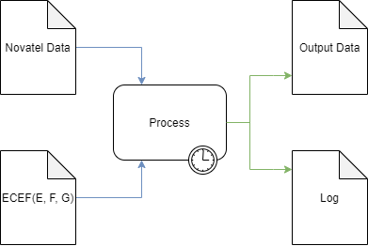
What is BestXYZ Processor?
Inputs
Novatel Data File
GPS Antenna Coordinates
Processing
Parse the input file
Extract and calculate
Write results to outputs
Outputs
Output Data file
Log file
GUI

Slide 3
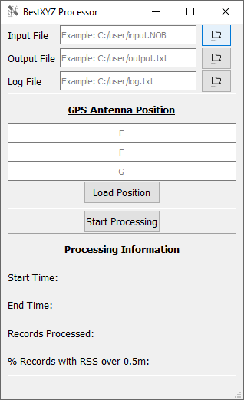
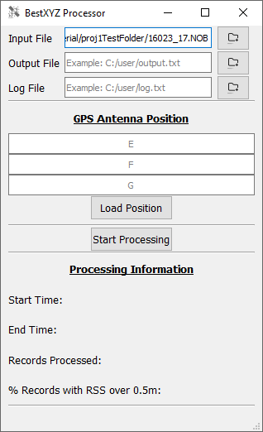
Specifying An Input File
File Selection
File Browsing
Direct Entry

Slide 4
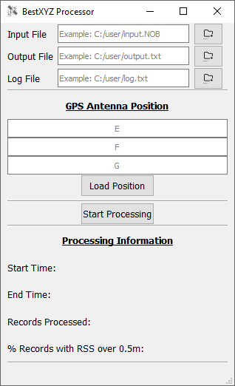
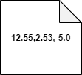
GPS Antenna Position
The user can input E, F, and G in meters
Direct Entry
Browsing for an input GPS Antenna Position file
The contents of the input file are required to be 3 comma separated floating point values on the same line. An example is shown below.

Slide 5
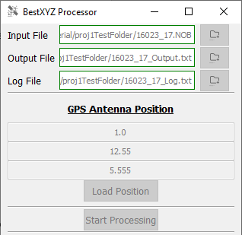
Generating Output Files
Output files are generated based on input file paths

