Slide 1
BestXYZ Processor
Hannselthill Camacho, 412 RANS/ENRT
Hannsel101@mail.fresnostate.edu
(650)307-3916
<Event if applicable>

Slide 2
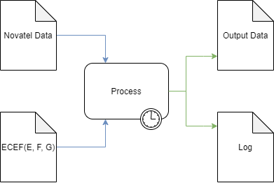
What is BestXYZ Processor?
Inputs
Novatel Data File
GPS Antenna Coordinates
Processing
Parse the input file
Extract and calculate
Write results to outputs
Outputs
Output Data file
Log file
GUI

Slide 3
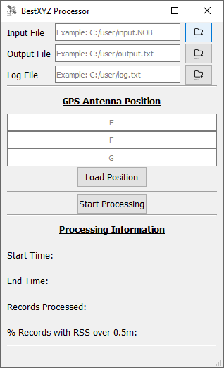
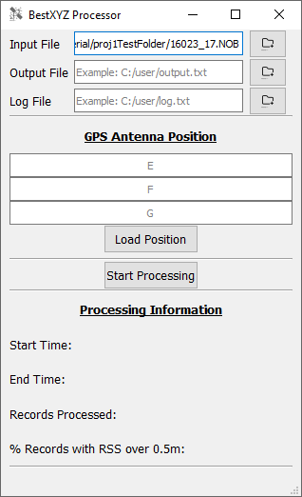
Selecting Input and Output Files
File Selection
File Browsing
Direct Entry

