Slide 1
BestXYZ Processor
Hannselthill Camacho, 412 RANS/ENRT
Hannsel101@mail.fresnostate.edu
(650)307-3916
Notes:
Hello. My name is Hannselthill Camacho and I am going to present the BestXYZ Processor Application

Slide 2
Introduction
TSPI’s ground reference receivers
Validation of data sources
Positional Accuracy
Why use the BestXYZ Processor?
Notes:
TSPI relies on ground reference receiver units for its operations.
An important part of the operations involves validating that the data sources are providing accurate values.
If the Positional accuracies are not within a certain margin of error, then further investigation and possible recalibration is required.
The BestXYZ processor allows the differences between a user entered position and collected messages to be compared for potential issues.

Slide 3
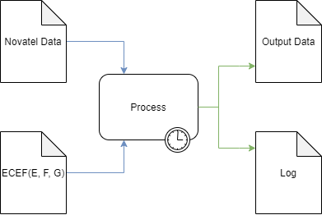
High Level Overview
Inputs
Novatel Data File
GPS Antenna Coordinates
Processing
Parse the input file
Extract and calculate
Write results to outputs
Outputs
Output Data file
Log file
Notes:
The BestXYZ Processor intends to parse Range, Time, and BestXYZ messages for useful data that is then formatted in a tabular form. A running log file is populated with post runtime statistics such as start time and end time for the current run.

Slide 4
Software Languages & Tools
Qt Creator
GUI
QThreads
C++
File parsing
Ring Buffer implementation and management
Populating output files
GitHub
Source control
Agile
User Stories
RDITs
Notes:
- Talk about how the project was not using any controlled information and is only for personal use only to emulate a version control environment for the intern project.

Slide 5
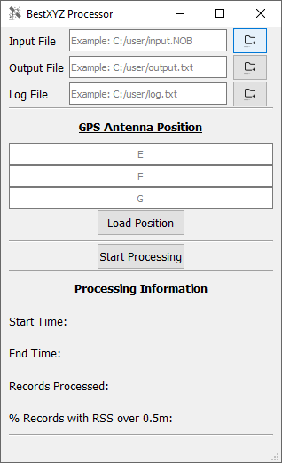
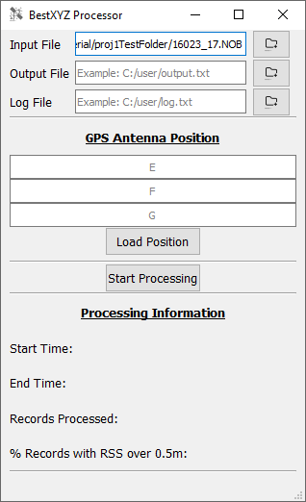
Specifying An Input File
File Selection
File Browsing
Direct Entry

Slide 6
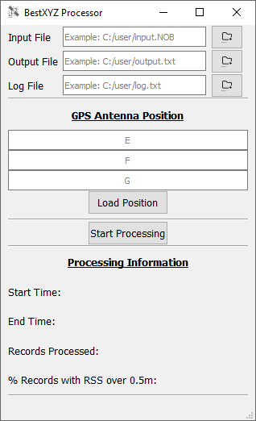
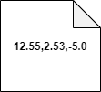
GPS Antenna Position
The user can input E, F, and G in meters
Direct Entry
Browsing for an input GPS Antenna Position file
The contents of the input file are required to be 3 comma separated floating point values on the same line. An example is shown below.

Slide 7
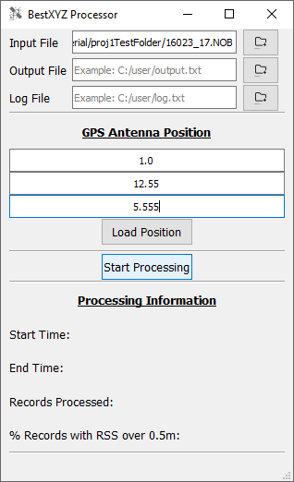
Ready to Processing
The program is ready to process the input Novatel data file and GPS antenna positions.

Slide 8
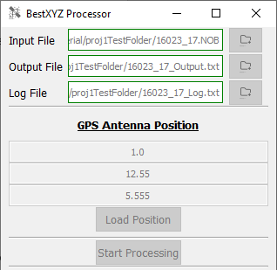
During Processing
Output files are generated
GUI elements are disabled

Slide 9
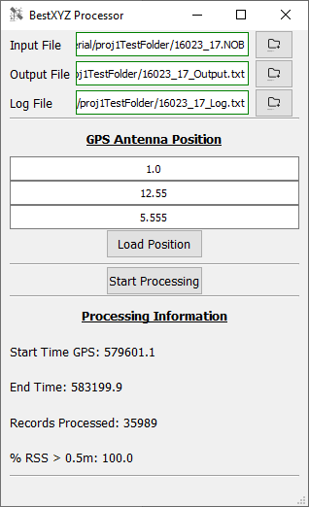
Processing Complete
GUI elements are re-enabled
Processing information is updated

Slide 10

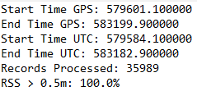
Processing Complete(cont.)
The extracted and calculated information has been written into the output files.
Output Data File
Log File

Slide 11
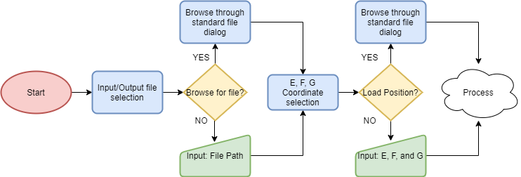
Pre-Process Flow Diagram

Slide 12
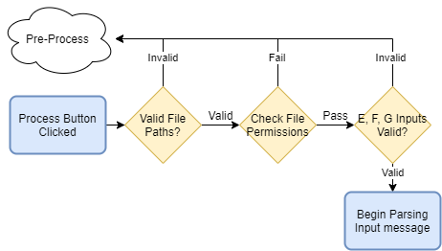
Error Checking Flow Diagram
Notes:
-Change the “Begin Parsing Input Message”

Slide 13
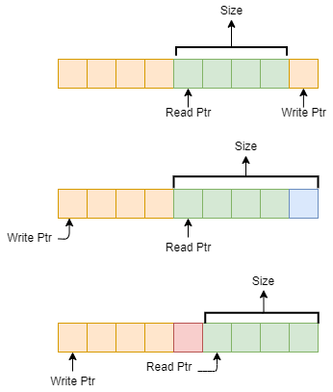
Buffer Implementation
Ring buffer
Write one byte
Read one byte
Notes:
- Ring Buffer Design
Read Pointer
Write Pointer
Max Buffer size of 8192
How is a Ring Buffer different from a linear buffer?
Wrap around
Edge Case 1: Reading up to the write pointer
Edge Case 2: Writing up to the read pointer
Edge Case 3: Wrapping around back to the beginning

Slide 14
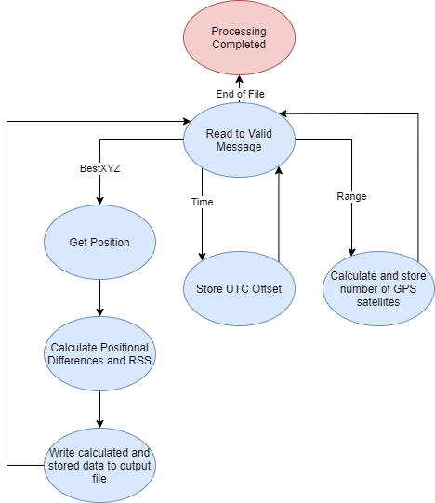
Message Parsing State Machine
Notes:
Range and Time
BestXYZ

Slide 15
Conclusion
Successfully read Novatel data
Parsed Range, Time, and BestXYZ messages
Formatted the data into a human readable form
Notes:
-Tie everything back in from the intro slide to how it was handled

Slide 16
Questions?

