Slide 1
BestXYZ Processor
Hannselthill Camacho, 412 RANS/ENRT
Hannsel101@mail.fresnostate.edu
(650)307-3916
Notes:
Hello. My name is Hannselthill Camacho and I am going to present the BestXYZ Processor Application

Slide 2
Introduction
TSPI’s ground reference receivers
Validation of data sources
Positional Accuracy
Why use the BestXYZ Processor?
Notes:
The BestXYZ Processor intends to parse Range, Time, and BestXYZ messages for useful data that is then formatted in a tabular form. A running log file is populated with post runtime statistics such as start time and end time for the current run.

Slide 3
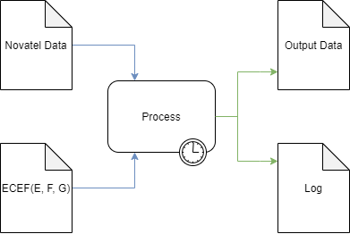
High Level Overview
Inputs
Novatel Data File
GPS Antenna Coordinates
Processing
Parse the input file
Extract and calculate
Write results to outputs
Outputs
Output Data file
Log file

Slide 4
Software Languages & Tools
Qt Creator
GUI
QThreads
C++
File parsing
Ring Buffer implementation and management
Populating output files
GitHub
Source control
Agile
User Stories
RDITs
Notes:
- Talk about how the project was not using any controlled information and is only for personal use only to emulate a version control environment for the intern project.

Slide 5
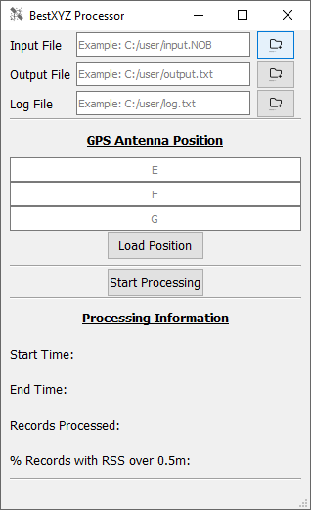
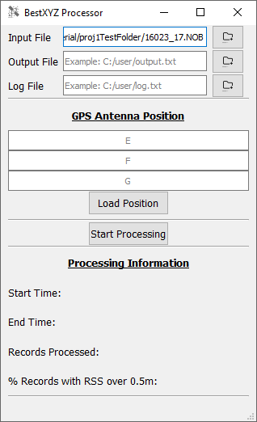
Specifying An Input File
File Selection
File Browsing
Direct Entry

Slide 6
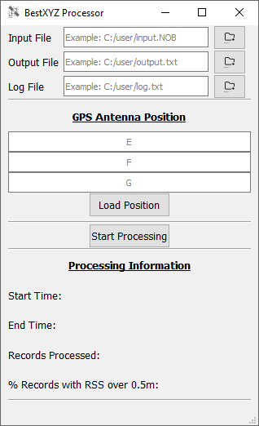
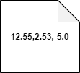
GPS Antenna Position
The user can input E, F, and G in meters
Direct Entry
Browsing for an input GPS Antenna Position file
The contents of the input file are required to be 3 comma separated floating point values on the same line. An example is shown below.

Slide 7
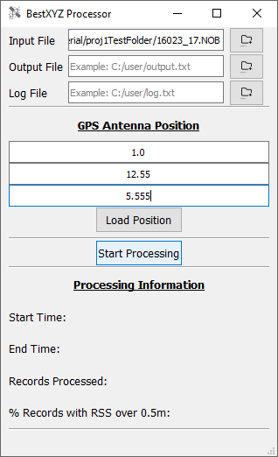
Ready to Processing
The program is ready to process the input Novatel data file and GPS antenna positions.

Slide 8
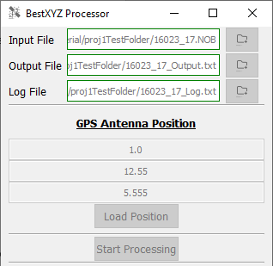
During Processing
Output files are generated
GUI elements are disabled

Slide 9
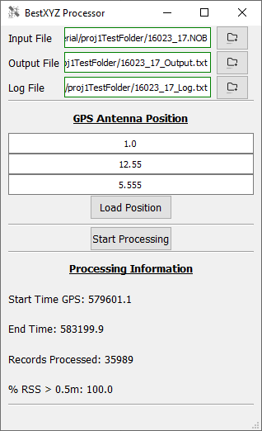
Processing Complete
GUI elements are re-enabled
Processing information is updated

Slide 10

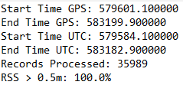
Processing Complete(cont.)
The extracted and calculated information has been written into the output files.
Output Data File
Log File

Slide 11
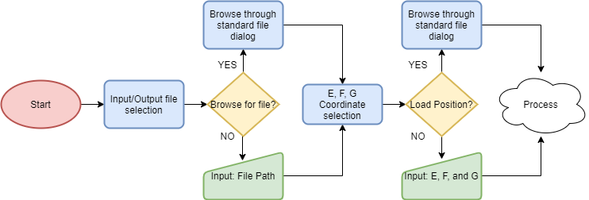
Pre-Process Flow Diagram

Slide 12
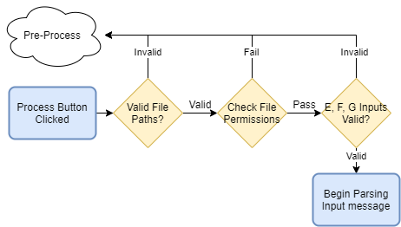
Error Checking Flow Diagram
Notes:
-Change the “Begin Parsing Input Message”

Slide 13
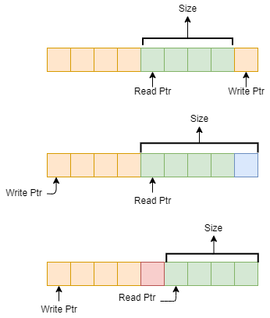
Buffer Implementation
Ring buffer
Write one byte
Read one byte
Notes:
- Ring Buffer Design
Read Pointer
Write Pointer
Max Buffer size of 8192
How is a Ring Buffer different from a linear buffer?
Wrap around
Edge Case 1: Reading up to the write pointer
Edge Case 2: Writing up to the read pointer
Edge Case 3: Wrapping around back to the beginning

Slide 14
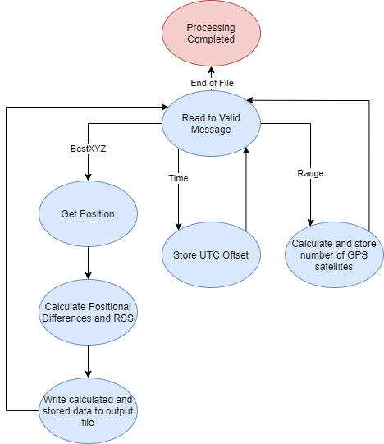
Message Parsing State Machine
Notes:
Range and Time
BestXYZ

Slide 15
Conclusion
Successfully read Novatel data
Parsed Range, Time, and BestXYZ messages
Formatted the data into a human readable form
Notes:
-Tie everything back in from the intro slide to how it was handled

Slide 16
Questions?

