Slide 1




Statistics Pertaining to Gun Violence in the US
CSIT 595 – 01
Zahid aziz, corey hannum, Benjamin cooper

Slide 2

Goals
lKMean for states that prohibit open gun carry: 8.154268
Uncover any correlation between gun policy in each state and gun-related violence
Correlation between median household income and gun-related deaths

Slide 3
Dataset
Gun-related deaths per 100,000 people per state
Income level per state
Open carry handgun laws per state

Slide 4
Tests / Concepts Used
One-sample t-test
Two-sample t-test
Chi-Square test
Correlation
Linear Regression
Histogram

Slide 5
Sample T-tests
One Sample t-Test
Null Hypothesis: The mean of gun-related deaths per state per 100,000 people are equal to the mean of gun-related deaths per 100,000 in New Jersey.
Mean = 5.69
Null Hypothesis proved to be false
P value =
Alternative Hypothesis: Mean is higher than the mean in New Jersey
True Mean = 11.7104

Slide 6
Sample T-tests (cont’d)
Two Sample t-Test
Null Hypothesis: The means of gun-related deaths per 100,000 people of states that allow open handgun carry are equal to the means of those states that do not.
Null Hypothesis proved to be false.
P-value = 0.05623
Alternative Hypothesis: Mean is higher for states that allow open gun carry.
Mean for states that prohibit open gun carry: 8.154268
Mean for states that allow open gun carry: 12.289302

Slide 7
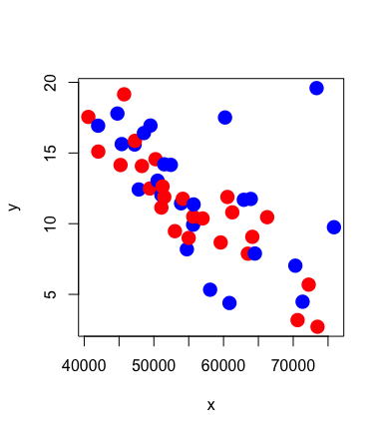
Linear Regression
Correlation between gun-related deaths and median household income per state.
Negative Correlation
More income – less gun-related deaths
- 0.6544557
Coefficient of Determination
.4283123
Meaning about 42% of the variation in gun-related deaths can be attributed to median household income

Slide 8
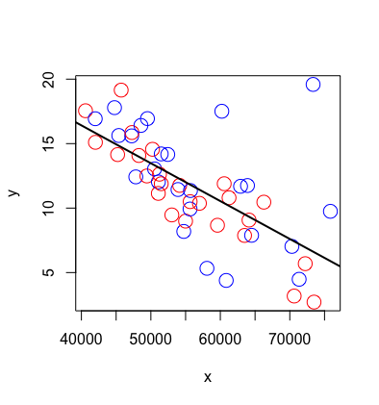
Linear Regression
Significance: ***
Y Intercept: 28.16
Slope of x = -0.0002936

Slide 9
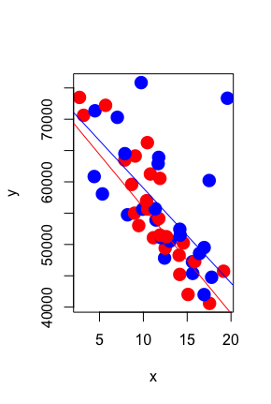
Additional Lines
The blue line is fitted to the states where open gun carry is allowed.
The red line is fitted to the states where open gun carry is prohibited.

Slide 10
Multiple Linear Regression
x1 = Median Incoming
x2 = Open carry permitted
Y = Number of gun-related deaths per 100,000 people
x2 = Held one * significance
x1 = 3 *** significance

Slide 11
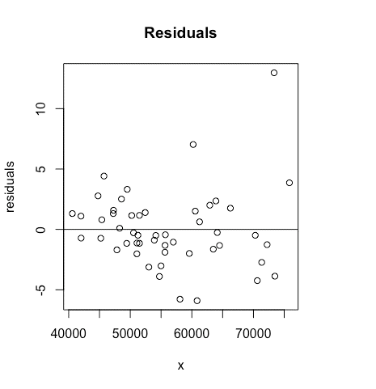
Residuals
Most data points fall within 5 units of the regression line.

Slide 12
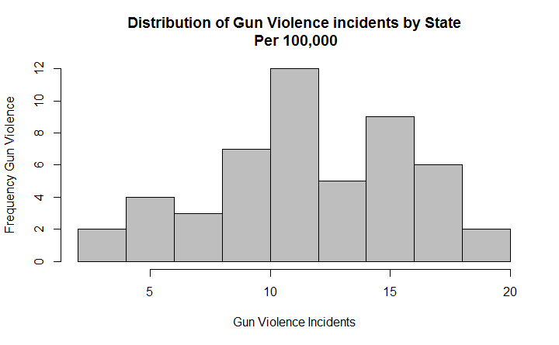
Histogram
Histogram data for Gun related deaths per 100000 per state
Min=2.71
1st Quarter=9.71
Median=11.76
Mean=11.71
3rd Quarter=14.47
Max=19.59
It shows the distribution is roughly unimodal and symmetric.

Slide 13
Chi-Square Test
Null Hypothesis: The laws requiring background checks for private sales is independent of the region of the United States the state is in.
Alternative Hypothesis: he laws requiring background checks for private sales is not independent of the region of the United States the state is in.
Null Hypothesis was proven to be false.
P-value = 0.03598

Slide 14
Chi-Square Test (Cont’d)
Observed Values Expected Values
Region | No | Yes
North East | 2 | 7
South | 13 | 3
Midwest | 8 | 4
West | 6 | 5
Region | No | Yes
North East | 5.44 | 3.56
South | 9.67 | 6.33
Midwest | 7.25 | 4.75
West | 6.65 | 4.35

Slide 15
Chi-Square Test (Cont’d)
Null Hypothesis: There is no relationship between permit level for concealed carry and the region of the United States a state is in.
Alternative Hypothesis: There is a relationship between permit level for concealed carry and the region of the United States a state is in.
The Null Hypothesis was proven to be false.
P-value = 0.01499

Slide 16
Chi-Square Test (Cont’d)
Observed Values Expected Values
Region | Unrestricted | Shall-Issue | May-Issue
North East | 3 | 1 | 4
South | 2 | 12 | 2
Midwest | 3 | 9 | 0
West | 4 | 7 | 1
Region | Unrestricted | Shall-Issue | May-Issue
North East | 2 | 5 | 1
South | 4 | 10 | 2
Midwest | 3 | 7 | 2
West | 3 | 7 | 2

