Slide 1
Course Overview
Data Structures and Algorithms
Nanjing University, Fall 2021
郑朝栋

Slide 2
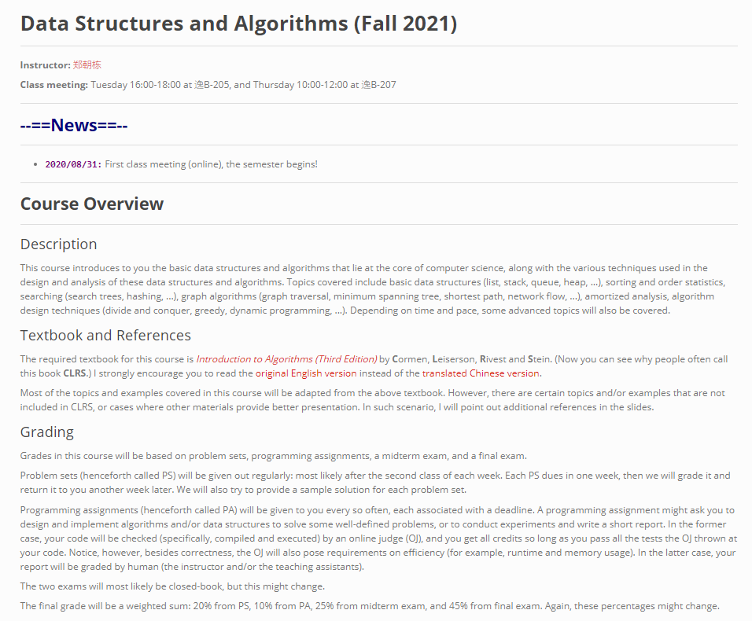
Logistics
Prerequisites: programming and discrete mathematics (including basic discrete probability theory)
We have 2 lectures per week, and you are welcome to talk to me via E-mail or face-to-face.
E-mail: chaodong.gm@gmail.com
Office hour: every Thursday 3:30pm-5:00pm, 计算机系楼302
There is also a QQ group: 907311959
We have some TAs. (More info on the course webpage.)
Yes, we have a course webpage, check it regularly!
https://chaodong.me/teaching/dsalg/2021

Slide 3
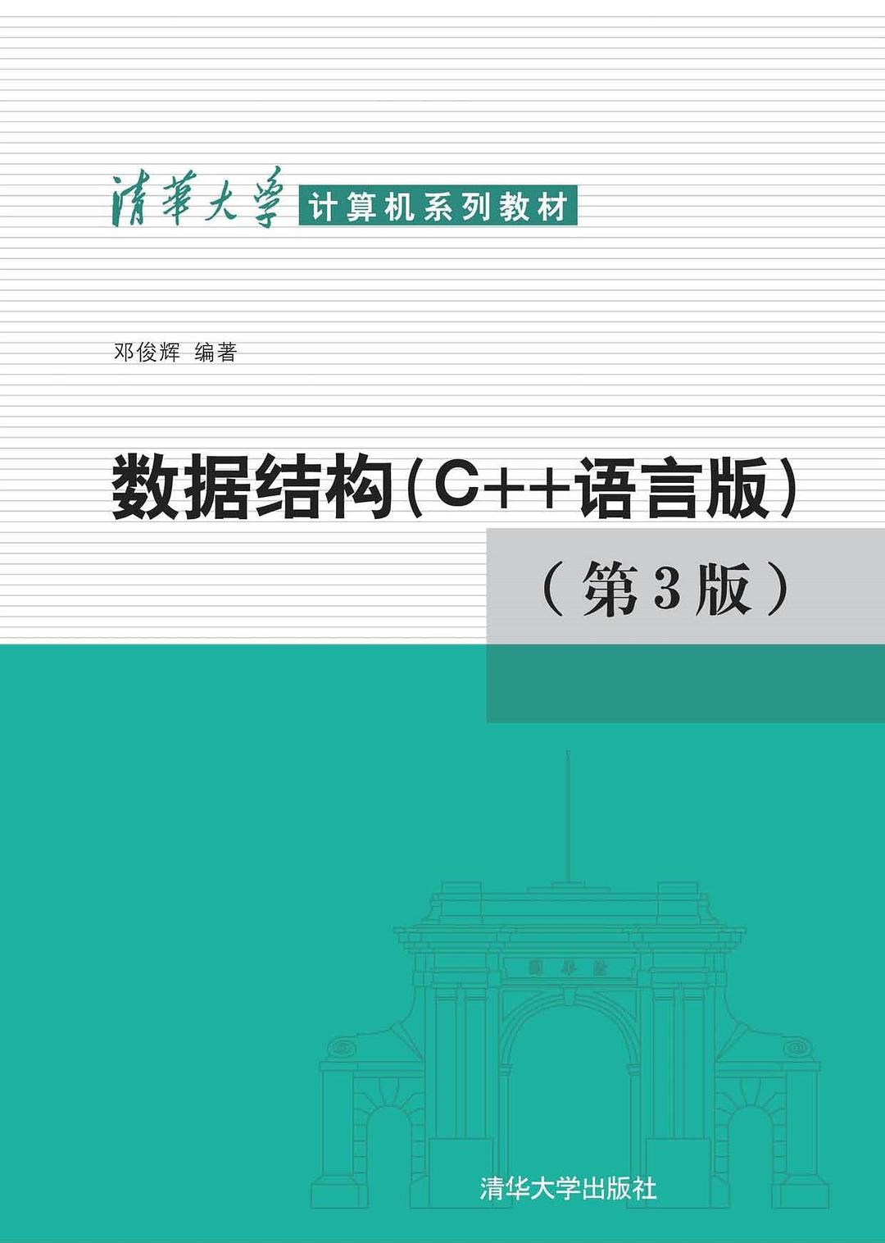
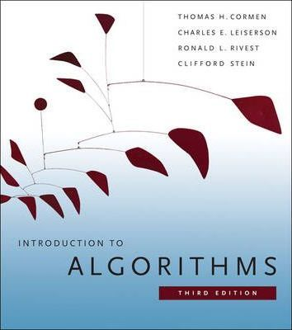
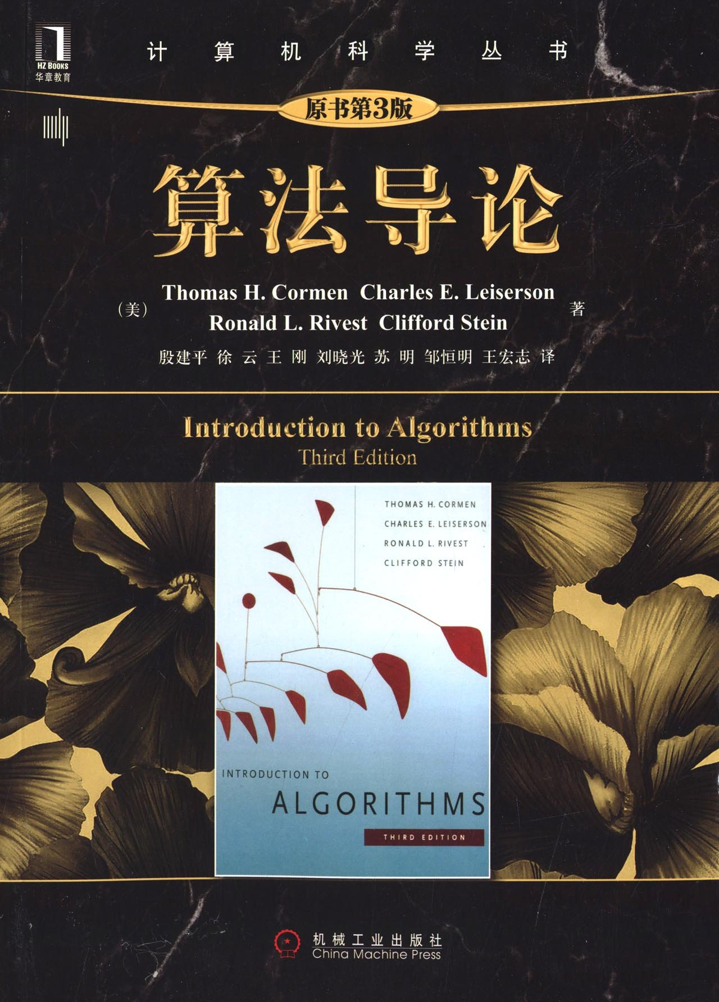
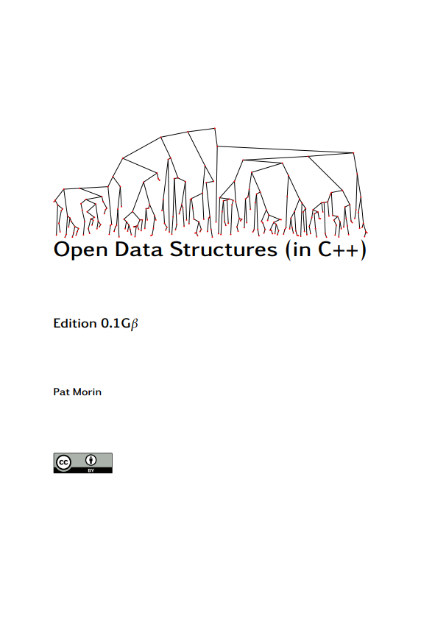
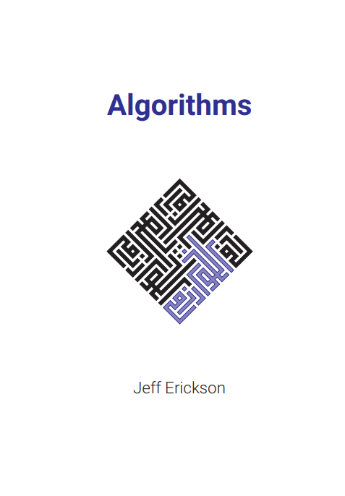
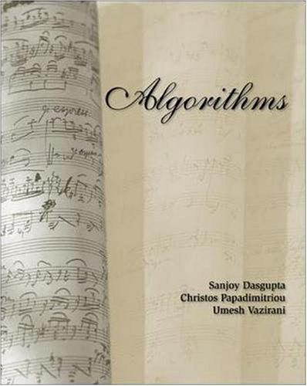
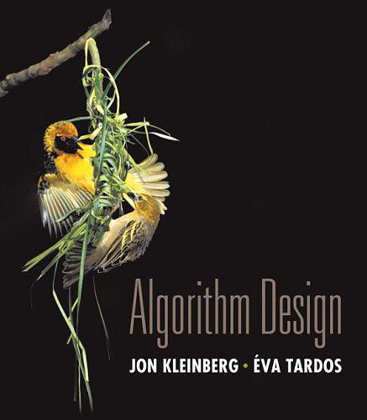
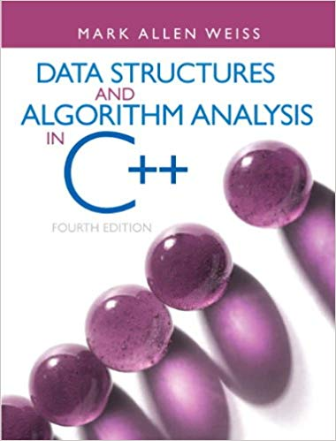

Textbook and References
Textbook is “Introduction to Algorithms (3ed)” by C.L.R.S.
Many others can be helpful references…
数据结构（C++语言版）, 3ed, 邓俊辉
Open Data Structures (in C++), 0.1G$β$, Pat Morin
Algorithms, Jeff Erickson
Algorithms, S. Dasgupta, C. Papadimitriou, and U. Vazirani
Algorithm Design, Jon Kleinberg and Éva Tardos
Data Structures and Algorithm Analysis in C++, 4ed, Mark Weiss

Slide 4
Grading
Problem Sets + Programming Assignments + Exams
Problem sets (PS): weekly, 20%
Programming assignments (PA): every so often, 10%
Exams: midterm (25%) and final (45%), likely closed-book
Each PS dues in one week, we will grade it and return it to you another week later. (Usually along with a sample solution.)
Each PA has a deadline, and you get all credits so long as you solve it before the deadline.
We take academic integrity seriously!
Always try to solve PS and PA independently.
You may discuss with others if you really need to, but you must list their names in your answers.
You may not search and/or copy-paste existing solutions.
Bottomline: write down your answers independently!

Slide 5
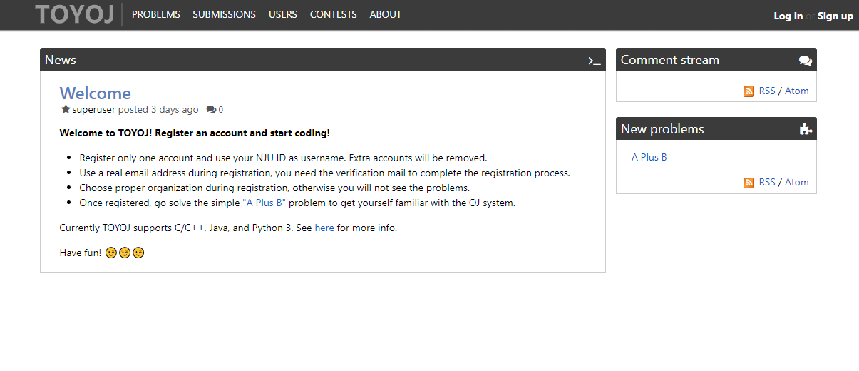
More on PA
We have built an Online-Judge (OJ) system for (most) PA.
https://oj.chaodong.me
Use NJU ID as username and pick proper class as organization.
Register only one account, fake/dummy accounts will be removed.
Use an authentic email address to receive the verification mail.
Use C (C99 with GCC) or C++ (C++11 with G++), Java (OpenJDK 8) and Python 3 sometimes allowed (but limited support).

Slide 6
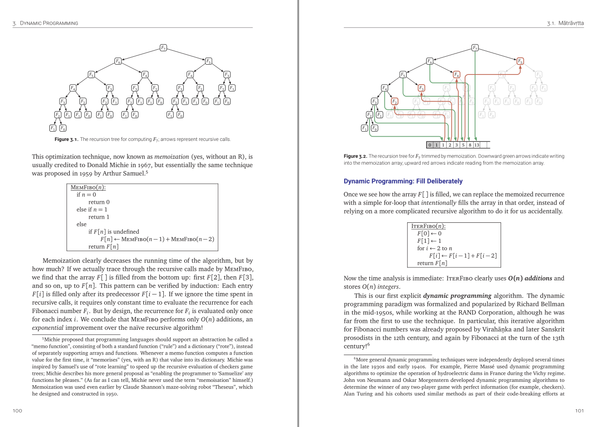
More on Typesetting
We recommend using LaTeX to typeset your PS solutions.
Why LaTeX? (Instead of, say, Microsoft Word)
In general, documents generated by LaTeX looks better
More convenient in many aspects (math, pseudocode, numbering, …)
However!
LaTeX is NOT a WYSIWYG typesetting software
It takes some (but not much) time to learn to use LaTeX
You can get more info on LaTeX from the course webpage.

Slide 7
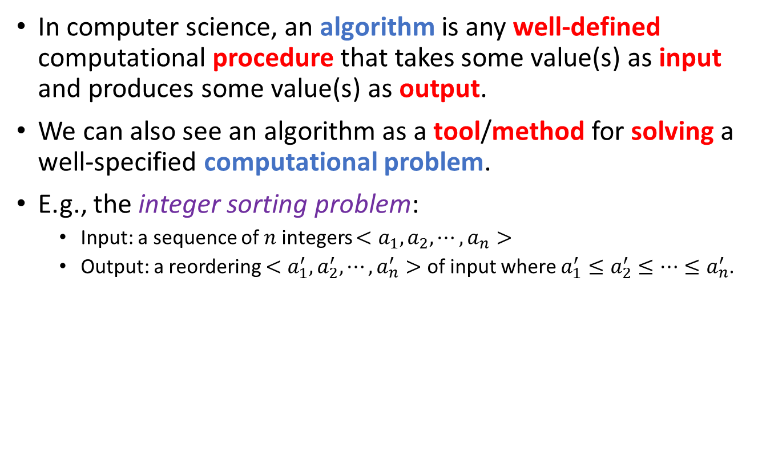
So, what is an “algorithm”?
In computer science, an algorithm is any well-defined computational procedure that takes some value(s) as input and produces some value(s) as output.
We can also see an algorithm as a tool/method for solving a well-specified computational problem.
E.g., the integer sorting problem:
Input: a sequence of $n$ integers $<a_{1},a_{2},⋯,a_{n}>$
Output: a reordering $<a_{1}^{′},a_{2}^{′},⋯,a_{n}^{′}>$ of input where $a_{1}^{′}≤a_{2}^{′}≤⋯≤a_{n}^{′}$.
Computer
Input
Execute an algorithm
Output

Slide 8

So, what is an “algorithm”?
An algorithm is a tool/method for solving a well-specified computational problem.
E.g., the integer sorting problem:
Input: a sequence of $n$ integers $<a_{1},a_{2},⋯,a_{n}>$
Output: a reordering $<a_{1}^{′},a_{2}^{′},⋯,a_{n}^{′}>$ of input where $a_{1}^{′}≤a_{2}^{′}≤⋯≤a_{n}^{′}$.
A particular input of a problem is an instance of that problem.
an instance of the integer sorting problem
Computer
<1, 9, 1, 3>
Execute an integer sorting algorithm
<1, 1, 3, 9>

Slide 9
Correctness of an algorithm
An algorithm is a tool/method for solving a well-specified computational problem.
A particular input of a problem is an instance of that problem.
An algorithm is correct (w.r.t. a problem) if for every input instance, the algorithm halts with the correct output.
Incorrect algorithms might:
Never halt on some instances;
Halt with incorrect outputs on some instances.
Incorrect (or, imperfect) algorithms can be useful!
Correct (perfect) algorithms might be too slow or even do not exist.
Imperfect algorithms may output good enough (but not perfect) answers.
Imperfect algorithms may never stop in some extreme cases, but halt and output correct answers in most (say 99.9%) cases.

Slide 10
What is a “data structure”?
A data structure is a way to store and organize data in order to facilitate access and modifications.
E.g., array and linked list.
Different types of data demand different data structures.
One type of data could be represented by different data structures. Picking an appropriate one is important!
Computer
<1, 9, 1, 3>
integer sorting algorithm A
<1, 1, 3, 9>
1
9
1
3
Computer
<1, 9, 1, 3>
integer sorting algorithm B
<1, 1, 3, 9>
1
9
1
3

Slide 11
Things you’ll learn in this course
A collection of common and widely used data structures;
Basic algorithm design and analysis techniques;
A collection of classical algorithms;
Some related advanced topics, if we have time.
General goal: You can use computers to correctly and efficiently solve computational problems. (Develop/pick appropriate algorithms and data structures along the way.)

Slide 12
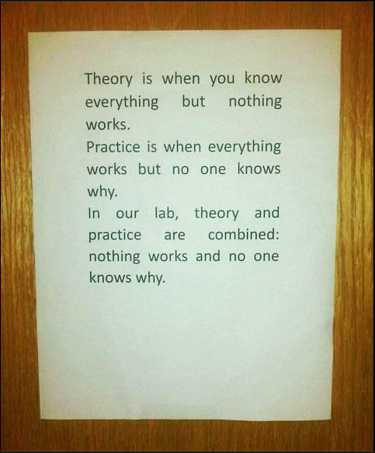
Before we move on…
This is an important course
This is a “heavy” course (4+4-2=4?!)
This is a hard course
Read the textbook, do the assignments!
Theory versus Practice

Slide 13
Reading
[CLRS] Ch.1

