Slide 1
Divide and Conquer
Data Structures and Algorithms
Nanjing University, Fall 2021
郑朝栋

Slide 2
Divide-and-Conquer
Reduce
Divide the problem into a set of subproblems.
Conquer the subproblems by solving them recursively.
Or, use brute-force if a subproblem is small enough.
Combine the solutions for the subproblems to obtain the solution for the original problem.
But, we might not need to consider all subproblems. In fact, sometimes only need to consider one subproblem.
The “combine” step will also be easier, or simply trivial…

Slide 3


Slide 4
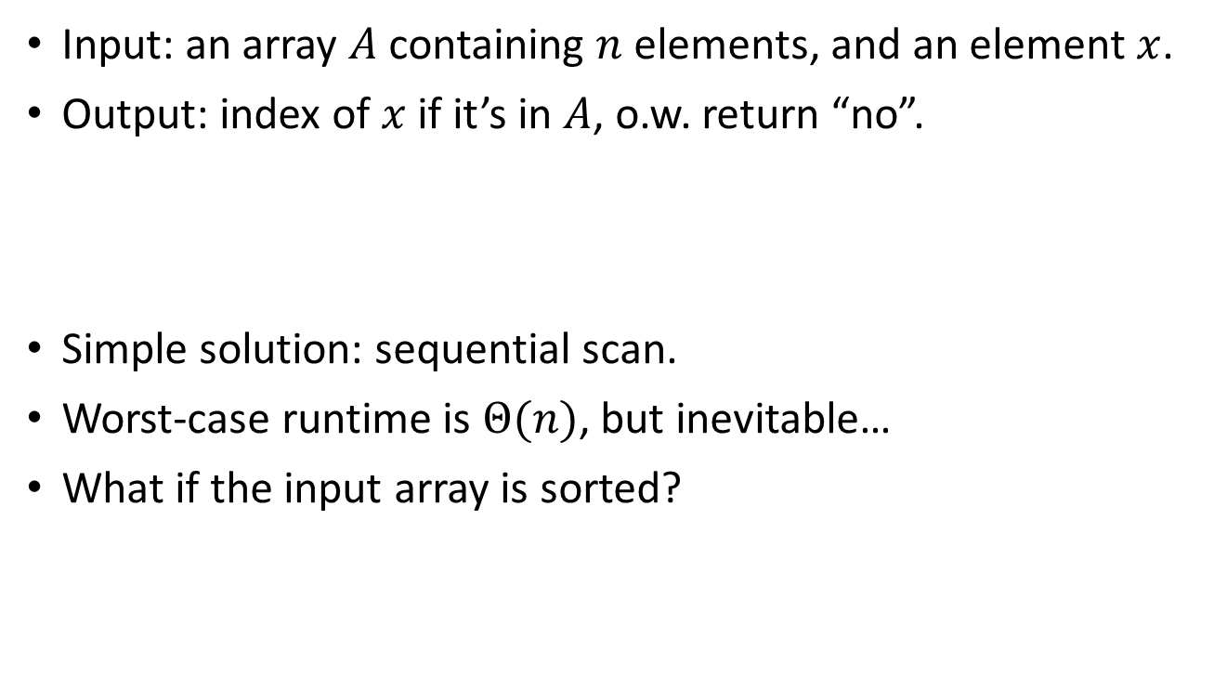
The Search Problem
sorted array
Input: an array $A$ containing $n$ elements, and an element $x$.
Output: index of $x$ if it’s in $A$, o.w. return “no”.
Simple solution: sequential scan.
Worst-case runtime is $Θ(n)$, but inevitable…
What if the input array is sorted?
9
3
7
1
5
6
1
9
3
7
1
5
6
8
returns “4”
returns “no”
2
4
4
5
6
7
8
9
11
17
23
28
17

Slide 5
Binary Search
2
4
4
5
6
7
8
9
11
17
23
28
17
Find the middle element: 7.
Compare 17 to the middle element: 7<17.
Reduce the array to one of the two splits: the right half.
Recurse!

Slide 6
Binary Search
2
4
4
5
6
7
8
9
11
17
23
28
17
Find the middle element: 11.
Compare 17 to the middle element: 11<17.
Reduce the array to one of the two splits: the right half.
Recurse!

Slide 7
Binary Search
2
4
4
5
6
7
8
9
11
17
23
28
17
Find the middle element: 23.
Compare 17 to the middle element: 23>17.
Reduce the array to one of the two splits: the left half.
Recurse!

Slide 8
Binary Search
2
4
4
5
6
7
8
9
11
17
23
28
17
Find the middle element: 17.
Compare 17 to the middle element: 17=17.
We have found the element, and we are done!

Slide 9
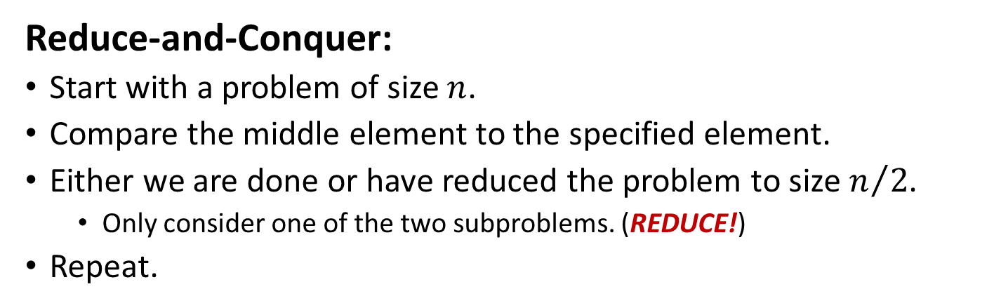
Binary Search
2
4
4
5
6
7
8
9
11
17
23
28
17
Reduce-and-Conquer:
Start with a problem of size $n$.
Compare the middle element to the specified element.
Either we are done or have reduced the problem to size $n/2$.
Only consider one of the two subproblems. (REDUCE!)
Repeat.

Slide 10
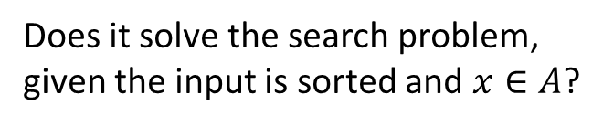


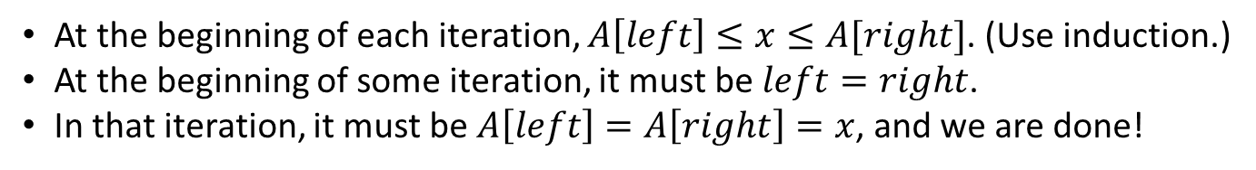
Binary Search
BinarySearch(A, x):
left=1, right=n
while (true)
middle = (left+right)/2
if (A[middle]==x)
return middle
else if (A[middle]<x)
left = middle+1
else
right = middle-1
Does it solve the search problem, given the input array is sorted?
floor or ceil?
No! (E.g., when $x$ is not in $A$.)
Does it solve the search problem, given the input is sorted and $x∈A$?
Yes?
At the beginning of each iteration, $A\left[left\right]≤x≤A[right]$. (Use induction.)
At the beginning of some iteration, it must be $left=right$.
In that iteration, it must be $A\left[left\right]=A\left[right\right]=x$, and we are done!
Okay, but what if $x∉A?$

Slide 11
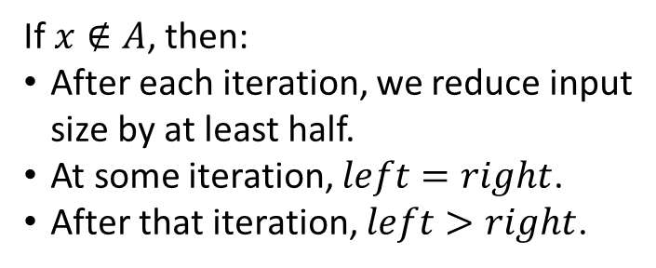


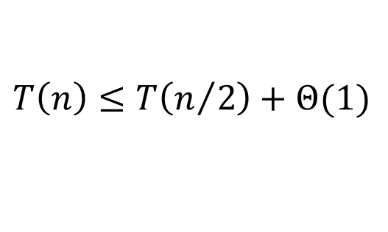
Binary Search
BinarySearch(A, x):
left=1, right=n
while (true)
middle = (left+right)/2
if (A[middle]==x)
return middle
else if (A[middle]<x)
left = middle+1
else
right = middle-1
return “no”
Why this algorithm works?
(left<=right)
If $x∈A$, previous argument still holds.
If $x∉A$, then:
After each iteration, we reduce input size by at least half.
At some iteration, $left=right$.
After that iteration, $left>right$.
Time complexity of BinarySearch?
$$T\left(n\right)≤T\left(n/2\right)+Θ(1)$$
$$T\left(n\right)=O\left(\log{n}\right)$$

Slide 12


Slide 13
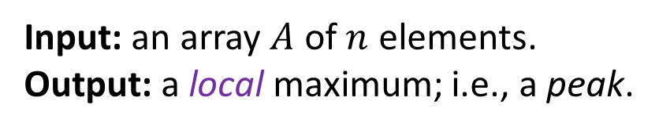
Peak finding
Input: an array $A$ of $n$ elements.
Output: a local maximum; i.e., a peak.
An element $A\left[i\right]$ is a peak if it’s no smaller than its adjacent elements.
Every non-empty $A$ has at least one peak. (WHY?)

Slide 14

Peak finding Local vs Global Maximum
Global max is better, but finding it takes more time…
Sequential scan needs $O(n)$ time, and it’s inevitable.
Sometimes a peak is “good enough”.
Finding a peak costs much less time!

Slide 15
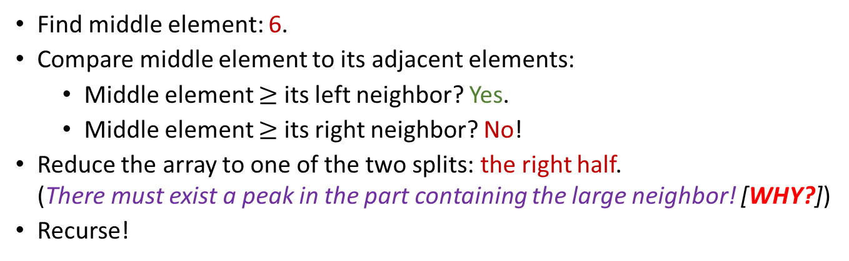
Peak finding
2
4
9
2
5
6
23
4
6
8
17
5
Find middle element: 6.
Compare middle element to its adjacent elements:
Middle element $≥$ its left neighbor? Yes.
Middle element $≥$ its right neighbor? No!
Reduce the array to one of the two splits: the right half. (There must exist a peak in the part containing the large neighbor! [WHY?])
Recurse!

Slide 16
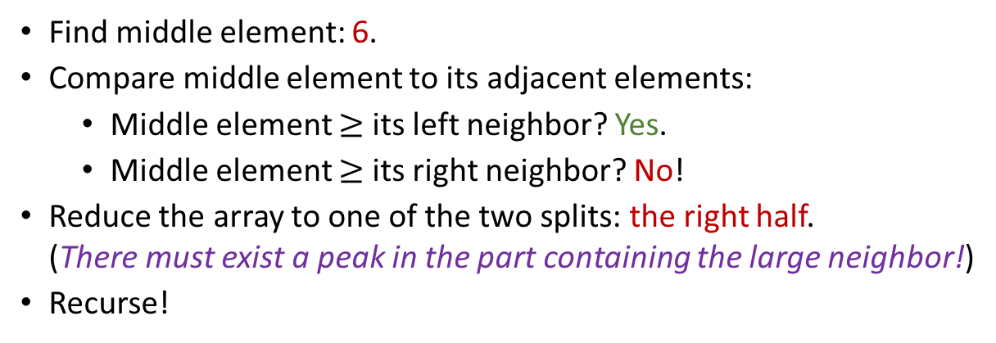
Peak finding
2
4
9
2
5
6
23
4
6
8
17
5
Find middle element: 6.
Compare middle element to its adjacent elements:
Middle element $≥$ its left neighbor? Yes.
Middle element $≥$ its right neighbor? No!
Reduce the array to one of the two splits: the right half. (There must exist a peak in the part containing the large neighbor!)
Recurse!

Slide 17

Peak finding
2
4
9
2
5
6
23
4
6
8
17
5
Find middle element: 17.
Compare middle element to its adjacent elements:
Middle element $≥$ its left neighbor? Yes.
Middle element $≥$ its right neighbor? Yes. WE ARE DONE!

Slide 18

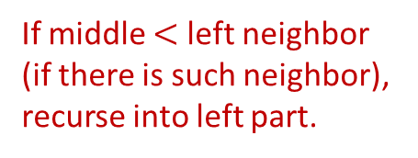
Peak finding
PeakFinding(A):
left=1, right=n
while (left<=right)
middle = (left+right)/2
if (middle>left and A[middle-1]>A[middle])
right = middle-1
else if (middle<right and A[middle+1]>A[middle])
left = middle+1
else
return A[middle]
Current array is not empty.
If middle $<$ left neighbor (if there is such neighbor), recurse into left part.
Get the middle element.
We find a peak!
If middle $<$ right neighbor (if there is such neighbor), recurse into right part.
Why this algorithm is correct?
It always terminates. (WHY?)

Slide 19
Peak finding
PeakFinding(A):
left=1, right=n
while (left<=right)
middle = (left+right)/2
if (middle>1 and A[middle-1]>A[middle])
right = middle-1
else if (middle<n and A[middle+1]>A[middle])
left = middle+1
else
return A[middle]
Current array is not empty.
If middle $<$ left neighbor (if there is such neighbor), recurse into left part.
Get the middle element.
We find a peak!
If middle $<$ right neighbor (if there is such neighbor), recurse into right part.
Why this algorithm is correct?
It always terminates. (WHY?)

Slide 20

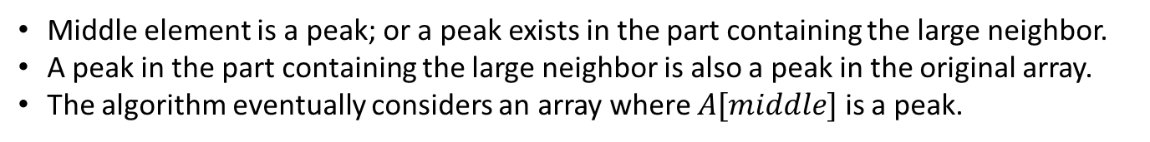
Peak finding
PeakFinding(A):
left=1, right=n
while (left<=right)
middle = (left+right)/2
if (middle>left and A[middle-1]>A[middle])
right = middle-1
else if (middle<right and A[middle+1]>A[middle])
left = middle+1
else
return A[middle]
Why this algorithm is correct?
It always returns an right answer. (WHY?)
Middle element is a peak; or a peak exists in the part containing the large neighbor.
A peak in the part containing the large neighbor is also a peak in the original array.
The algorithm eventually considers an array where $A[middle]$ is a peak.
Runtime of this algorithm?
$$O(\log{n})$$
Finding local max is faster!

Slide 21


Peak finding, now in 2D!
Input: a 2D array $A$ of $n×n=n^{2}$ elements.
Output: a local maximum; i.e., a peak.
An element $A\left[i\right][j]$ is a peak if it’s no smaller than its four adjacent elements.
Every non-empty $A$ has at least one peak. (WHY?)
(Proof: Start from a node, follow an “increasing path”, eventually must reach a peak.)
10
8
5
2
1
3
2
1
5
7
17
5
9
2
5
7
9
4
6
8
6
1
4
6
8

Slide 22



Peak finding in 2D, Algorithm I
“Compress” each column into one element, resulting an 1D array.
Use max of each column to represent that column.
Run previous algorithm on the 1D array and return a peak.
Why it works?
How fast is it?
10
8
5
2
1
$$O\left(n^{2}\right)+O\left(\log{n}\right)=O\left(n^{2}\right)$$
3
2
1
5
7
a
Nice idea, but too slow…
17
5
9
2
5
c
m
d
7
9
4
6
8
m_{i}
b
m_{j}
6
1
4
6
8
17
9
9
6
8
$$m≥a,m≥b$$
$$m≥m_{i}≥c,m≥m_{j}≥d$$

Slide 23

Peak finding in 2D, Algorithm II
Scan the middle column and find max element $m$.
If $m$ is a peak then return it, and we are done.
Otherwise, left or right neighbor of $m$ is bigger than $m$. Recurse into that part.
A divide (reduce) and conquer algorithm!
10
8
5
2
1
3
2
1
5
7
17
11
9
2
5
7
9
4
6
8
6
1
4
6
8

Slide 24
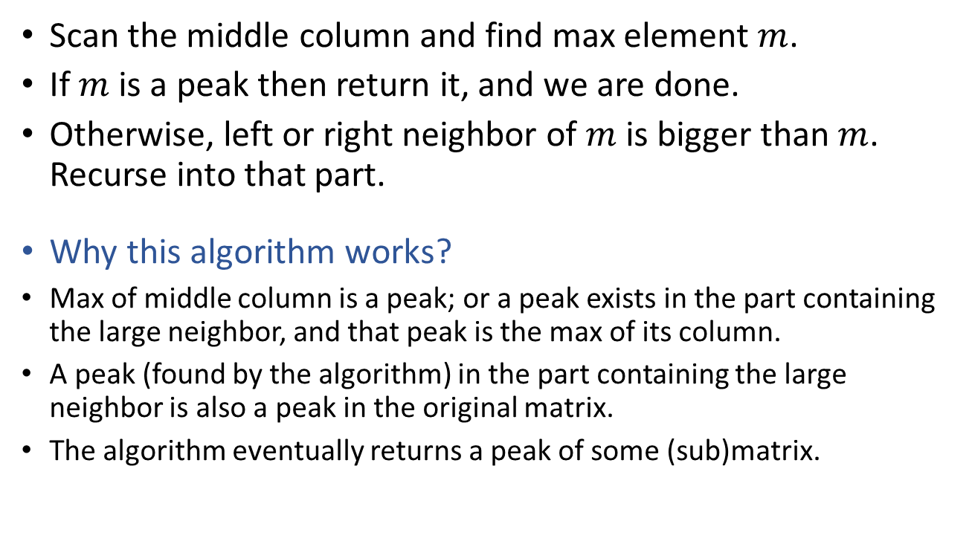
Peak finding in 2D, Algorithm II
Scan the middle column and find max element $m$.
If $m$ is a peak then return it, and we are done.
Otherwise, left or right neighbor of $m$ is bigger than $m$. Recurse into that part.
Why this algorithm works?
Max of middle column is a peak; or a peak exists in the part containing the large neighbor, and that peak is the max of its column.
A peak (found by the algorithm) in the part containing the large neighbor is also a peak in the original matrix.
The algorithm eventually returns a peak of some (sub)matrix.

Slide 25
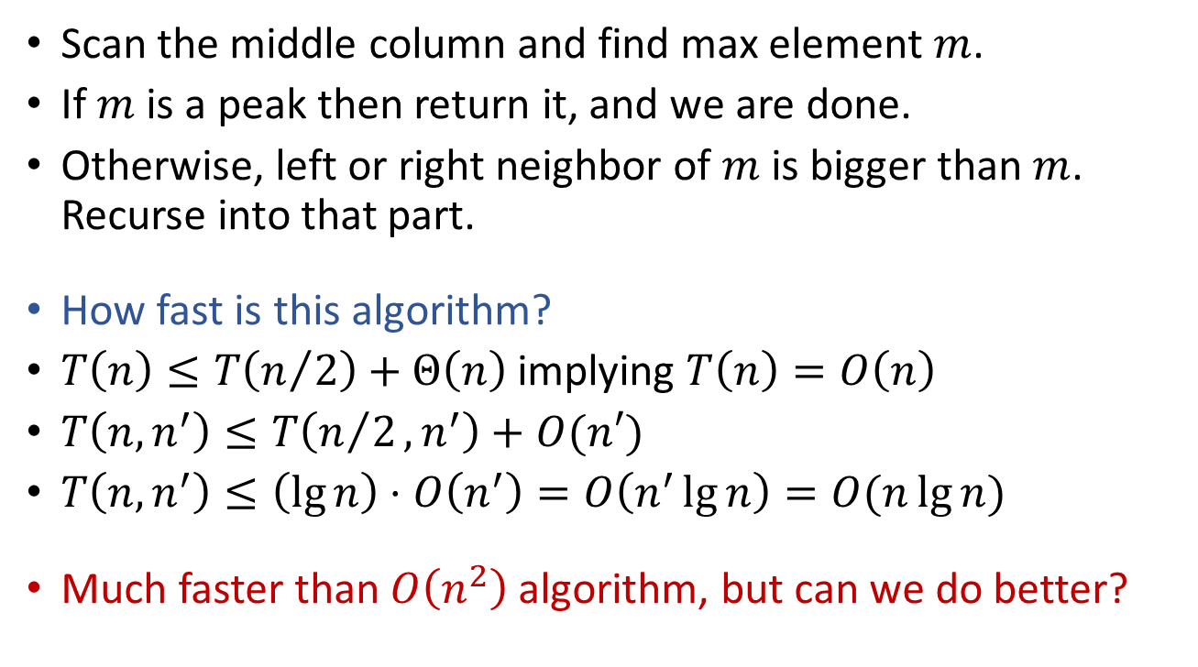
Peak finding in 2D, Algorithm II
Scan the middle column and find max element $m$.
If $m$ is a peak then return it, and we are done.
Otherwise, left or right neighbor of $m$ is bigger than $m$. Recurse into that part.
How fast is this algorithm?
$T\left(n\right)≤T\left(n/2\right)+Θ\left(n\right)$ implying $T\left(n\right)=O\left(n\right)$
$T\left(n,n^{′}\right)≤T\left(n/2,n^{′}\right)+O(n′)$
$T\left(n,n^{′}\right)≤\left(\lg{n}\right)⋅O\left(n^{′}\right)=O\left(n^{′}\lg{n}\right)=O(n\lg{n})$
Much faster than $O\left(n^{2}\right)$ algorithm, but can we do better?

Slide 26

Peak finding in 2D, Algorithm III
Scan the “cross” and find max element $m$.
If $m$ is a peak then return it, and we are done.
Otherwise, some neighbor of $m$ is bigger than $m$. Recurse into that quadrant.
10
8
5
2
1
3
2
1
5
7
5
11
9
2
5
7
21
4
6
8
6
1
4
6
8

Slide 27
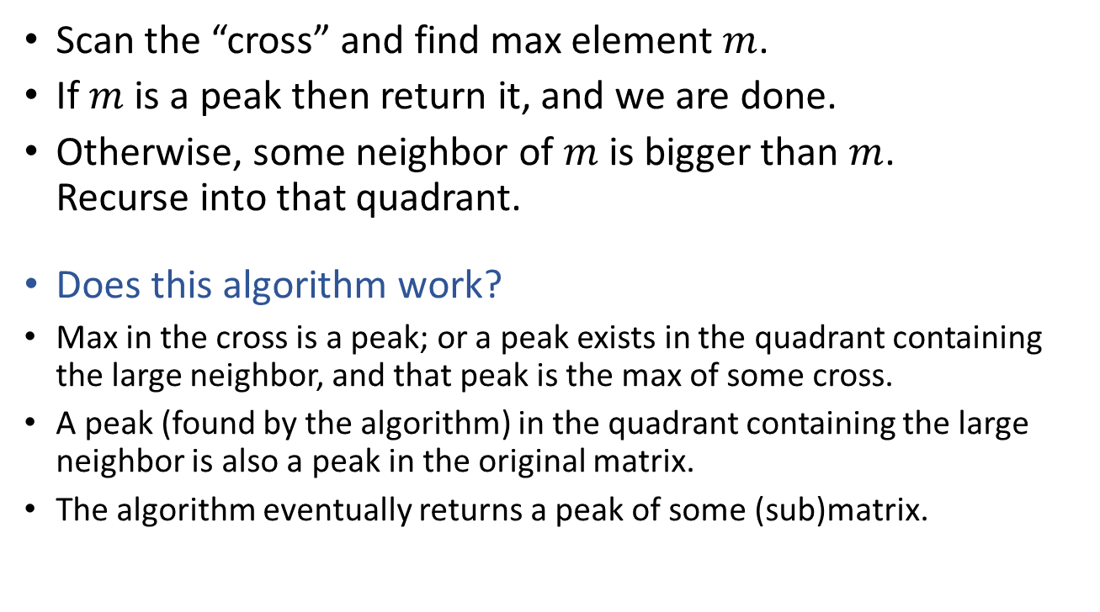
Peak finding in 2D, Algorithm III
Scan the “cross” and find max element $m$.
If $m$ is a peak then return it, and we are done.
Otherwise, some neighbor of $m$ is bigger than $m$. Recurse into that quadrant.
Does this algorithm work?
Max in the cross is a peak; or a peak exists in the quadrant containing the large neighbor, and that peak is the max of some cross.
A peak (found by the algorithm) in the quadrant containing the large neighbor is also a peak in the original matrix.
The algorithm eventually returns a peak of some (sub)matrix.

Slide 28

Peak finding in 2D, Algorithm III
Scan the “cross” and find max element $m$.
If $m$ is a peak then return it, and we are done.
Otherwise, some neighbor of $m$ is bigger than $m$. Recurse into that quadrant.
False Claim: A peak (found by the algorithm) in the quadrant containing the large neighbor is also a peak in the original matrix.
4
If the peak found in the quadrant is on the boundary of the quadrant, then it may be smaller than its neighbor that is in the original matrix!
4
4
4
4
4
4
4
4
5
4
1
6
How to fix this?!
4
1
1
1
4
3
2

Slide 29
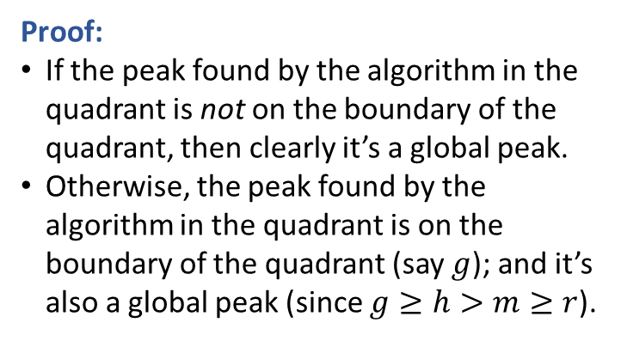
Peak finding in 2D, Algorithm III
“cross and boundary” (i.e., a “window frame”)
Scan the “cross” and find max element $m$.
If $m$ is a peak then return it, and we are done.
Otherwise, some neighbor of $m$ is bigger than $m$. Recurse into that quadrant.
Claim: A peak (found by the algorithm) in the quadrant containing the large neighbor is also a peak in the original matrix.
Proof:
If the peak found by the algorithm in the quadrant is not on the boundary of the quadrant, then clearly it’s a global peak.
Otherwise, the peak found by the algorithm in the quadrant is on the boundary of the quadrant (say $g$); and it’s also a global peak (since $g≥h>m≥r$).
m
h
r
g

Slide 30
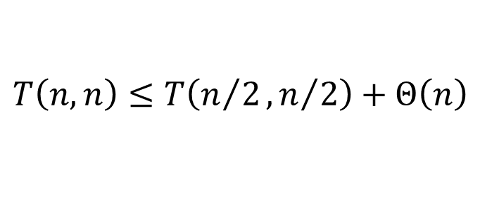

Peak finding in 2D, Algorithm III
“cross and boundary” (i.e., a “window frame”)
Scan the “cross” and find max element $m$.
If $m$ is a peak then return it, and we are done.
Otherwise, some neighbor of $m$ is bigger than $m$. Recurse into that quadrant.
How fast is this algorithm?
$$T\left(n,n\right)≤T\left(n/2,n/2\right)+Θ\left(n\right)$$
$$T\left(n,n\right)=O\left(n\right)$$
m
h
r
g

