Slide 1
Disjoint Sets
Data Structures and Algorithms
Nanjing University, Fall 2021
郑朝栋

Slide 2
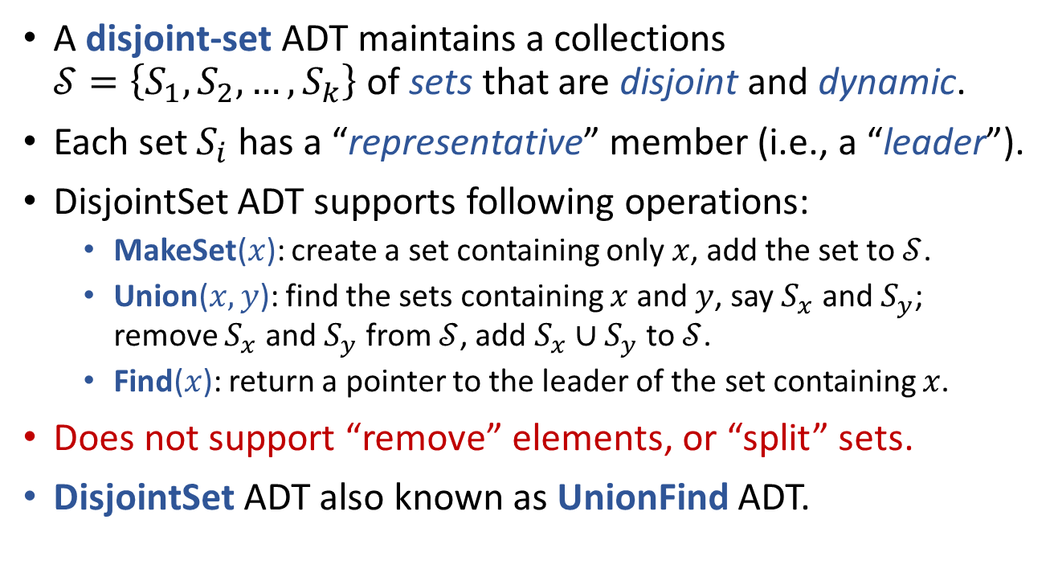
DisjointSet ADT
A disjoint-set ADT maintains a collections $𝒮=\left\{S_{1},S_{2},…,S_{k}\right\}$ of sets that are disjoint and dynamic.
Each set $S_{i}$ has a “representative” member (i.e., a “leader”).
DisjointSet ADT supports following operations:
MakeSet($x$): create a set containing only $x$, add the set to $𝒮$.
Union($x,y$): find the sets containing $x$ and $y$, say $S_{x}$ and $S_{y}$; remove $S_{x}$ and $S_{y}$ from $𝒮$, add $S_{x}∪S_{y}$ to $𝒮$.
Find($x$): return a pointer to the leader of the set containing $x$.
Does not support “remove” elements, or “split” sets.
DisjointSet ADT also known as UnionFind ADT.

Slide 3
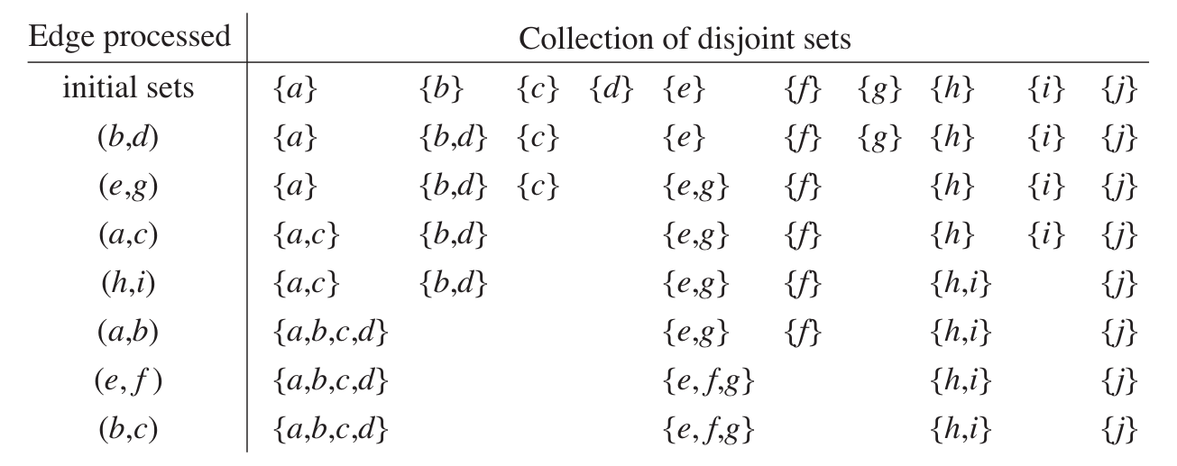










Sample application of DisjointSet ADT Computing connected components
$$a$$
$$b$$
$$e$$
$$f$$
$$h$$
$$j$$
$$c$$
$$d$$
$$g$$
$$i$$
MakeSet(·)
Union(b,d)

Slide 4
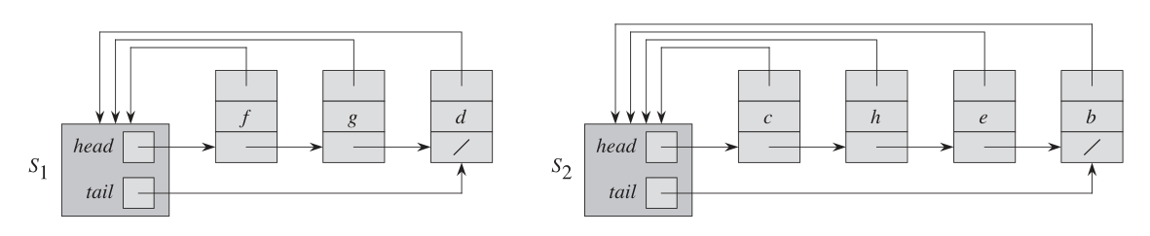
Linked-list implementation of DisjointSet
Basic Idea: Use a linked list to store and represent a set.
Some more details:
A set object has pointers pointing to head and tail of the linked-list.
The linked-list contains the elements in the set.
Each element has a pointer pointing back to the set object.
The leader of a set is the first element in the linked-list.

Slide 5



Linked-list implementation of DisjointSet
Basic Idea: Use a linked list to store and represent a set.
MakeSet($x$): Create a linked list containing only $x$.
Find($x$): Follow pointer from $x$ back to the set object, then return pointer to the first element in the linked-list.
$$Θ\left(1\right)$$
$$Θ\left(1\right)$$

Slide 6
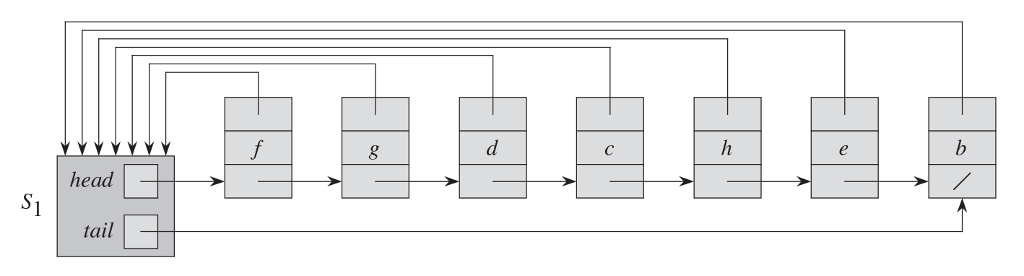



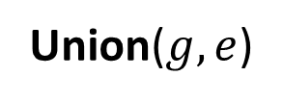
Linked-list implementation of DisjointSet
Basic Idea: Use a linked list to store and represent a set.
Union($x,y$): Append list in $S_{y}$ to list in $S_{x}$; destroy set object $S_{y}$; update set object pointers for elements originally in $S_{y}$.
$$Θ\left(1\right)$$
Union can be slow, even in amortized sense!
Time depends on size of $S_{y}$.
Union($g,e$)

Slide 7

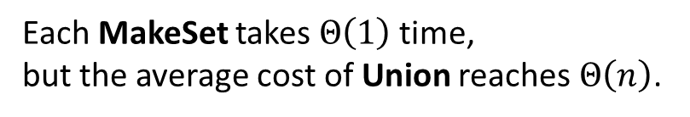
Linked-list implementation of DisjointSet
Basic Idea: Use a linked list to store and represent a set.
Union($x,y$): Append list in $S_{y}$ to list in $S_{x}$; destroy set object $S_{y}$; update set object pointers for elements originally in $S_{y}$.
MakeSet(x₀)
for (i=1 to n)
MakeSet(x_{i})
Union(x_{i},x₀)
Complexity of this sequence of operations?
$Θ\left(n^{2}\right)$ in total.
Each MakeSet takes $Θ\left(1\right)$ time, but the average cost of Union reaches $Θ\left(n\right)$.
Union operation is too expensive!

Slide 8
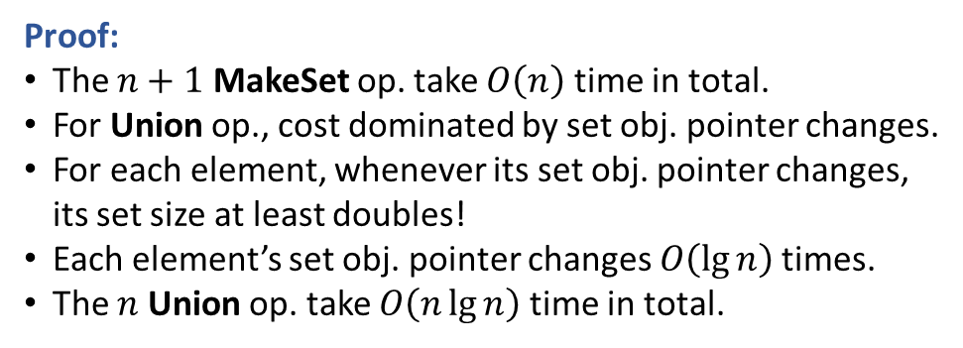

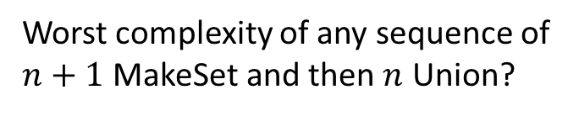

Linked-list implementation of DisjointSet
Improvement: Weighted-union heuristic (or, union-by-size).
Basic Idea: In Union, append the shorter list to the longer one!
Complication: Need to maintain size for each set (but this is easy).
MakeSet(x₀)
for (i=1 to n)
MakeSet(x_{i})
Union(x_{i},x₀)
Complexity of this sequence of operations?
Worst complexity of any sequence of $n+1$ MakeSet and then $n$ Union?
$$O\left(n\lg{n}\right)$$
Proof:
The $n+1$ MakeSet op. take $O\left(n\right)$ time in total.
For Union op., cost dominated by set obj. pointer changes.
For each element, whenever its set obj. pointer changes, its set size at least doubles!
Each element’s set obj. pointer changes $O\left(\lg{n}\right)$ times.
The $n$ Union op. take $O\left(n\lg{n}\right)$ time in total.
Average cost of Union operation is reduced to $O\left(\lg{n}\right)$.

Slide 9
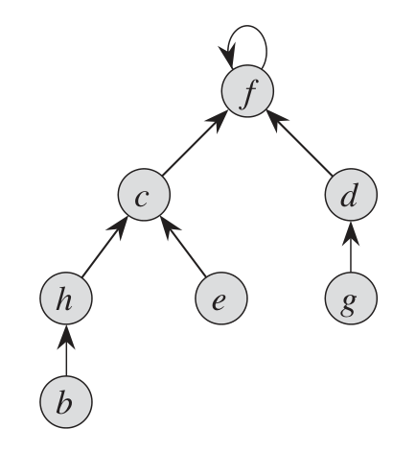
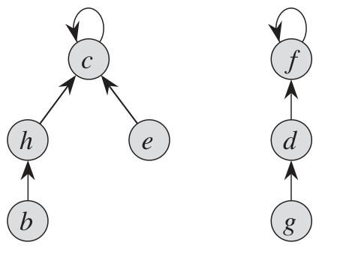






Rooted-tree implementation of DisjointSet
Basic idea: Use a rooted-tree to represent a set; the root of a tree is the “leader” of that set.
Some details: Each node has a pointer pointing to its parent; parent of a “leader” is the leader itself.
MakeSet($x$): Create a tree containing only (root) $x$; parent of $x$ is $x$.
Find($x$): Follow parent pointer from $x$ back to the root, and return root.
Union($x,y$): Change the parent pointer of the root of $x$ to the root of $y$.
$$Θ\left(1\right)$$
Time complexity depends on depth of $x$ and $y$.
Linked-list vs Rooted-tree Implementation:
MakeSet is fast in both cases.
Linked-list: Find is fast, but Union is slow.
Rooted-tree: Find is slow, but Union is fast. (If Union always unions roots of trees.)
Union($e,g$)
Set $\left\{c,h,e,b\right\}$ with leader $c$
Set $\left\{f,d,g\right\}$ with leader $f$

Slide 10

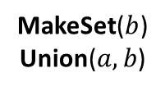

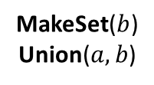













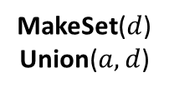

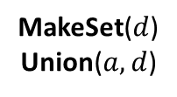




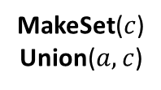

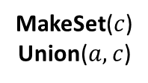
Rooted-tree implementation of DisjointSet
$$d$$
MakeSet($b$)
Union($a,b$)
MakeSet($c$)
Union($a,c$)
$$c$$
MakeSet($d$)
Union($a,d$)
$$b$$
$$c$$
$$a$$
$$b$$
MakeSet($x$): Create a tree containing only (root) $x$; parent of $x$ is $x$.
Find($x$): Follow parent pointer from $x$ back to the root, and return root.
Union($x,y$): Change the parent pointer of the root of $x$ to the root of $y$.
A sequence of $n$ Union can cost $Θ\left(n\right)$ on avg; Many following Find will also cost $Θ\left(n\right)$.
Again, use union-by-size heuristic; reduce worst-case cost of Union and Find to $O\left(\lg{n}\right)$. (Each time a node’s depth increases, the tree size at least doubles. So size $n$ tree has height $O\left(\lg{n}\right)$.)
Alternatively, use union-by-height heuristic: In Union, let tree of smaller height be subtree of larger height.
Union-by-height reduces worst-case cost of Union and Find to $O\left(\lg{n}\right)$. (Easy proof via induction: height $h$ tree has $≥2^{h}$ nodes.)
$$a$$
$$b$$
$$a$$
$$a$$
MakeSet(x₀)
for (i=1 to n)
MakeSet(x_{i})
Union(x₀,x_{i})
Find(x₀)
MakeSet($b$)
Union($a,b$)
MakeSet($c$)
Union($a,c$)
MakeSet($d$)
Union($a,d$)
$$b$$
$$b$$
$$b$$
$$a$$
$$a$$
$$a$$
$$c$$
$$a$$
$$c$$
$$d$$
Can we do better?

Slide 11
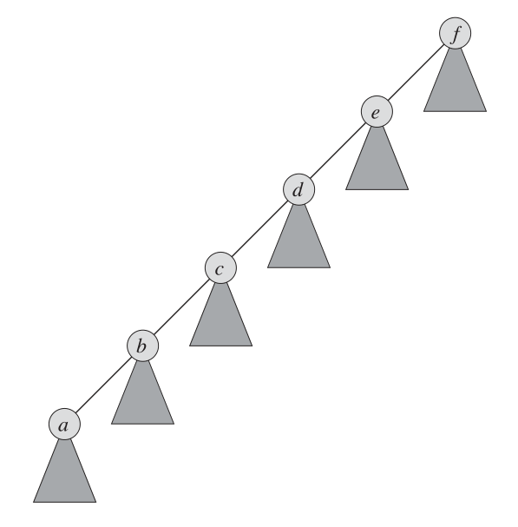
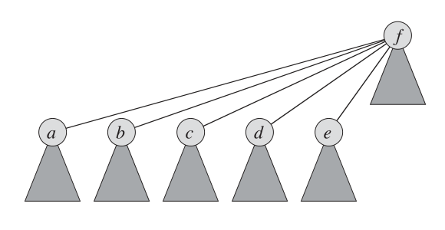

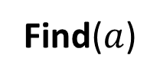
Rooted-tree implementation of DisjointSet Path-compression in Find
MakeSet($x$): Create a tree containing only (root) $x$; parent of $x$ is $x$. Height of the tree is set to 0.
Find($x$): Follow parent pointer from $x$ back to the root, and return root.
Union($x,y$): [union-by-height] Change the parent of the root of the shallow tree to the root of the deep tree. Increase height if necessary.
Do some work in Find to speed-up future Find, without increasing asymptotic cost of Find.
Path-Compression: In Find($x$), when travelling from $x$ to root $r_{x}$, make all nodes on this path directly points to root $r_{x}$.
Path-compression will not increase cost of Find asymptotically.
Find($a$)

Slide 12
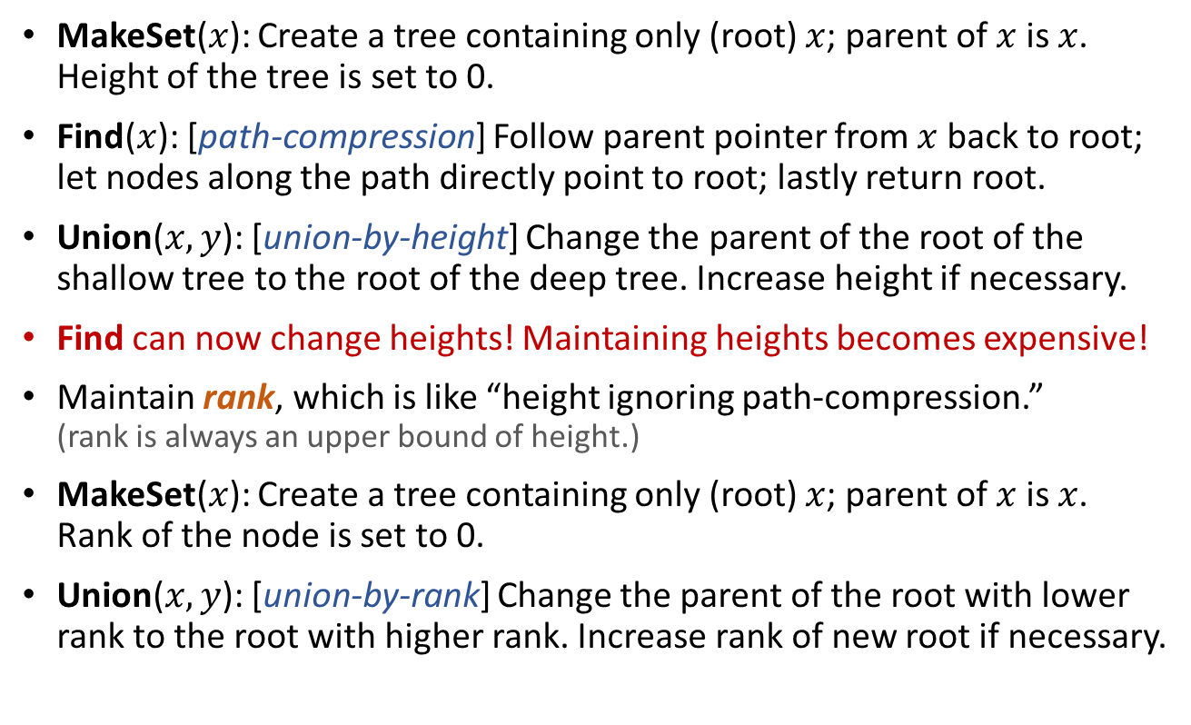
Rooted-tree implementation of DisjointSet Union-by-height and Path-compression
MakeSet($x$): Create a tree containing only (root) $x$; parent of $x$ is $x$. Height of the tree is set to 0.
Find($x$): [path-compression] Follow parent pointer from $x$ back to root; let nodes along the path directly point to root; lastly return root.
Union($x,y$): [union-by-height] Change the parent of the root of the shallow tree to the root of the deep tree. Increase height if necessary.
Find can now change heights! Maintaining heights becomes expensive!
Maintain rank, which is like “height ignoring path-compression.” (rank is always an upper bound of height.)
MakeSet($x$): Create a tree containing only (root) $x$; parent of $x$ is $x$. Rank of the node is set to 0.
Union($x,y$): [union-by-rank] Change the parent of the root with lower rank to the root with higher rank. Increase rank of new root if necessary.

Slide 13
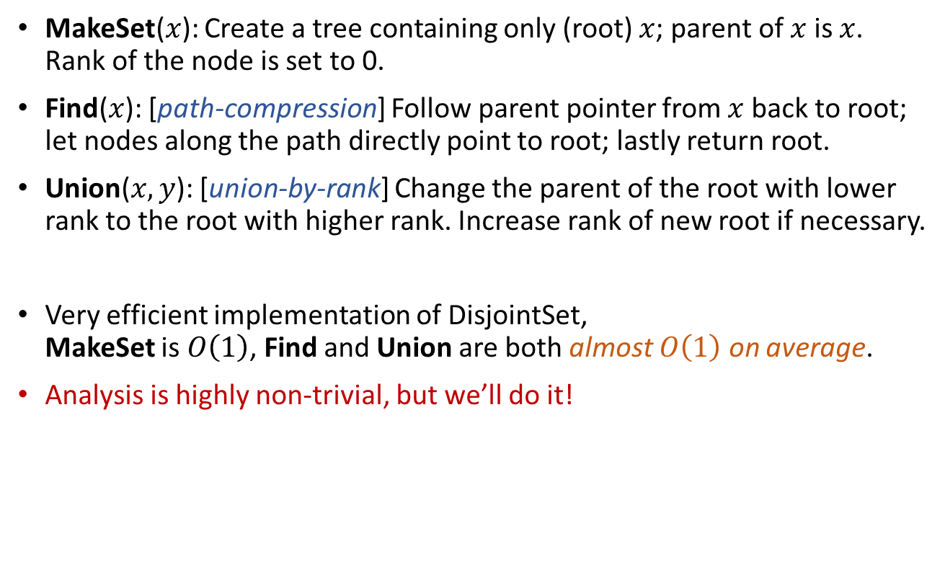
Rooted-tree implementation of DisjointSet Union-by-rank and Path-compression
MakeSet($x$): Create a tree containing only (root) $x$; parent of $x$ is $x$. Rank of the node is set to 0.
Find($x$): [path-compression] Follow parent pointer from $x$ back to root; let nodes along the path directly point to root; lastly return root.
Union($x,y$): [union-by-rank] Change the parent of the root with lower rank to the root with higher rank. Increase rank of new root if necessary.
Very efficient implementation of DisjointSet, MakeSet is $O\left(1\right)$, Find and Union are both almost $O\left(1\right)$ on average.
Analysis is highly non-trivial, but we’ll do it!

Slide 14
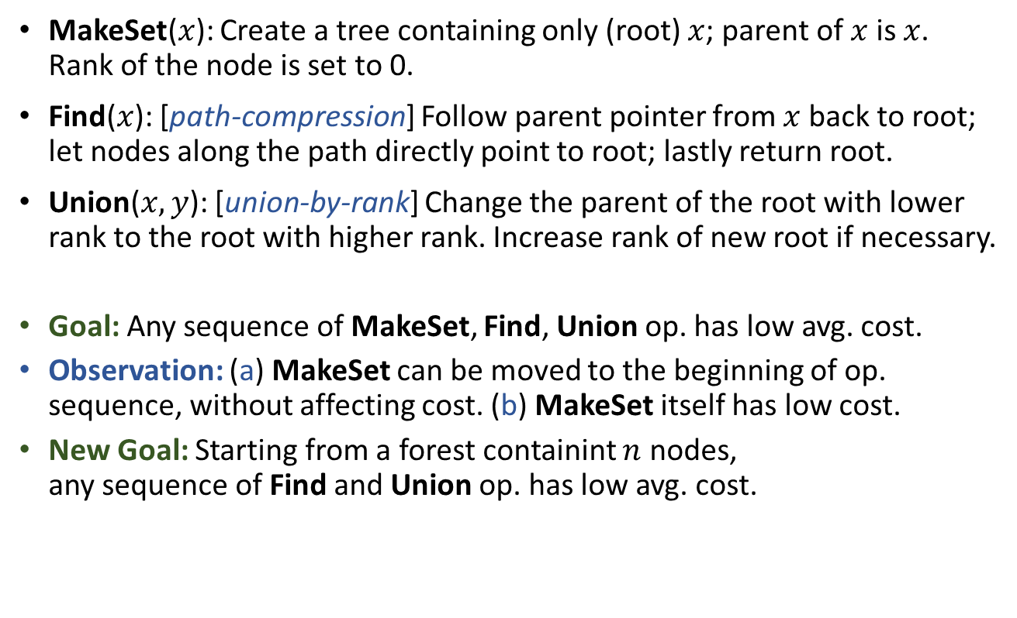
Rooted-tree implementation with union-by-rank and path-compression Performance Analysis
MakeSet($x$): Create a tree containing only (root) $x$; parent of $x$ is $x$. Rank of the node is set to 0.
Find($x$): [path-compression] Follow parent pointer from $x$ back to root; let nodes along the path directly point to root; lastly return root.
Union($x,y$): [union-by-rank] Change the parent of the root with lower rank to the root with higher rank. Increase rank of new root if necessary.
Goal: Any sequence of MakeSet, Find, Union op. has low avg. cost.
Observation: (a) MakeSet can be moved to the beginning of op. sequence, without affecting cost. (b) MakeSet itself has low cost.
New Goal: Starting from a forest containint $n$ nodes, any sequence of Find and Union op. has low avg. cost.

Slide 15
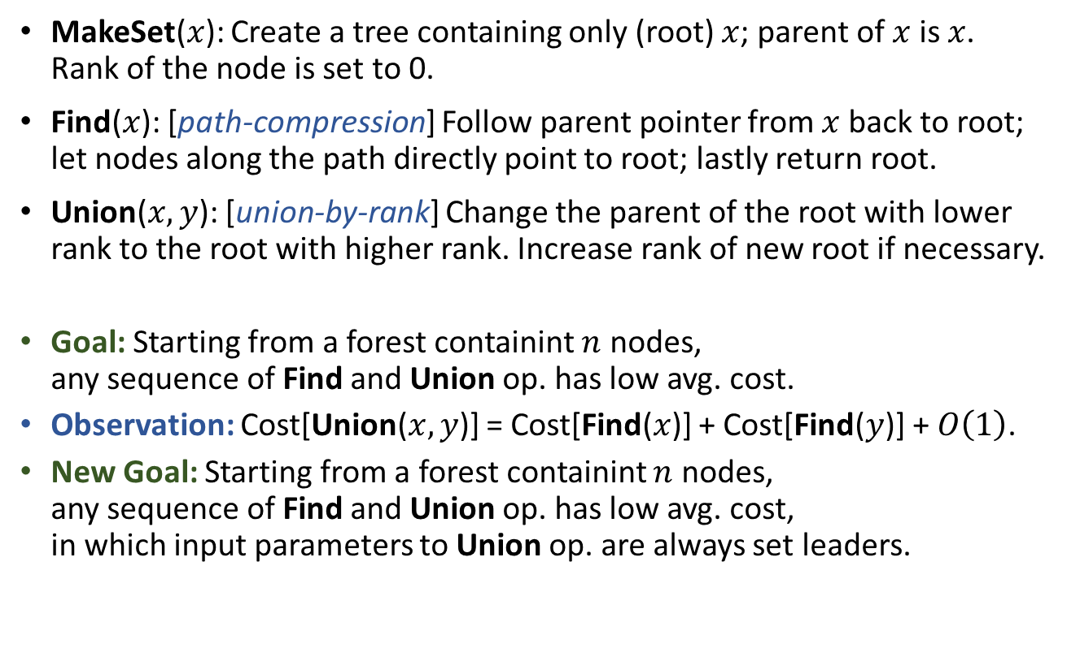
Rooted-tree implementation with union-by-rank and path-compression Performance Analysis
MakeSet($x$): Create a tree containing only (root) $x$; parent of $x$ is $x$. Rank of the node is set to 0.
Find($x$): [path-compression] Follow parent pointer from $x$ back to root; let nodes along the path directly point to root; lastly return root.
Union($x,y$): [union-by-rank] Change the parent of the root with lower rank to the root with higher rank. Increase rank of new root if necessary.
Goal: Starting from a forest containint $n$ nodes, any sequence of Find and Union op. has low avg. cost.
Observation: Cost[Union($x,y$)] = Cost[Find($x$)] + Cost[Find($y$)] + $O\left(1\right)$.
New Goal: Starting from a forest containint $n$ nodes, any sequence of Find and Union op. has low avg. cost, in which input parameters to Union op. are always set leaders.

Slide 16
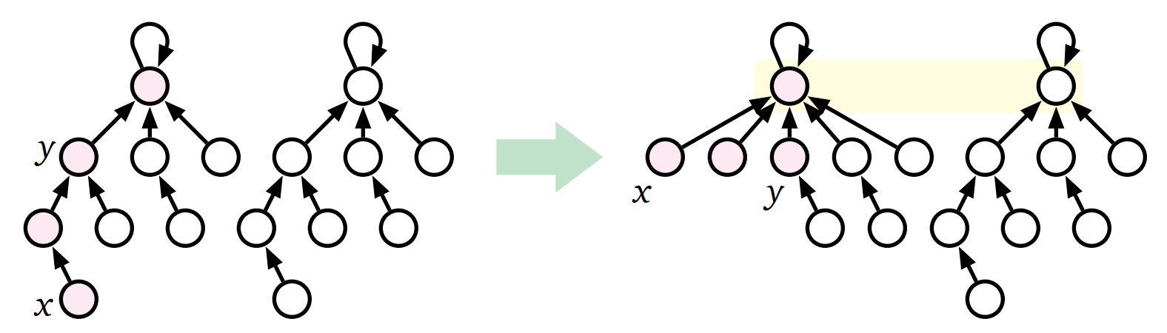

Rooted-tree implementation with union-by-rank and path-compression Performance Analysis
Find($x$): [path-compression] Follow parent pointer from $x$ back to root; let nodes along the path directly point to root; lastly return root.
PartialFind($x,y$): [$y$ is ancestor of $x$] Follow parent pointer from $x$ back to $y$; let nodes along the path point to $y$’s parent; return parent of $y$.
Goal: Starting from a forest containint $n$ nodes, any sequence of Find and Union op. has low avg. cost, in which input parameters to Union op. are always set leaders.
Observation: Every Find op. can be replaced by a PartialFind op.
New Goal: Starting from a forest containint $n$ nodes, any sequence of PartialFind and Union op. has low avg. cost, in which input parameters to Union op. are always set leaders.

Slide 17
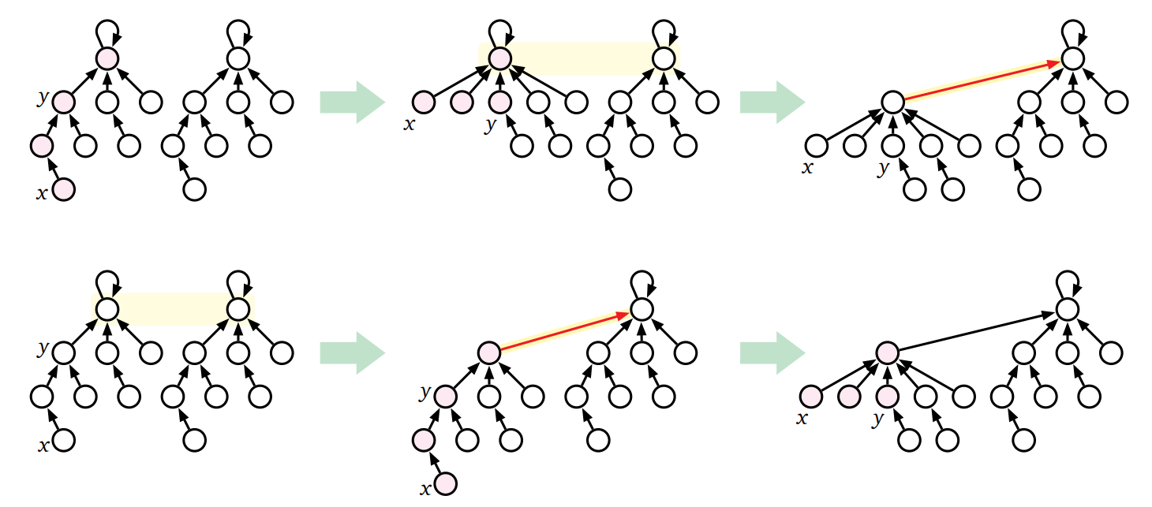

Rooted-tree implementation with union-by-rank and path-compression Performance Analysis
PartialFind($x,y$): [$y$ is ancestor of $x$] Follow parent pointer from $x$ back to $y$; let nodes along the path point to $y$’s parent; return parent of $y$.
Union($x,y$): [union-by-rank] Change the parent of the root with lower rank to the root with higher rank. Increase rank of new root if necessary.
Goal: Starting from a forest containint $n$ nodes, any sequence of PartialFind and Union op. has low avg. cost, in which input parameters to Union op. are always set leaders.
Observation: We can push all Union op. to the beginning. (Relative order among all Union op. is preserved.)
New Goal: Starting from a forest containint $n$ nodes, any sequence of PartialFind and Union op. has low avg. cost, in which every Union occurs before any PartialFind, and input parameters to Union op. are always set leaders.
PartialFind
Union
Union
PartialFind

Slide 18
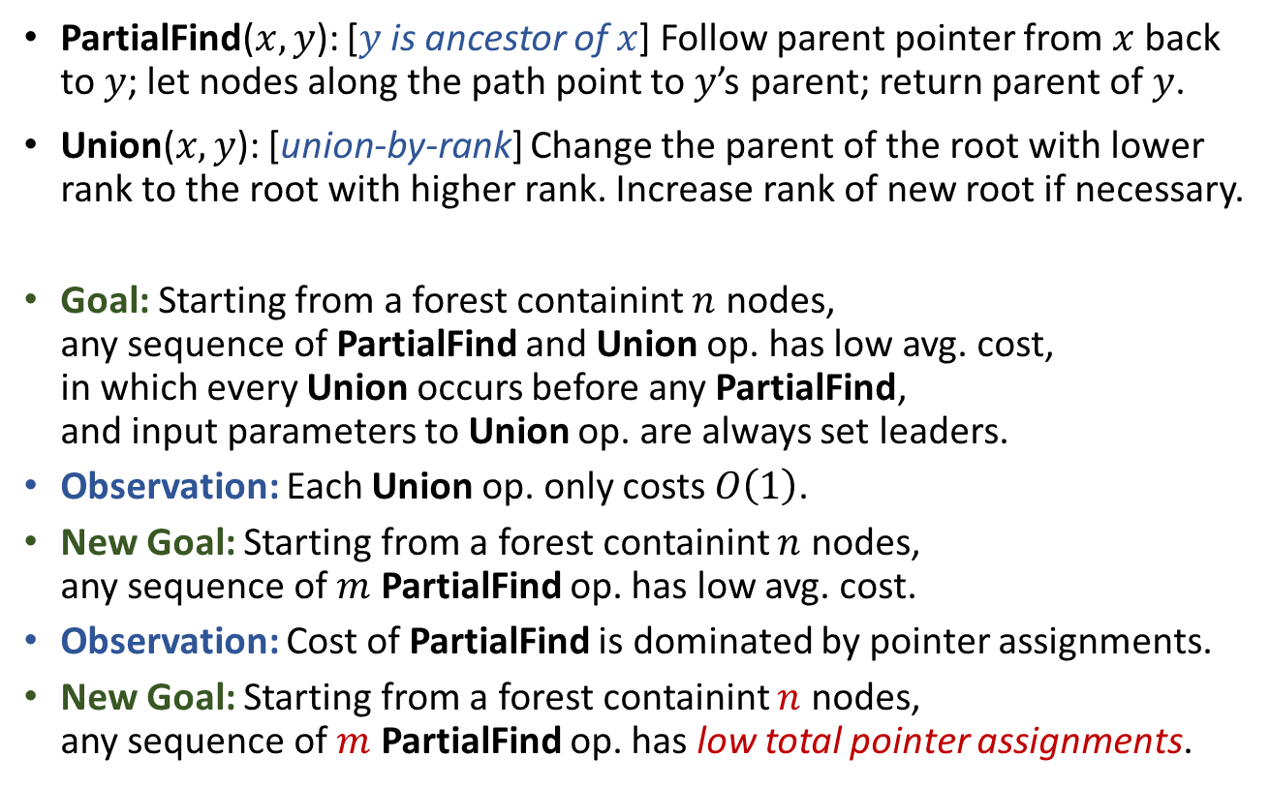
Rooted-tree implementation with union-by-rank and path-compression Performance Analysis
PartialFind($x,y$): [$y$ is ancestor of $x$] Follow parent pointer from $x$ back to $y$; let nodes along the path point to $y$’s parent; return parent of $y$.
Union($x,y$): [union-by-rank] Change the parent of the root with lower rank to the root with higher rank. Increase rank of new root if necessary.
Goal: Starting from a forest containint $n$ nodes, any sequence of PartialFind and Union op. has low avg. cost, in which every Union occurs before any PartialFind, and input parameters to Union op. are always set leaders.
Observation: Each Union op. only costs $O\left(1\right)$.
New Goal: Starting from a forest containint $n$ nodes, any sequence of $m$ PartialFind op. has low avg. cost.
Observation: Cost of PartialFind is dominated by pointer assignments.
New Goal: Starting from a forest containint $n$ nodes, any sequence of $m$ PartialFind op. has low total pointer assignments.

Slide 19
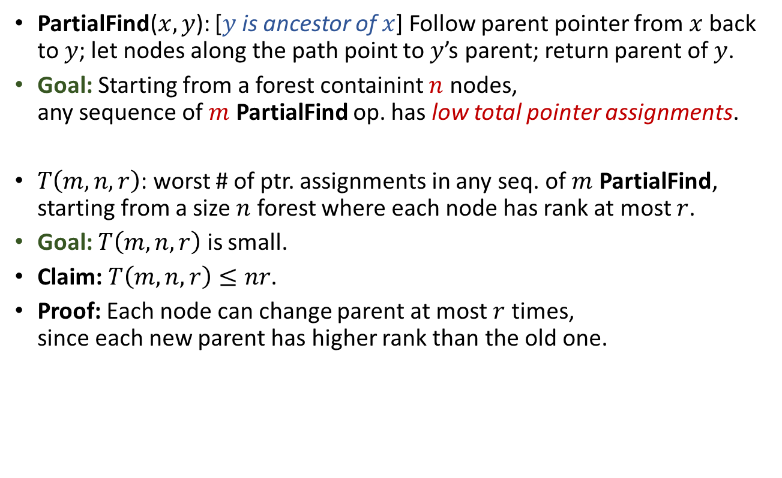
Rooted-tree implementation with union-by-rank and path-compression Performance Analysis
PartialFind($x,y$): [$y$ is ancestor of $x$] Follow parent pointer from $x$ back to $y$; let nodes along the path point to $y$’s parent; return parent of $y$.
Goal: Starting from a forest containint $n$ nodes, any sequence of $m$ PartialFind op. has low total pointer assignments.
$T\left(m,n,r\right)$: worst # of ptr. assignments in any seq. of $m$ PartialFind, starting from a size $n$ forest where each node has rank at most $r$.
Goal: $T\left(m,n,r\right)$ is small.
Claim: $T\left(m,n,r\right)≤nr$.
Proof: Each node can change parent at most $r$ times, since each new parent has higher rank than the old one.

Slide 20
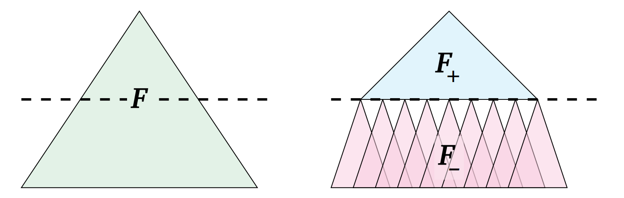

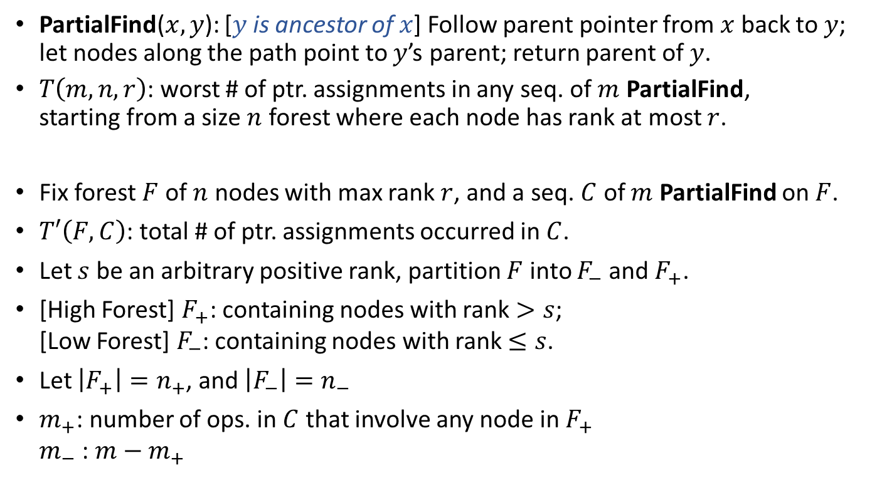



Rooted-tree implementation with union-by-rank and path-compression Performance Analysis
$$rank>s$$
$$rank>s$$
PartialFind($x,y$): [$y$ is ancestor of $x$] Follow parent pointer from $x$ back to $y$; let nodes along the path point to $y$’s parent; return parent of $y$.
$T\left(m,n,r\right)$: worst # of ptr. assignments in any seq. of $m$ PartialFind, starting from a size $n$ forest where each node has rank at most $r$.
Fix forest $F$ of $n$ nodes with max rank $r$, and a seq. $C$ of $m$ PartialFind on $F$.
$T′\left(F,C\right)$: total # of ptr. assignments occurred in $C$.
Let $s$ be an arbitrary positive rank, partition $F$ into $F_{−}$ and $F_{+}$.
[High Forest] $F_{+}$: containing nodes with rank $>s$; [Low Forest] $F_{−}$: containing nodes with rank $≤s$.
Let $\left|F_{+}\right|=n_{+}$, and $\left|F_{−}\right|=n_{−}$
$m_{+}$: number of ops. in $C$ that involve any node in $F_{+}$ $m_{−}$: $m−m_{+}$
$$rank≤s$$
$$rank≤s$$

Slide 21
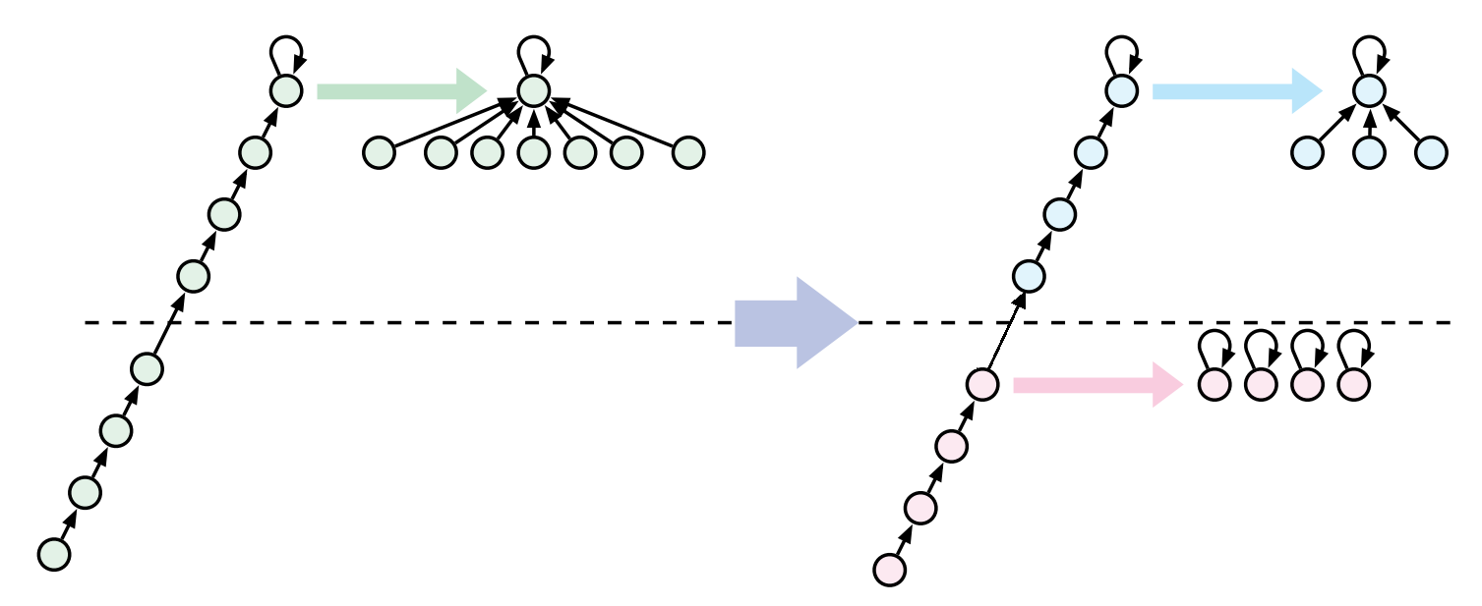

Rooted-tree implementation with union-by-rank and path-compression Performance Analysis
Fix forest $F$ of $n$ nodes with max rank $r$, and a seq. $C$ of $m$ PartialFind on $F$.
$T′\left(F,C\right)$: total # of ptr. assignments occurred in $C$.
Let $s$ be an arbitrary positive rank, partition $F$ into $F_{−}$ and $F_{+}$.
[High Forest] $F_{+}$: containing nodes with rank $>s$; [Low Forest] $F_{−}$: containing nodes with rank $≤s$.
Let $\left|F_{+}\right|=n_{+}$, and $\left|F_{−}\right|=n_{−}$
$m_{+}$: number of ops. in $C$ that involve any node in $F_{+}$ $m_{−}$: $m−m_{+}$
Consider a PartialFind($x,y$) in $C$:
If $rank\left(x\right)>s$: the op. is a PartialFind op. in $F_{+}$.
If $rank\left(y\right)≤s$: the op. is a PartialFind op. in $F_{−}$.
If $rank\left(x\right)≤s$ and $rank\left(y\right)>s$: Split the op. into (a) a PartialFind op. in $F_{+}$; (b) some shatter op. in $F_{−}$; and (c) a pointer assignment for the “topmost” node in $F_{−}$.

Slide 22
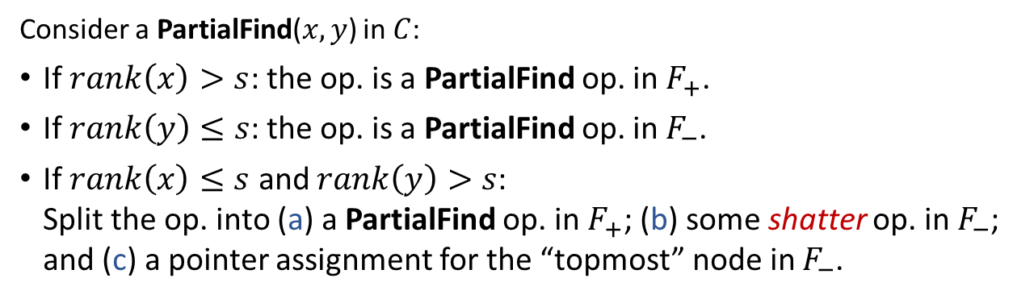
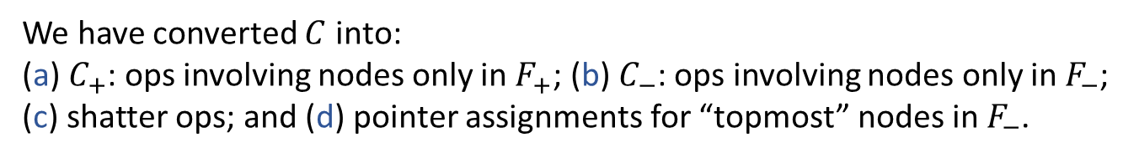
Consider a PartialFind($x,y$) in $C$:
If $rank\left(x\right)>s$: the op. is a PartialFind op. in $F_{+}$.
If $rank\left(y\right)≤s$: the op. is a PartialFind op. in $F_{−}$.
If $rank\left(x\right)≤s$ and $rank\left(y\right)>s$: Split the op. into (a) a PartialFind op. in $F_{+}$; (b) some shatter op. in $F_{−}$; and (c) a pointer assignment for the “topmost” node in $F_{−}$.
We have converted $C$ into:
(a) $C_{+}$: ops involving nodes only in $F_{+}$; (b) $C_{−}$: ops involving nodes only in $F_{−}$; (c) shatter ops; and (d) pointer assignments for “topmost” nodes in $F_{−}$.
Observation: each node get shattered at most once (then be “topmost” node in $F_{−}$).
Observation: there are at most $m_{+}$ pointer assignments for “topmost” nodes in $F_{−}$.
$$T′\left(F,C\right)≤T′\left(F_{+},C_{+}\right)+T′\left(F_{−},C_{−}\right)+n+m_{+}$$

Slide 23
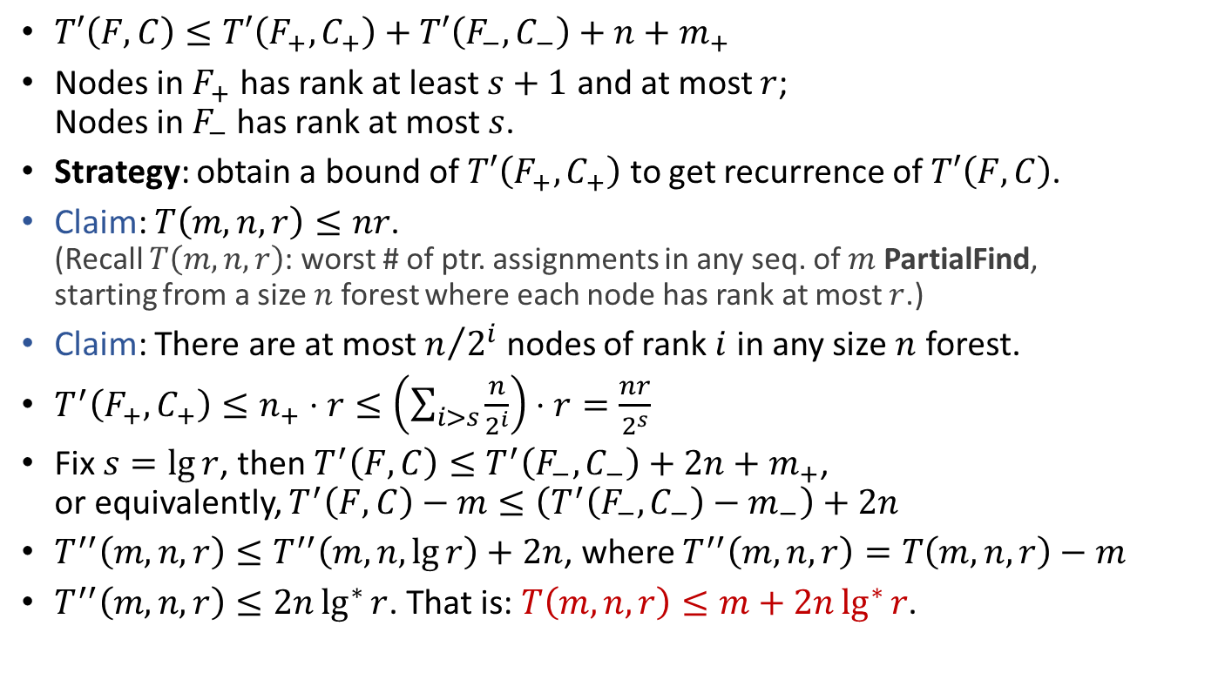


Rooted-tree implementation with union-by-rank and path-compression Performance Analysis
Any sequence of $m$ Union and Find on a size $n$ forest takes $O\left(m+2n\lg^{∗}{n}\right)$ time, even in worst-case.
$$rank>s$$
Actual performance is even better!
$T′\left(F,C\right)≤T′\left(F_{+},C_{+}\right)+T′\left(F_{−},C_{−}\right)+n+m_{+}$
Nodes in $F_{+}$ has rank at least $s+1$ and at most $r$; Nodes in $F_{−}$ has rank at most $s$.
Strategy: obtain a bound of $T′\left(F_{+},C_{+}\right)$ to get recurrence of $T′\left(F,C\right)$.
Claim: $T\left(m,n,r\right)≤nr$. (Recall $T\left(m,n,r\right)$: worst # of ptr. assignments in any seq. of $m$ PartialFind, starting from a size $n$ forest where each node has rank at most $r$.)
Claim: There are at most $n/{2^{i}}$ nodes of rank $i$ in any size $n$ forest.
$T^{′}\left(F_{+},C_{+}\right)≤n_{+}⋅r≤\left(\sum_{i>s}{\frac{n}{2^{i}}}\right)⋅r=\frac{nr}{2^{s}}$
Fix $s=\lg{r}$, then $T^{′}\left(F,C\right)≤T^{′}\left(F_{−},C_{−}\right)+2n+m_{+}$, or equivalently, $T^{′}\left(F,C\right)−m≤\left(T^{′}\left(F_{−},C_{−}\right)−m_{−}\right)+2n$
$T^{′′}\left(m,n,r\right)≤T^{′′}\left(m,n,\lg{r}\right)+2n$, where $T^{′′}\left(m,n,r\right)=T\left(m,n,r\right)−m$
$T^{′′}\left(m,n,r\right)≤2n\lg^{∗}{r}$. That is: $T\left(m,n,r\right)≤m+2n\lg^{∗}{r}$.

Slide 24
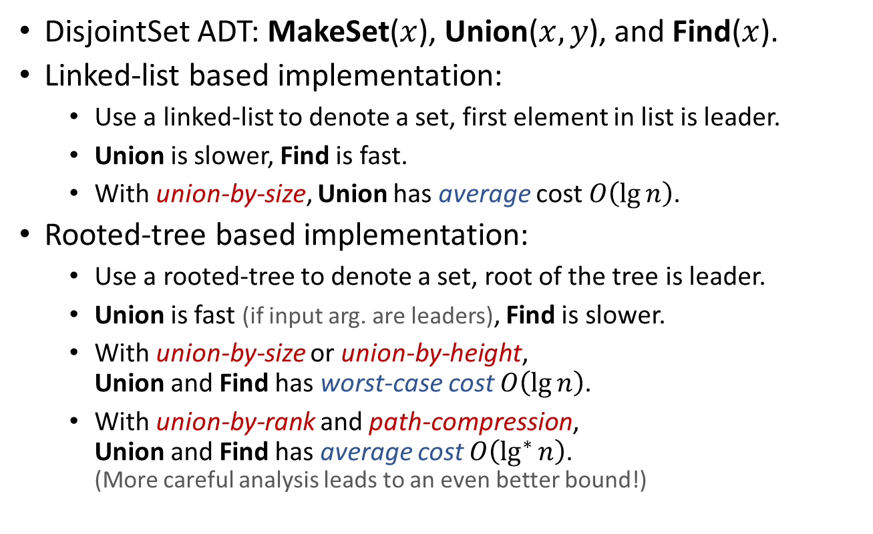
Summary
DisjointSet ADT: MakeSet($x$), Union($x,y$), and Find($x$).
Linked-list based implementation:
Use a linked-list to denote a set, first element in list is leader.
Union is slower, Find is fast.
With union-by-size, Union has average cost $O\left(\lg{n}\right)$.
Rooted-tree based implementation:
Use a rooted-tree to denote a set, root of the tree is leader.
Union is fast (if input arg. are leaders), Find is slower.
With union-by-size or union-by-height, Union and Find has worst-case cost $O\left(\lg{n}\right)$.
With union-by-rank and path-compression, Union and Find has average cost $O\left(\lg^{∗}{n}\right)$. (More careful analysis leads to an even better bound!)

Slide 25

Reading
[CLRS] Ch.21 (excluding 21.4)
Compared with CLRS, following material presents a simpler analysis for the performance of the DisjointSet data structure when both union-by-rank and path-compression are used.
[Weiss] Ch.8 (8.6)
Lecture notes by Jeff Erickson: http://jeffe.cs.illinois.edu/teaching/algorithms/notes/11-unionfind.pdf

