Slide 1
Single-Source Shortest Path
Data Structures and Algorithms
Nanjing University, Fall 2021
郑朝栋

Slide 2
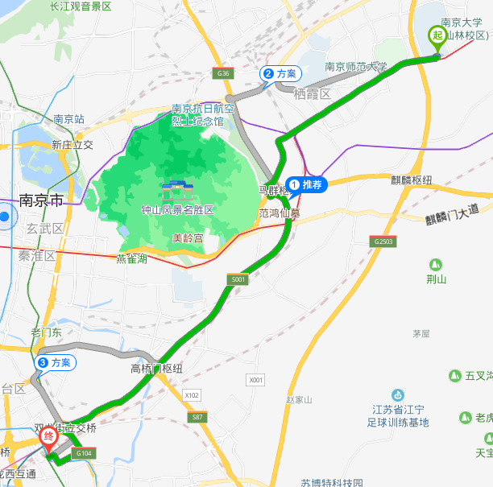
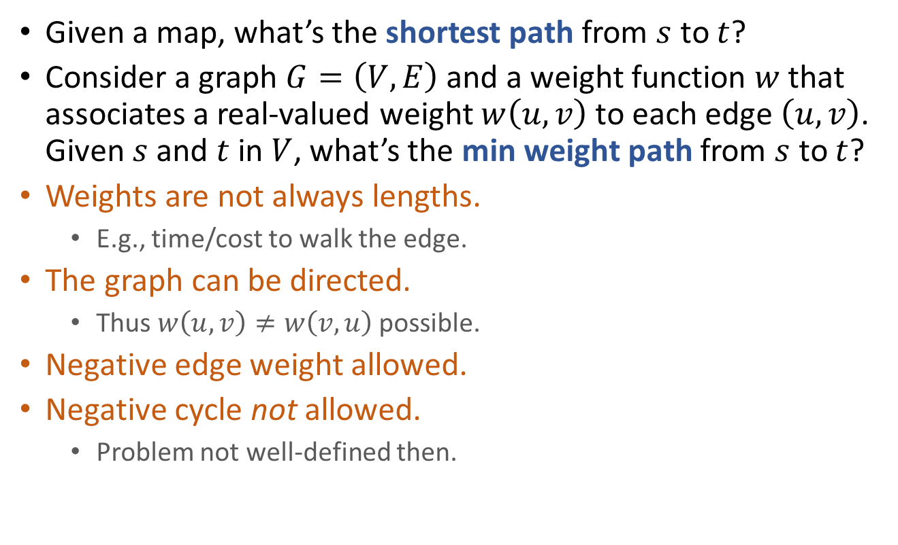
The Shortest Path Problem
Given a map, what’s the shortest path from $s$ to $t$?
Consider a graph $G=\left(V,E\right)$ and a weight function $w$ that associates a real-valued weight $w\left(u,v\right)$ to each edge $\left(u,v\right)$. Given $s$ and $t$ in $V$, what’s the min weight path from $s$ to $t$?
Weights are not always lengths.
E.g., time/cost to walk the edge.
The graph can be directed.
Thus $w\left(u,v\right)≠w\left(v,u\right)$ possible.
Negative edge weight allowed.
Negative cycle not allowed.
Problem not well-defined then.

Slide 3
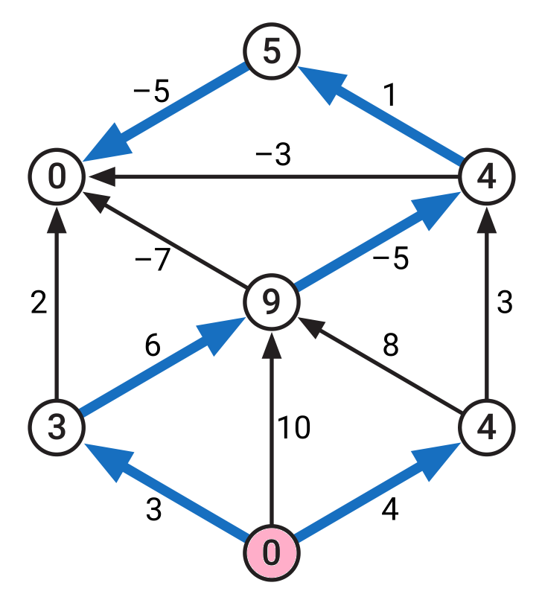
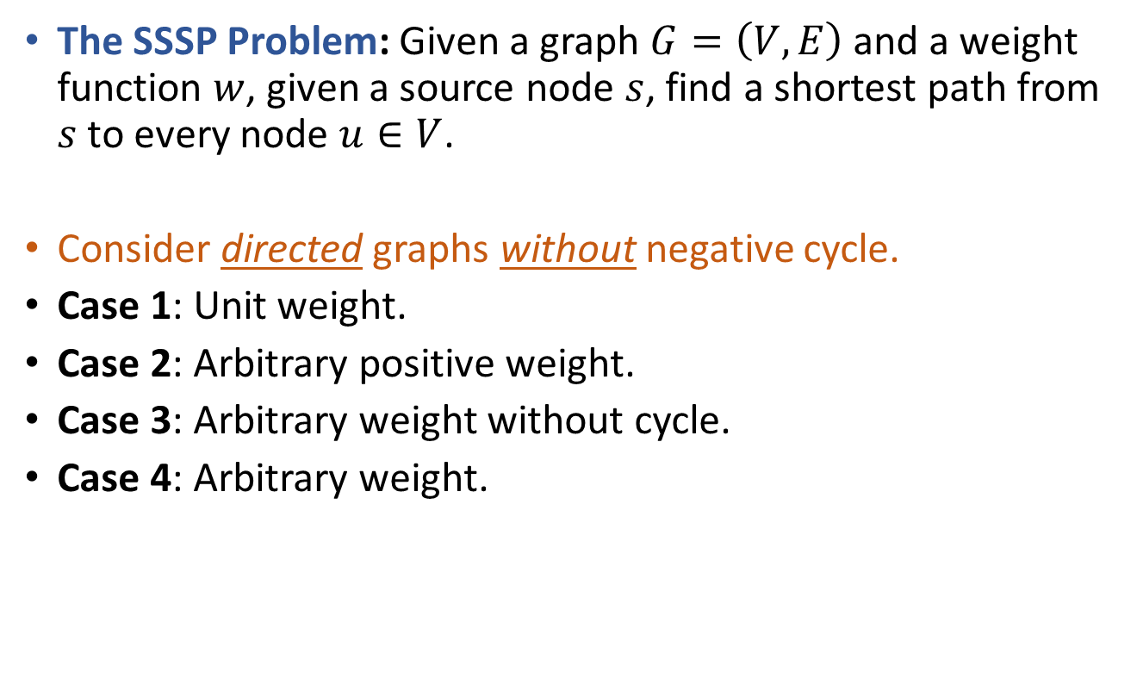
Single-Source Shortest Path (SSSP)
The SSSP Problem: Given a graph $G=\left(V,E\right)$ and a weight function $w$, given a source node $s$, find a shortest path from $s$ to every node $u∈V$.
Consider directed graphs without negative cycle.
Case 1: Unit weight.
Case 2: Arbitrary positive weight.
Case 3: Arbitrary weight without cycle.
Case 4: Arbitrary weight.

Slide 4
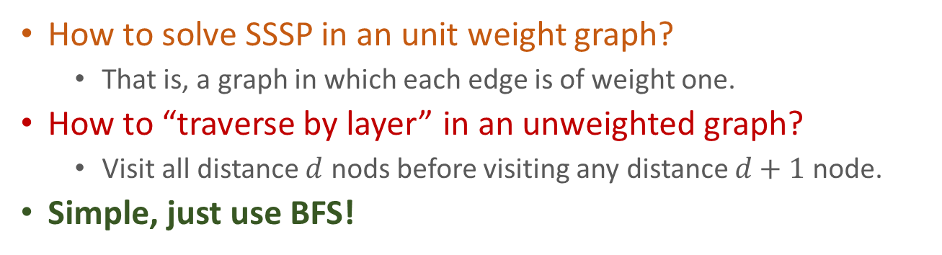
SSSP in unit weight graphs
How to solve SSSP in an unit weight graph?
That is, a graph in which each edge is of weight one.
How to “traverse by layer” in an unweighted graph?
Visit all distance $d$ nods before visiting any distance $d+1$ node.
Simple, just use BFS!
1
1
1
1
E
S
A
E
S
A
1
1
1
1
D
C
1
B
D
C
B
2
2
1

Slide 5






SSSP in positive weight graphs
Solve SSSP in a graph with arbitrary positive weights?
Extension of unit graph SSSP algorithm:
Add dummy nodes on edges so graph becomes unit weight graph.
Run BFS on the resulting graph.
Problem with this approach?
Too slow when edge weights differs a lot!
A
A
$$u_{49}$$
$$u_{2}$$
50
$$u_{1}$$
1
S
B
S
$$v_{1}$$
$$v_{2}$$
$$v_{79}$$
B
80

Slide 6

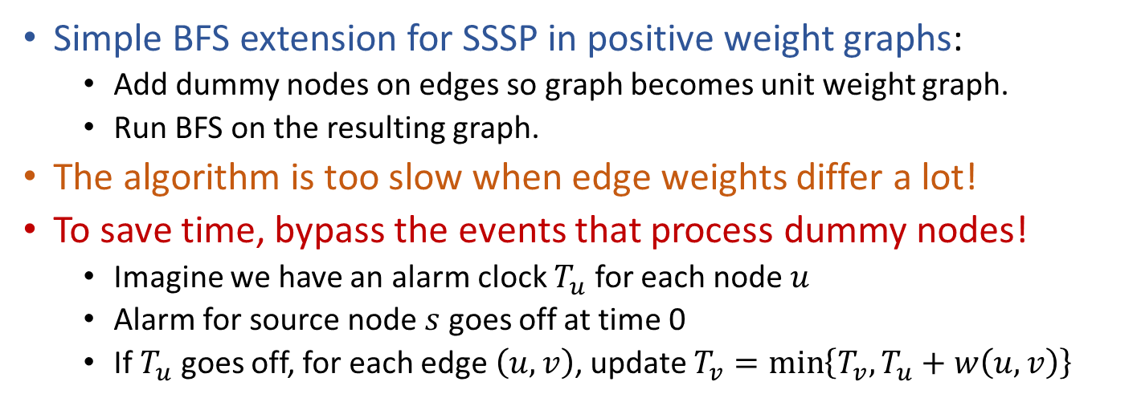





SSSP in positive weight graphs
Simple BFS extension for SSSP in positive weight graphs:
Add dummy nodes on edges so graph becomes unit weight graph.
Run BFS on the resulting graph.
The algorithm is too slow when edge weights differ a lot!
To save time, bypass the events that process dummy nodes!
Imagine we have an alarm clock $T_{u}$ for each node $u$
Alarm for source node $s$ goes off at time 0
If $T_{u}$ goes off, for each edge $\left(u,v\right)$, update $T_{v}=\min\left\{T_{v},T_{u}+w\left(u,v\right)\right\}$
A
A
$$u_{49}$$
$$u_{2}$$
50
$$u_{1}$$
1
S
B
S
$$v_{1}$$
$$v_{2}$$
$$v_{79}$$
B
80

Slide 7


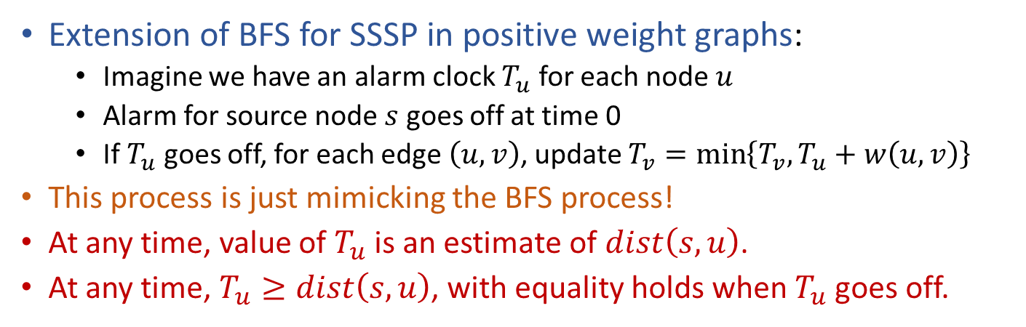





SSSP in positive weight graphs Extension of the BFS algorithm
Extension of BFS for SSSP in positive weight graphs:
Imagine we have an alarm clock $T_{u}$ for each node $u$
Alarm for source node $s$ goes off at time 0
If $T_{u}$ goes off, for each edge $\left(u,v\right)$, update $T_{v}=\min\left\{T_{v},T_{u}+w\left(u,v\right)\right\}$
This process is just mimicking the BFS process!
At any time, value of $T_{u}$ is an estimate of $dist\left(s,u\right)$.
At any time, $T_{u}≥dist\left(s,u\right)$, with equality holds when $T_{u}$ goes off.
49
50
2
A
1
$$u_{49}$$
$$u_{2}$$
0
$$u_{1}$$
80
51
S
$$v_{1}$$
$$v_{2}$$
$$v_{79}$$
B

Slide 8
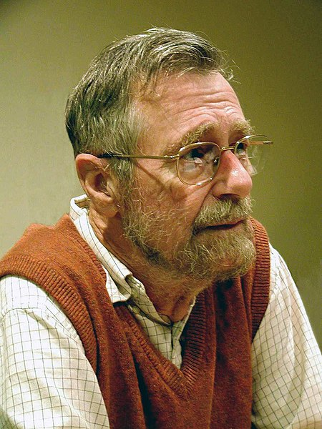
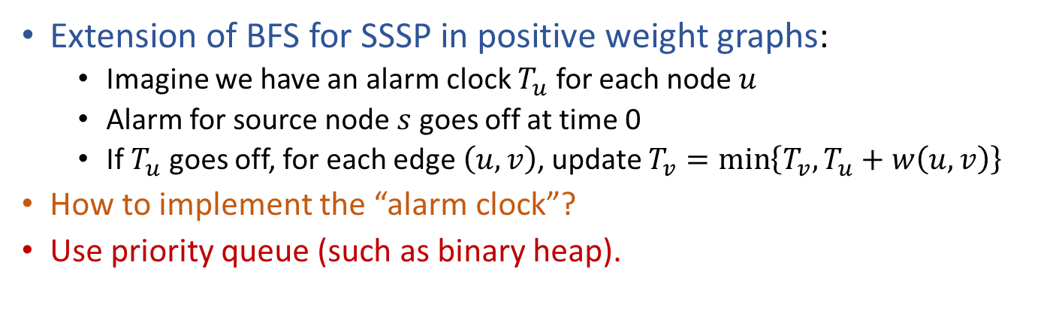
SSSP in positive weight graphs via extension of BFS Dijkstra's algorithm
Extension of BFS for SSSP in positive weight graphs:
Imagine we have an alarm clock $T_{u}$ for each node $u$
Alarm for source node $s$ goes off at time 0
If $T_{u}$ goes off, for each edge $\left(u,v\right)$, update $T_{v}=\min\left\{T_{v},T_{u}+w\left(u,v\right)\right\}$
How to implement the “alarm clock”?
Use priority queue (such as binary heap).
Shortest-path Tree
(Similar to BFS tree.)
DijkstraSSSP(G,s):
for (each u in V)
u.dist=INF, u.parent=NIL
s.dist = 0
Build priority queue Q based on dist
while (!Q.empty())
u = Q.ExtractMin()
for (each edge (u,v) in E)
if (v.dist > u.dist + w(u,v))
v.dist = u.dist + w(u,v)
v.parent = u
Q.DecreaseKey(v)
Edsger W. Dijkstra (1930-2002)
ACM Turing Award Recipient

Slide 9





SSSP in positive weight graphs via extension of BFS Dijkstra's algorithm
Correctness of Dijkstra’s algorithm?
Similar to the correctness proof of BFS.
Efficiency of Dijkstra’s algorithm?
$O\left(\left(n+m\right)\log{n}\right)$ when using a binary heap.
DijkstraSSSP(G,s):
for (each u in V)
u.dist=INF, u.parent=NIL
s.dist = 0
Build priority queue Q based on dist
while (!Q.empty())
u = Q.ExtractMin()
for (each edge (u,v) in E)
if (v.dist > u.dist + w(u,v))
v.dist = u.dist + w(u,v)
v.parent = u
Q.DecreaseKey(v)
$O\left(n\right)$ in total
$O\left(n\right)$ in total
$O\left(n\log{n}\right)$ in total
$O\left(m\log{n}\right)$ in total

Slide 10
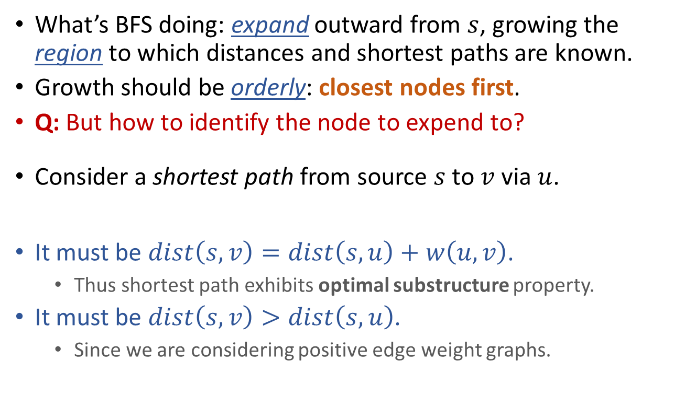



Alternative derivation of Dijkstra’s alg.
What’s BFS doing: expand outward from $s$, growing the region to which distances and shortest paths are known.
Growth should be orderly: closest nodes first.
Q: But how to identify the node to expend to?
Consider a shortest path from source $s$ to $v$ via $u$.
It must be $dist\left(s,v\right)=dist\left(s,u\right)+w\left(u,v\right)$.
Thus shortest path exhibits optimal substructure property.
It must be $dist\left(s,v\right)>dist\left(s,u\right)$.
Since we are considering positive edge weight graphs.
$$s$$
$$u$$
$$v$$

Slide 11
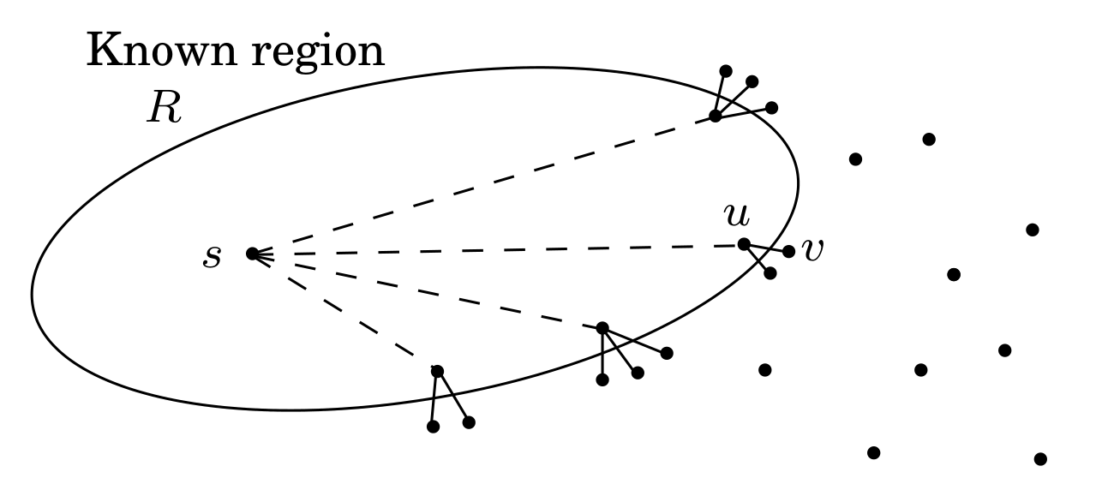
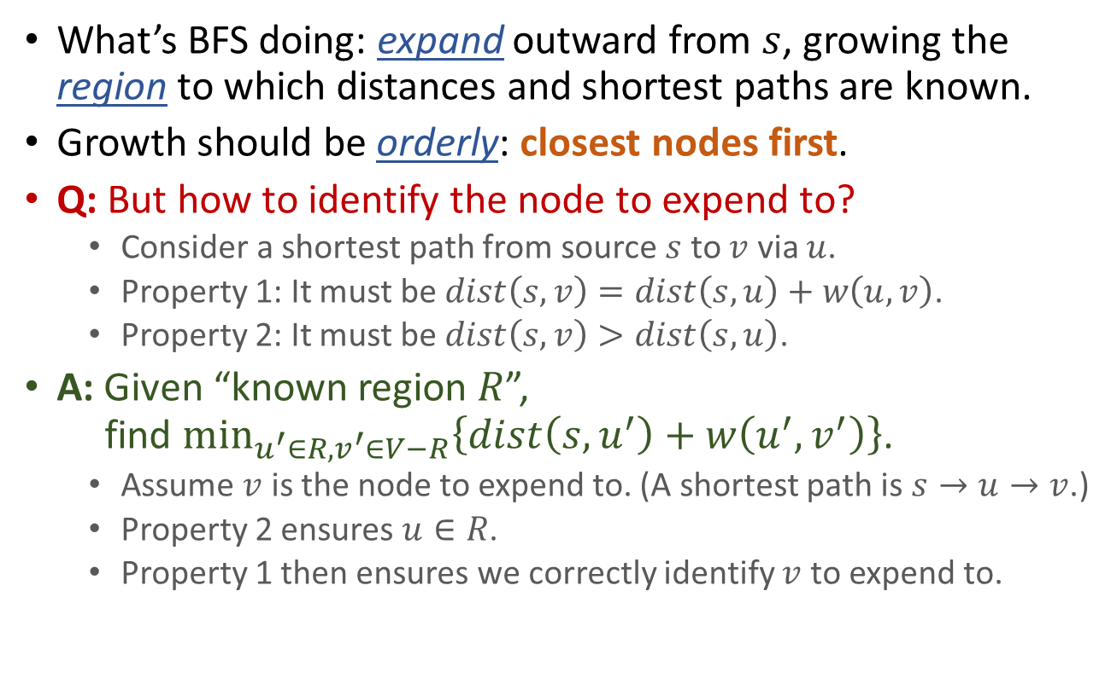
Alternative derivation of Dijkstra’s alg.
What’s BFS doing: expand outward from $s$, growing the region to which distances and shortest paths are known.
Growth should be orderly: closest nodes first.
Q: But how to identify the node to expend to?
Consider a shortest path from source $s$ to $v$ via $u$.
Property 1: It must be $dist\left(s,v\right)=dist\left(s,u\right)+w\left(u,v\right)$.
Property 2: It must be $dist\left(s,v\right)>dist\left(s,u\right)$.
A: Given “known region $R$”, find $\min_{u^{′}∈R,v^{′}∈V−R}\left\{dist\left(s,u^{′}\right)+w\left(u^{′},v^{′}\right)\right\}$.
Assume $v$ is the node to expend to. (A shortest path is $s→u→v$.)
Property 2 ensures $u∈R$.
Property 1 then ensures we correctly identify $v$ to expend to.

Slide 12
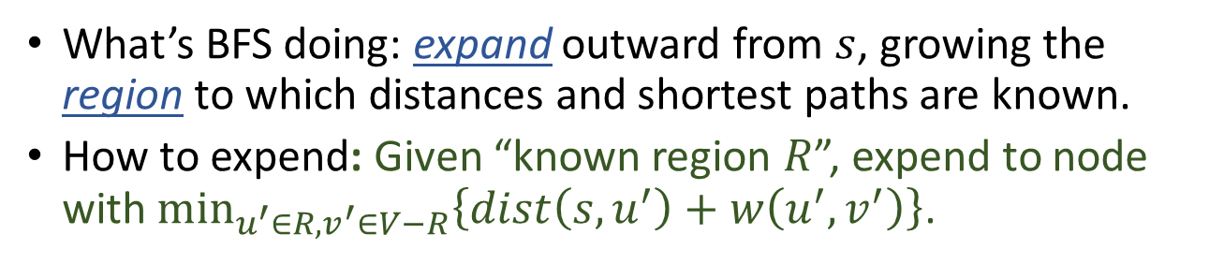
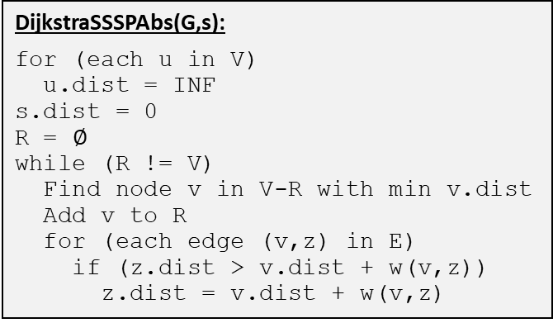
What’s BFS doing: expand outward from $s$, growing the region to which distances and shortest paths are known.
How to expend: Given “known region $R$”, expend to node with $\min_{u^{′}∈R,v^{′}∈V−R}\left\{dist\left(s,u^{′}\right)+w\left(u^{′},v^{′}\right)\right\}$.
DijkstraSSSP(G,s):
for (each u in V)
u.dist=INF, u.parent=NIL
s.dist = 0
Build priority queue Q based on dist
while (!Q.empty())
u = Q.ExtractMin()
for (each edge (u,v) in E)
if (v.dist > u.dist + w(u,v))
v.dist = u.dist + w(u,v)
v.parent = u
Q.DecreaseKey(v)
DijkstraSSSPAbs(G,s):
for (each u in V)
u.dist = INF
s.dist = 0
R = $∅$
while (R != V)
Find node v in V-R with min v.dist
Add v to R
for (each edge (v,z) in E)
if (z.dist > v.dist + w(v,z))
z.dist = v.dist + w(v,z)
Priority queue implementation

Slide 13
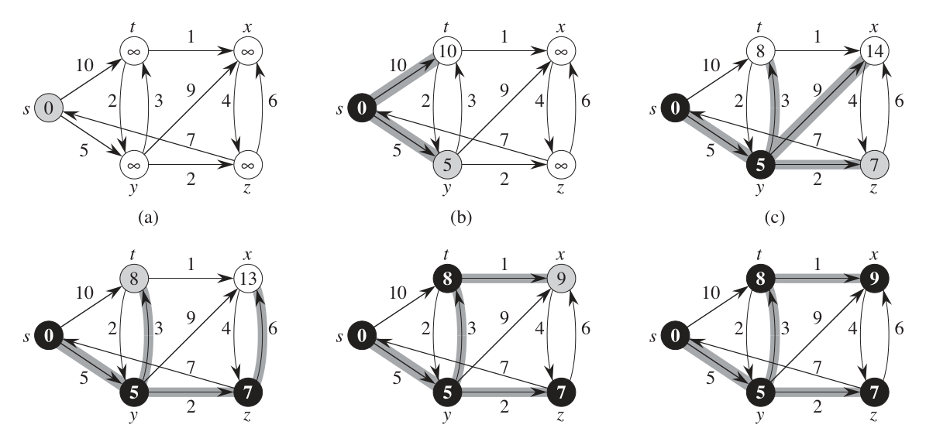
DijkstraSSSP(G,s):
for (each u in V)
u.dist=INF, u.parent=NIL
s.dist = 0
Build priority queue Q based on dist
while (!Q.empty())
u = Q.ExtractMin()
for (each edge (u,v) in E)
if (v.dist > u.dist + w(u,v))
v.dist = u.dist + w(u,v)
v.parent = u
Q.DecreaseKey(v)

Slide 14
DFS, BFS, Prim, Dijkstra, and others…
DFSIterSkeleton(G,s):
Stack Q
Q.push(s)
while (!Q.empty())
u = Q.pop()
if (!u.visited)
u.visited = true
for (each edge (u,v) in E)
Q.push(v)
BFSSkeletonAlt(G,s):
FIFOQueue Q
Q.enque(s)
while (!Q.empty())
u = Q.dequeue()
if (!u.visited)
u.visited = true
for (each edge (u,v) in E)
Q.enque(v)
PrimMSTSkeleton(G,x):
PriorityQueue Q
Q.add(x)
while (!Q.empty())
u = Q.remove()
if (!u.visited)
u.visited = true
for (each edge (u,v) in E)
if (!v.visited and …)
Q.update(v,…)
DijkstraSSSPSkeleton(G,x):
PriorityQueue Q
Q.add(x)
while (!Q.empty())
u = Q.remove()
if (!u.visited)
u.visited = true
for (each edge (u,v) in E)
if (!v.visited and …)
Q.update(v,…)

Slide 15
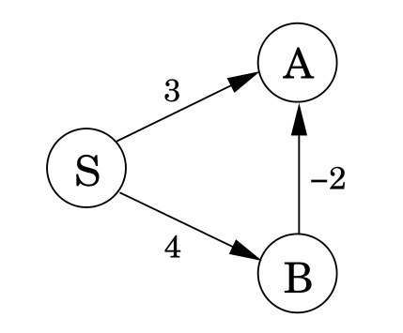
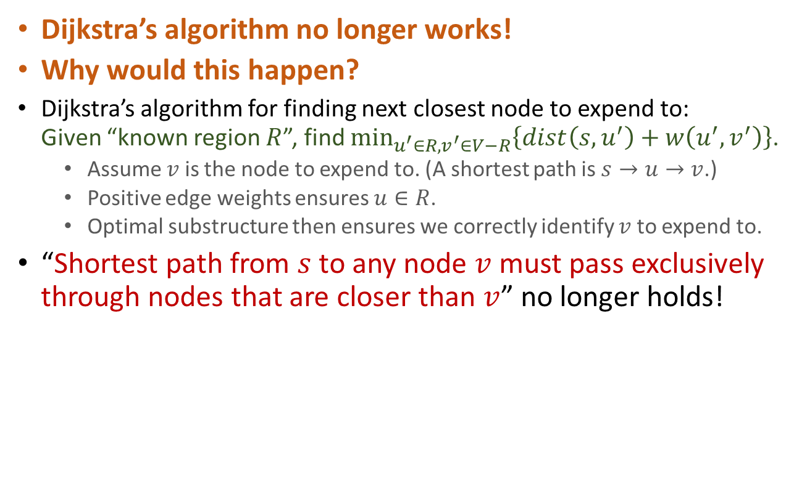
SSSP in graphs with negative weights
Dijkstra’s algorithm no longer works!
Why would this happen?
Dijkstra’s algorithm for finding next closest node to expend to: Given “known region $R$”, find $min_{u^{′}∈R,v^{′}∈V−R}\left\{dist\left(s,u^{′}\right)+w\left(u^{′},v^{′}\right)\right\}$.
Assume $v$ is the node to expend to. (A shortest path is $s→u→v$.)
Positive edge weights ensures $u∈R$.
Optimal substructure then ensures we correctly identify $v$ to expend to.
“Shortest path from $s$ to any node $v$ must pass exclusively through nodes that are closer than $v$” no longer holds!

Slide 16
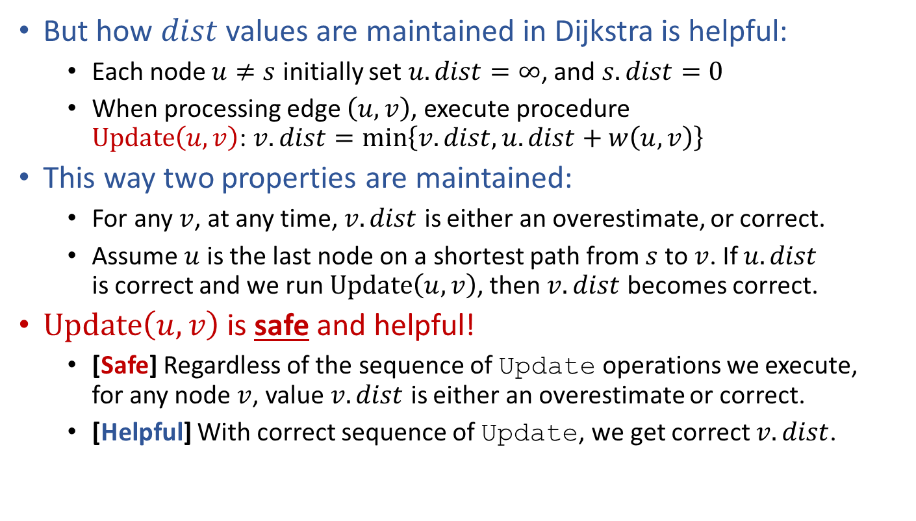
SSSP in graphs with negative weights
But how $dist$ values are maintained in Dijkstra is helpful:
Each node $u≠s$ initially set $u.dist=∞$, and $s.dist=0$
When processing edge $\left(u,v\right)$, execute procedure $Update\left(u,v\right)$: $v.dist=\min\left\{v.dist,u.dist+w\left(u,v\right)\right\}$
This way two properties are maintained:
For any $v$, at any time, $v.dist$ is either an overestimate, or correct.
Assume $u$ is the last node on a shortest path from $s$ to $v$. If $u.dist$ is correct and we run $Update\left(u,v\right)$, then $v.dist$ becomes correct.
$Update\left(u,v\right)$ is safe and helpful!
[Safe] Regardless of the sequence of Update operations we execute, for any node $v$, value $v.dist$ is either an overestimate or correct.
[Helpful] With correct sequence of Update, we get correct $v.dist$.

Slide 17





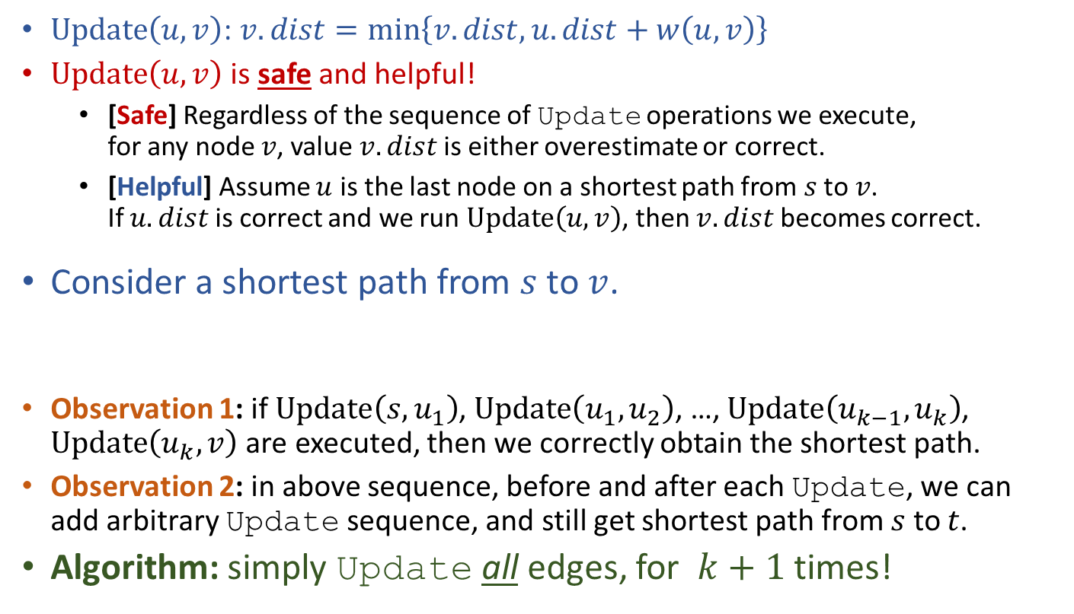







SSSP in graphs with negative weights
$Update\left(u,v\right)$: $v.dist=\min\left\{v.dist,u.dist+w\left(u,v\right)\right\}$
$Update\left(u,v\right)$ is safe and helpful!
[Safe] Regardless of the sequence of Update operations we execute, for any node $v$, value $v.dist$ is either overestimate or correct.
[Helpful] Assume $u$ is the last node on a shortest path from $s$ to $v$. If $u.dist$ is correct and we run $Update\left(u,v\right)$, then $v.dist$ becomes correct.
Consider a shortest path from $s$ to $v$.
Observation 1: if $Update\left(s,u_{1}\right)$, $Update\left(u_{1},u_{2}\right)$, …, $Update\left(u_{k−1},u_{k}\right)$, $Update\left(u_{k},v\right)$ are executed, then we correctly obtain the shortest path.
Observation 2: in above sequence, before and after each Update, we can add arbitrary Update sequence, and still get shortest path from $s$ to $t$.
Algorithm: simply Update all edges, for $k+1$ times!
$$Update\left(s,u_{1}\right)$$
$$Update\left(…\right)$$
$$Update\left(u_{1},u_{2}\right)$$
$$Update\left(…\right)$$
$$Update\left(…\right)$$
$$Update\left(u_{k},v \right)$$
$$Update\left(…\right)$$
Update all edges
Update all edges
Update all edges
Update all edges
$$s$$
$$u_{1}$$
$$u_{2}$$
$$u_{k}$$
$$v$$

Slide 18


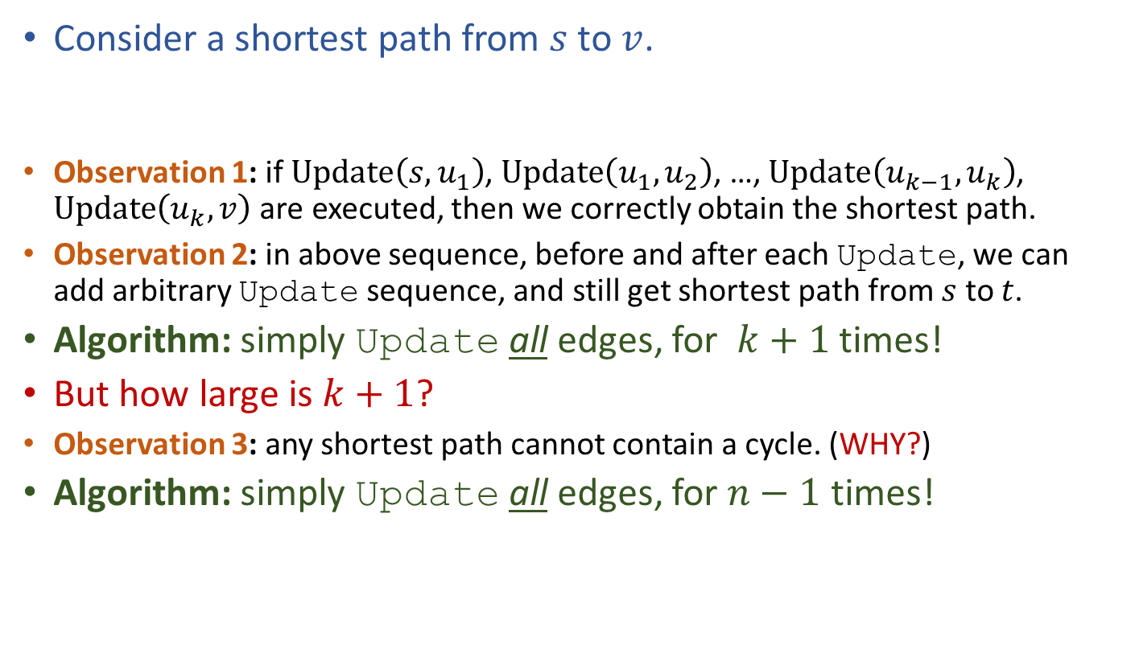



SSSP in graphs with negative weights
Consider a shortest path from $s$ to $v$.
Observation 1: if $Update\left(s,u_{1}\right)$, $Update\left(u_{1},u_{2}\right)$, …, $Update\left(u_{k−1},u_{k}\right)$, $Update\left(u_{k},v\right)$ are executed, then we correctly obtain the shortest path.
Observation 2: in above sequence, before and after each Update, we can add arbitrary Update sequence, and still get shortest path from $s$ to $t$.
Algorithm: simply Update all edges, for $k+1$ times!
But how large is $k+1$?
Observation 3: any shortest path cannot contain a cycle. (WHY?)
Algorithm: simply Update all edges, for $n−1$ times!
Update all edges
Update all edges
Update all edges
Update all edges
$$s$$
$$u_{1}$$
$$u_{2}$$
$$u_{k}$$
$$v$$

Slide 19

SSSP in directed graphs with negative weights The Bellman-Ford Algorithm
Bellman-Ford Algorithm:
Update all edges;
Repeat above step for $n−1$ times.
Time complexity of Bellman-Ford: $Θ\left(nm\right)$
BellmanFordSSSP(G,s):
for (each u in V)
u.dist=INF, u.parent=NIL
s.dist = 0
repeat n-1 times:
for (each edge (u,v) in E)
if (v.dist > u.dist + w(u,v))
v.dist = u.dist + w(u,v)
v.parent = u

Slide 20
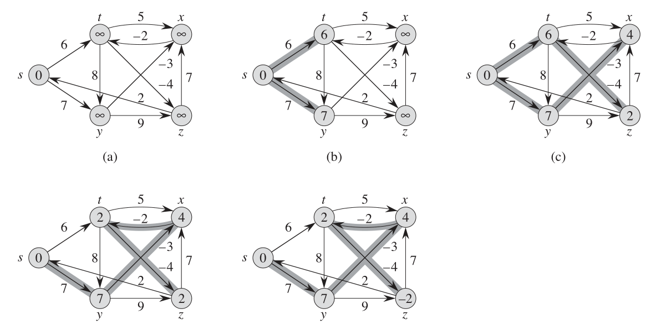
BellmanFordSSSP(G,s):
for (each u in V)
u.dist=INF, u.parent=NIL
s.dist = 0
repeat n-1 times:
for (each edge (u,v) in E)
if (v.dist > u.dist + w(u,v))
v.dist = u.dist + w(u,v)
v.parent = u
Edge order: $\left(t,x\right),\left(t,y\right),\left(t,z\right), \left(x,t\right),\left(y,x\right),\left(y,z\right),\left(z,x\right), \left(z,s\right),\left(s,t\right),\left(s,y\right)$

Slide 21

SSSP in directed graphs with negative weights The Bellman-Ford Algorithm
What if the graph contains a negative cycle?
After $n−1$ repetitions of “Update all edges”, some node $v$ still has $v.dist>u.dist+w\left(u,v\right)$.
Bellman-Ford can also detect negative cycle!
BellmanFordSSSP(G,s):
for (each u in V)
u.dist=INF, u.parent=NIL
s.dist = 0
repeat n-1 times:
for (each edge (u,v) in E)
if (v.dist > u.dist + w(u,v))
v.dist = u.dist + w(u,v)
v.parent = u
for (each edge (u,v) in E)
if (v.dist > u.dist + w(u,v))
return “Negative Cycle”

Slide 22
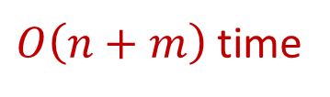
SSSP in DAG (with negative weights)
Bellman-Ford still works, but we can be more efficient!
Core idea of Bellman-Ford: perform a sequence of Update that includes every shortest path as a subsequence.
Observation: in DAG, every path, thus every shortest path, is a subsequence in the topological order.
DAGSSSP(G,s):
for (each u in V)
u.dist=INF, u.parent=NIL
s.dist = 0
Run DFS to obtain topological order
for (each node u in topological order)
for (each edge (u,v) in E)
if (v.dist > u.dist + w(u,v))
v.dist = u.dist + w(u,v)
v.parent = u
$O\left(n+m\right)$ time

Slide 23
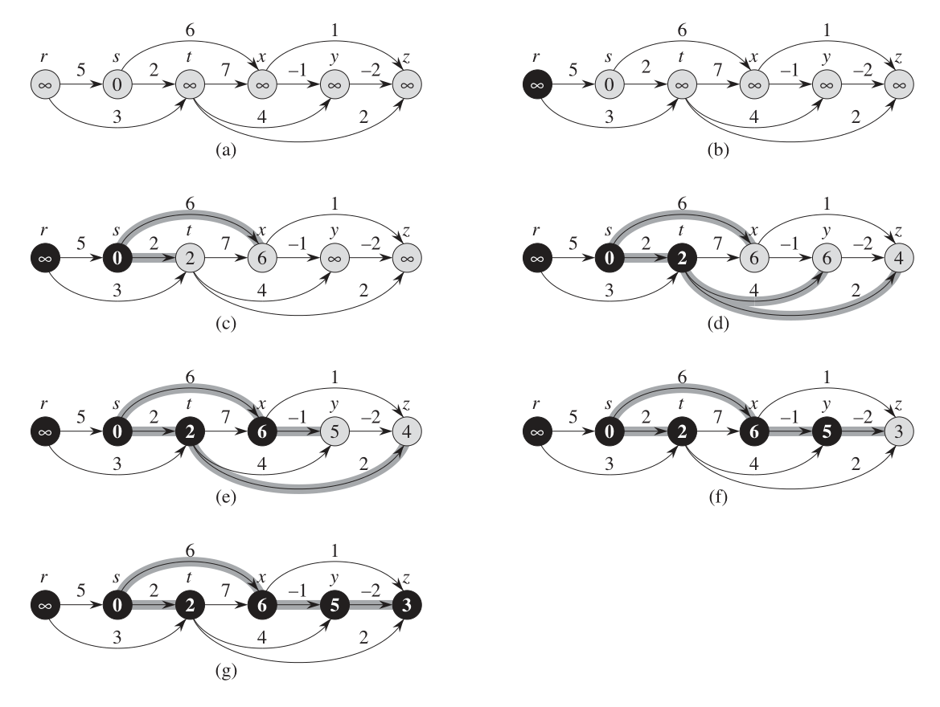
DAGSSSP(G,s):
for (each u in V)
u.dist=INF, u.parent=NIL
s.dist = 0
Run DFS to obtain topological order
for (each node u in topological order)
for (each edge (u,v) in E)
if (v.dist > u.dist + w(u,v))
v.dist = u.dist + w(u,v)
v.parent = u

Slide 24
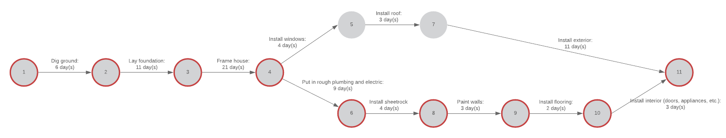
Application of SSSP in DAG Computing Critical Path
Assume you want to finish a task that involves multiple steps. Each step takes some time. For some step(s), it can only begin after certain steps are done.
These dependency can be modeled as a DAG. (PERT Chart)
How fast can you finish this task?
Equivalently, longest path, a.k.a. critical path, in the DAG?
Negate edge weights and compute a shortest path.

Slide 25
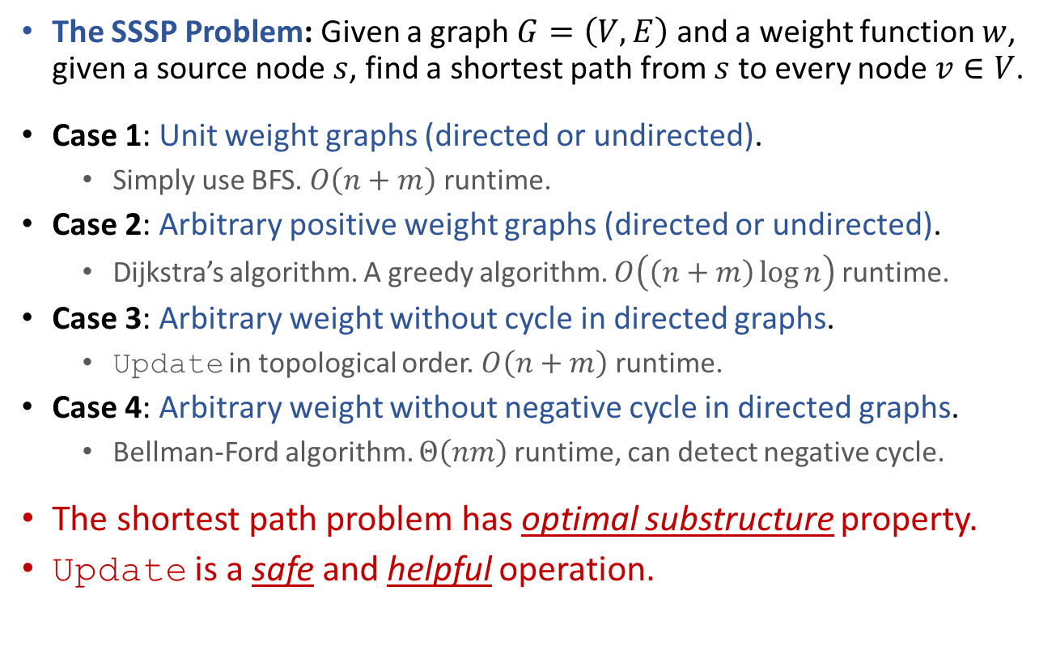
Summary
The SSSP Problem: Given a graph $G=\left(V,E\right)$ and a weight function $w$, given a source node $s$, find a shortest path from $s$ to every node $v∈V$.
Case 1: Unit weight graphs (directed or undirected).
Simply use BFS. $O\left(n+m\right)$ runtime.
Case 2: Arbitrary positive weight graphs (directed or undirected).
Dijkstra’s algorithm. A greedy algorithm. $O\left(\left(n+m\right)\log{n}\right)$ runtime.
Case 3: Arbitrary weight without cycle in directed graphs.
Update in topological order. $O\left(n+m\right)$ runtime.
Case 4: Arbitrary weight without negative cycle in directed graphs.
Bellman-Ford algorithm. $Θ\left(nm\right)$ runtime, can detect negative cycle.
The shortest path problem has optimal substructure property.
Update is a safe and helpful operation.

Slide 26


Reading
[DPV] Ch.4 (More intuitive presentation.)
[CLRS] Ch.24 (excluding 24.4) (Formal and rigorous.)
Optional reading: [Erickson v1] Ch.8

