Slide 1
Unlocking the Power of IoT Sensors for Parking Space Occupancy
Discover the potential of ultrasonic sensors in detecting parking space occupancy and learn how to collect and transmit data using Python scripts on Raspberry Pi.
by Hano MJ

Slide 2
Introduction
1
Purpose of the Presentation
2
Overview of IoT Sensors
3
Importance of Ultrasonic Sensors
Understand the capabilities of IoT sensors and their application in the context of parking space occupancy monitoring.
Explore the different types of IoT sensors and their wide-ranging applications in various industries.
Delve into the unique advantages of ultrasonic
sensors and why they are well-suited for
parking space occupancy detection.

Slide 3
Configuring IoT Sensors for Parking Space Occupancy
1
Explanation of the Configuration Process
Step-by-step guide on setting up and calibrating IoT sensors to accurately detect parking space occupancy.
Benefits of Using Ultrasonic Sensors
2
Discover the advantages of ultrasonic sensors in terms of accuracy, reliability, and ease of installation for parking space monitoring.
3
Real-time Monitoring and Analytics
Explore how configured IoT sensors provide valuable data for real-time monitoring and analytics of parking space utilization.

Slide 4
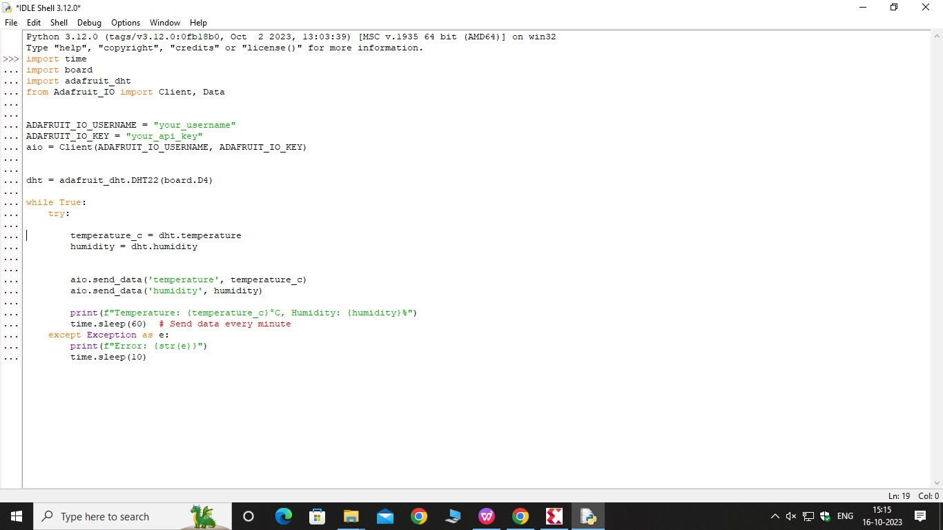
Writing Python Scripts on Raspberry Pi
.

Slide 5
Sending Data to the Cloud or Mobile App Server
Methods for Sending Data
Pros and Cons of Each Method
Explore different methods to transmit parking space occupancy data from Raspberry Pi to the cloud or mobile app server.
Evaluate the advantages and limitations of each data transmission method to determine the most suitable approach for your application.

Slide 6
Conclusion
hence the python script on Raspberry Pi to collect data from sensors and send it to the cloud or mobile app server is written and successfully executed.

