Slide 1
Optimizing Maintenance with Predictive Algorithm
by
Hano MJ

Slide 2
Benefits of Predictive Maintenance
Cost Savings 💰
Improved Safety 🛡️
Predictive maintenance algorithms help identify potential failures before they occur, reducing repair costs and minimizing equipment downtime.
By proactively identifying and addressing maintenance needs, businesses can ensure safer working conditions for employees, reducing the risk of accidents and injuries.
Enhanced Efficiency ⚙️
Extended Equipment Lifespan 🔄
Predictive maintenance allows for planned and strategic maintenance, eliminating the need for reactive, disruptive repairs and optimizing overall operational efficiency.
By identifying potential issues early on, businesses can take preventive measures, extending the lifespan of their equipment and minimizing the need for costly replacements.

Slide 3
Implementing Predictive Maintenance
1
Data Collection & Analysis
Gather sensor data from equipment and utilize advanced analytics to identify patterns and anomalies that could indicate maintenance needs.
Algorithm Development
2
Develop algorithms that analyze sensor data in real-time, using machine learning techniques to predict equipment failures and maintenance requirements.
3
Integration & Automation
Integrate the predictive maintenance algorithms with existing monitoring systems and automate maintenance alerts and notifications for timely action.
Ongoing Optimization
4
Continuously monitor and refine the predictive algorithms based on feedback, ensuring accurate predictions and efficient maintenance planning.

Slide 4



Maximizing Equipment Reliability
Reliable Machinery
Real-Time Monitoring
Proactive Maintenance
Implementing predictive maintenance algorithms helps identify and mitigate potential equipment failures, ensuring reliable operation and minimizing disruptions.
By leveraging sensor data and real-time monitoring, businesses gain constant visibility into equipment performance, allowing prompt action to prevent failures.
Predictive algorithms enable maintenance teams to shift from reactive to proactive maintenance, addressing issues before they escalate, and avoiding costly repairs.

Slide 5
Industry Applications
Manufacturing
Transportation
Predictive maintenance algorithms support efficient production processes by identifying maintenance requirements in advance, minimizing downtime, and ensuring product quality.
Deploying predictive maintenance in the transportation sector helps optimize vehicle performance, schedule maintenance strategically, and improve overall fleet management.
Energy
Healthcare
By using predictive algorithms, energy companies can enhance the reliability of critical infrastructure, reducing downtime and maximizing the production of renewable resources.
Predictive maintenance algorithms in healthcare enable timely maintenance of medical equipment, ensuring uninterrupted access to essential healthcare services.

Slide 6
Challenges & Considerations
1
Data Quality and Availability
2
Implementation Complexity
3
Change Management
Ensuring the accuracy and reliability of sensor data is crucial for effective predictive maintenance. Businesses must address challenges related to data quality and availability.
Integrating predictive maintenance algorithms into existing systems may require substantial efforts, including data integration, algorithm development, and infrastructure enhancements.
Successfully adopting predictive
maintenance requires organizational
alignment, effective change management,
and training programs to enable
employees to embrace the new approach.

Slide 7
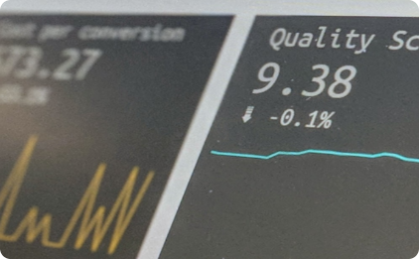
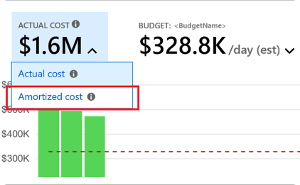

Driving Performance with
Predictive Maintenance
Equipment Optimization
Cost Savings
Customer Satisfaction
By proactively addressing maintenance needs, businesses can optimize equipment performance, leading to increased productivity and improved operational efficiency.
Predictive maintenance algorithms help prevent costly breakdowns, reduce maintenance expenses, and enable more efficient resource allocation, resulting in significant cost savings.
Minimizing equipment downtime and ensuring reliable service delivery enhances customer satisfaction, fostering loyalty and trust in your organization.

Slide 8
Future of Predictive Maintenance
Predictive Maintenance as a Service
Advanced Analytics
Internet of Things
As the technology matures,
businesses may choose to leverage
third-party providers offering predictive
maintenance as a service to optimize
their maintenance processes.
Continual advancements in analytics, including artificial intelligence and machine learning, will enable more accurate predictions and proactive maintenance strategies.
The proliferation of connected devices will provide businesses with a greater volume and variety of data, further enhancing the effectiveness of predictive maintenance algorithms.

Slide 9

Conclusion
By harnessing the power of predictive maintenance algorithms, businesses can transform their maintenance strategies, introducing proactive and data-driven approaches that enhance efficiency, reliability, and overall performance.

