Slide 1
DRONE PATHFINDER AI REINFORCMENT LEARNING
By: Daniel Fridström & Hans Fredö
Notes:
Our project is called Drone Pathfinder,

Slide 2
AGENDA
01
02
03
04
05
PROJECT CONCEPT
GAME DESIGN
[RL]
Short description of the project
Short explination of the design of the simulation
How the Reinforcement Learning work
RESULT
CONCLUSIONS
Will show the “drone” in action during Demo
Short conclusion of the work
Notes:
During this presentation, we will explain the project concept, how we designed the simulation, how the reinforcement learning works, and what we achieved.

Slide 3
01
PROJECT CONCEPT
Train an AI controlled drone to navigate a 3D environment.
Reach checkpoints and avoid obstacles.
Investigate how learning strategies affect success rate and navigation efficiency.

Slide 4
02
GAME DESIGN
Engine: Godot - 3D simulation.
Objective: Reach five checkpoints
Obstacles: Collisions terminates it.
Actions: Eight discrete movement actions.
Curriculum: Ten levels, increasing from 5 to 60 obstacles.
Episode: One attempt from reset until success, death or timeout.

Slide 5
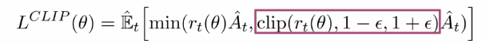
03
[RL] Reinforcement learning
PPO – Proximal Policy optimization.
Placed in a simulted environment.
It observs the current situation.
It chooses an action.
It receives feedback and learns from the result.

Slide 6
03
[RL] Reinforcement learning
Positive feedback for making progress.
Learn to reach checkpoints and complete the course.
Better path efficiency is part of evaluating performance.
Repeated attems help the AI discover better behaviour.

Slide 7
03
[RL] Reinforcement learning
PPO updates the drone's neural network during training.
Training consists of repeated interaction and learning cycles.
A curriculum gradually increases the difficulty.

Slide 8
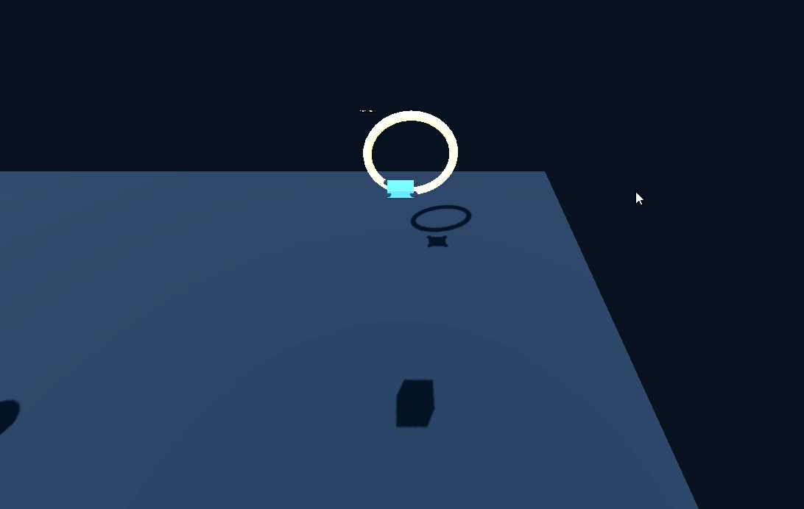
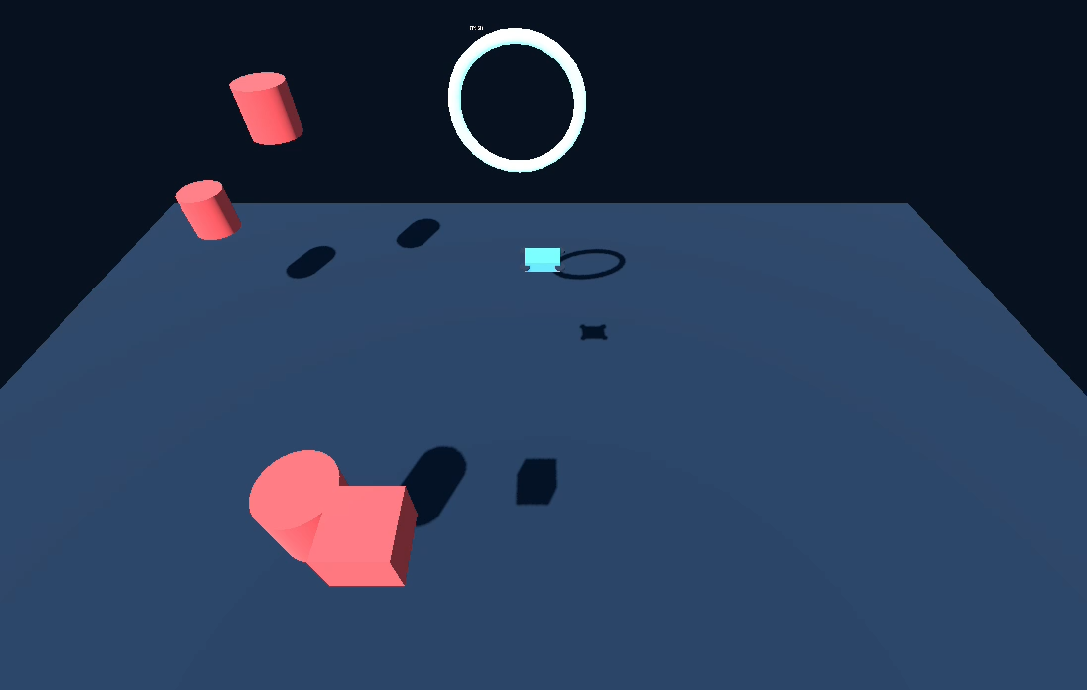
04
DEMO
Untrained Model
Trained Model
Notes:
DEMO VIDEOS

Slide 9
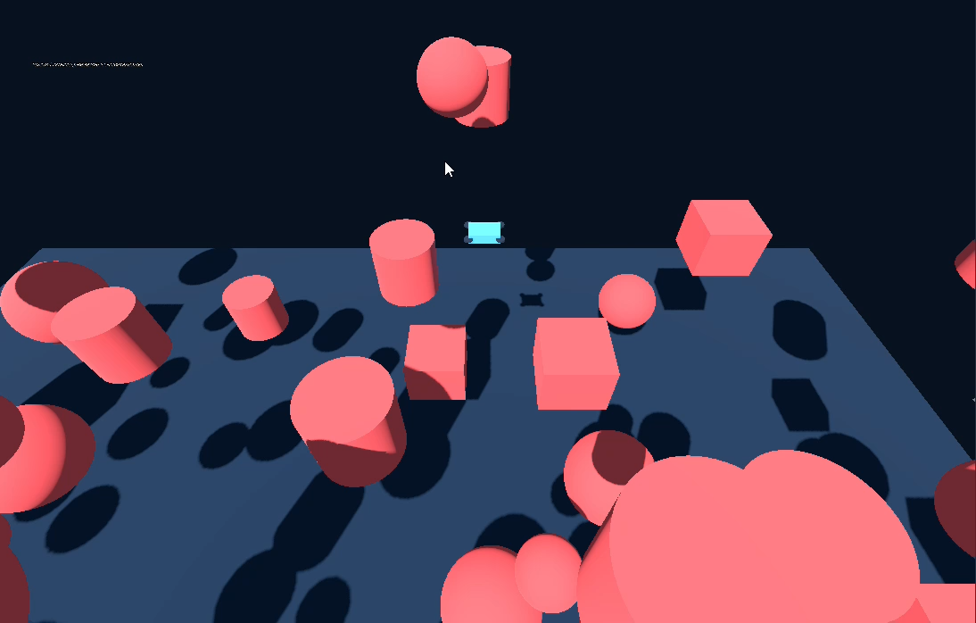
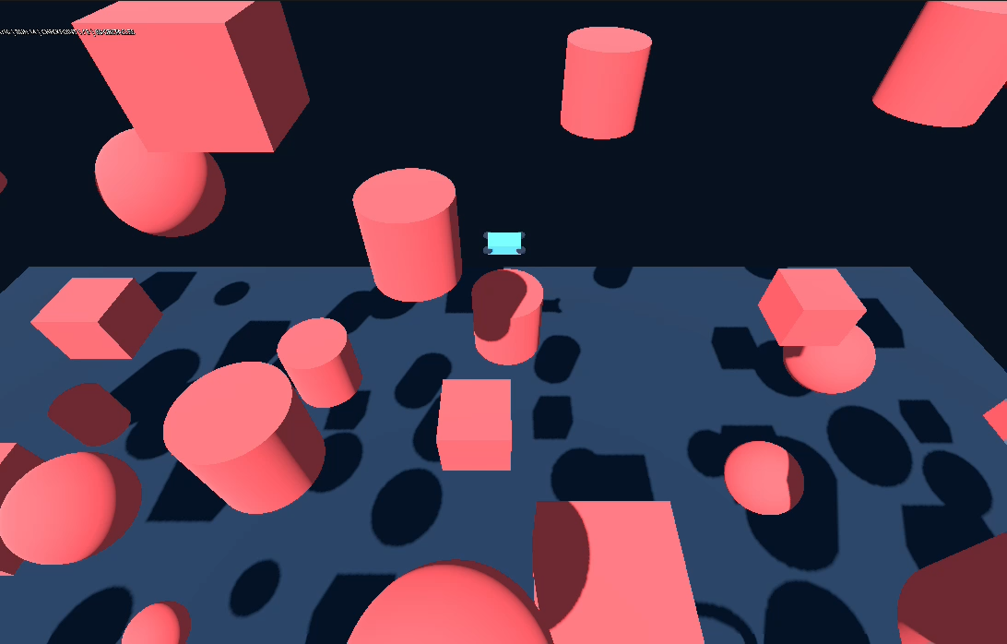
04
DEMO
Untrained Model
Trained Model
Notes:
DEMO VIDEOS 2

Slide 10
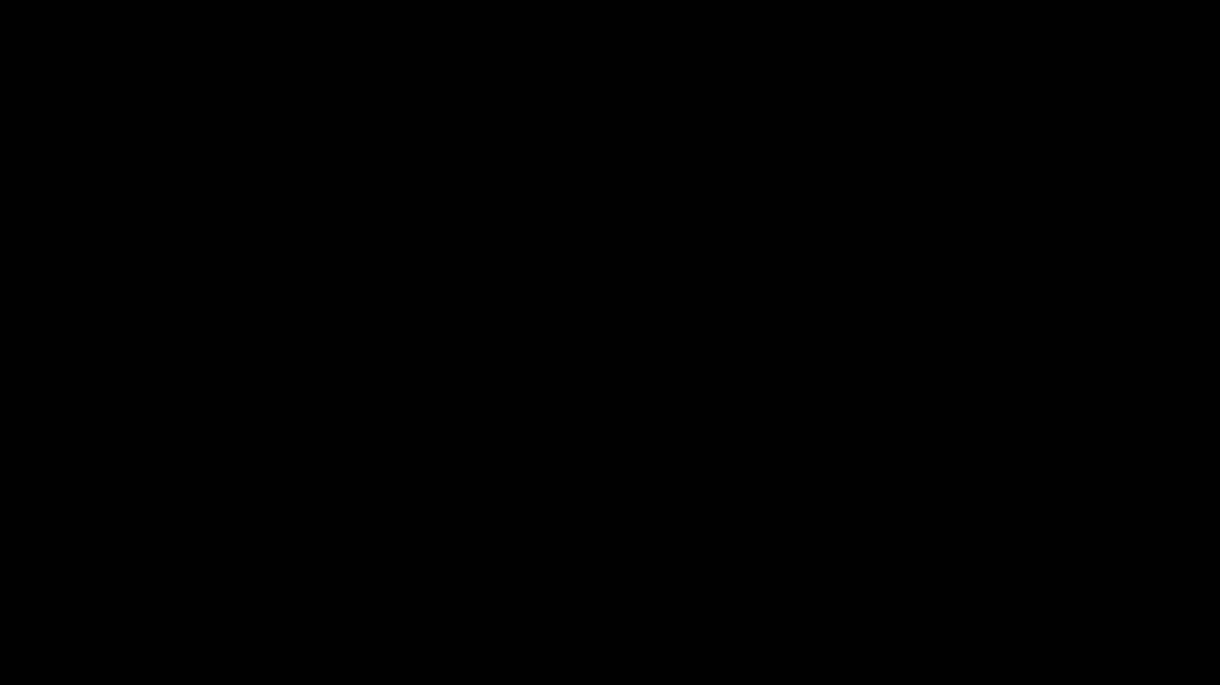
05
CONCLUSION
Final Version

