Slide 1
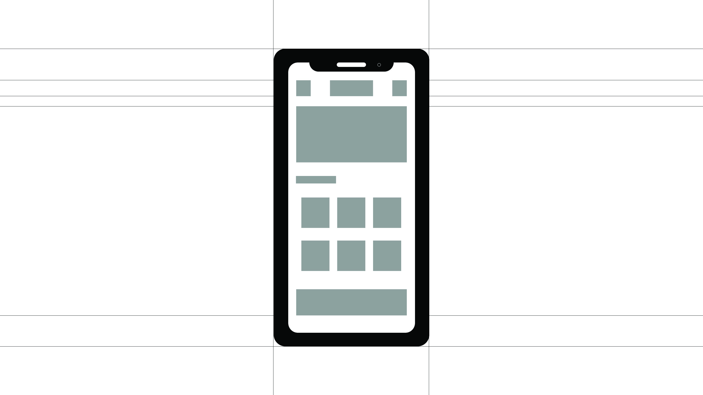
최한올

Slide 2
Mobile Web Dev. Introduce
ONE. Mobile WebSite Introduce
Two. Color && Fonts
Thr. Design
Fur. Code

Slide 3
ONE. Mobile WebSite Introduce ( 모바일 웹사이트 소개 )
TITLE : RAAW (Review About Around the World)
기존에는 해외 여행에 대한 정보를 얻으려면 각 지역과 카테고리를 직접 검색하여 찾아야하는 불편함이 있었지만, 이 어플은 해외여행지에 대한 기본 정보를 제공, 호텔/항공권 검색 등 다양한 기능을 제공한다. 또한 사람들의 후기를 한 데 모아 여행을 준비하는 이들에게 필수어플이 될 것이다.

Slide 4
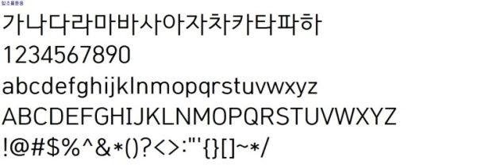
Two. Color && Fonts ( 색상 및 폰트 선택)
Color
#aee9e8
#8dc8e8
#ff5858
#d5d717
#888
하늘과 바다를 연상시키는 컬러를 사용해 여행에 대한 설레임을 투영하고자 하였고
#ff5858, #d5d717 색상은 강조하고 싶은 부분에 사용, 그 외에는 #888, #999, #ccc
컬러를 주로 사용하였음.
Fonts
한글/영문폰트 : 함초롬돋움체 사용
글자의 가독성을 높이되 촌스럽지 않은 폰트를 사용함

Slide 5
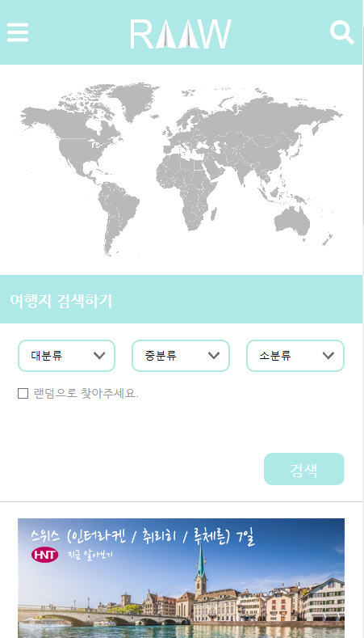
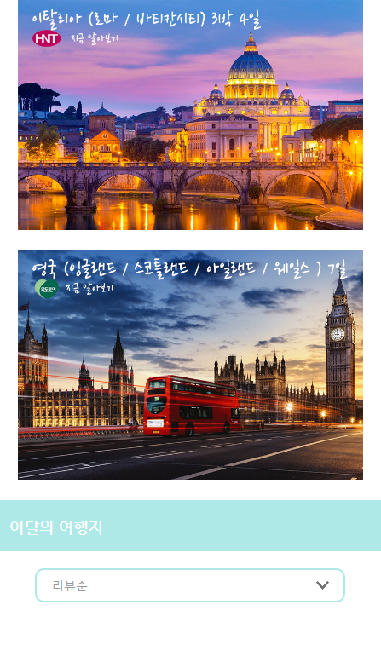
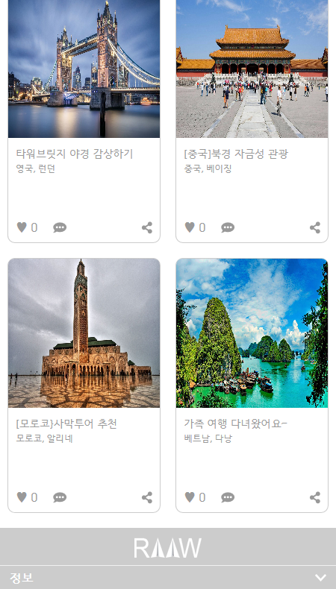
Thr. Design ( 모바일 웹 디자인 )
Top
Middle
Under

Slide 6
Thr. Code ( HTML CODE )
<!DOCTYPE html>
<html lang="ko">
<head>
<meta charset="UTF-8">
<meta name="viewport" content="width=device-width, initial-scale=1, minimum-scale=1, maximum-scale=1, user-scalable=no">
<meta name="viewport" content="width=device-width, initial-scale=1.0 ">
<meta http-equiv="X-UA-Compatible" content="ie=edge">
<script src="https://code.jquery.com/jquery-1.12.1.js"></script>
<script src="https://code.jquery.com/ui/1.12.1/jquery-ui.js"></script>
<script defer src="https://use.fontawesome.com/releases/v5.0.8/js/all.js"></script>
<script src="js/mobile.js"></script>
<link rel="stylesheet" href="css/base.css">
<link rel="stylesheet" href="css/style.css">
<title>RAAW(Review About Around the World</title>
</head>
<body>
<div id="wrap">
<header> <div id="blackbg"></div>
<nav id="gnb">
<ul>
<li><a href="#"><i class="fas fa-user-circle"></i>&nbsp;&nbsp;나의 프로필</a></li>
<li><a href="#">&nbsp;<i class="fas fa-angle-down"></i>&nbsp;&nbsp;여행정보</a>
<ul class="depth2">
<li><a href="#">나라별</a></li>
<li><a href="#">테마별</a></li>
<li><a href="#">해외여행 안전정보</a></li>

Slide 7
Thr. Code ( HTML CODE )
</ul>
</li>
<li><a href="#">&nbsp;<i class="fas fa-angle-down"></i>&nbsp;&nbsp;후기</a>
<ul class="depth2">
<li><a href="#">나라별</a></li>
<li><a href="#">테마별</a></li>
<li><a href="#">인기 TOP 10</a></li>
<li><a href="#">추천도시</a></li>
<li><a href="#">커뮤니티</a></li>
</ul>
</li>
<li><a href="#">&nbsp;<p class="circle">●</p>&nbsp;&nbsp;&nbsp;호텔검색</a></li>
<li><a href="#">&nbsp;<p class="circle">●</p>&nbsp;&nbsp;&nbsp;항공권 검색</a></li>
<li><a href="#">&nbsp;<i class="fas fa-angle-down"></i>&nbsp;&nbsp;알림</a>
<ul class="depth2">
<li><a href="#">공지사항</a></li>
<li><a href="#">이벤트</a></li>
</ul>
</li>
</ul>
</nav>
<div id="headerIn">
<!-- 오픈 메뉴 버튼 -->
<div class="navi">
<a href="#"><i class="fas fa-bars" style="color:white"></i></a>

Slide 8
Thr. Code ( HTML CODE )
</div>
<!-- 로고 -->
<h1 class="logo"><a href="index.html"><img src="images/RAAW_logo.png" alt="로고"></a></h1>
<!-- 서치 -->
<div class="search">
<a href="#"><i class="fas fa-search" style="color:white"></i></a>
</div>
</div>
<div id="searchBar">
<input type="search" name="sch" id="sch" placeholder="검색하기">
</div>
</header>
<main>
<div id="mainVisual">
<a href="#"><img src="images/worldmap.png" alt="세계지도"></a>
</div>
<div class="l_search">여행지 검색하기</div>
<div id="find">
<ul>
<select id="b">
<option>대분류</option>
<option>아메리카</option>

Slide 9
Thr. Code ( HTML CODE )
<option>오세아니아</option>
<option>유럽</option>
</select>
<select id="m">
<option>중분류</option>
</select>
<select id="s">
<option>소분류</option>
</select>
</ul>
<input type="checkbox" name="random"><p>랜덤으로 찾아주세요.</p>
<div class="find_box"><a href="#">검색</a></div>
</div>
<div id="line1"></div>
<!-- 여행사 광고 -->
<div id="gall1">
<ul>
<li><a href="#">
<img src="images/swiss.png" alt="스위스">
<p class="conts">
<span class="tit">스위스 (인터라켄 / 취리히 / 루체른) 7일</span>
<span class="exp">도시 곳곳이 동화 속 처럼 아름다운 스위스로 지금 떠나보세요.</span>
</p>
</a></li>

Slide 10
Thr. Code ( HTML CODE )
<li><a href="#">
<img src="images/italy.png" alt="이탈리아">
<p class="conts">
<span class="tit">이탈리아 (로마 / 바티칸시티) 3박 4일</span>
<span class="exp">바쁜 직장인을 위한 로마 3박 4일 알찬 투어!</span>
</p>
</a></li>
<li><a href="#">
<img src="images/london.png" alt="런던">
<p class="conts">
<span class="tit">영국 (잉글랜드 / 스코틀랜드 / 아일랜드 / 웨일스) 7일</span>
<span class="exp">7일간의 영국과 아일랜드 정통일주를 체험해보세요.</span>
</p>
</a></li>
</ul>
</div>
<div class="thismonth">이달의 여행지</div>
<div id="choice">
<select class="selbox" onchange="setSelectText('searchSubCate', this)">
<option value="show1">리뷰순</option>
<option value="show2">검색순</option>
<option value="show3">추천순</option>
<option value="show4">댓글순</option>
</select>

Slide 11
Thr. Code ( HTML CODE )
<div class="showpic">
<div id="show1" class="mm">
<a href="#"><img src="images/croatia.png" alt="크로아티아"></a>
<p class="choice_text1">이번 달 가장 많은 리뷰를 차지한 요즘 가장 핫한<br>여행지,아드리아해의 숨은 보석 크로아티아! 가족,<br>친구, 연인과 크로아티아로 떠나보는 건 어떨까요?</p>
<p class="choice_text1-1"><a href="#">크로아티아 정보 알아보기 ></a></p>
</div>
<div id="show2" class="mm">
<a href="#"><img src="images/laos.png" alt="라오스"></a>
<p class="choice_text2">저렴한 물가는 기본, 색다른 자연에서 즐기는<br>다양한 액티비티와 풍부한 먹거리로 우리나라뿐만<br>아니라 전세계적으로 유명한 배낭지가 된 라오스가<br>이달의 검색순 1위입니다!</p>
<p class="choice_text2-1"><a href="#">라오스 정보 알아보기 ></a></p>
</div>
<div id="show3" class="mm">
<a href="#"><img src="images/hawaii.png" alt="하와이"></a>
<p class="choice_text3">전세계인에게 꾸준히 사랑받는 여행지 하와이!<br>천혜의 자연환경에서 휴양과 관광을 동시에<br>즐겨보세요.</p>
<p class="choice_text2-1"><a href="#">하와이 정보 알아보기 ></a></p>
</div>
<div id="show4" class="mm">
<a href="#"><img src="images/hokkaido.png" alt="홋카이도"></a>
<p class="choice_text4">눈의 도시 홋카이도에서 눈의 축제부터 온천까지<br>겨울여행만의묘미를 느껴보세요.</p>
<p class="choice_text2-1"><a href="#">홋카이도 정보 알아보기 ></a></p>
</div>
</div>

Slide 12
Thr. Code ( HTML CODE )
<ul class="sum3">
<li>
<a href="#"><img src="images/morocco.png" alt="모로코"></a>
<p class="exp_3">
<span class="title">[모로코}사막투어 추천</span>
<span class="sum_exp">모로코, 알리네</span></p>
<p class="btn"><span id="clickme3">♥ 0</span></p>
<p class="cmmt3"><i class="fas fa-comment-alt"></i></p>
<p class="cmmt_num3">0</p>
<a href="#" class="share"><i class="fas fa-share-alt"></i></a>
</li>
</ul>
<ul class="sum4">
<li>
<a href="#"><img src="images/vietnam.png" alt="베트남"></a>
<p class="exp_4">
<span class="title">가족 여행 다녀왔어요~</span>
<span class="sum_exp">베트남, 다낭</span></p>
<p class="btn"><span id="clickme4">♥ 0</span></p>
<p class="cmmt4"><i class="fas fa-comment-alt"></i></p>
<p class="cmmt_num4">0</p>
<a href="#" class="share"><i class="fas fa-share-alt"></i></a>
</li>
</ul>
</div>
</main>

Slide 13
Thr. Code ( HTML CODE )
</div>
<div class="review">후기<p><a href="#">더보기 ></a></p></div>
<div id="sumImg">
<ul class="sum1">
<a href="#"><img src="images/towerbridge.png" alt="타워브릿지"></a>
<p class="exp_1">
<span class="title">타워브릿지 야경 감상하기</span>
<span class="sum_exp">영국, 런던</span></p>
<p class="btn"><span id="clickme1">♥ 0</span></p>
<p class="cmmt1"><i class="fas fa-comment-alt"></i></p>
<p class="cmmt_num1">0</p>
<a href="#" class="share"><i class="fas fa-share-alt"></i></a>
</ul>
<ul class="sum2">
<li>
<a href="#"><img src="images/beijing.png" alt="베이징"></a>
<p class="exp_2">
<span class="title">[중국]북경 자금성 관광</span>
<span class="sum_exp">중국, 베이징</span></p>
<p class="btn"><span id="clickme2">♥ 0</span></p>
<p class="cmmt2"><i class="fas fa-comment-alt"></i></p>
<p class="cmmt_num2">0</p>
<a href="#" class="share"><i class="fas fa-share-alt"></i></a>
</li>
</ul>

Slide 14
Thr. Code ( HTML CODE )
<ul class="sum3">
<li>
<a href="#"><img src="images/morocco.png" alt="모로코"></a>
<p class="exp_3">
<span class="title">[모로코}사막투어 추천</span>
<span class="sum_exp">모로코, 알리네</span></p>
<p class="btn"><span id="clickme3">♥ 0</span></p>
<p class="cmmt3"><i class="fas fa-comment-alt"></i></p>
<p class="cmmt_num3">0</p>
<a href="#" class="share"><i class="fas fa-share-alt"></i></a>
</li>
</ul>
<ul class="sum4">
<li>
<a href="#"><img src="images/vietnam.png" alt="베트남"></a>
<p class="exp_4">
<span class="title">가족 여행 다녀왔어요~</span>
<span class="sum_exp">베트남, 다낭</span></p>
<p class="btn"><span id="clickme4">♥ 0</span></p>
<p class="cmmt4"><i class="fas fa-comment-alt"></i></p>
<p class="cmmt_num4">0</p>
<a href="#" class="share"><i class="fas fa-share-alt"></i></a>
</li>
</ul>
</div>
</main>

Slide 15
Thr. Code ( HTML CODE )
<footer>
<div class="flogo">
<a href="#"><img src="images/RAAW_flogo.png" alt="푸터로고"></a>
</div>
<nav id="fnav">
<ul>
<li><a href="#">정보</a>
<ul class="fdepth2">
<li>
<p>RAAW(Review About Around the World)<br><br>책임자: 최한올<br>연락처: 010-9238-1328<br><br>ⓒ All Rights Reserved.</p>
</li>
</ul>
</li>
</ul>
</nav>
</footer>
</div>
</body>
<script>
$(".search>a").click(function(){
$("#searchBar").slideToggle("500");
});
$(".navi>a").click(function(){
var poi = $("#gnb").css("display");

Slide 16
Thr. Code ( HTML CODE )
if(poi == "none"){
$("#gnb").show(100).animate({left:"0"});
$("#blackbg").fadeIn();
}else if(poi == "block"){
$("#gnb").animate({left:"-100%"});
$("#gnb").fadeOut(200);
$(".depth2").slideUp();
}
return false;
});
$("#blackbg").click(function(){
$("#gnb").animate({left:"-100%"});
$("#blackbg").fadeOut();
});
$("#gnb>ul>li>a").click(function(){
var dis = $(this).siblings(".depth2");
var two = dis.css("display");
if(two == "none"){
$(".depth2").slideUp();
dis.slideDown(); // dis -> display:block;
}else if(two == "block"){
dis.slideUp();
}
return false;
});

Slide 17
Thr. Code ( HTML CODE )
$(".selbox").change(function(){
$(".mm").hide(); // 현재 선택한 옵션 메뉴를 제외하고 다른 나머지 메뉴는 사라짐
$("#"+$(this).val()).show(); // 선택한 옵션 메뉴에 관련된 value의 값과 일치하는 id명을 가지고 있는 메뉴만 나타냄
});
/* 좋아요 버튼 */
var count = 0;
$("#clickme1").click(function(){
count += 1;
$("#clickme1").html("♥"+count);
$("#clickme1").css("color", "red");
return false;
});
var count2 = 0;
$("#clickme2").click(function(){
count2 += 1;
$("#clickme2").html("♥"+count2);
$("#clickme2").css("color", "red");
return false;
});
var count3 = 0;
$("#clickme3").click(function(){
count3 += 1;
$("#clickme3").html("♥"+count3);
$("#clickme3").css("color", "red");
return false;

Slide 18
Thr. Code ( HTML CODE )
});
var count4 = 0;
$("#clickme4").click(function(){
count4 += 1;
$("#clickme4").html("♥"+count4);
$("#clickme4").css("color", "red");
return false;
});
var count5 = 0;
$(".cmmt1, .cmmt_num1").click(function(){
count5 += 1;
$(".cmmt_num1").html(""+count5);
$(".cmmt1, .cmmt_num1").css("color", "#d5d717");
return false;
});
var count6 = 0;
$(".cmmt2, .cmmt_num2").click(function(){
count6 += 1;
$(".cmmt_num2").html(""+count6);
$(".cmmt2, .cmmt_num2").css("color", "#d5d717");
return false;
});
var count7 = 0;
$(".cmmt3, .cmmt_num3").click(function(){

Slide 19
Thr. Code ( HTML CODE )
count7 += 1;
$(".cmmt_num3").html(""+count7);
$(".cmmt3, .cmmt_num3").css("color", "#d5d717");
return false;
});
var count8 = 0;
$(".cmmt4, .cmmt_num4").click(function(){
count8 += 1;
$(".cmmt_num4").html(""+count8);
$(".cmmt4, .cmmt_num4").css("color", "#d5d717");
return false;
});
$("#fnav>ul>li>a").click(function(){
var dis = $(this).siblings(".fdepth2");
var two = dis.css("display");
if(two == "none"){
$(".fdepth2").slideUp();
dis.slideDown(); // dis -> display:block;
}else if(two == "block"){
dis.slideUp();
}
return false;
});

Slide 20
Thr. Code ( HTML CODE )
$("#gall1 a").click(function(){
$(this).find(".conts").slideToggle();
return false;
});
</script>
</html>

Slide 21
Thr. Code ( CSS CODE )
@charset "utf-8";
#wrap{
width:100%;
font-family: "함초롬돋움",sans-serif;
}
header, main, footer{
position: relative;
width:100%;
}
#blackbg{
position:fixed;
width:100%;
height: 100%;
background: rgba(0,0,0,0.7);
z-index:998;
display:none;
}
/* 왼쪽 슬라이드 메뉴 */
#gnb{
position: fixed;
left:-100%;
width:70%;
height:100%;
display:none;

Slide 22
Thr. Code ( CSS CODE )
background:#8dc8e8;
z-index: 999;
}
.fa-user-circle{
font-size: 30px;
}
.fa-angle-down{
font-size: 25px;
}
#gnb>ul>li>a{
position: relative;
display: block;
font-size: 18px;
font-weight: 600;
padding:15px 0;
color:#fff;
padding-left: 30px;
border-bottom:1px solid #aee9e8;
}
#gnb>ul>li>a:after{
position: absolute;
top:50%;
transform: translateY(-50%);

Slide 23
Thr. Code ( CSS CODE )
right:10px;
display:block;
}
#gnb>ul>li:nth-child(4)>a, #gnb>ul>li:nth-child(5)>a{
display:flex;
}
#gnb p{
font-size: 10px;
line-height: 20px;
}
.depth2{
display: none;
}
.depth2 a{
display: block;
padding:10px;
font-size: 16px;
color:#fff;
border-bottom:1px solid #aee9e8;
padding-left:50px;
}
#headerIn{
position: relative;

Slide 24
Thr. Code ( CSS CODE )
top : 0;
width : 100%;
height : 80px;
display : flex;
justify-content : space-between;
align-items : center;
background : #aee9e8;
}
.navi, .search{
position : relative;
width : 30px;
height : 30px;
}
.navi{
left : 10px;
}
.search{
right : 10px;
}
.navi>a, .search>a{
display : block;
width : 30px;
height : 30px;
}

Slide 25
Thr. Code ( CSS CODE )
.navi span, .search span{
display : block;
width : 30px;
height : 30px;
margin : 0 auto;
}
.fa-bars, .fa-search{
font-size : 30px;
}
/* 로고 */
.logo{
width : 125px;
height : 40px;
}
#searchBar{
position : relative;
width : 100%;
height : 50px;
background : #aee9e8;
display : none;
}
#sch{
position : relative;
top : 5px;

Slide 26
Thr. Code ( CSS CODE )
display : block;
width : 80%;
height : 40px;
margin : 0 auto;
border : 0;
text-indent : 10px;
background : #fff;
color : #ccc;
}
/* 메인 CSS */
#mainVisual{
position : relative;
width : 100%;
height : 220px;
margin-top : 20px;
margin-bottom : 20px;
}
#mainVisual img{
position: absolute;
left:5%;
width:90%;
height:100%;
}
#mainVisual a{

Slide 27
Thr. Code ( CSS CODE )
display : block;
justify-content : space-around;
margin : 0 auto;
}
/* 여행지 검색하기 */
.l_search{
position : relative;
width : 100%;
height : 60px;
font-size: 18px;
font-weight: 600;
line-height: 60px;
align-items: center;
color:#fff;
padding-left: 3%;
background:#aee9e8;
}
#find{
position : relative;
width : 90%;
height : 200px;
margin : 0 auto;
}
#find>ul{

Slide 28
Thr. Code ( CSS CODE )
display:flex;
padding-top: 20px;
justify-content: space-between;
}
#find>ul>select{
width:30%;
height:40px;
border:2px solid #aee9e8;
border-radius: 10px;
appearance: none;
background: url("../images/arrow_down.png") no-repeat 90% 50% / 15px 10px;
}
#find>ul>select::-ms-expand{
display:none;
}
#b, #m, #s{
padding-left: 3%;
}
input{
position: absolute;
top:40%;
left:0;
}

Slide 29
Thr. Code ( CSS CODE )
#find p{
position: absolute;
top:38%;
left:20px;
color:#999;
font-size: 14px;
}
.find_box{
position: absolute;
bottom:0;
right:0;
width:100px;
height:40px;
background:#aee9e8;
border-radius: 10px;
}
.find_box a{
display:block;
color:#fff;
text-align: center;
font-size: 18px;
line-height: 40px;
}
#line1{
position: relative;

Slide 30
Thr. Code ( CSS CODE )
margin-top: 20px;
width:100%;
border-bottom: 1px solid #ccc;
}
/* 여행사 광고 */
#gall1{
width:100%;
height:auto;
margin-top:20px;
}
#gall1 li{
width:90%;
height:auto;
margin: 0 auto 20px auto;
}
#gall1 a{
display:block;
width:100%;
height:auto;
}
#gall1 img{
width:100%;
height:auto;
}

Slide 31
Thr. Code ( CSS CODE )
.tit{
display:block;
font-size: 16px;
text-indent: 10px;
padding:5px 0;
}
.exp{
display:block;
font-size: 14px;
text-indent: 20px;
padding: 5px 0;
}
.btn{
position: relative;
width:80px;
margin-left: auto;
display:flex;
justify-content: space-between;
align-items: center;
}
.btn>span{
display:block;
cursor: pointer;
}

Slide 32
Thr. Code ( CSS CODE )
/* 이달의 여행지 */
.thismonth{
position: relative;
width:100%;
height:60px;
font-size: 18px;
font-weight: 600;
line-height: 60px;
padding-left: 3%;
align-items: center;
color:#fff;
background:#aee9e8;
}
#choice, .showpic{
width:90%;
height:auto;
margin: 20px auto 0 auto;
margin-bottom: 70px;
}
.selbox{
width:90%;
height:40px;
font-size: 14px;
color:#999;
margin: 0 auto;
border-radius: 10px;

Slide 33
Thr. Code ( CSS CODE )
border:2px solid #aee9e8;
padding-left: 4%;
appearance: none;
background: url("../images/arrow_down.png") no-repeat 95% 50% / 15px 10px;
}
#choice>select::-ms-expand{
display:none;
}
#show1, #show2, #show3, #show4{
position: relative;
display:none;
}
.choice_text1, .choice_text2, .choice_text3, .choice_text4{
position: relative;
text-align: center;
margin: 0 auto;
color:#999;
margin-top: 10px;
}
.choice_text1-1 a, .choice_text2-1 a{
position: absolute;
right:0;
display:block;
margin-top: 20px;

Slide 34
Thr. Code ( CSS CODE )
font-size: 14px;
font-weight: 600;
color:#999;
}
.showpic img{
position: relative;
margin: 0 auto;
width:350px;
height:150px;
}
select{
display:block;
width:100%;
height:30px;
border:1px solid #ccc;
}
.showpic img{
width:100%;
height:auto;
}
/* 후기 */
.review{
position: relative;
width:100%;

Slide 35
Thr. Code ( CSS CODE )
height:60px;
font-size: 18px;
font-weight: 600;
line-height: 60px;
color:#fff;
padding-left: 3%;
background:#aee9e8;
}
.review p>a{
position: absolute;
top:0;
right:6%;
font-size: 16px;
color:#fff;
}
#sumImg{
position: relative;
width:100%;
display:flex;
flex-wrap: wrap;
justify-content: space-around;
margin-top:20px;
}
#sumImg img{
position: absolute;

Slide 36
Thr. Code ( CSS CODE )
width:100%;
height:200px;
border-top-left-radius: 8px;
border-top-right-radius: 8px;
z-index: 99;
}
.sum1, .sum2, .sum3, .sum4{
position: relative;
width:45%;
height:340px;
display:block;
border:1px solid #ccc;
border-radius: 10px;
margin: 0 auto 20px auto;
}
.title{
position: absolute;
line-height: 440px;
font-size: 14px;
text-indent: 10px;
color:#999;
}
.sum_exp{
position: absolute;
line-height: 480px;

Slide 37
Thr. Code ( CSS CODE )
font-size: 12px;
text-indent: 10px;
color:#999;
}
.sum1 .btn, .sum2 .btn, .sum3 .btn, .sum4 .btn{
position: absolute;
left:10px;
bottom: 10px;
color:#999;
}
.sum1 .cmmt1, .sum2 .cmmt2, .sum3 .cmmt3, .sum4 .cmmt4{
position: absolute;
left:60px;
bottom:10px;
color:#999;
}
.sum1 .cmmt_num1, .sum2 .cmmt_num2, .sum3 .cmmt_num3, .sum4 .cmmt_num4{
position: absolute;
left:85px;
bottom: 10px;
color:#999;
}
.share{
position: absolute;

Slide 38
Thr. Code ( CSS CODE )
right:10px;
bottom: 10px;
color:#999;
}
/* 푸터 */
footer{
width:100%;
height:auto;
background:#ccc;
}
.flogo{
width:100%;
height:50px;
background:#ccc;
}
.flogo>a{
display:block;
position: relative;
width:90px;
height:29px;
margin: 0 auto;
top:50%;
transform: translateY(-50%);
}

Slide 39
Thr. Code ( CSS CODE )
#fnav>ul>li>a{
position: relative;
display:block;
font-size: 16px;
font-weight: 600;
color:#fff;
padding:5px 0;
padding-left: 3%;
border-top:1px solid rgba(255,255,255,0.7);
border-bottom:1px solid rgba(255,255,255,0.7);
}
#fnav>ul>li>a:after{
position: absolute;
top:50%;
right:3%;
transform: translateY(-50%);
appearance: none;
content: url("../images/arrow_down2.png");
display:block;
font-size: 14px;
}
.fdepth2 li{
background: #ccc;
padding:10px 0;
}

Slide 40
Thr. Code ( CSS CODE )
.fdepth2 p{
font-size: 12px;
color:#fff;
padding-left: 4%;
}

Slide 41
Thr. Code ( JS CODE )
/* JavaScript Document */
/* 서치메뉴버튼 JSCODE */
$(".search>a").click(function(){
$("#searchBar").slideToggle
});

