Slide 1


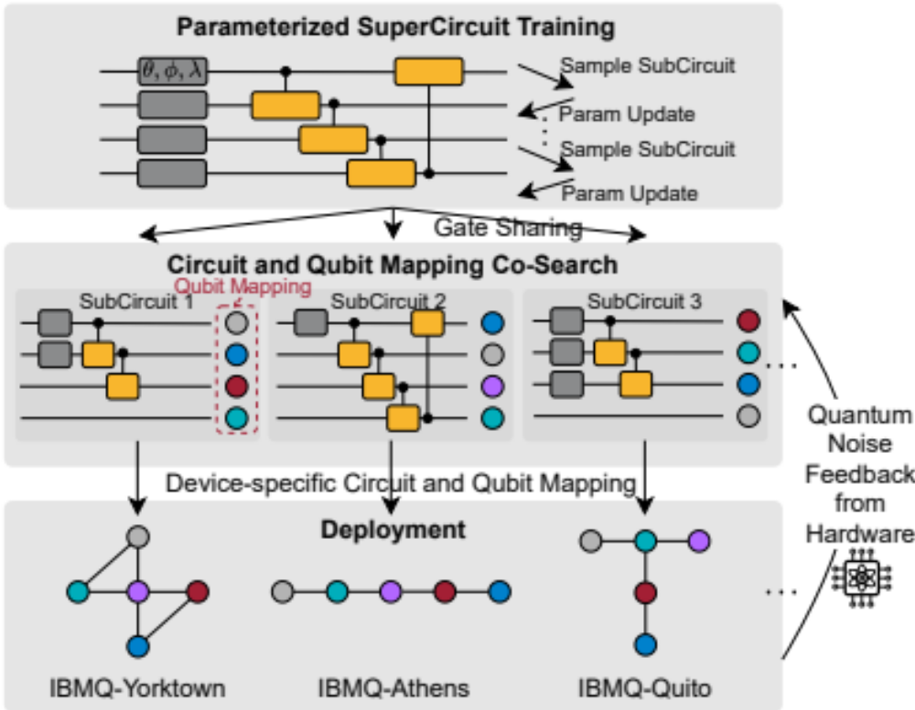
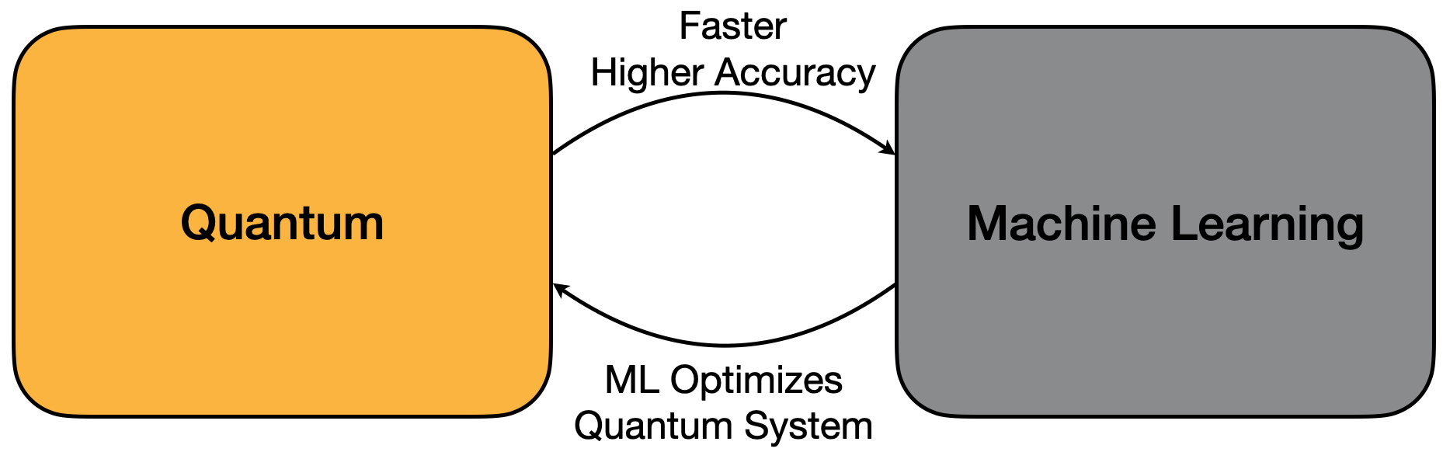
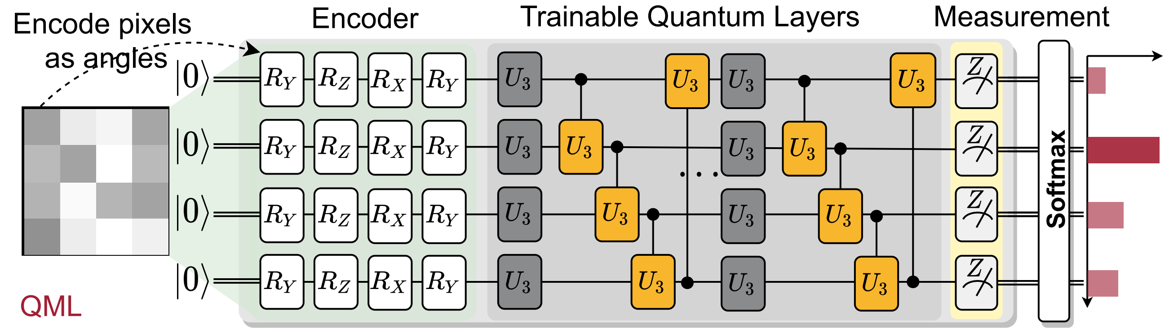
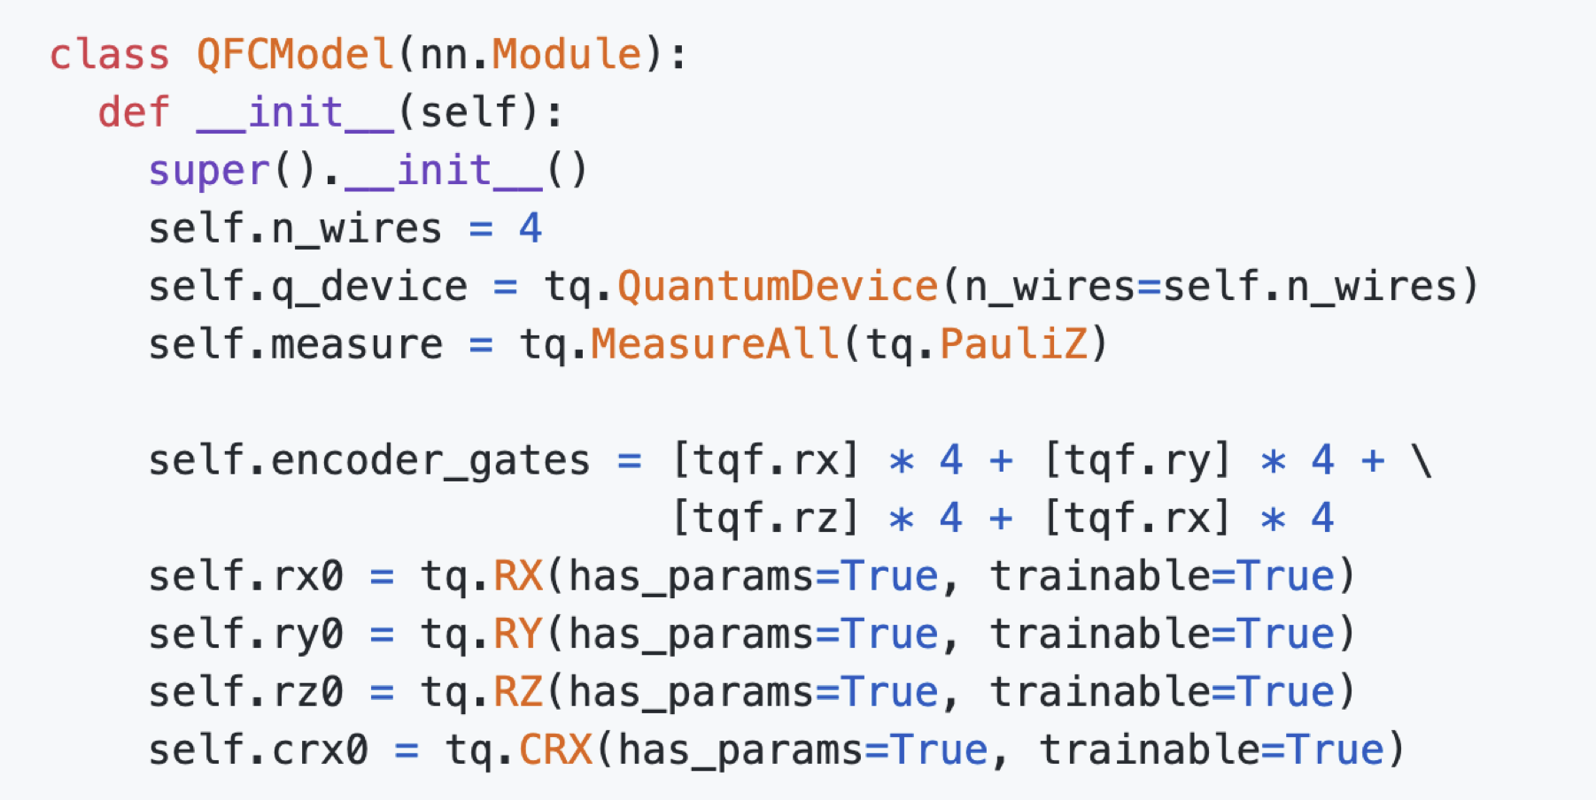
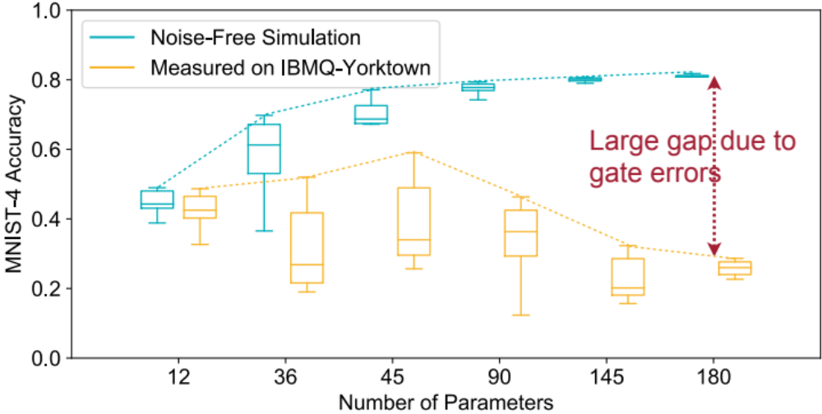
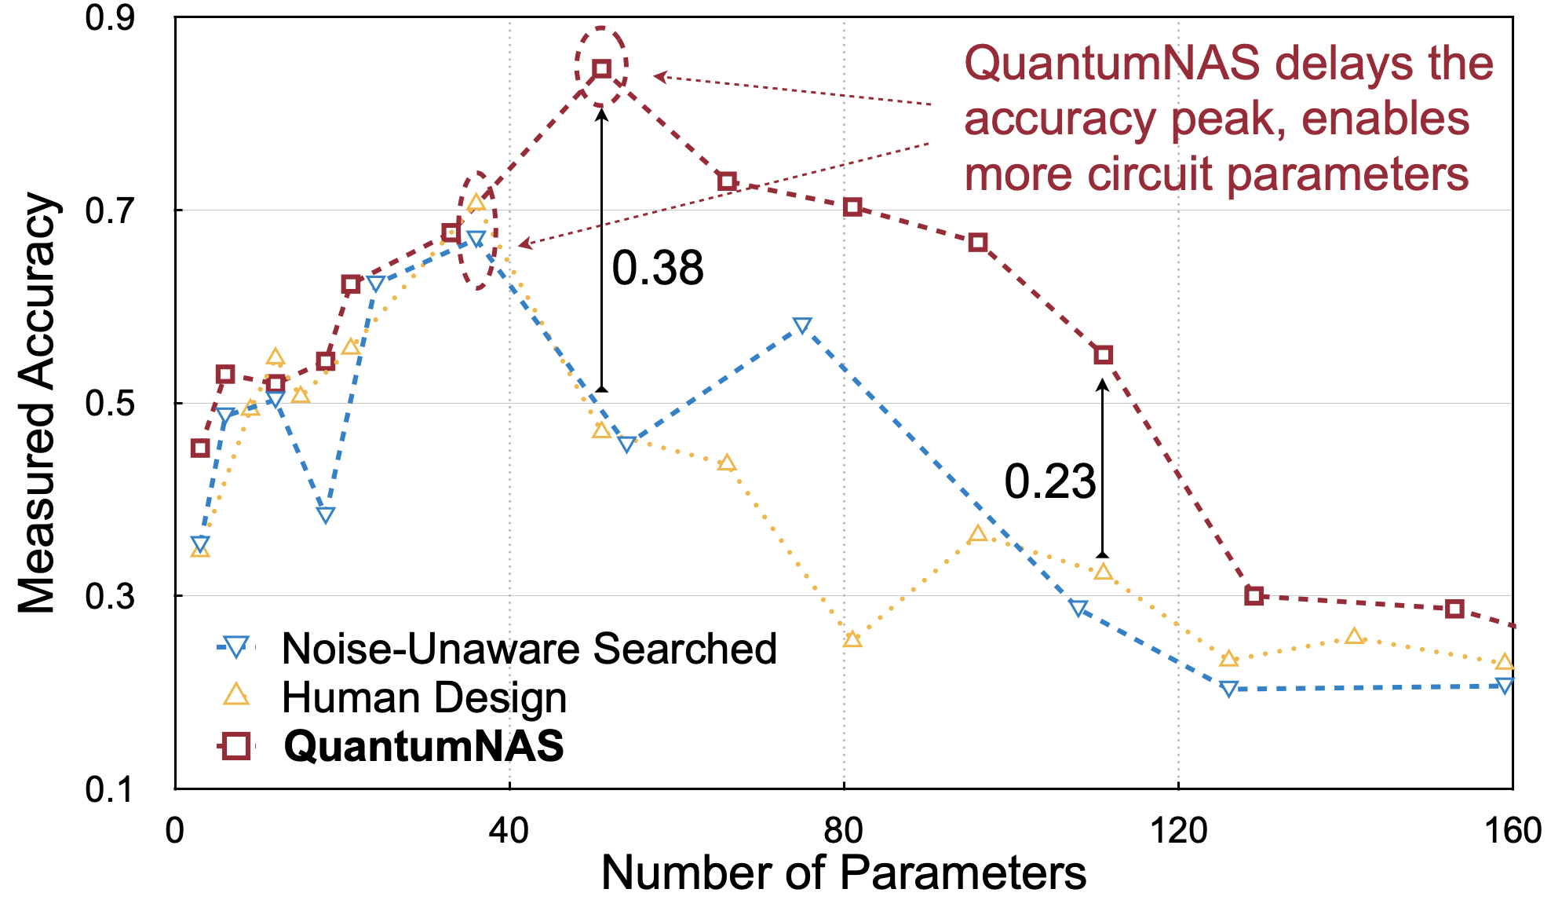

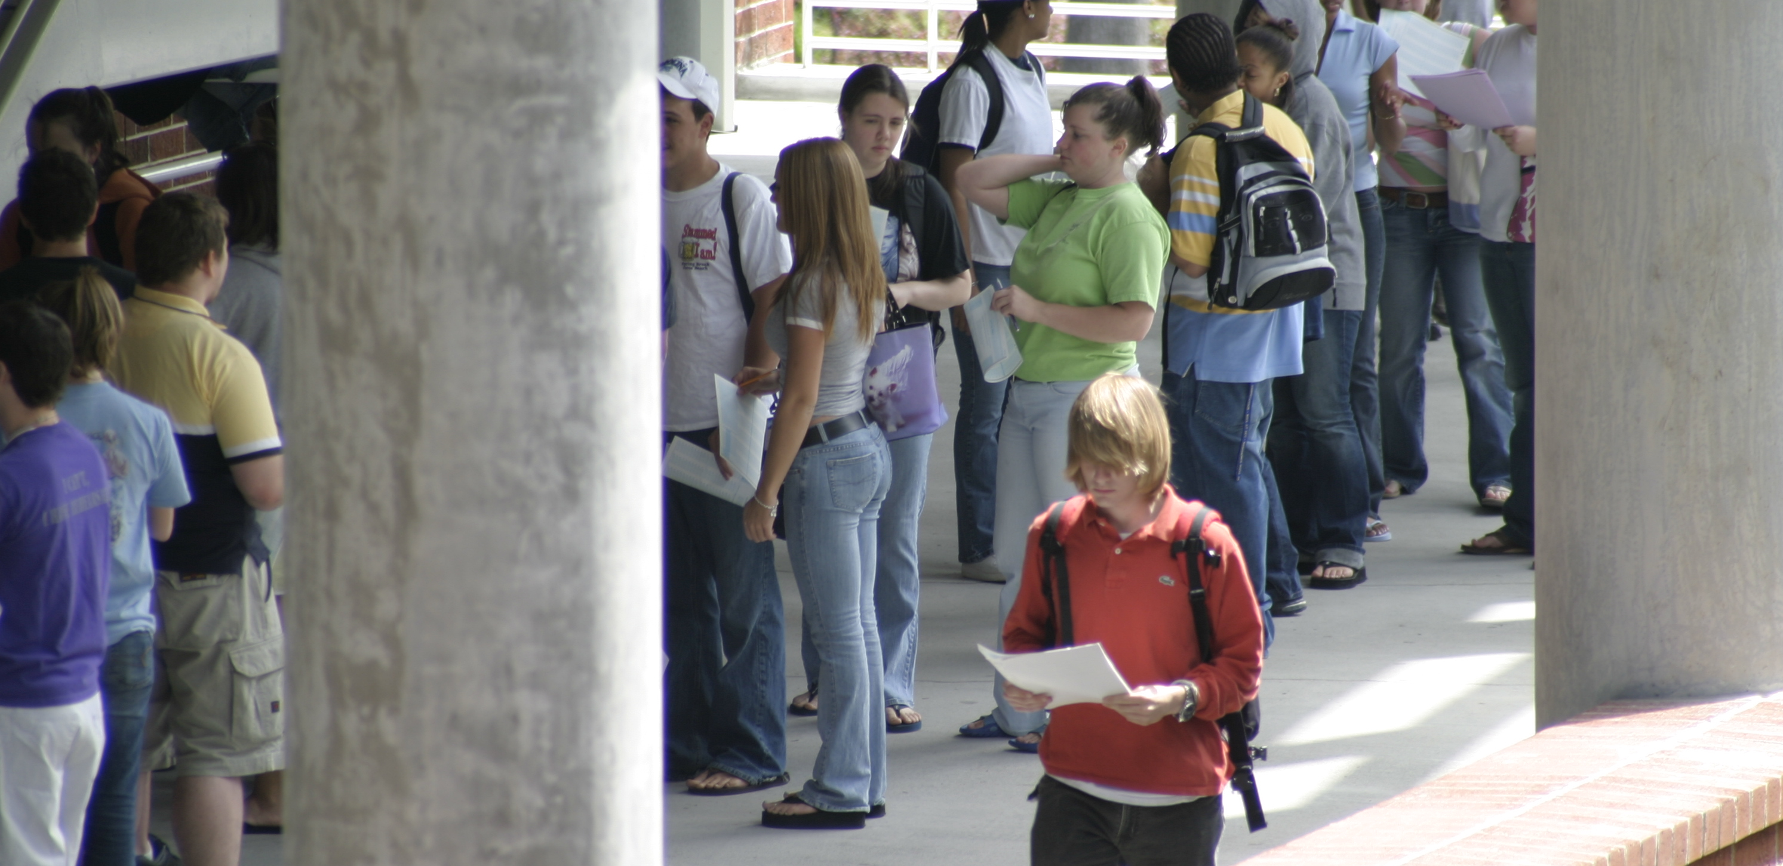
QuantumNAS: Noise-Adaptive Search for Robust Quantum Circuits
Hanrui Wang
Song Han
EECS
MIT
hanrui@mit.edu
Abstract
Search for Robust Quantum Circuit and
Qubit Mapping
TorchQuantum – A library for fast Quantum+ML
Quantum Computer can potentially provide exponential speedup on problems such as quantum machine learning and molecular dynamics
However, the current bottleneck is the large quantum noise which severely degrades the reliability of computed results
Our core contribution is a framework to search for the most noise-robust circuit and corresponding qubit mapping for parameterized quantum circuits
Demonstrate over 95% 2-class, and 32% 10-class image classification accuracy on real quantum computers; more accurate eigenvalue for VQE tasks on H2, H2O, LiH, CH4, BeH2 compared with UCCSD baselines
Step 1: Given a circuit design space, a ‘SuperCircuit’ is constructed as the largest possible circuit. The parameters of it are trained by iteratively sampling and updating a subset of parameters (‘SubCircuit’)
Step 2: Perform an evolutionary search with real hardware feedback to find the most robust model architecture and its qubit mapping
Step 3: Train the search architecture from-scratch
Step 4: Perform magnitude-based fine-grained pruning of quantum gates. Gates with small rotation angles will be removed
Easy construction of parameterized quantum circuits such as Quantum Neural Networks in PyTorch
Support batch mode inference and training on GPU/CPU, supports highly-parallelized parameter shift and back-propagation training
Support both static and dynamic computation graph for easy debugging (statevector simulation & tensor network simulation)
Support easy deployment on real QC e.g IBMQ
Provide tutorials, videos and example projects of QML and using ML to optimize quantum computer system problems.
Background and Motivation
Abstract
Example Quantum Neural Networks architecture for image classification
Contains encoder, trainable quantum layers, measurement
MNIST-4
Results
Reference
Wang, H., Ding, Y., Gu, J., Lin, Y., Pan, D. Z., Chong, F. T., & Han, S. (2021). Quantumnas: Noise-adaptive search for robust quantum circuits. HPCA 2022
Wang, H., Gu, J., Ding, Y., Li, Z., Chong, F. T., Pan, D. Z., & Han, S. (2022). QuantumNAT: Quantum Noise-Aware Training with Noise Injection, Quantization and Normalization. DAC 2022
Wang, H., Li, Z., Gu, J., Ding, Y., Pan, D. Z., & Han, S. (2022). QOC: Quantum On-Chip Training with Parameter Shift and Gradient Pruning. DAC 2022
Liang, Z.*, Wang, H*. et al. Variational quantum pulse learning. QCE 2022
qmlsys.mit.edu
Methods
Results
Table Heading | Table Heading | Table Heading
Table row 1
Table row 2
Table row 3
Introduction
Table 1. Title for table 1.
Table Heading | Table Heading | Table Heading
Table row 1
Table row 2
Table row 3
Table 2. Title for table 2.
Conclusions
References
Figure 1. Example

