Slide 1
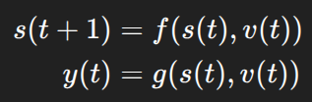




L: sensitivity (input --> output)
tau: Rate of convergence
0 --> I don’t care about the historical v
0 --> I don’t care about the historical s
small is good
current time
historical time
output bound
dependency

Slide 2




larger: more aggressive
(model is complex)
penality of dependency
G2 is too complicated...
small is good
current time
historical time
output bound
dependency

Slide 3
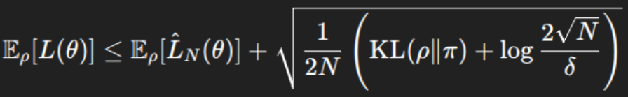
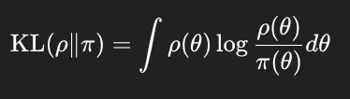

i.i.d.
samples = metropolis_hastings(...)
MCMC
Estimated empirical loss = 1.044406705458196
KL = 4.753243523221739
PAC-Bayes generalization bound = 1.2761900964758628

Slide 4
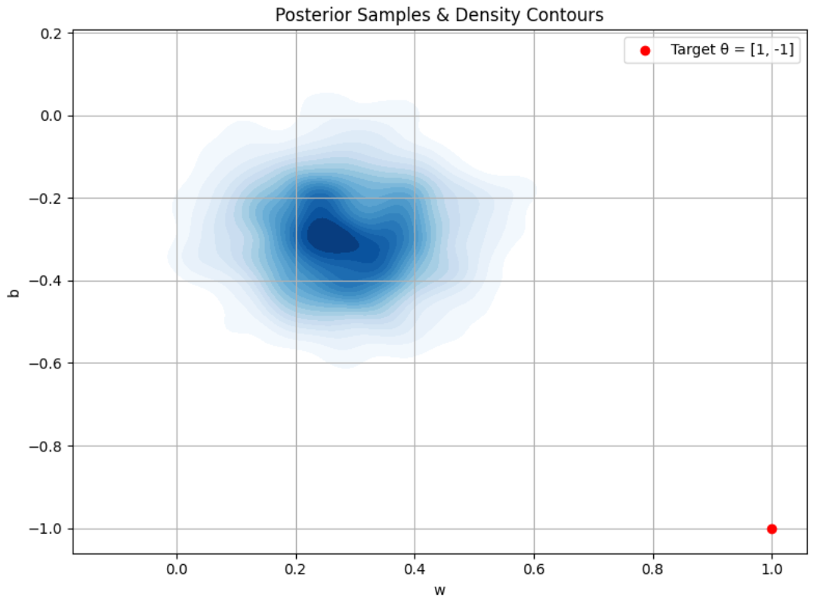
samples = metropolis_hastings(...)
MCMC
Estimated empirical loss = 1.044406705458196
KL = 4.753243523221739
PAC-Bayes generalization bound = 1.2761900964758628

Slide 5
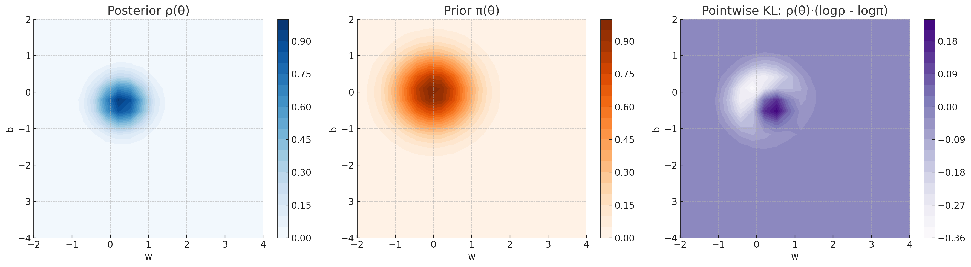


Slide 6
What is the exact rho??
samples = metropolis_hastings(...)
KDE --> rho
MCMC

Slide 7
i.i.d.
G2 is too complicated...

